Slide 1
How to conduct a proper Scientific Research ??
Dr. Mohab Abd-Alhameed Mangoud
Professor of Wireless Communications
University of Bahrain, College of Engineering,
Department of Electrical and Electronics Engineering,
http://mangoud.com

Slide 2
Outlines
تعريف البحث العلمي و أساليب و مناهج البحث العلمي
القياسات و التجارب و التأكد من النتائج
أخلاقيات البحث العلمي
التوثيق و الكتابة

Slide 3
Main Reference
All Slides / photographs included in this lecture have been drawn from course
http://egyptscholars.org/fundamentals-of-scientific-research-سلسلة-أساسيات-البحث-العلمي/
© 2002-2014 Egypt Scholars Inc.

Slide 4
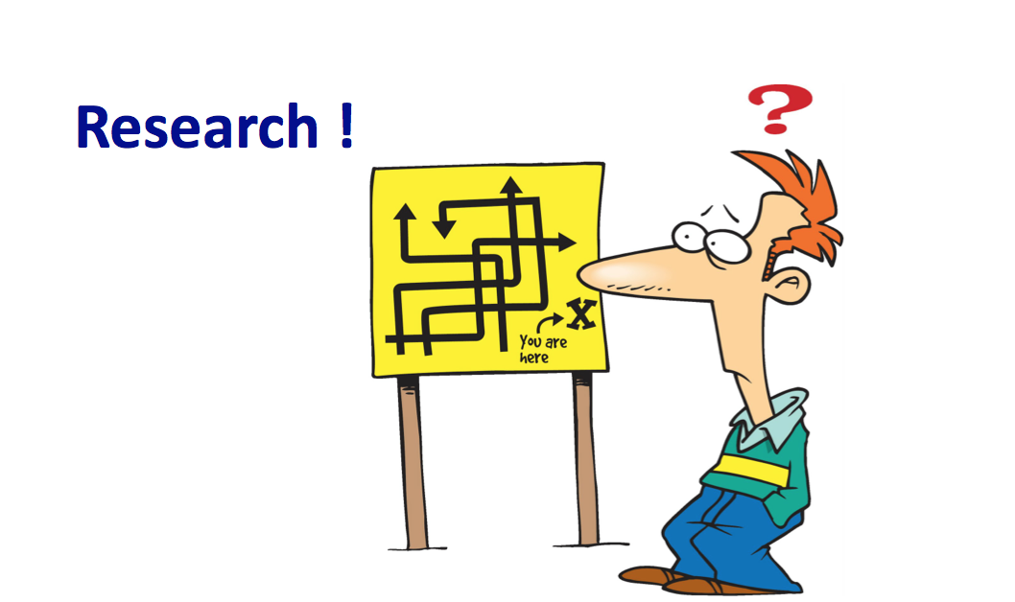
تعريف البحث العلمي أساليب و مناهج البحث العلمي

Slide 6
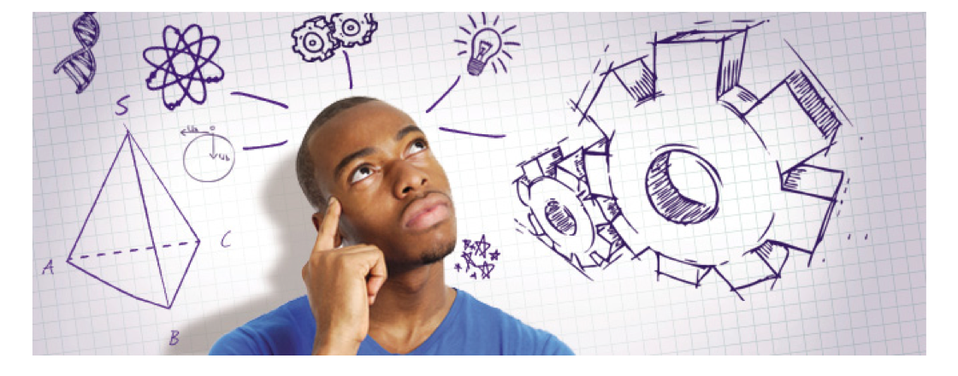

Slide 8
What is research?
Research is what we do when we have a question or a problem we want to resolve
We may already think we know the answer to our question already
We may think the answer is obvious, common sense even
But until we have subjected our problem to rigorous scientific scrutiny, our 'knowledge' remains little more than guesswork or at best, intuition.

Slide 32
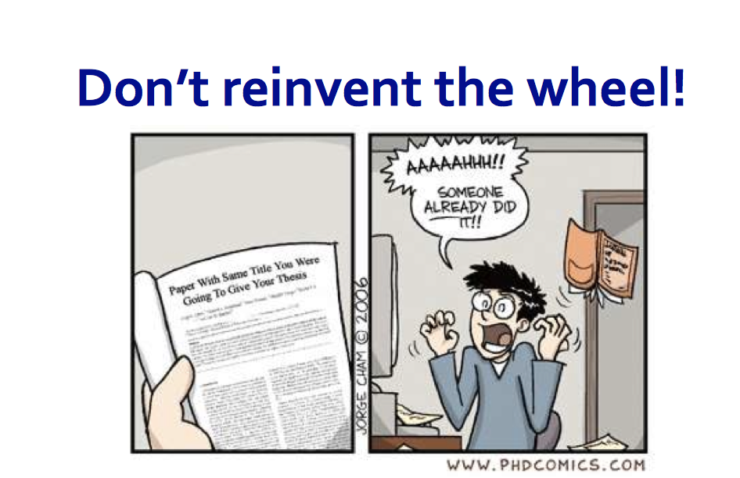

Slide 36
القياسات و التجارب و التأكد من النتائج

Slide 37
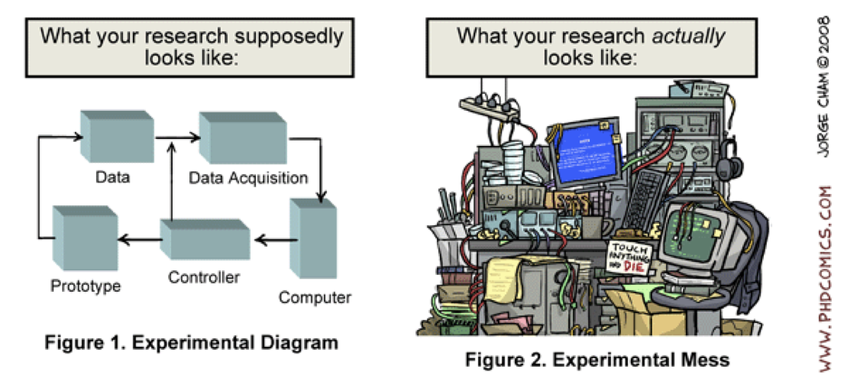

Slide 40
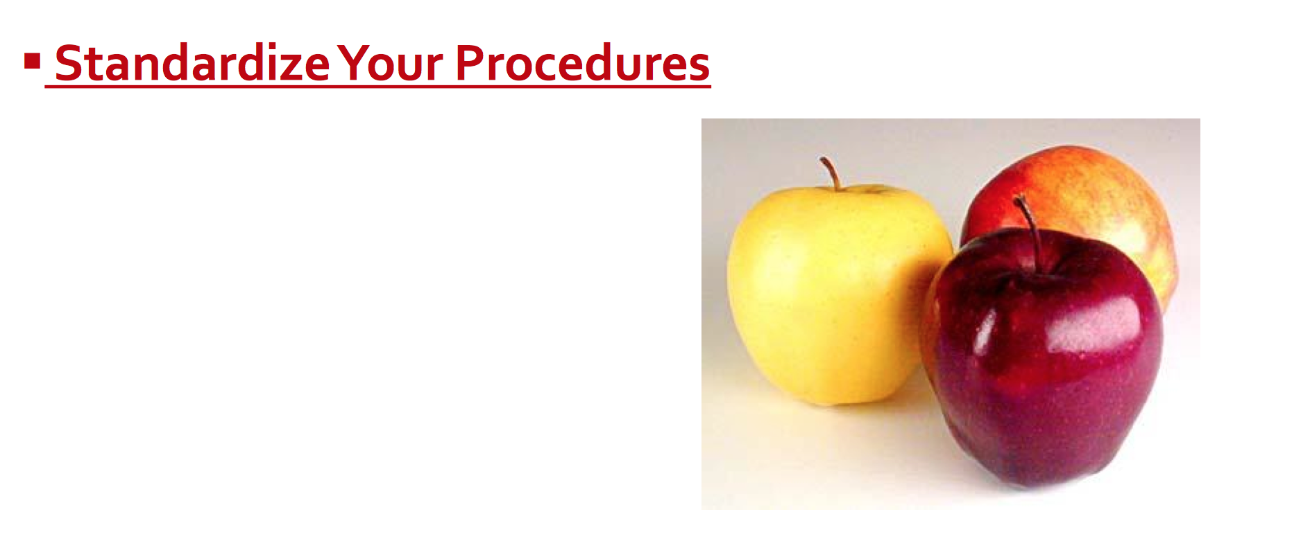

Slide 41
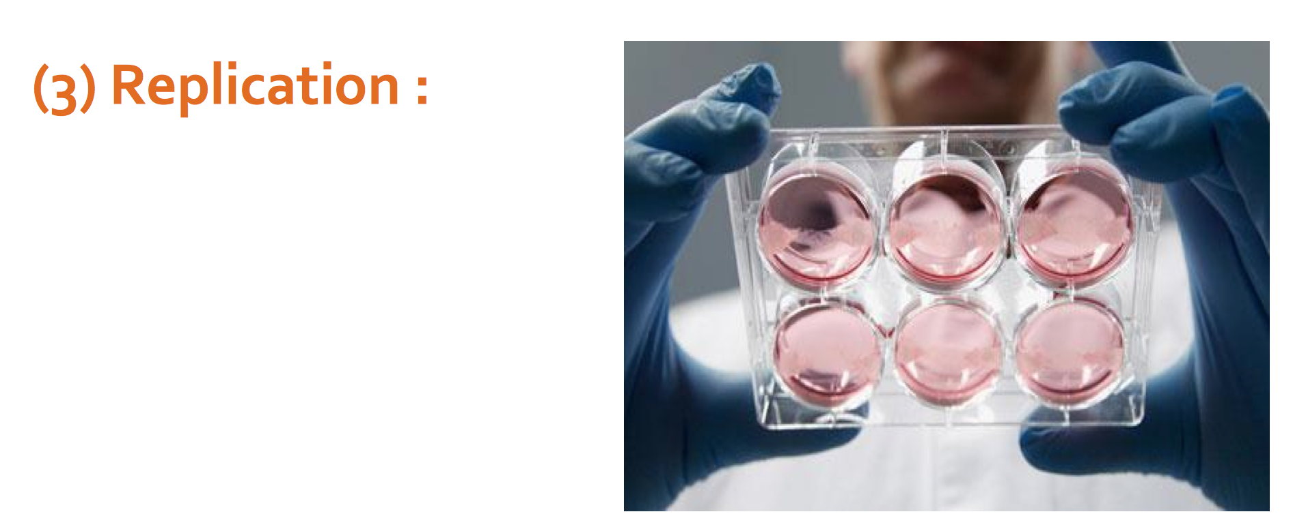

Slide 44
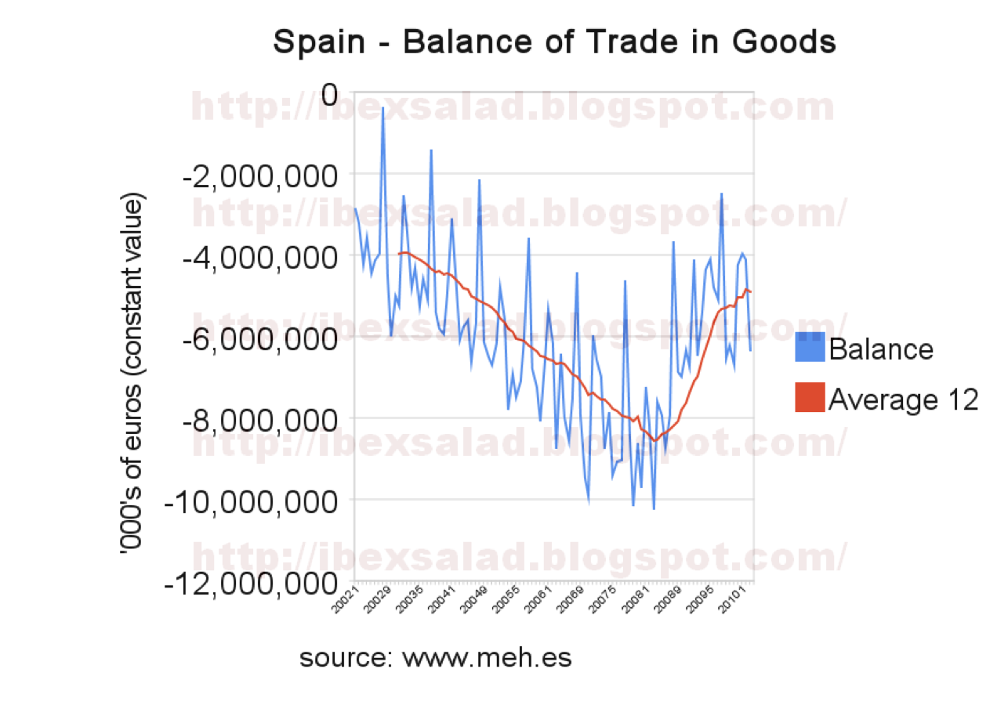

Slide 48
Conclusion

Slide 49
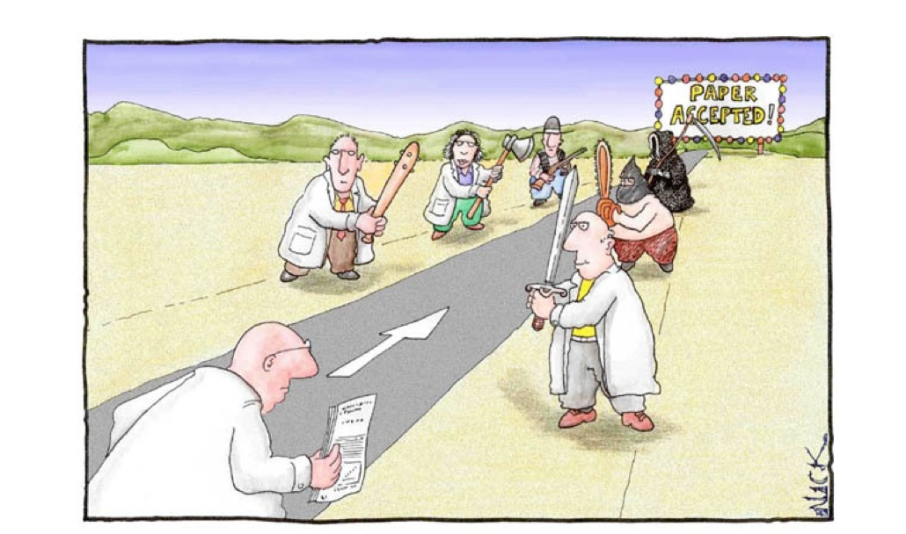
Part II
التوثيق و الكتابة

Slide 51
أخلاقيات البحث العلمي

Slide 58
Thank You
Dr. Mohab Abd-Alhameed Mangoud
Associate Professor of Wireless Communications
University of Bahrain, College of Engineering,
Department of Electrical and Electronics Engineering,
http://mangoud.com

