Slide 1
UNIVERSITY OF BAHRAIN
COLLEGE OF ENGINEERING
ELECTRICAL & ELECTRONICS ENGINEERING DEPARTMENT
BONUS TERM PROJECT
CONFIGURING IOT TEMPERATURE SENSOR DEVICES ON CLOUD WITH MOBILE APPLICATION
Prepared by:
Abdulaziz Sami Abdulla Qambar
20112926
12th January 2021

Slide 2
CONTENT
1
2
Project Background & Details
Configuration Steps
Problem
Solution
3
IOT Device
Demonstration
EEM 602 Internet of Things – Bonus Term Project ID: 20112926
Slide 1 / 7

Slide 3
CONFIGURING IOT TEMPERATURE SENSOR DEVICES ON CLOUD WITH MOBILE APPLICATION
Project Background
In Sewage Treatment Plants, a Sludge Drying Facility is responsible for drying the sludge up to 85% dryness. The aim of this process is to reduce the sludge volume by evaporating the water. Thus, it will contribute to reducing the sludge transport and disposal costs to Landfill.
Solar Sludge Dryer
Figure 1: Askar Sewage Treatment Plant
EEM 602 Internet of Things – Bonus Term Project ID: 20112926
Slide 2 / 7

Slide 4
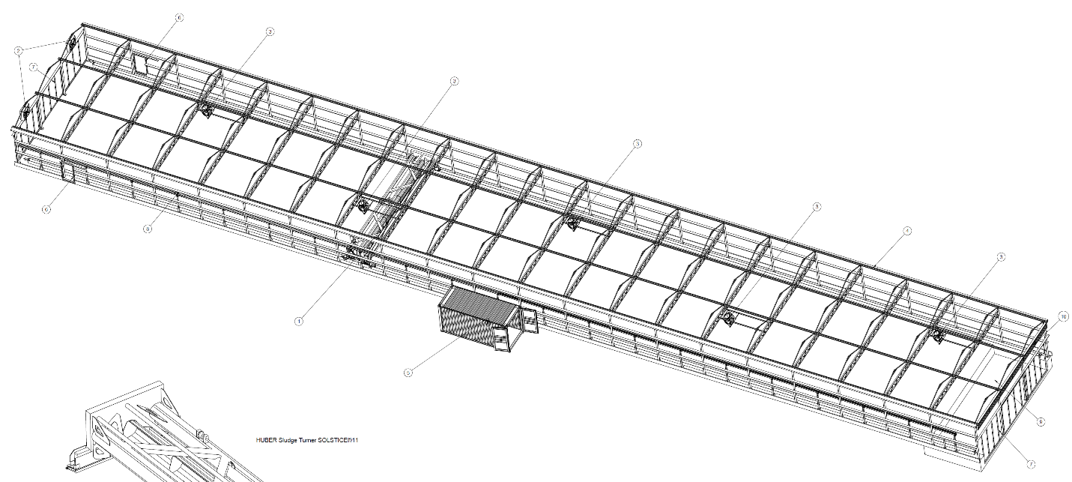
CONFIGURING IOT TEMPERATURE SENSOR DEVICES ON CLOUD WITH MOBILE APPLICATION
Project Details
Solar Sludge Drying facility owner would like to deploy “3” temperature sensors inside the solar sludge drying greenhouse to provide live temperature monitoring over internet for the sludge drying process.
Figure 2: Askar STP - Solar Sludge Dryer
Project Requirements
Sensor 2
Cloud
Mobile App
Dashboard
Sensor 1
Sensor 3
WLAN
24/7
Low Cost
EEM 602 Internet of Things – Bonus Term Project ID: 20112926
Slide 3 / 7

Slide 5
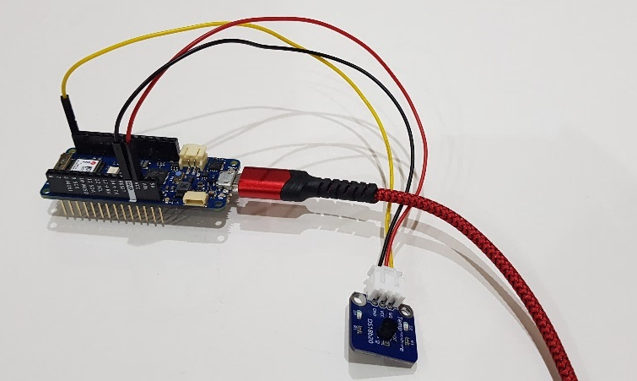
CONFIGURING IOT TEMPERATURE SENSOR DEVICES ON CLOUD WITH MOBILE APPLICATION
Equipment’s & Platforms
Arduino MKR WIFI 1010 Board (Cost: 32$ = 12.5 BD per piece).
Temperature sensor type: DS18b20 (3 BD).
Micro USB wire (3 BD).
Arduino Cloud powered by AWS.
Arduino IOT Cloud Remote Mobile Application.
MKR WIFI 1010
DS18b20
Figure 3: AWS & Arduino IOT Cloud logos
Figure 4: IOT device components
EEM 602 Internet of Things – Bonus Term Project ID: 20112926
Slide 4 / 7

Slide 6
CONFIGURATION PROCESS
Configure
Arduino
Connect Internet
Link Cloud
Sign in
Arduino
Deploy
Code
Mobile App
Connect Dashboard
Design Dashboard
EEM 602 Internet of Things – Bonus Term Project ID: 20112926
Slide 5 / 7

Slide 7
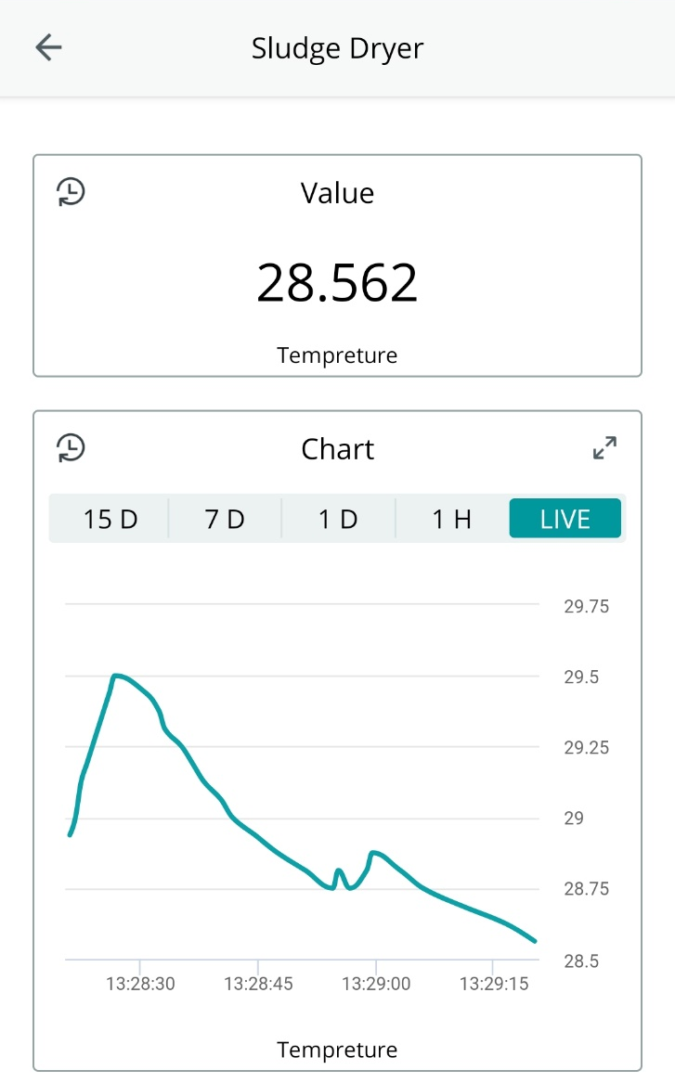
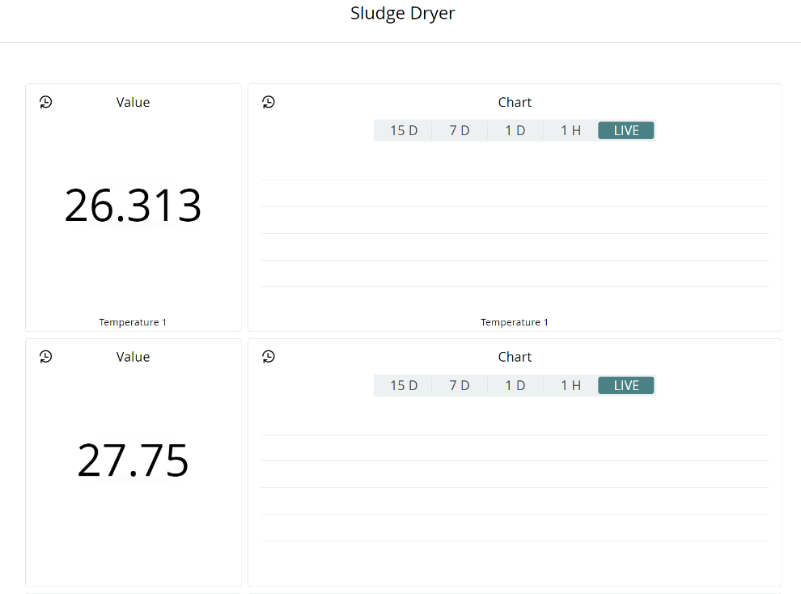
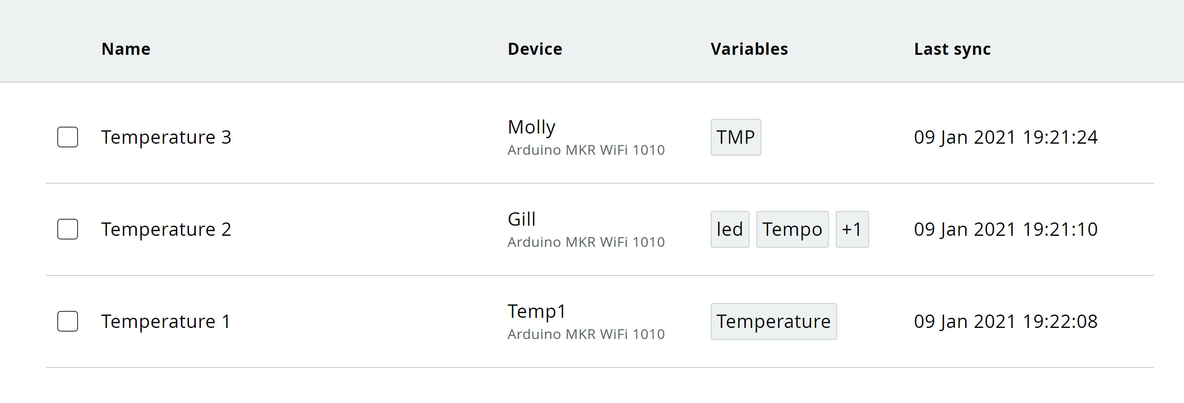
DEMONSTRATION
Total Project cost is 18.5 BD per device (55.5 BD Total cost)
Data recorded can be retrieved and downloaded
Figure 5: Temperature Sensors Dashboard
EEM 602 Internet of Things – Bonus Term Project ID: 20112926
Slide 6 / 7

Slide 8
REFERENCE
M. Electronics, “www.GitHub.com,” arduinoWiFi_home_automation, Available: https://cutt.ly/Jjlppyz. [Accessed 19 November 2020].
EEM 602 Internet of Things – Bonus Term Project ID: 20112926
Slide 7 / 7

