Slide 1
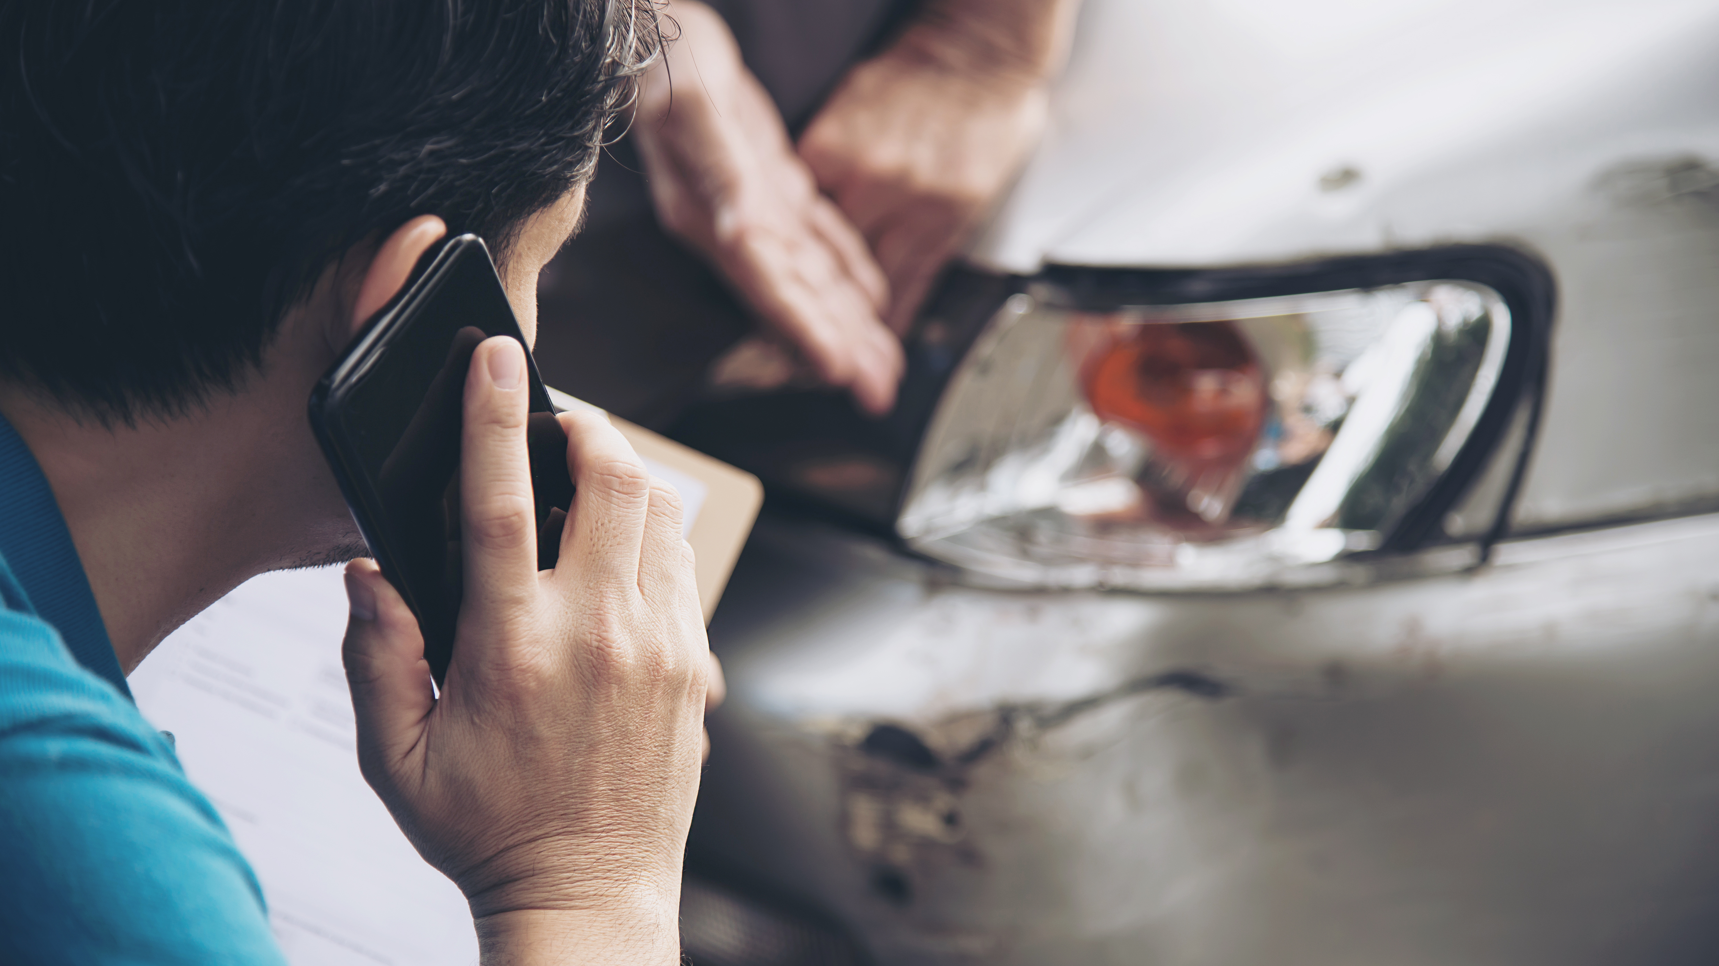

A Smart Blackbox for Vehicle Tracking and Monitoring
By Ahmed Alsahlawi, Supervised by Prof. Mohab

Slide 2
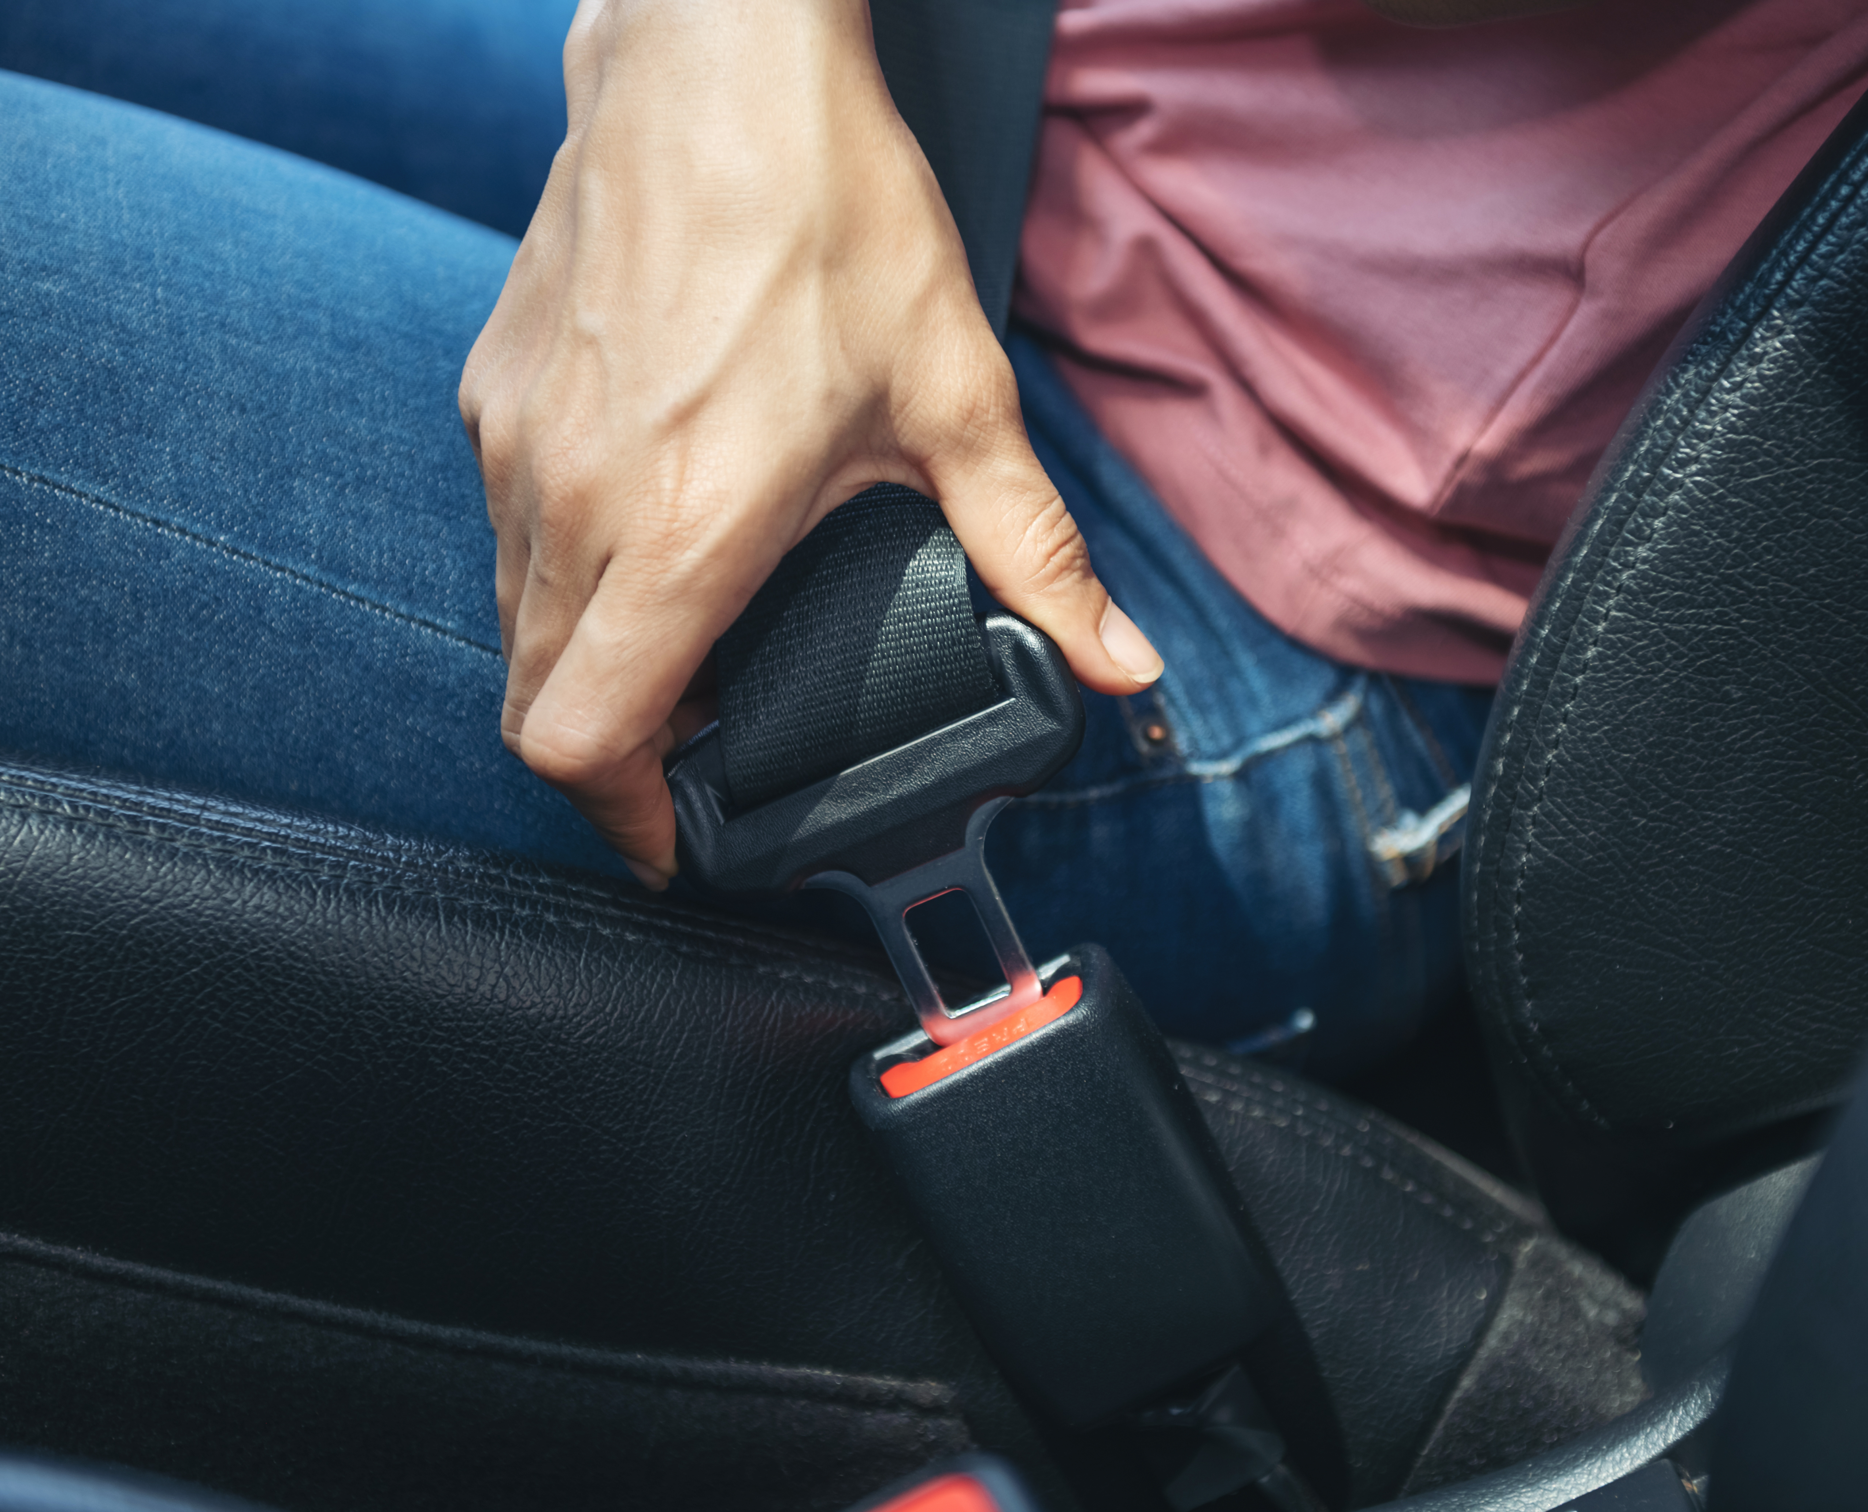

Agenda
Introduction
Current Problem
Proposed Solution
How it works!
Results
Challenges
Live Demo
Q&A

Slide 3

Introduction
Most countries nowadays are shifting to become smart cities and automate all their processes with the help of Artificial Intelligence (AI)
Applications: Traffic Smart Grids and Smart vehicles
Safety and better life quality are the main aims.
Some luxury vehicle brands are equipped with safety tools, but regular and most of the vehicles are not
Hard to analyze accidents manually, experts often use break marks or collision shape to estimate the speed and damages
50%
Total of critical accidents
36%
Total of light accidents
14%
Total of death Accidents
735,905
Total used and licened vehicles up to January 2021
https://www.policemc.gov.bh/statistics/statistics-2021-january/114666

Slide 4




Current Problem
What is missing in this the current approach?
01
02
03
04
Data Unavailability
Intelligence Factor
Unclear or absent footage, Unknown speeds.
Time & Cost
Manual advanced analysis performed by experts
Human Errors
Experts hiring, Expensive equipment.
Wrong Judgments, Inaccurate calculations

Slide 5

Proposed Solution
The Blackbox under the hood.
“Sometimes it is the people no one can imagine anything of who do the things no one can imagine.” – Alan Touring

Slide 6



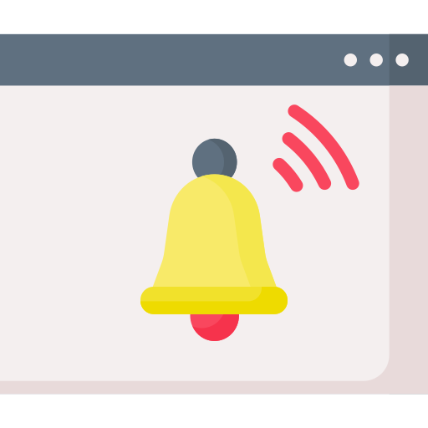
Components Overview
High level view
Microcontroller to manage all the components and perform MQTT communication.
Sensors: Vibration, GPS and Wi-Fi
MQTT Broker, handle MQTT communication between sensors and subscribers.
Subscribers to receive MQTT messages and use sensors data.

Slide 7
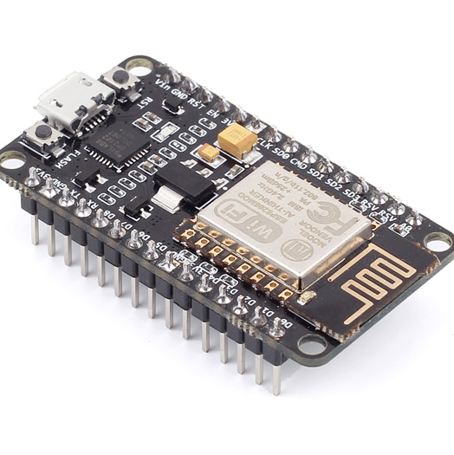
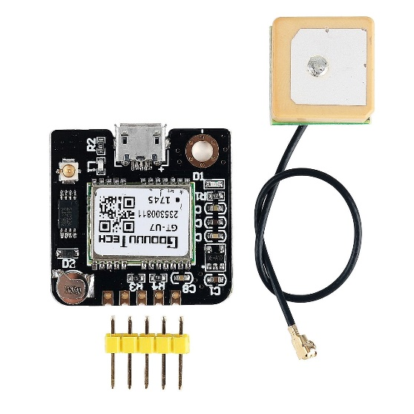
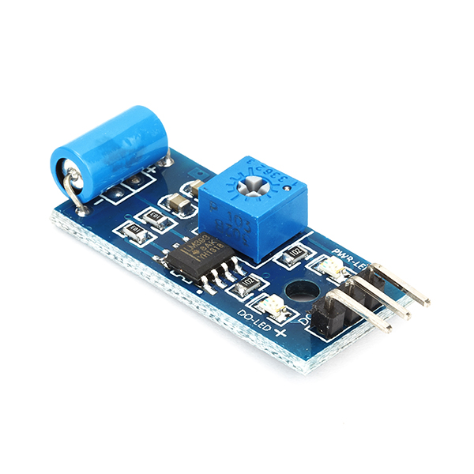
Hardware Details
Physical components of the Blackbox
Microcontroller
GPS Sensor
Vibration Sensor
ESP8266
NEO-6M GPS
SW-140
Power Saving, compact size, Wi-Fi Chip onboard.
Cost: 2.3 BHD
UART Protocol, USB Interface, A-GPS Assist now autonomous.
Cost: 6 BHD
Open when vibration detected, closes when no vibration.
Cost: 0.452 BHD

Slide 8




Software Details
Software used in the Blackbox
Arduino IDE
Mosquitto
MQTT Explorer
Node Red
Code Editor
MQTT Broker
3rd Party Explorer
Flow Control
Boards Manager, Library Manager, Sketch upload
Service application, handle mqtt communication in Background
View MQTT messages, see the logs
Manage Sensors data, Interface with MQTT
References on Slide 14, each.
Notes:
All applications are open source.

Slide 9



HOW IT WORKS?
Type the subtitle of your great here
Blackbox Startup
1
For the first run, the Blackbox will be started and attempt to connect to the Wi-Fi and MQTT client. Meanwhile, the GPS will start searching for satellites.
2
Accident Occur
Blackbox can live on normal batteries for months, thanks for both ESP8266 and NEO-6M power optimizations.
Accidents can happen to the vehicle, when its in Park, or moving on the road. The sensors data will keep in sync, until a shock detected.
Amount of vibration (shock), is monitored with vehicle location and speed.

Slide 10


Communication
3
The MCU publish the data collected from the sensors through MQTT broker into the cloud. This process is regular to keep track of past data ( before & after accident)
4
Information Analysis
If the MCU is not connected to the cloud, the latest values will be stored until the device is connected.
Once the data is published, Node-Red will grab this data and perform basic analysis to determine the power of the impact, to send require notifications.
Data will be displayed in dashboards, and will be stored in csv files for further analysis ( could be SQL databases)

Slide 11


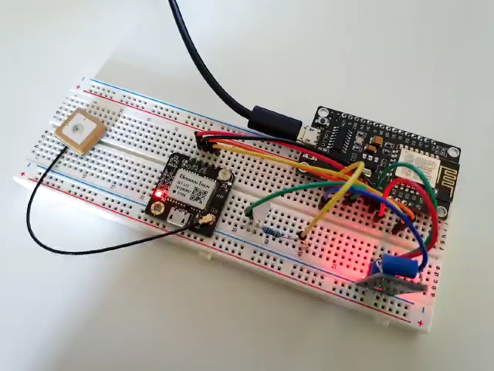
Accuracy
Availability
From the proposed solution, we got all the required parameters to analyze an accidents effectively. The power of shock, speed of the vehicle at the time of the accidents, location ( for some big countries). These data is obtained with the highest accuracy.
The device connected the vehicle to the grid. Any accident is reported onetime, with all the necessary information recorded. The Traffic department then can decide, whether to send policemen or ambulances. The device will give availability for every registered vehicle.
RESULTS
Show MCU Code
Notes:
As a result, we achieved both accuracy and availability in this solution.
Regarding Accuracy , we got all the required parameters such as vibration, speed, location which can helps in the assessments.
And in terms of Availability, those data is captured in Realtime, and available to access at any time.

Slide 12
Challenges
Obstacles and limitations
Privacy
01
Privacy of the user, as we will capture location data and his speeds real-time
Security
02
Security of data transmitted, can be abused if data leaked
Implementation Cost
03
The cost is low, but for large vehicle fleet it will be big number.
Storage
04
Massive data, will require Big Data analysis to handle and store all these data.
Infrastructure
05
Connectivity such as 4G/5G for faster data transfer. Delays is not acceptable.

Slide 13
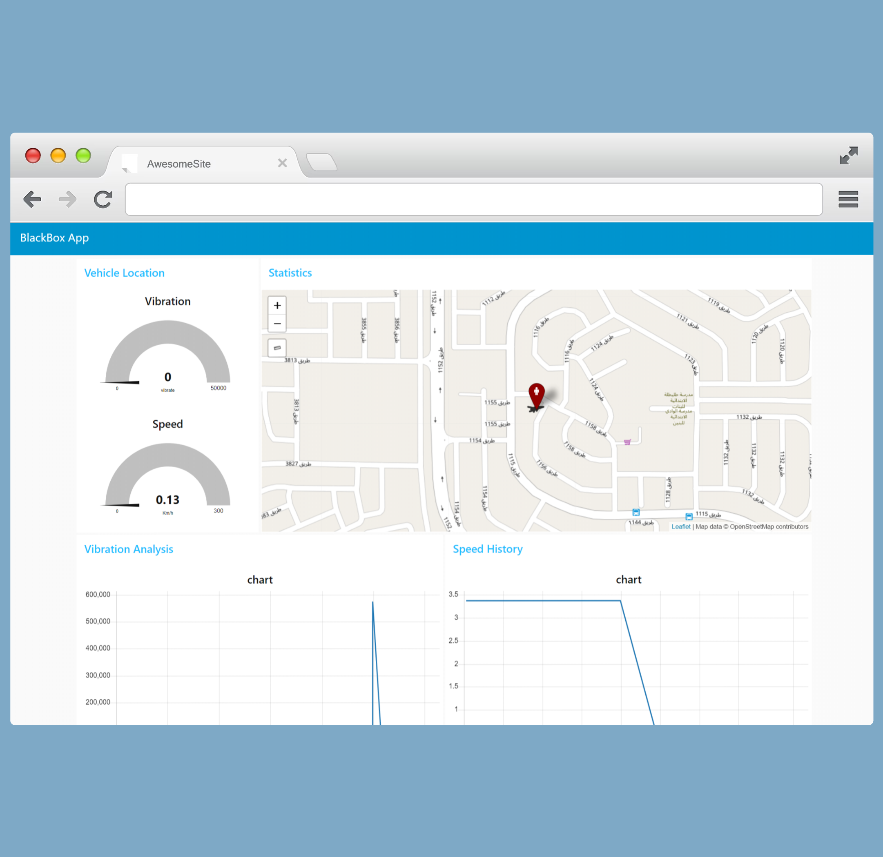

Live Demo
Node-Red UI dashboard
Scan Me

Slide 14
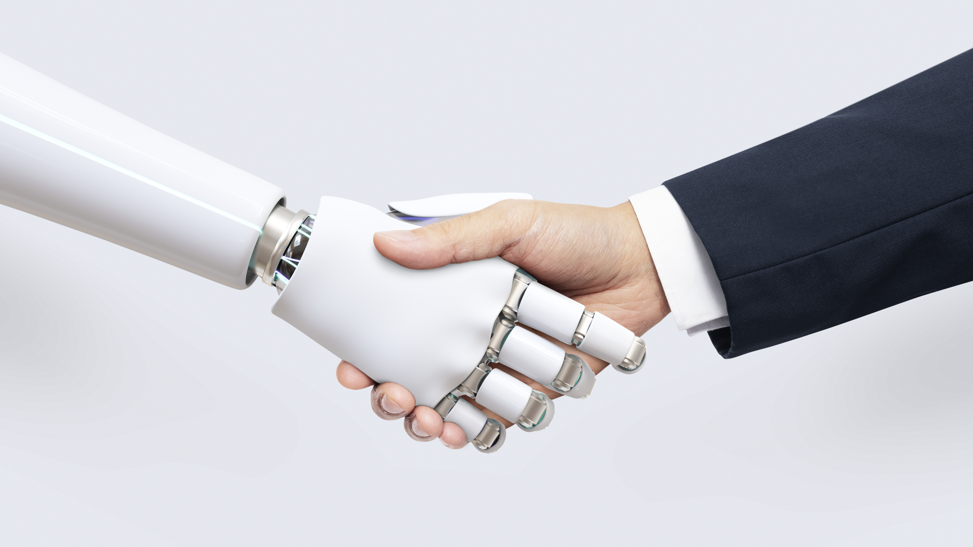

Thank you for Listening!
Q&A

Slide 15
References
Things used in the slides
Images and Icons
  https://www.freepik.com
  https://www.flaticon.com
Statistics:
  https://www.policemc.gov.bh/statistics
Software:
  Node-Red: https://nodered.org
  Mosquitto: https://mosquitto.org
  Arduino IDE: https://arduino.cc
  MQTT Explorer: http://mqtt-explorer.com
Hardware:
  https://www.espressif.com/en/products/socs/esp8266
  https://images-na.ssl-images-amazon.com/images/I/91tuvtrO2jL.pdf

