Slide 1
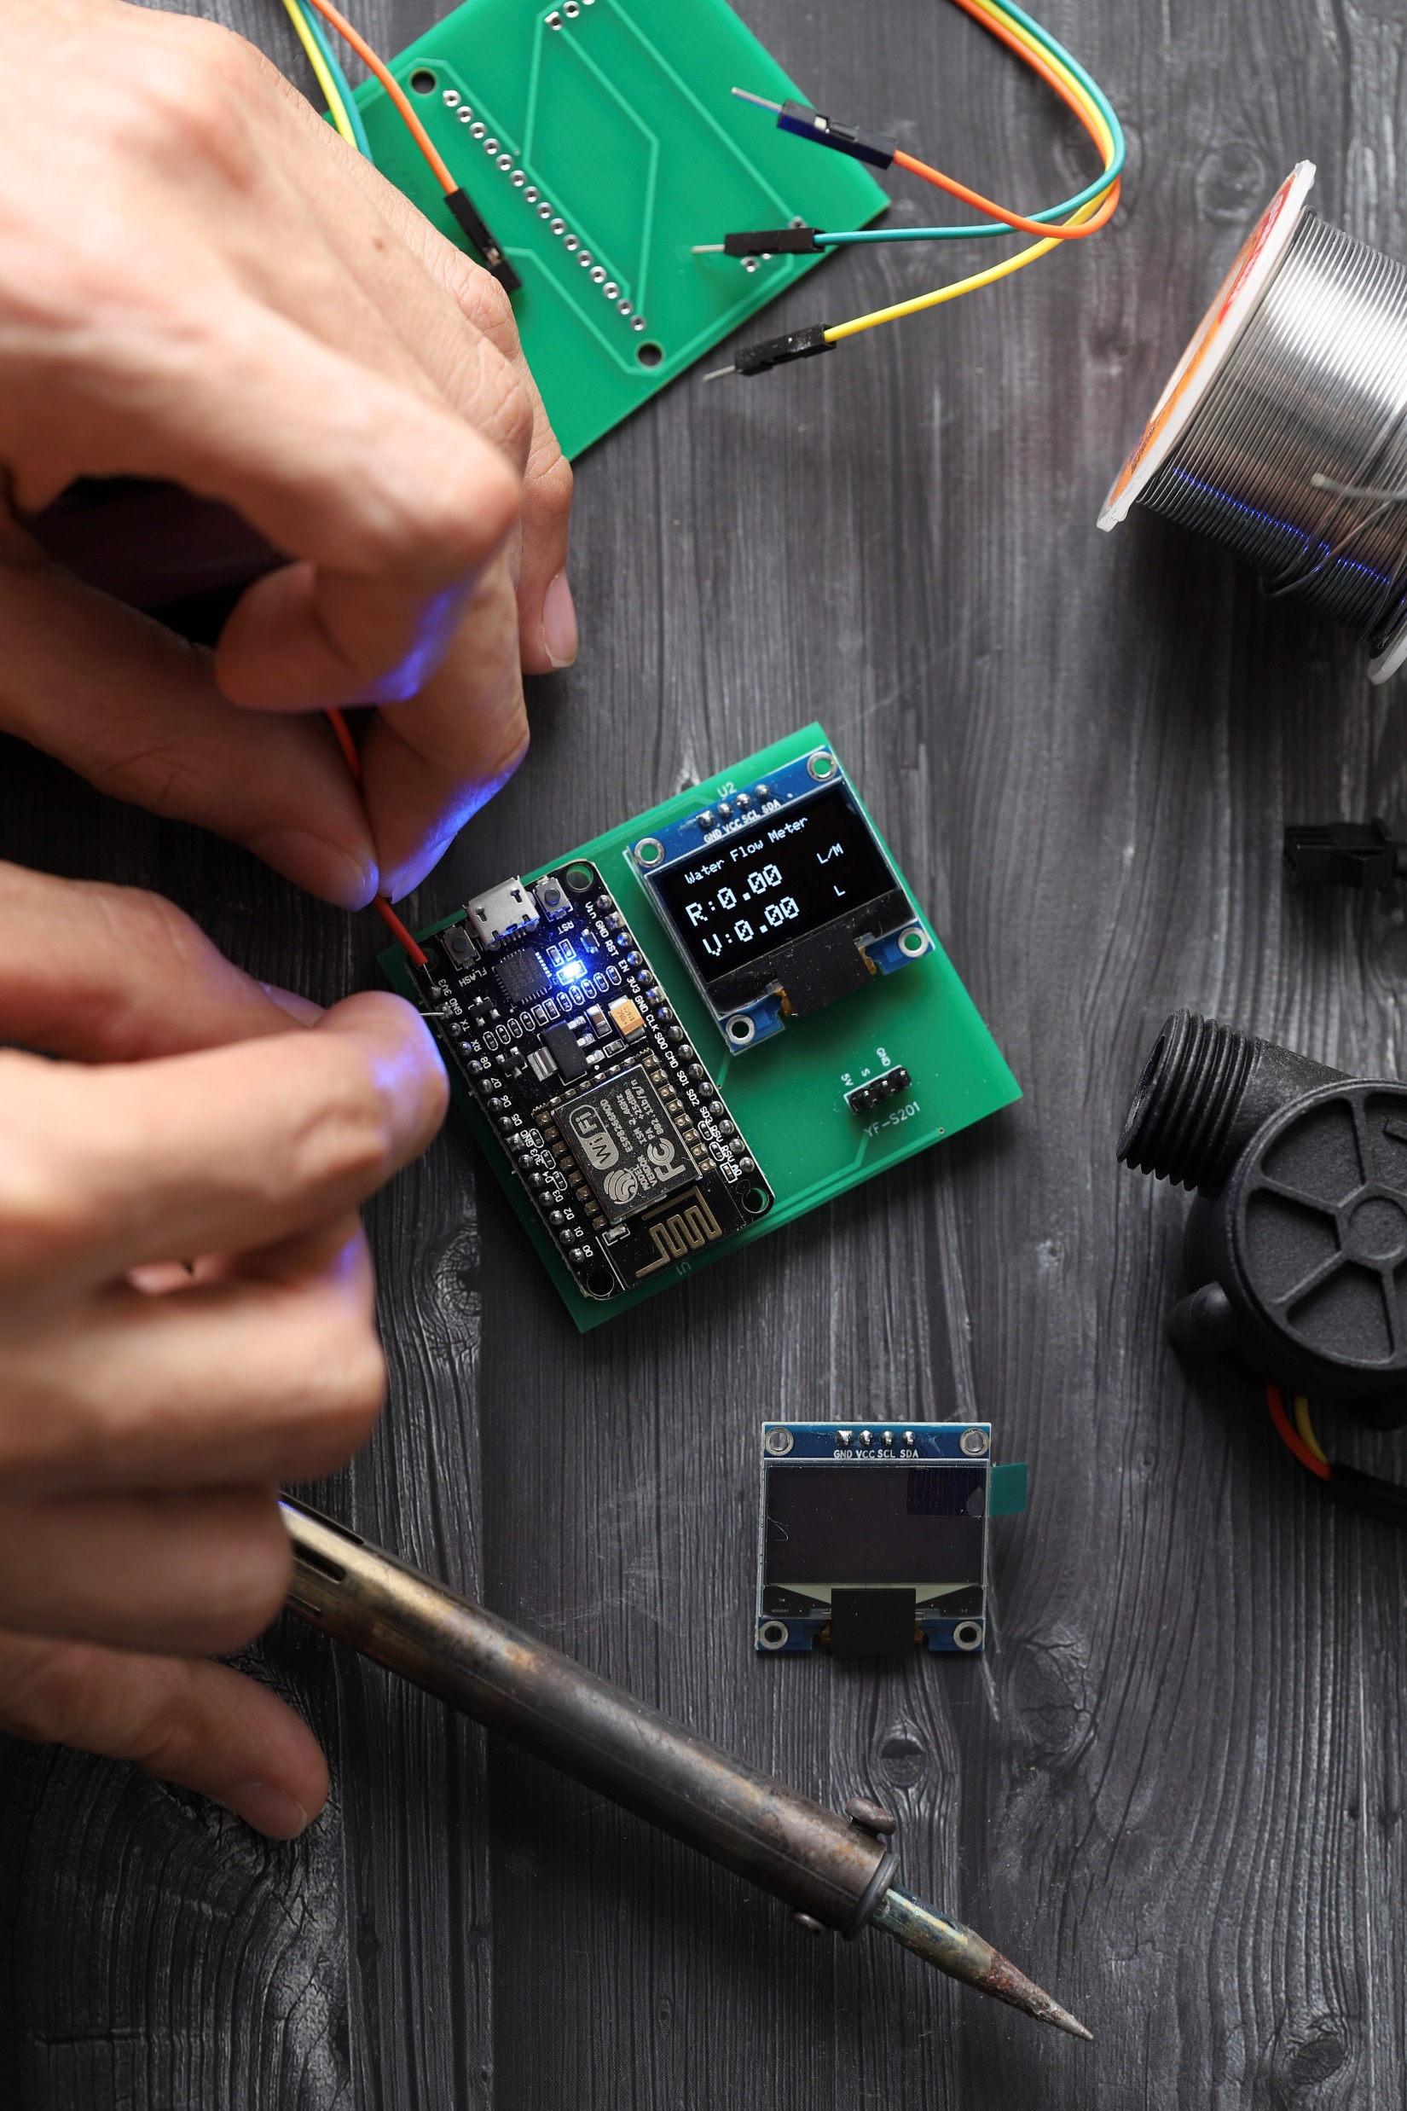
University of Bahrain
College of Engineering
Electrical & Electronic Engineering Department
Smart Water
consumption measurement
system based on IoT
Prepared By
Supervised By
Farooq Abdulaziz
Prof. Mohab Mangoud
Student ID# 19992198
Notes:
Good afternoon everyone, and welcome to my presentation. First of all, let me thank you all for being here till this time.
I am Farooq Abdulaziz and, today I would like to talk about ‘Smart water consumption measurement system based on iot’, this is an extension of my previous seminar project, but today I will discuss more about the practical and technical part of implementing a smart water meter. so let us start

Slide 2
Facts & Statistics
771
million
People in the world do not have clean water close to home
* Facts were taken from https://www.wateraid.org/us/facts-and-statistics
Notes:
Do you know that about 771 (Seven hundreds and seventy-one) million people in the world do not have clean water close to home?

Slide 3
Facts & Statistics
1.7
billion
People in the world do not have a decent toilet of their own
* Facts were taken from https://www.wateraid.org/us/facts-and-statistics
Notes:
Can you imagine that
1.7 billion people in the world do not have a decent toilet of their own?

Slide 4
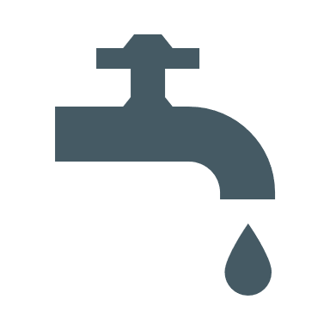
Facts & Statistics
489
million
People in the world have no choice but to drink dirty water
* Facts were taken from https://www.wateraid.org/us/facts-and-statistics
Notes:
Or Do you have any idea that about
489 (four hundreds and eighty-nine) million people in the world have no choice but to drink dirty water?

Slide 5
Facts & Statistics
60
secs
Every 60 seconds a newborn dies from an infection caused by lack of safe water
* Facts were taken from https://www.wateraid.org/us/facts-and-statistics
Notes:
Do you believe that in Every minute a newborn dies from an infection caused by lack of safe water?
These are real facts around us, but we might not be aware of them because we are not suffering from the lack of fresh or drinking water today, but it could be tomorrow.
So let us help others by saving the water in our hands from excess use and being more careful when consuming water in home, office, schools, or anywhere else!!

Slide 6
Introduction
Fresh water
Tracking
Population
Saving
Notes:
Now let me highlight some points that is related to water consumption problem…..
-------Click here-------------------
The rapid growth of population around the world,
-------Click here--------------------
Led the increase in demands for freshwater, people need more water to consume
-------Click here--------------------
So, we have high demands on water consumption and unmanaged water supply,
-------Click here--------------------
we don’t have a tracking system to track and monitor daily water usage.
-------Click here--------------------
Which causes the high monthly billings that need to be paid

Slide 7
Objectives
Implement a low cost, reliable and scalable water smart meter that helps to monitor our daily water consumption.
To experiment how to build and program an IoT application based on Arduino microcontrollers and how integrate them with other platforms.
Save the excess water consumption and reduce the monthly billing.
A
B
C
Notes:
So what is my objective ?
The objective of this project is to implement a low cost, reliable and scalable water smart meter that helps to monitor our daily water consumption.
------click--------------------
To experiment how to solve this problem by building and programing an IoT application based on Arduino microcontrollers and how we can integrate them with other platforms.
------click--------------------
Save the excess water consumption and reduce the monthly billing.
------click--------------------

Slide 8
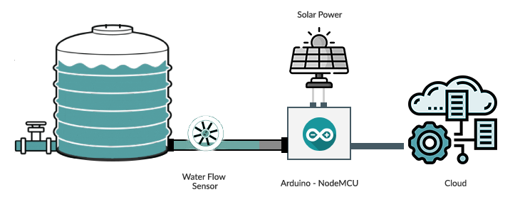
What is Smart Meter?
Notes:
So here is my plan in how to build the smart meter and where to install it?
As it shows in this figure, the water flow sensor is connected to the main water tank, which will sense the water flow and then will move the readings to the microcontroller. As the plan the microcontroller should be powered by a solar panels. The microcontroller will push the data to the cloud for processing and presenting in a proper detailed dashboard

Slide 9
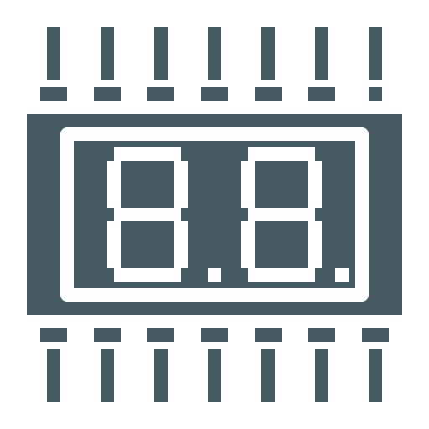
Block Diagram
OLED
Display
Arduino
Node-MCU
Email
Alert
Water Flow
sensor
Thinger.io
Cloud
Database
Dashboard
Notes:
This is a block diagram for the water meter system, as we can see on the left side where the water flow sensor take the readings from any water source…
---------click-------------------------------
then that readings will be passed into the microcontroller which is connected the OLED display screen to show the water volume and water flow.
---------click-------------------------------
The microcontroller will push the fetched data to the thinger.io cloud where the data can be processed
Alert***
All the data will be stored into the database in the cloud, and by using node-red we set a simple flow to alert me by email whenever the data is disconnected
The dashboard built by utilizing the widgets offered by thinger.io to present these data

Slide 10
Installation
Water Flow
Sensor
Notes:
For the device installation we have 3 options,
Option: 1 Install it on every facet that available at home in
either to install it on the main water source or installing it in every facet in home

Slide 11
Demonstration

Slide 12
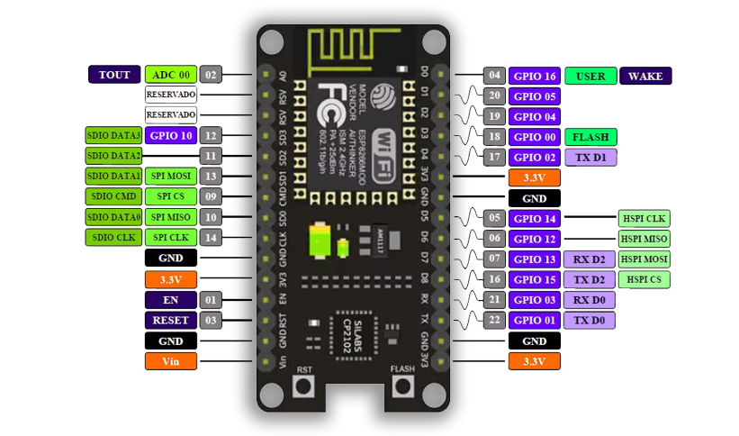
Why Arduino Node-MCU?
Taken from https://hackster.imgix.net/uploads/attachments/790923/pinout-nodemcu-1_1_8_YQmrIoNMO1.jpg?auto=compress%2Cformat&w=1280&h=960&fit=max
Notes:
NodeMCU is an open source platform based on ESP8266 which can connect objects and let data transfer using the Wi-Fi protocol.
Low cost
Integrated support for WIFI network
Reduced size of the board
Low energy consumption
In addition, by providing some of the most important features of microcontrollers such as GPIO, PWM, ADC, and etc, it can solve many of the project’s needs alone.
GPIO : General Purpose Input/Output

Slide 13
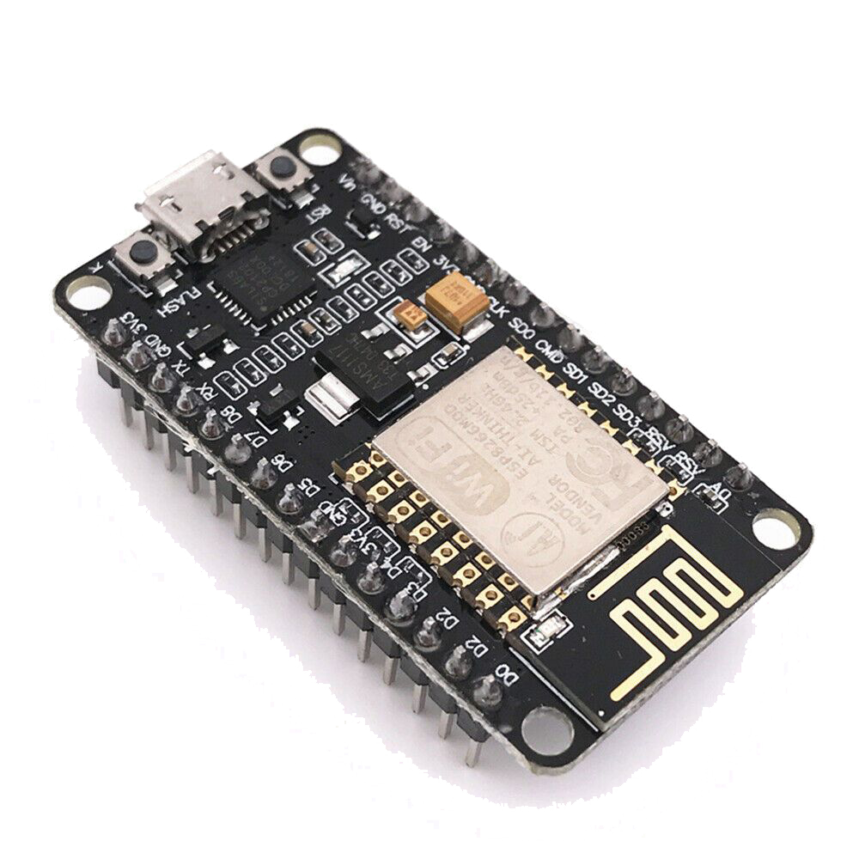
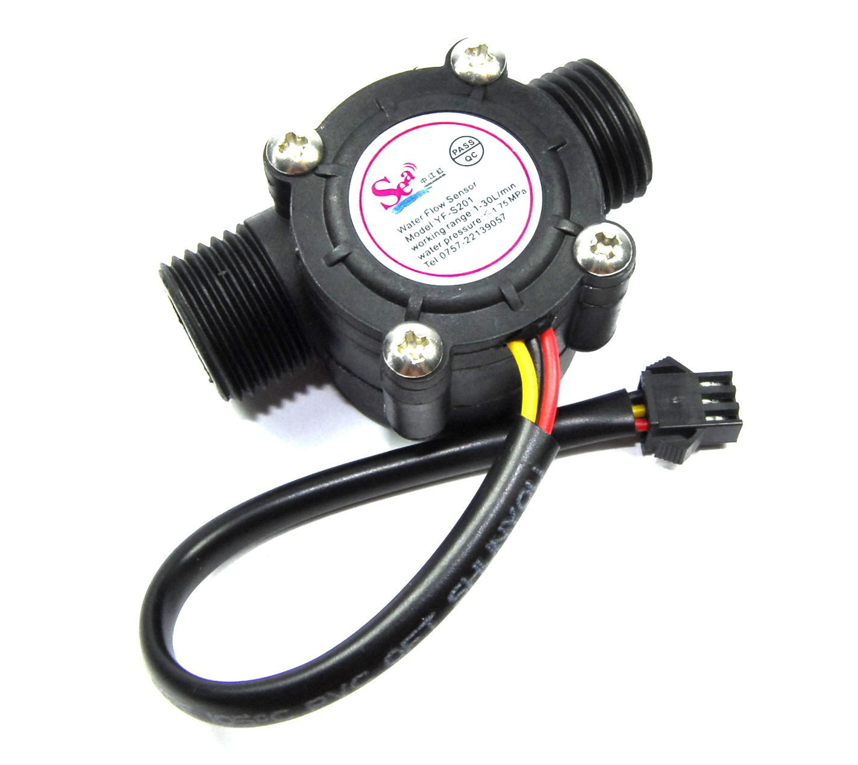
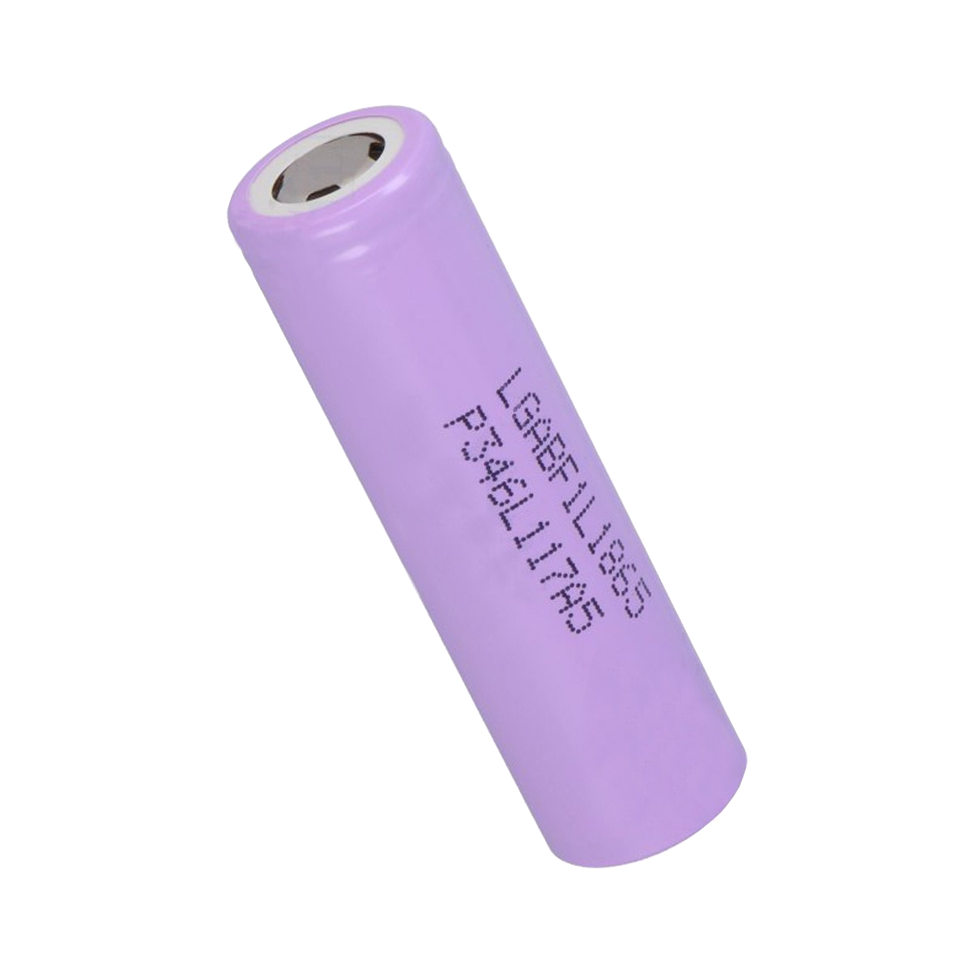
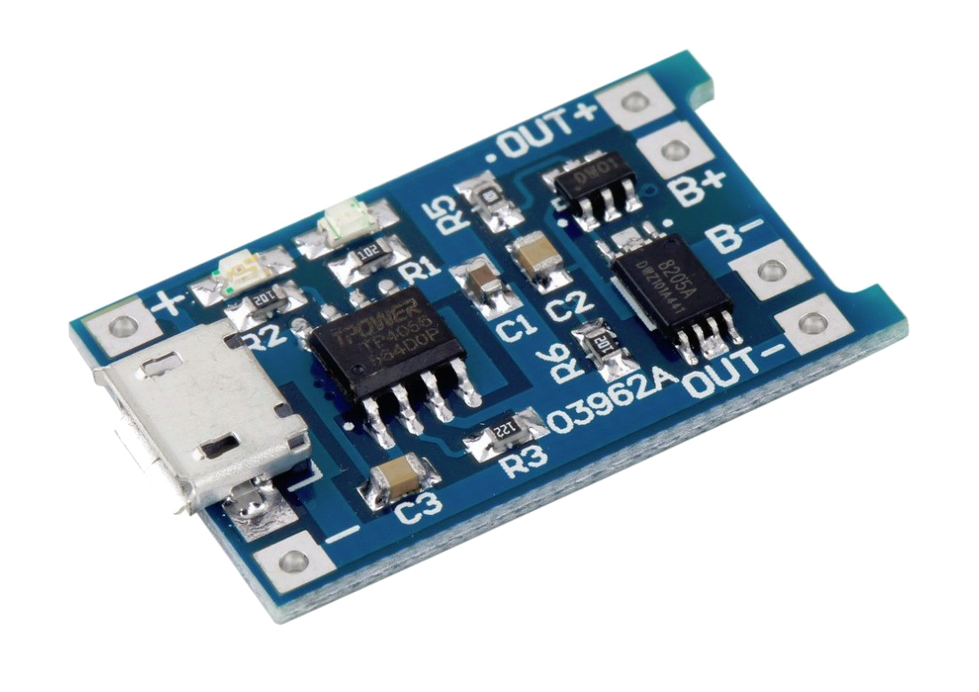
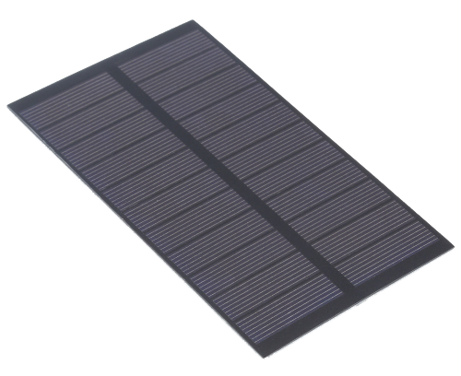
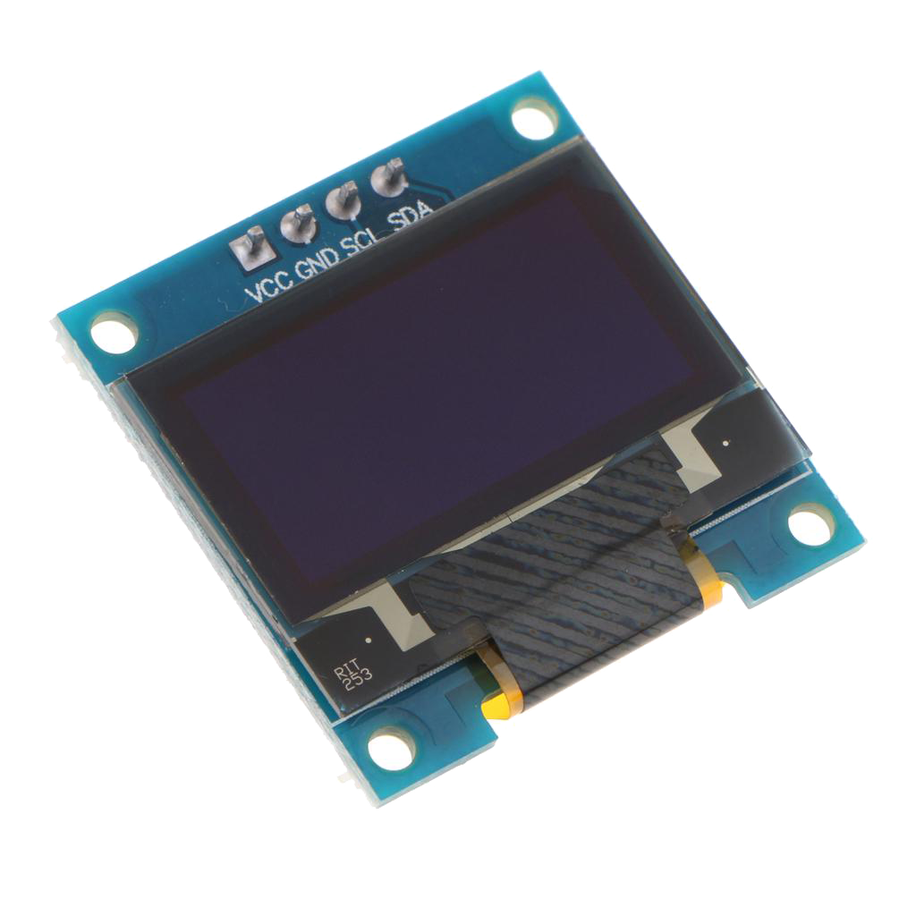
Components
Notes:
Here are the list of components that I have used in this project beside some resistors and capacitors for the solar power

Slide 14
Circuit Construction
B
A
Notes:
In this slide I am sharing the circuit construction, actually it consist of 2 parts
Part A and part B
Part A is where our Arduino board and water flow sensor
And part B is a small circuit for operating part A using the solar power

Slide 15
Software Development

Slide 16
Source Code
Include Thinger & Adafruit Library
{
}
Define & Initialize variables
Set Display Screen & water flow variables
Set the formulas to calculate the water consumption
Push data to the cloud every 2 second

Slide 17
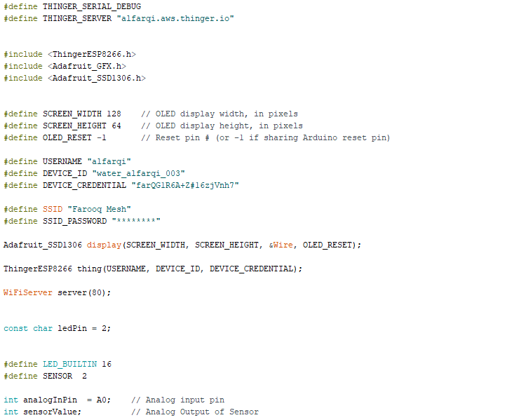
Source Code
Include Thinger.io and adafruit libraries
Define Variables

Slide 18
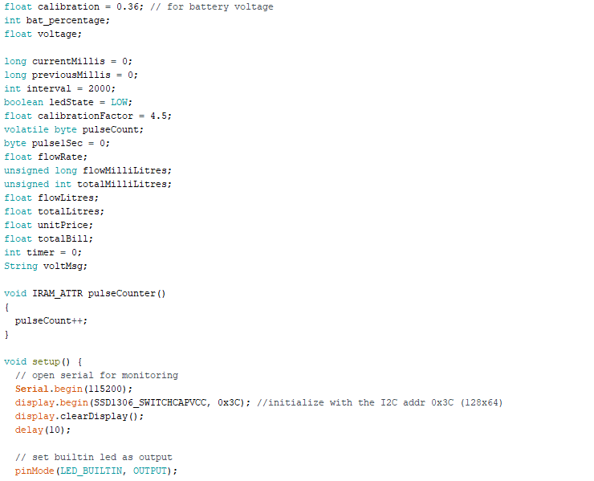
Source Code
Define and initialize
variables
Pulse counter function

Slide 19
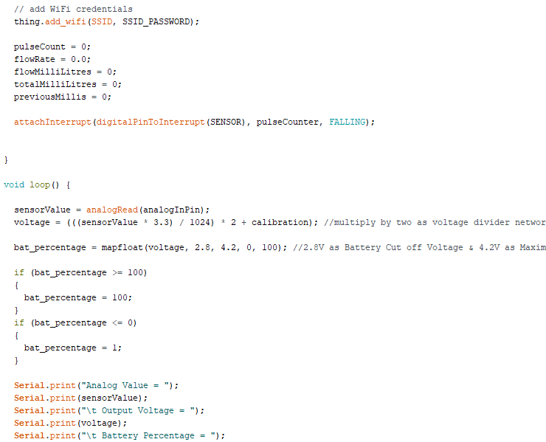
Source Code
Battery Readings

Slide 20
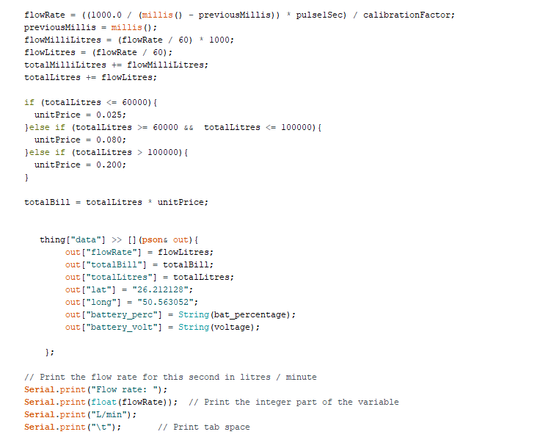
Source Code
Water flow
Calculations
Pushing data to the cloud

Slide 21
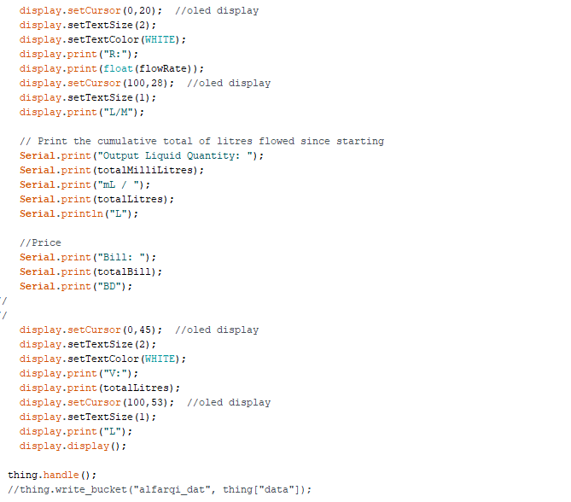
Source Code
Display data on OLED screen
Print output data for debugging

Slide 22
Why Thinger.io?
OTA
01
Easy to connect and administrate your device
Console
02
Store Device Data in buckets and easy to fetch or edit
Node
Red
03
Display Real-time or Stored Data in multiple widgets
MQTT
04
Customizable dashboard widgets

Slide 23
Challenges
Continuous, low-cost Power supply
Wireless signals
coverage

Slide 24
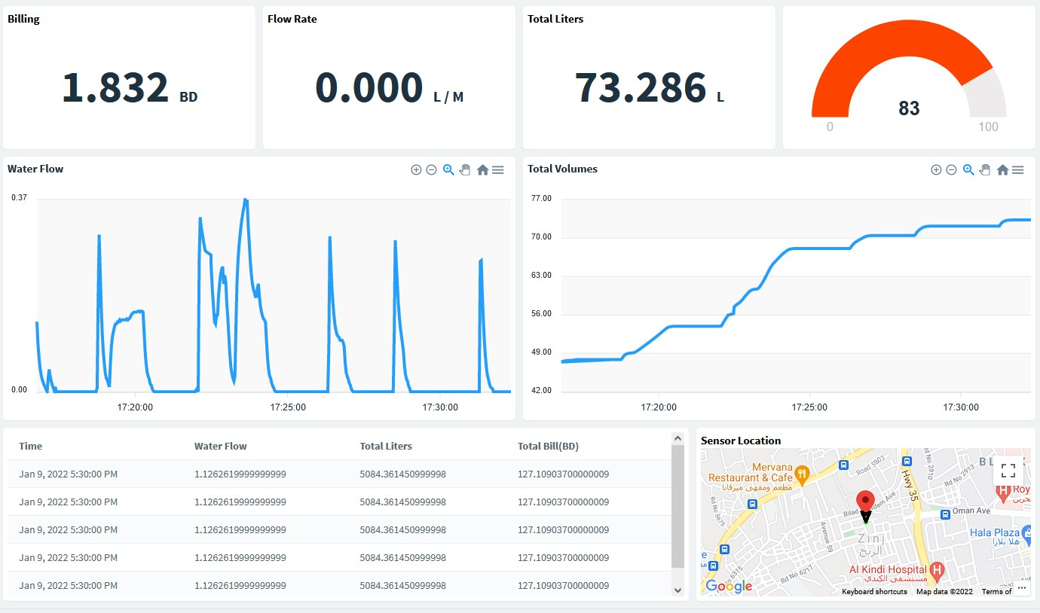
Dashboard

Slide 25
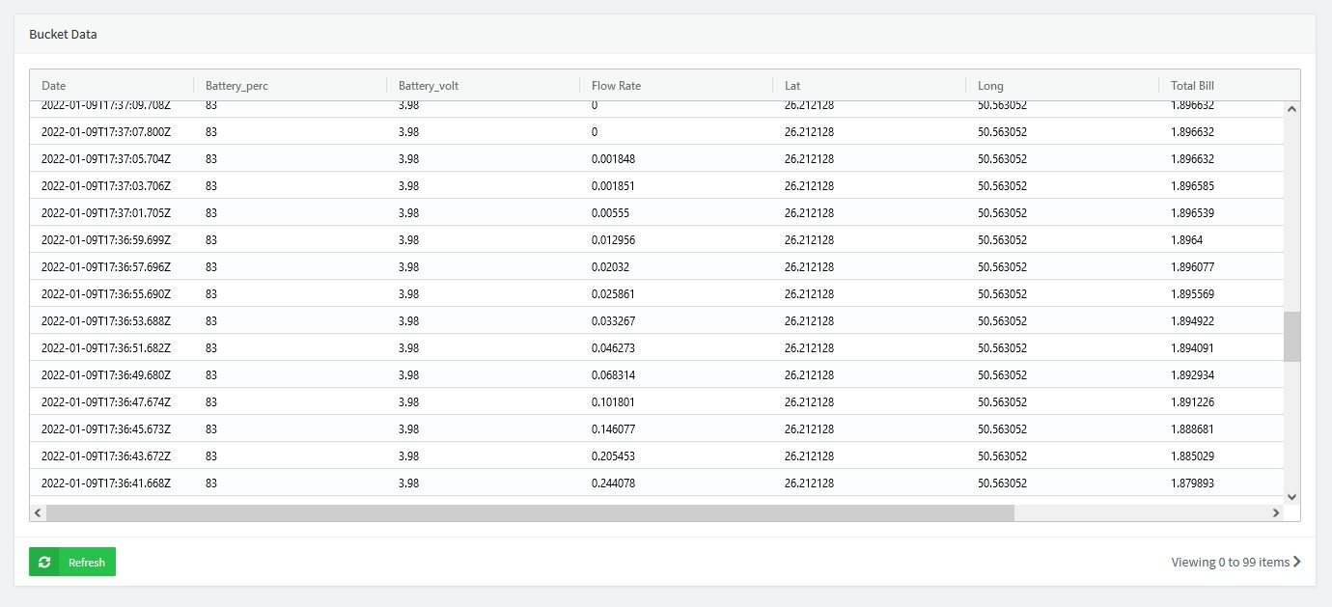
Database

Slide 26
Cost & Time Calculation
10
8
4 Weeks
Almost to complete
BD
BD
3 Hours
Arduino Board
+ Water flow sensor almost
Solar
Power System
Per day
40
Extra Cost
100
Total
BD
Home Mesh Wi-Fi
BD
Amount Paid
Notes:
Total amount spent on this project is almost 100 BD for four smart meters (Including Home Mesh Wi-Fi device ).
The list below shows the total cost of building one smart water meter:
Arduino Board + Water flow sensor almost 10 BD
Solar System 8 BD
Total cost per device = 18 BD
Additional Cost
Home Mesh Wi-Fi 40 BD

Slide 27
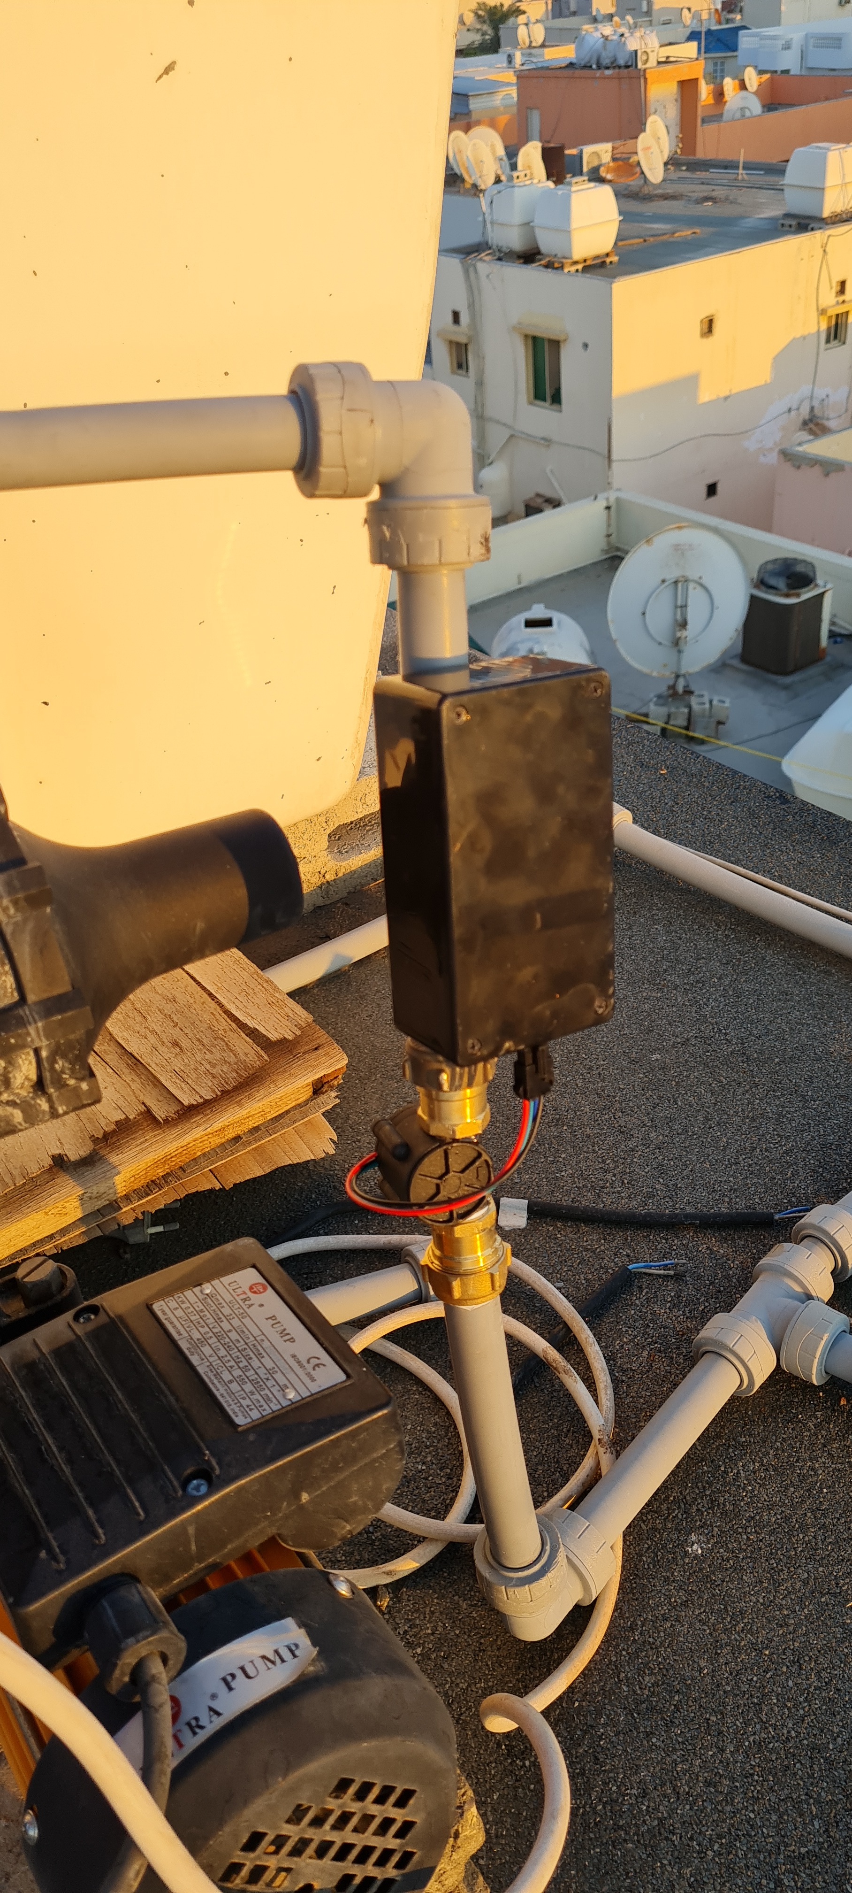
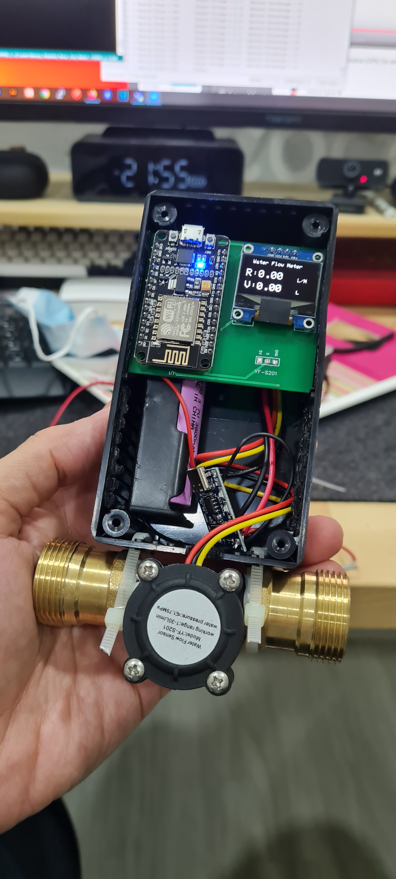
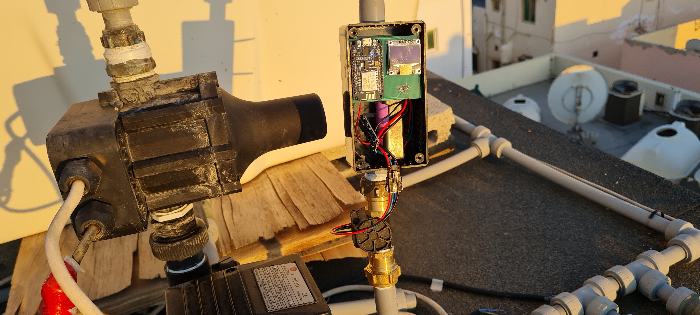
Clips

Slide 28
Conclusion
Build a smart water meter to monitor daily water consumption.
Integrating solar energy as source power to Arduino board.
Integrating machine learning algorithms to predict future water needs and costs.
Notes:
The project demonstrates how to build a smart water meter with an Arduino Node-MCU microcontroller such that household owners can monitor the amount of water used every day.
We were able to achieve our goals more efficiently by integrating solar energy into the system to power the microcontroller.
Future plans will take advantage of machine learning algorithms to improve the smart meter by incorporating them into the current system in order to automate the process of predicting future water needs and costs based on consumption levels.

Slide 29
References
IoT Water Flow Meter using ESP8266 & Water Flow Sensor, Alex Newton, accessed Oct 01, 2021, <https://how2electronics.com/iot-water-flow-meter-using-esp8266-water-flow-sensor/>
Fuentes, H., Mauricio, D. Smart water consumption measurement system for houses using IoT and cloud computing. Environ Monit Assess 192, 602 (2020). https://doi.org/10.1007/s10661-020-08535-4
Power ESP32/ESP8266 with Solar Panels, Nick, accessed Dec 12, 2021, <https://randomnerdtutorials.com/power-esp32-esp8266-solar-panels-battery-level-monitoring/>

Slide 30
Thank You

