Slide 1
Implementation of an IoT-based plant monitoring system
Prepared by: Fatema Abduljabbar Jawad
ID: 20163743
Supervised by: Prof. Mohab Mangoud

Slide 2
CONTENT
Introduction:
Objectives
Problem Statement
System Design and
Implementation
Demo
Conclusion:
Challenges and Future work

Slide 3
Introduction
Objectives:
The goal of the project is to protect plants from infections and conserve water by creating an Internet of Things system that consists of several sensors that monitor plant status 24/7 and determine when the plant requires watering.

Slide 4
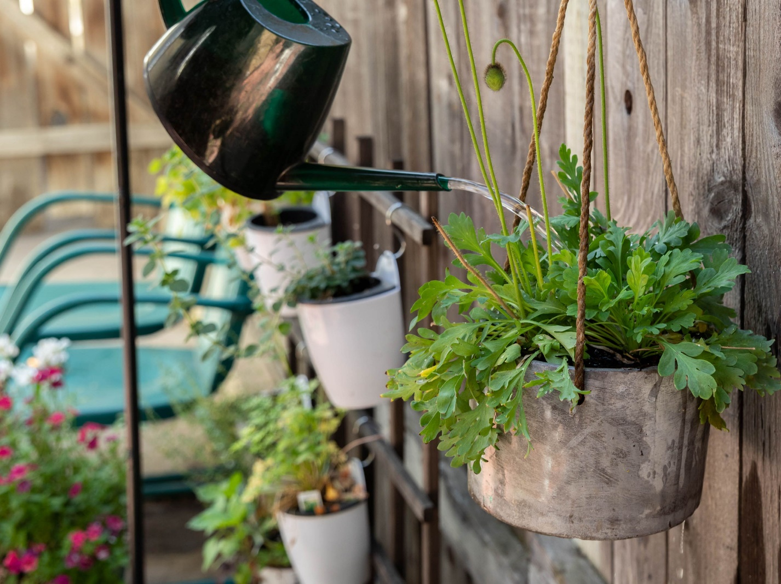
Problem Statement
Plants diseases has affected food production and civilization’s evolution throughout the years.
Back into the start of agricultural era, Plants diseases was viewed as god’s punishment and disease control methods were limited.
Lack of food stocks:
Irish famine caused by potato late blight in the 1840s [3].
The 1943 Bengal famine caused by rice brown spot [3].
In India between 1947 and 1960, when food production was insufficient due to the increasing population [1].
Fact: only six countries have access to half of the world's freshwater. Over a billion people do not have access to enough safe and clean water [2].

Slide 5
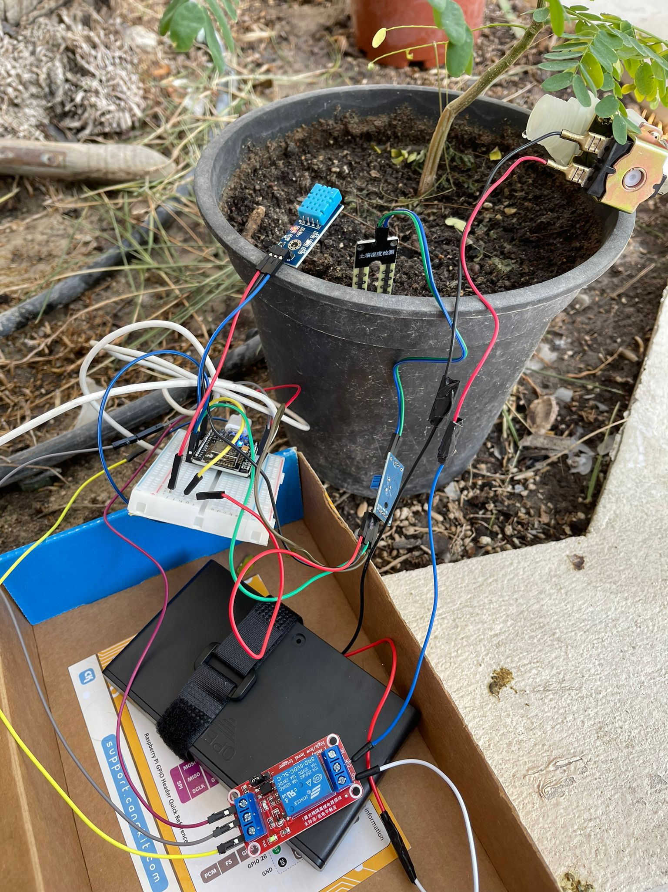
System Design and Implementation

Slide 6
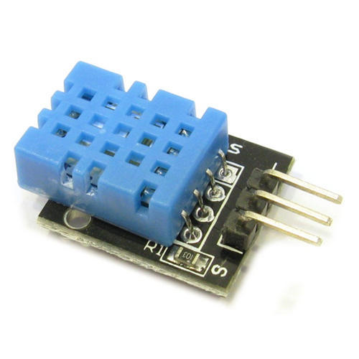
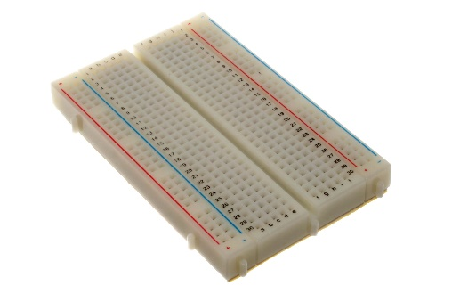
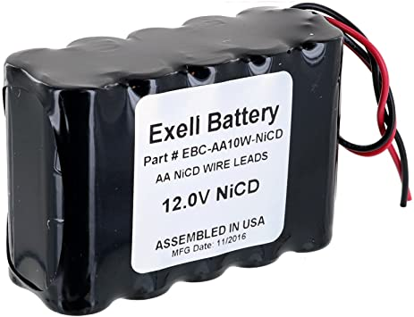
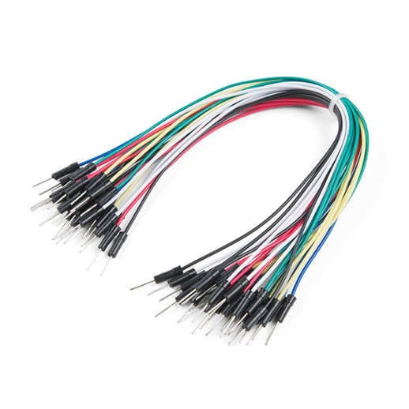
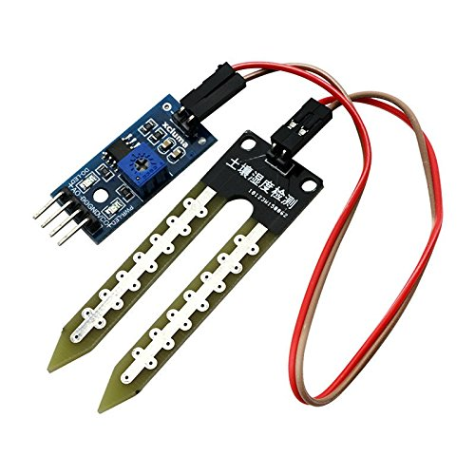
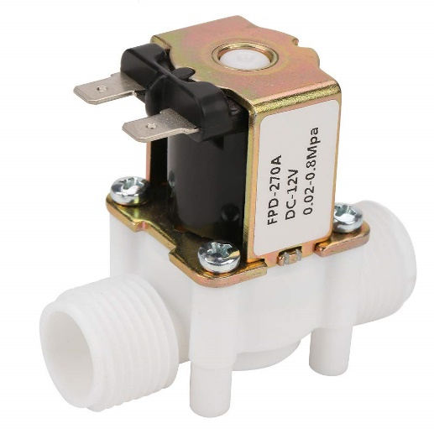
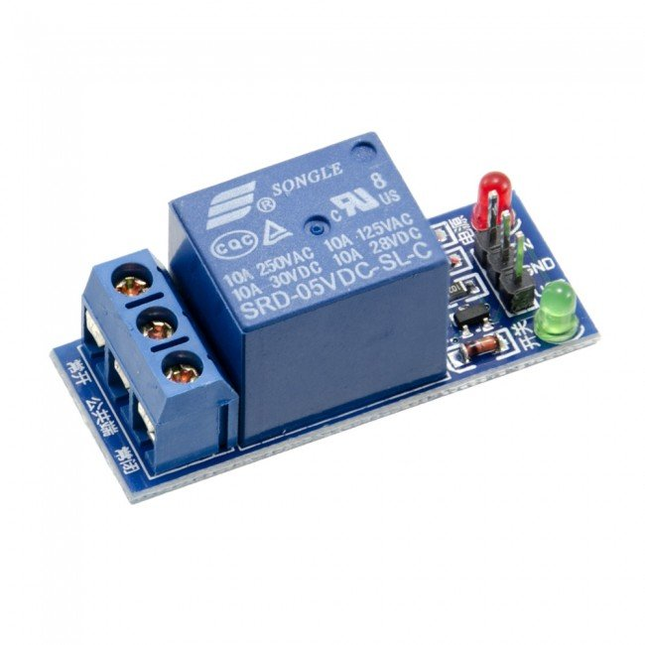
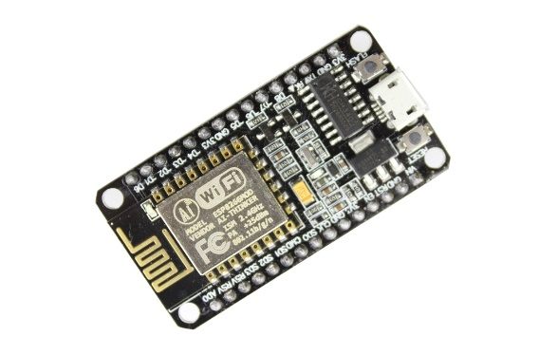
Hardware Equipment's

Slide 7
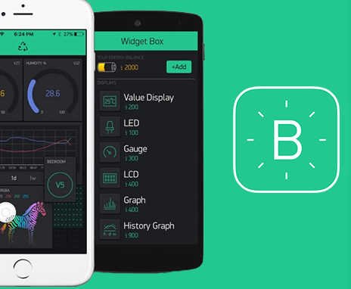
Software Equipment's
Blynk, Arduino and Fritzing

Slide 8
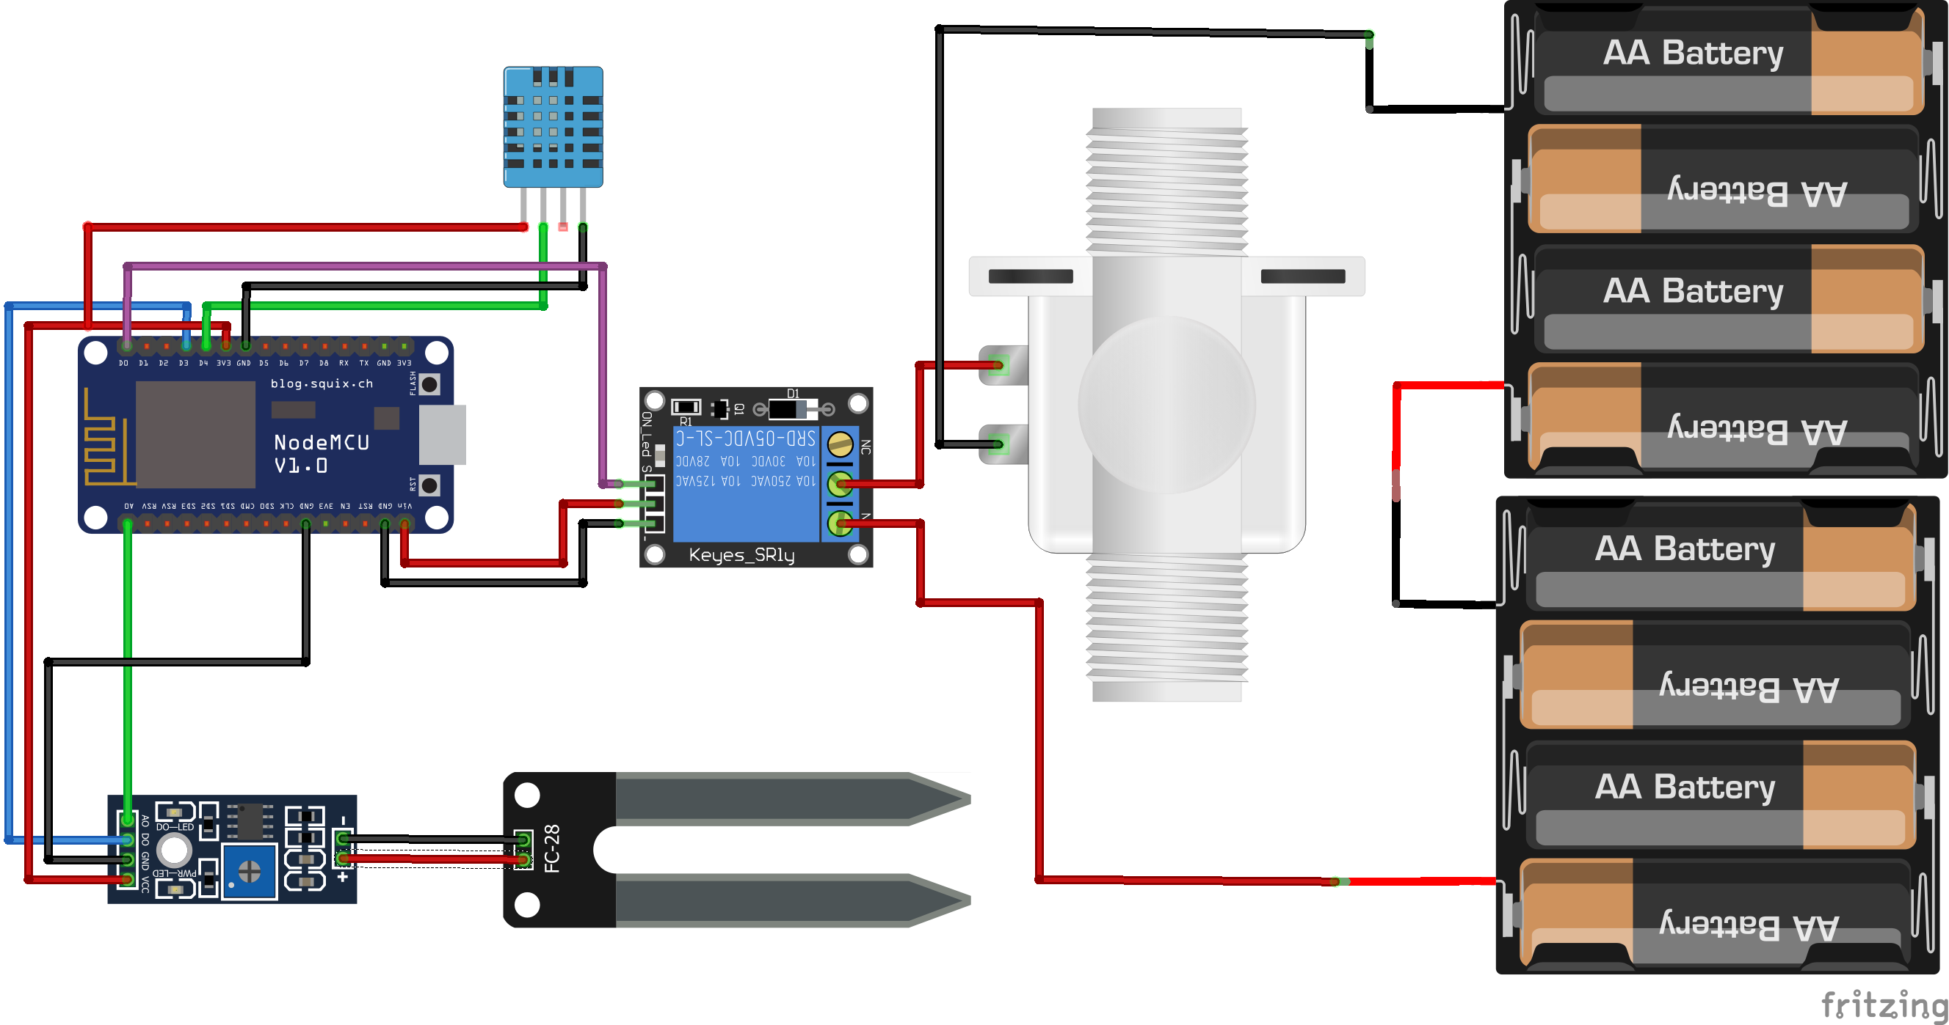
Circuit Diagram

Slide 9
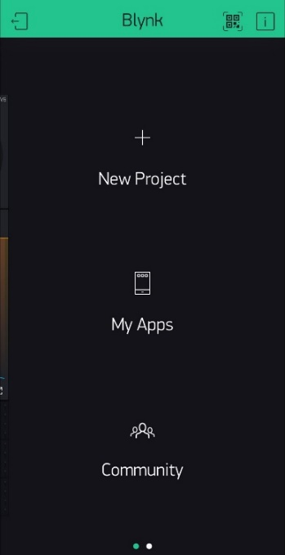
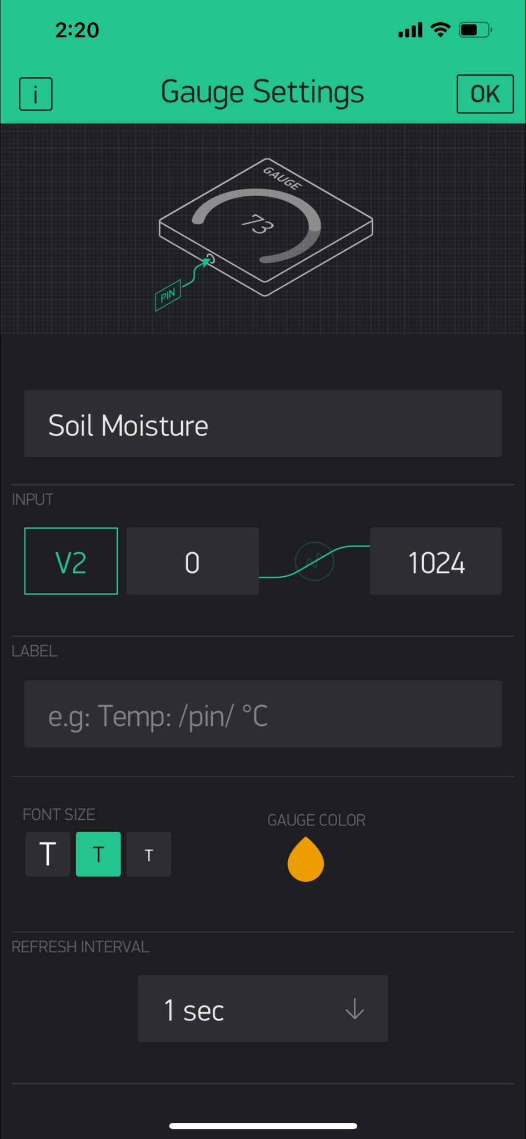
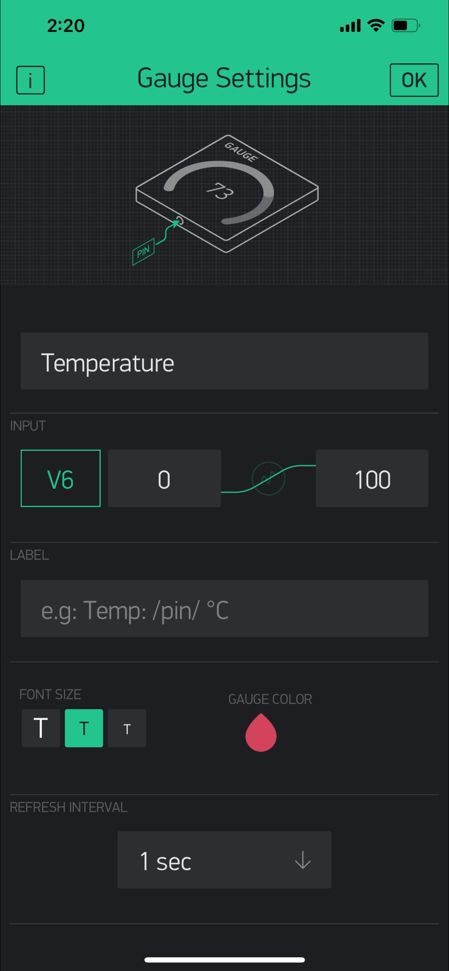
1. Create a new project named (IOT Plant Monitoring)
2. Add two gauges for temperature and humidity

Slide 10
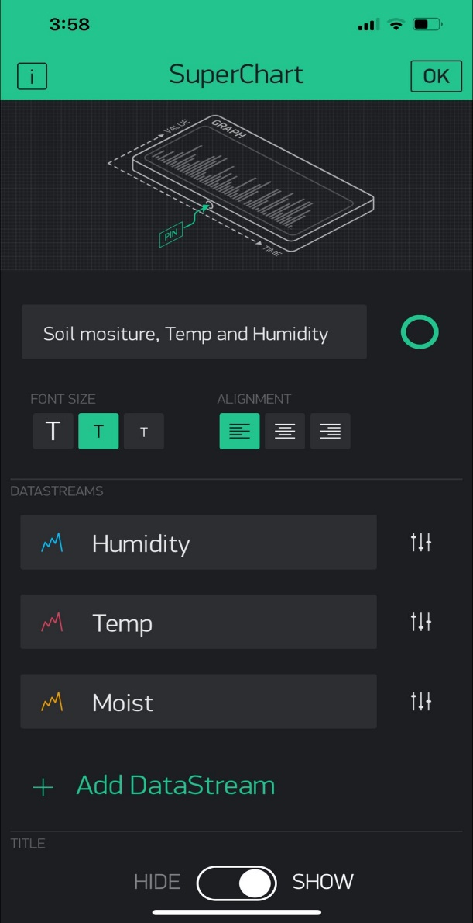
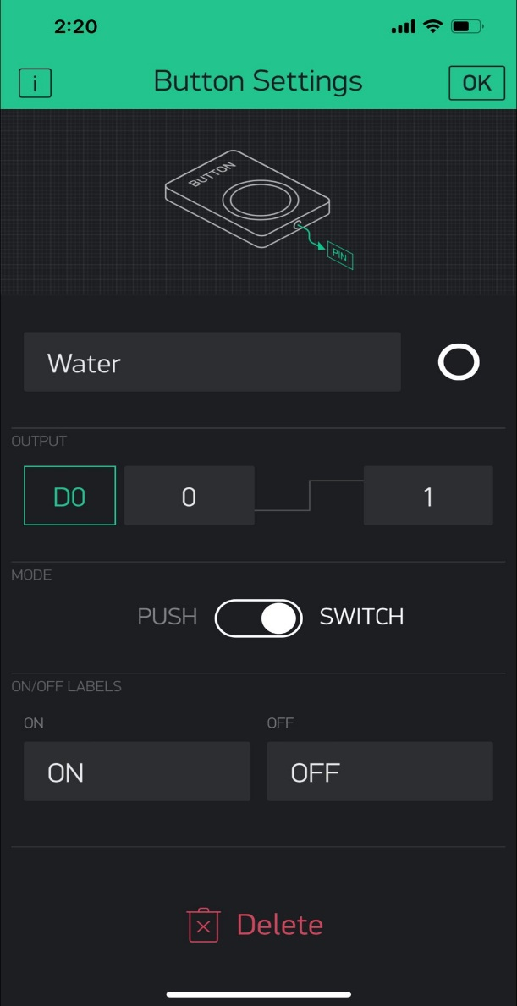
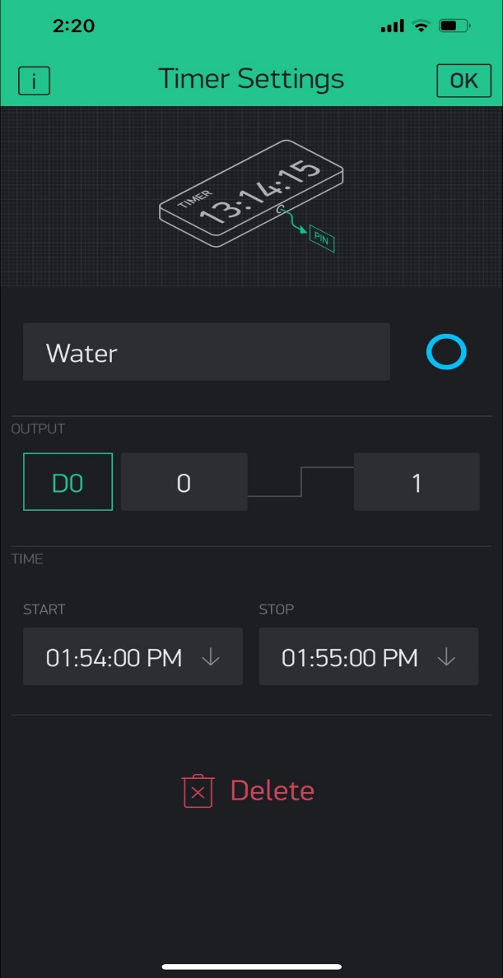
4. Add a new chart to read moisture, temperature and humidity
5. Add a switch button to control the solenoid water valve
6. Add a timer to set interval time for opening and closing the solenoid water valve

Slide 11
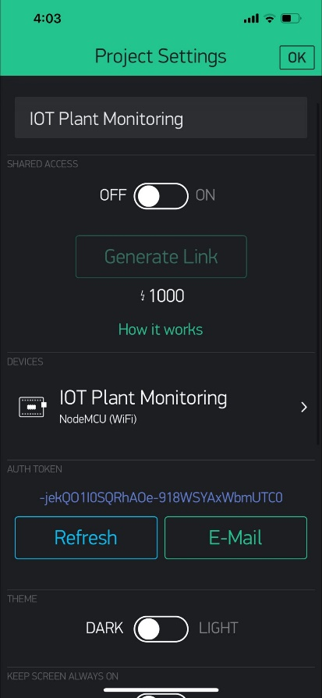
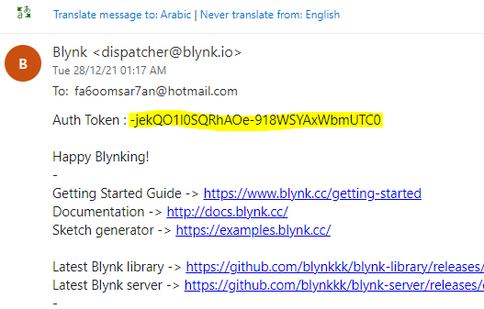
7. Send the authentication token by e-mail and add it to the code

Slide 12
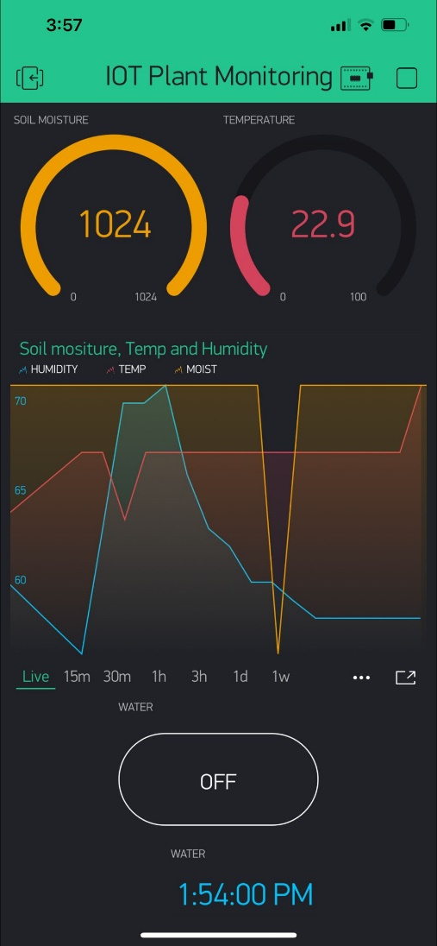
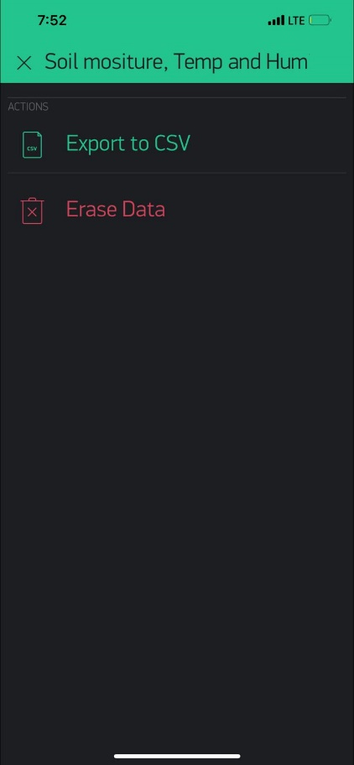
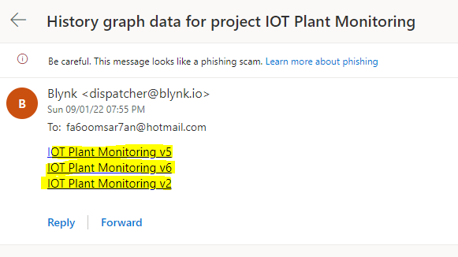
8. After powering the circuit and connecting the project with esp8266
9. We can export the data from super chart by email

Slide 13
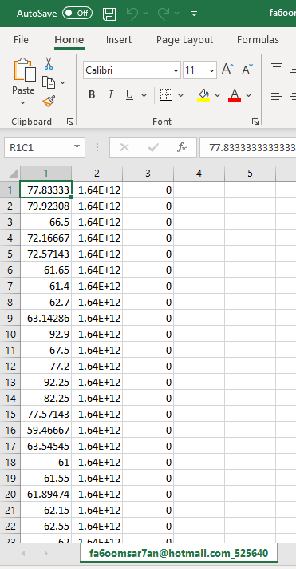
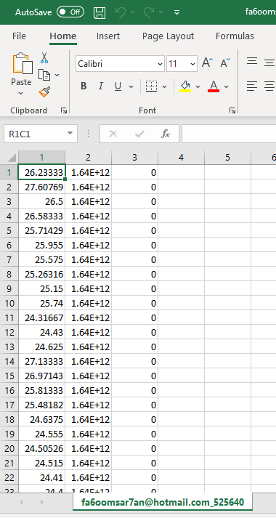
Soil Moisture
Humidity
Temperature

Slide 14
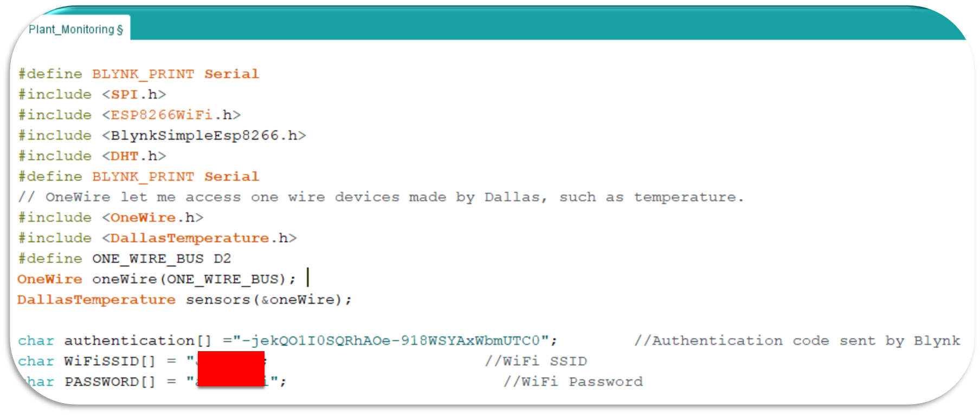
Code Explanation
Libraries
Authentication
Network

Slide 15
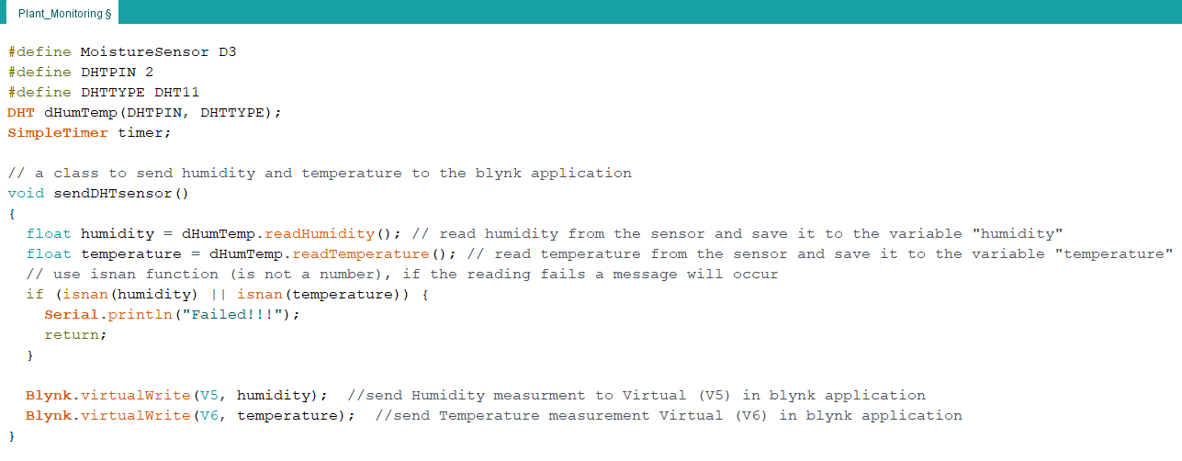
A class to send temperature and humidity to Blynk application through the cloud

Slide 16
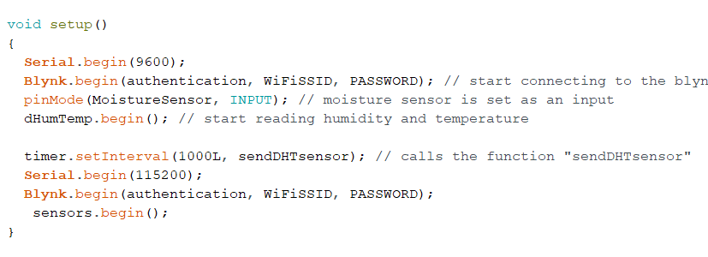
Start connection to Blynk and network and start sending data to Blynk throughout the network

Slide 17
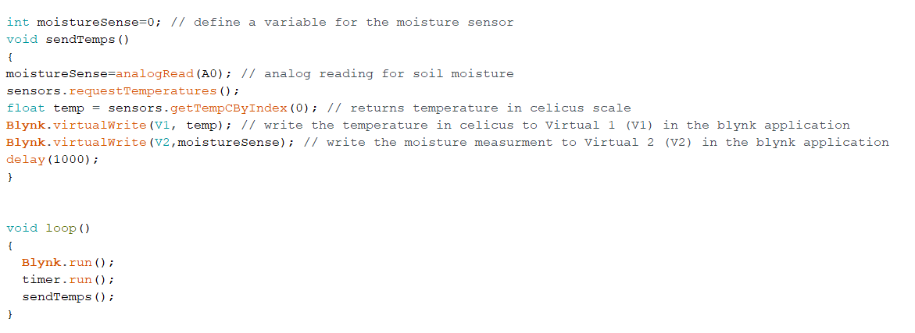
Send moisture measurements to the cloud

Slide 18
Demo

Slide 19
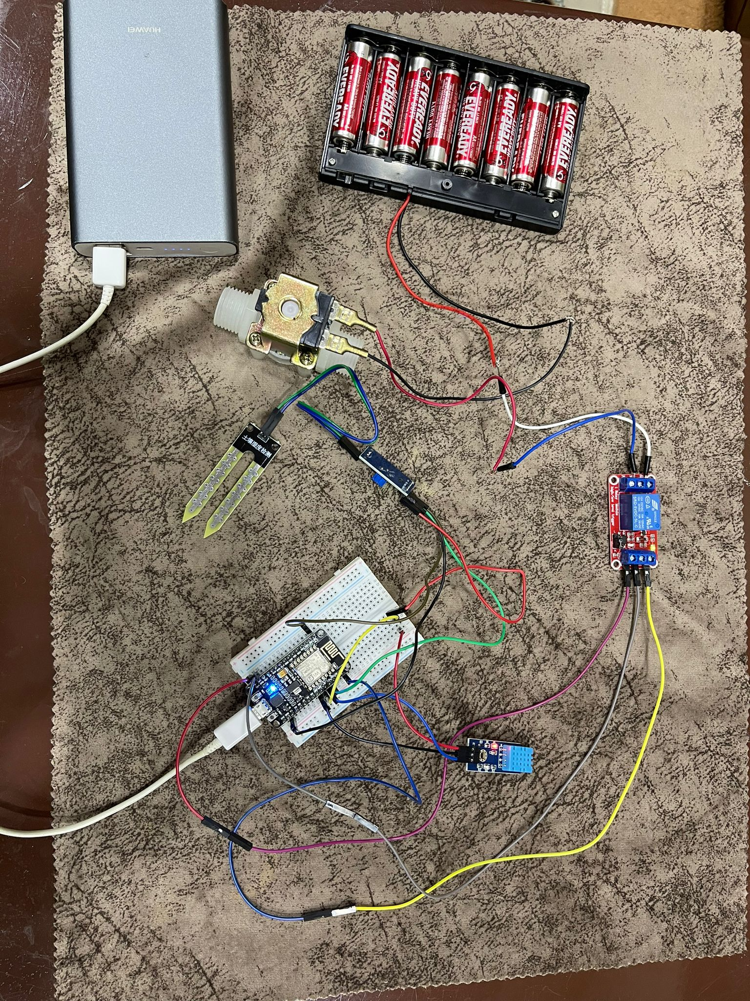
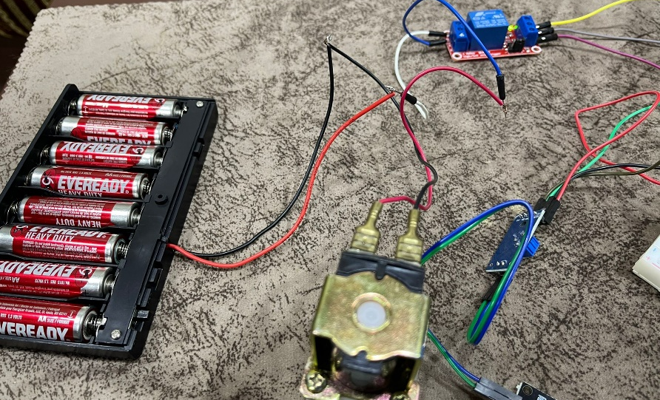

Slide 20
Video
https://stuuobedu-my.sharepoint.com/:v:/g/personal/20163743_stu_uob_edu_bh/EWysufGQRKlLl6qRepZ37ZABACzsEl4yScJhB7nOblJ42A?e=ZhsFjk

Slide 21
Conclusion:
Challenges and Future work
SAVING PLANT’S LIFE IS SAVING OUR’S

Slide 22
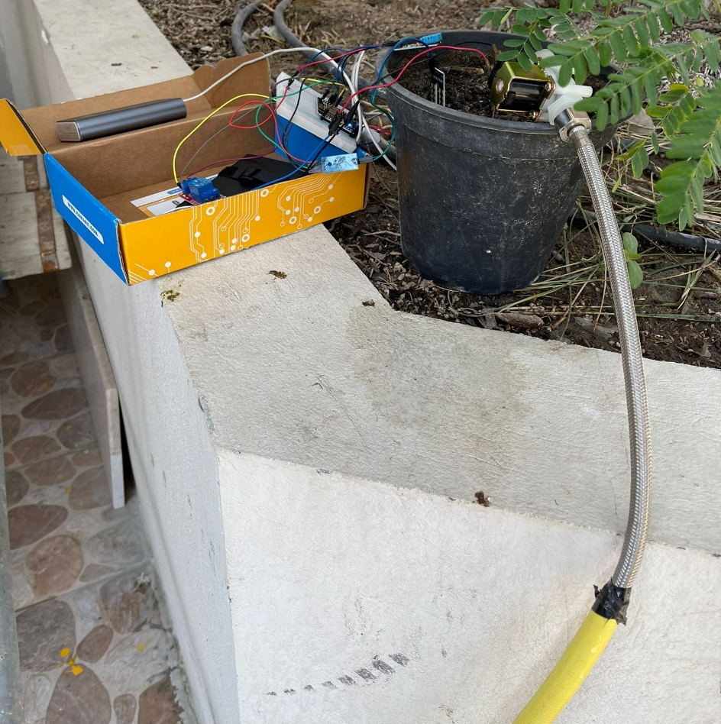
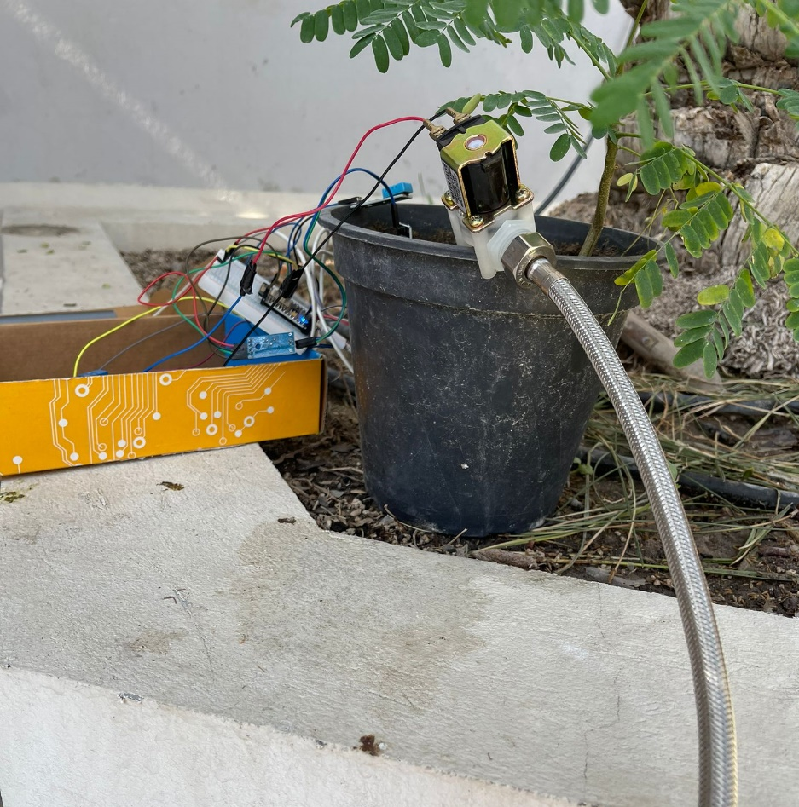
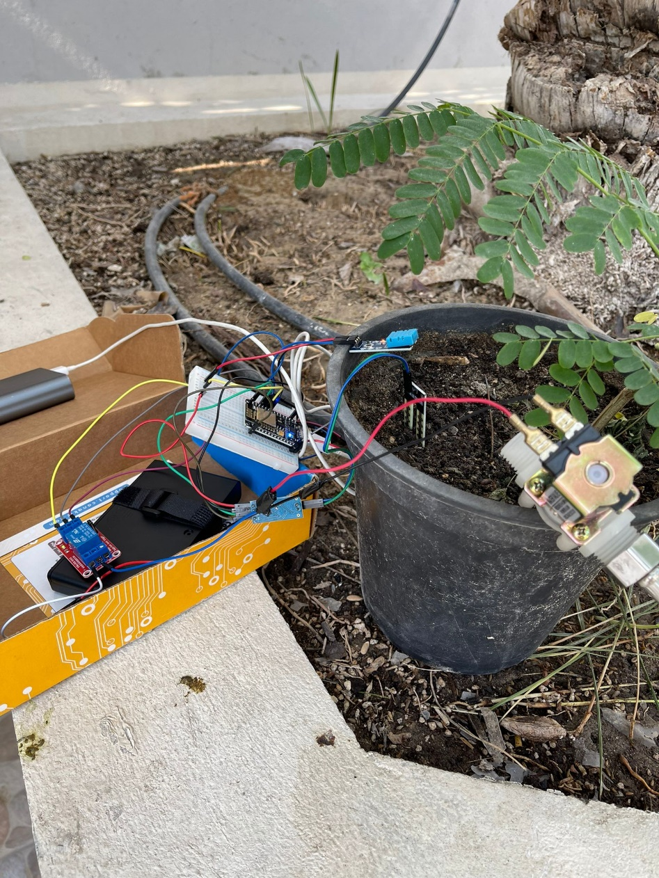
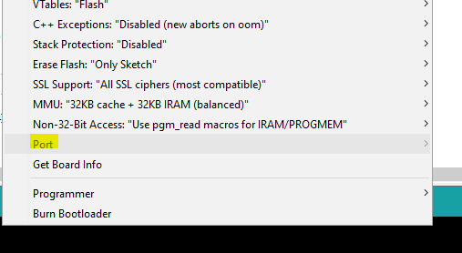
Challenges
Didn’t find a suitable pipe
Finding ESP8266 port

Slide 23
Future Work:
If the plant requires water, it can be watered automatically.
If there are any issues with the status of the plants, a notification will be sent to your phone, allowing you to respond quickly.
Within a geographical area, the health status of all available plants can be gathered to see if the area is infected with a plant disease or if more plants are needed.

Slide 24
References:
D. John and G. Babu, "Lessons From the Aftermaths of Green Revolution on Food System and Health", Frontiers in Sustainable Food Systems, vol. 5, 2021. Available: 10.3389/fsufs.2021.644559.
2022. [Online]. Available: https://www.amnh.org/explore/ology/earth/ask-a-scientist-about-our-environment/will-earth-run-out-of-water.
D. HE, J. ZHAN and L. XIE, "Problems, challenges and future of plant disease management: from an ecological point of view", Journal of Integrative Agriculture, vol. 15, no. 4, pp. 705-715, 2016. Available: 10.1016/s2095-3119(15)61300-4.
Instructables.com, 2022. [Online]. Available: https://www.instructables.com/Blynk-With-ESP8266/.
Youtube.com, 2022. [Online]. Available: https://www.youtube.com/watch?v=1e0zIfCzxBo. "NodeMCU Relay Controlled Solenoid Valve", Instructables, 2022. [Online]. Available: https://www.instructables.com/NodeMCU-Relay-Controlled-Solenoid-Valve/.
Instructables.com, 2022. [Online]. Available: https://www.instructables.com/How-to-Connect-Soil-Moisture-Sensor-and-ESP8266-to/.
Youtube.com, 2022. [Online]. Available: https://www.youtube.com/watch?v=WLFUwyyPrKo.

Slide 25
Thank You

