Slide 1
Smart Home Plants Monitoring
An Investigation of Agriculture Data Collection, Transmission, Storage, Visualization & Analysis

Slide 2
Smart Home Plants Monitoring
An Investigation of Agriculture Data Collection, Transmission, Storage, Visualization & Analysis
Agenda
Objective
Methodology
Results
Live Demo
Conclusion

Slide 3
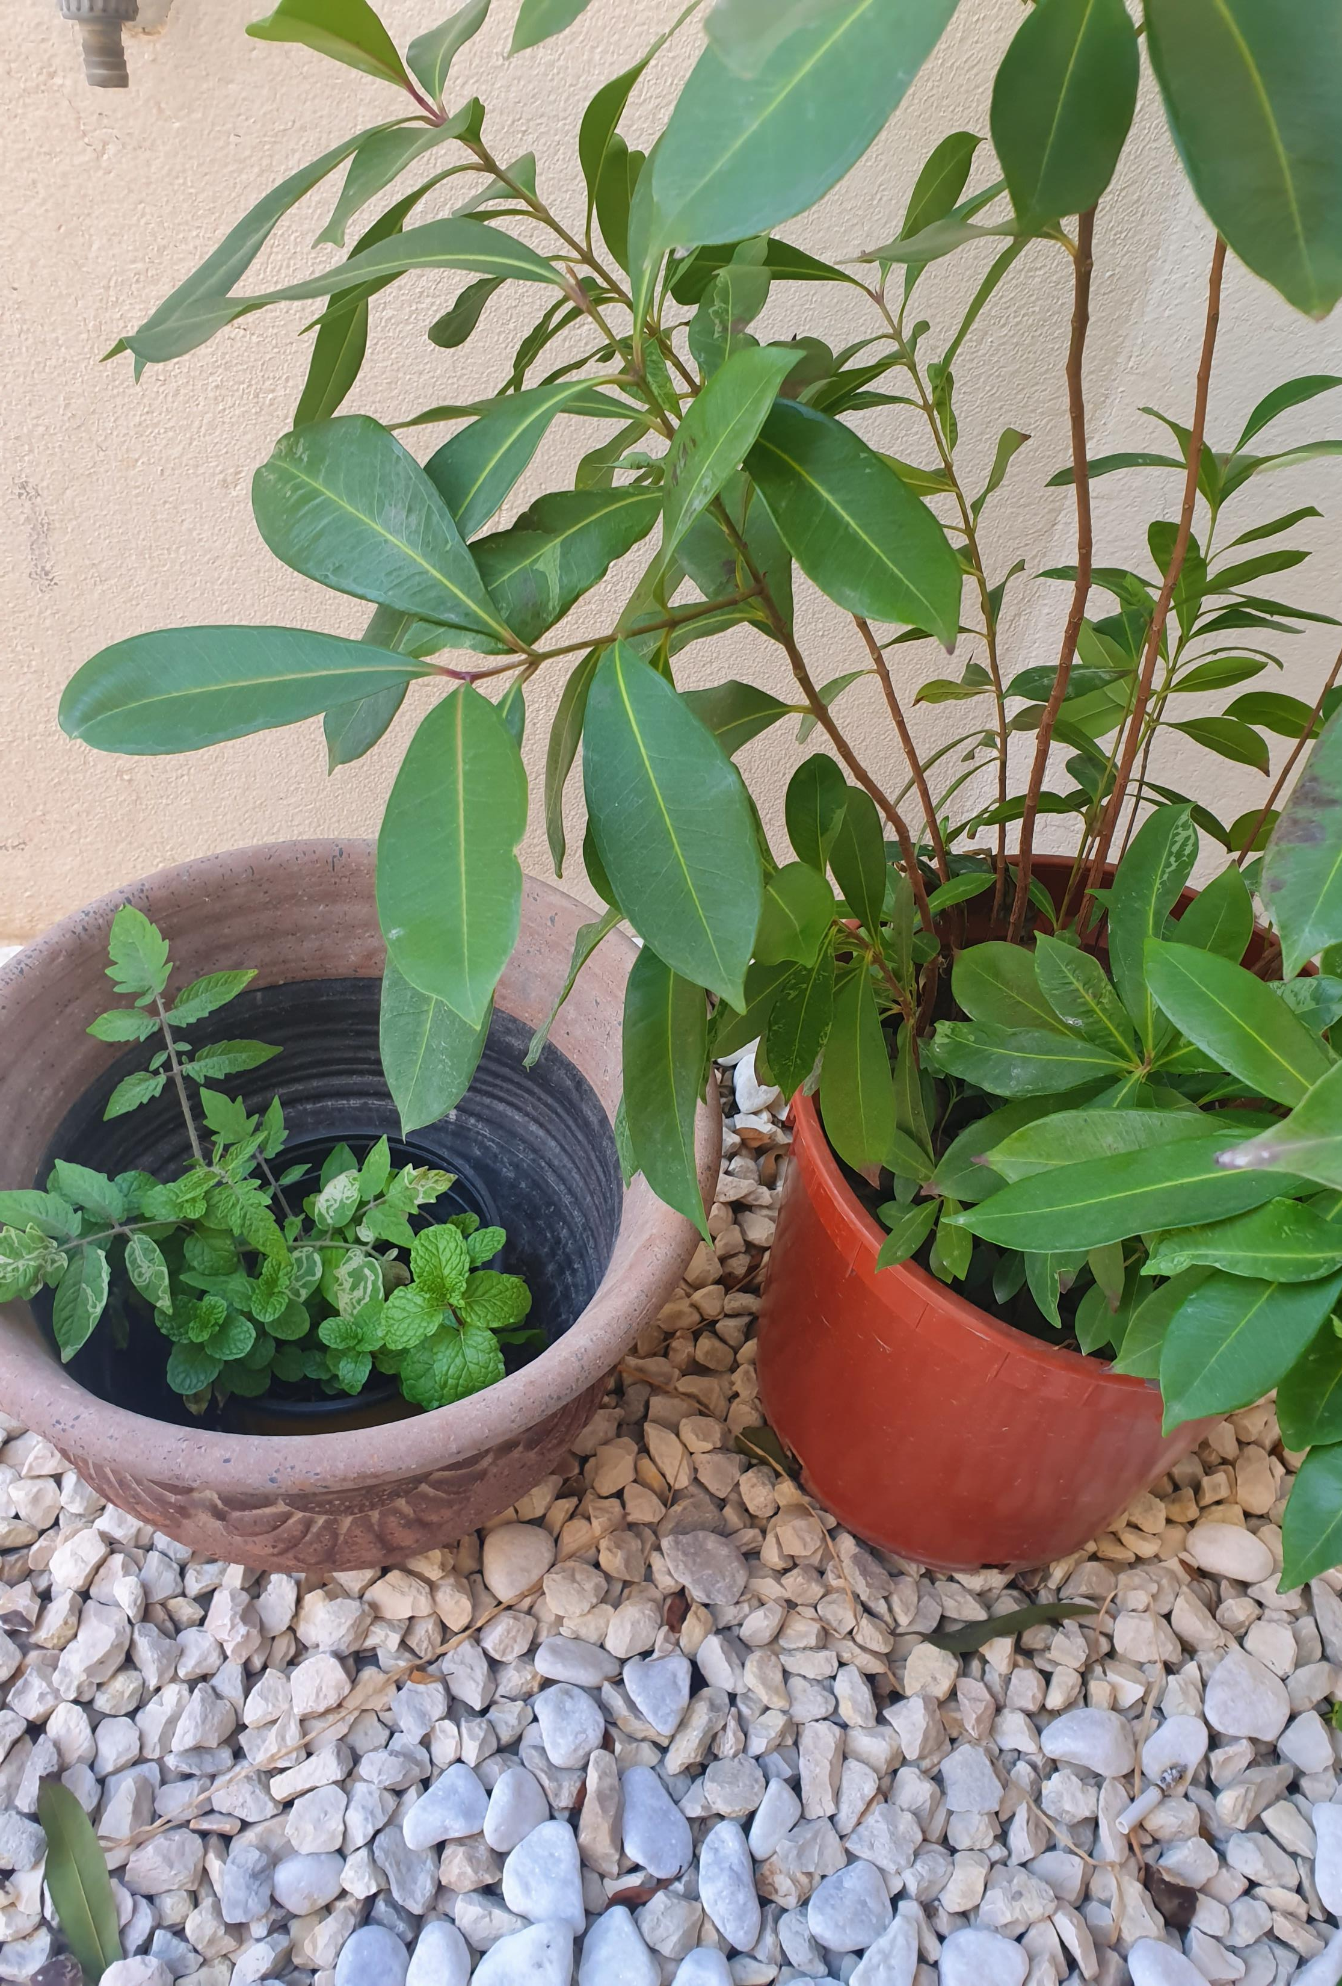
Objective
The aim of the project is to apply the concepts discussed in the course through a practical IoT implementation. The project attempts to collect useful data for smart home plants monitoring.

Slide 4
Methodology
The project revolves around utilizing two sensors for measuring the temperature, humidity, and soil moisture for a home plant. The data will be processed by Arduino MKR1000 and sent to the ThingSpeak cloud via Wi-Fi. The ThingSpeak cloud allows for storing and visualizing the data.
Sensing Layer
Network Layer
Application Layer
Arduino MKR1000
This “thing” will process data collected from sensors and send them to ThingSpeak Server.
DHT11
This “thing” is a humidity and temperature sensor
Adafruit-l2d Capacitive
This “thing” is a soil moisture sensor
WIFi
WiFi was utilized to send collected data to ThingSpeak server.
ThingSpeak
ThingSpeak is a platform that supports the management of IoT devices and data collection, processing and visualization tasks.

Slide 5
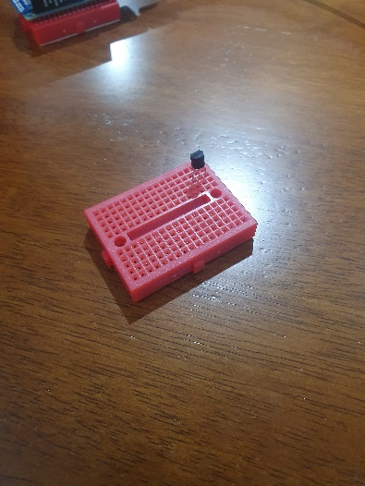
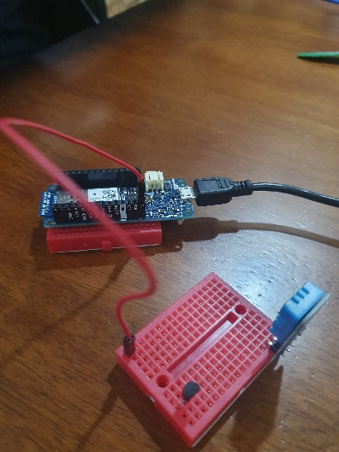
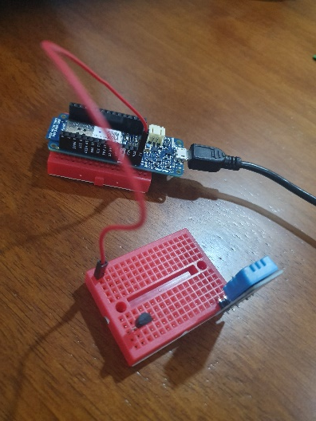
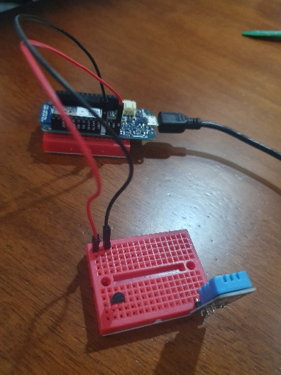
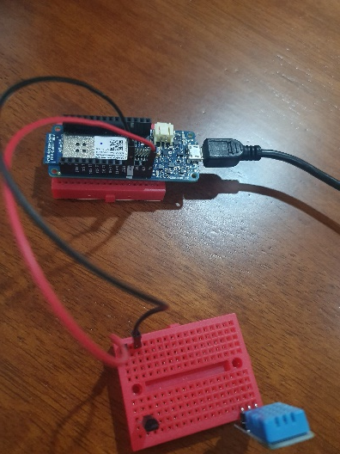
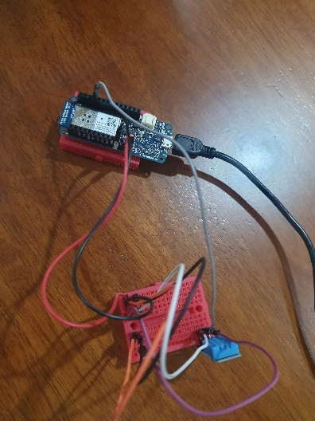
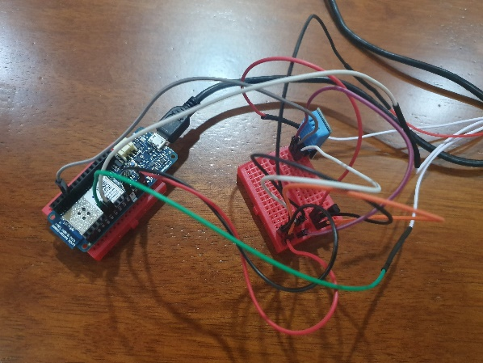
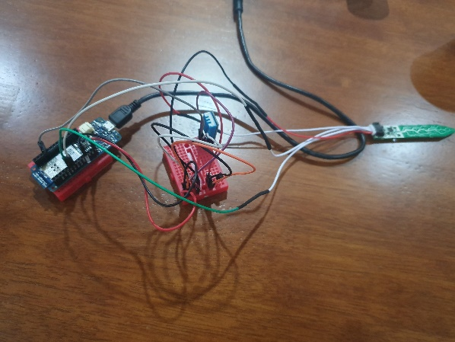
Setting up Sensors
Setting up ground and power supply for the electronic circuit
Setting up the temperature and humidity sensor (DHT11)
Setting up the soil moisture sensor (Adafruit-I2C)

Slide 6
Setting up Arduino Code
ThingSpeak "write" API key
Wi-Fi SSID and
Wi-Fi password
Get sensors readings
Construct url
The code is based on:
https://create.arduino.cc/projecthub/detox/mkr1000-to-thingspeak-com-5bb252

Slide 7
Setting up Arduino Code
ThingSpeak "write" API key,
Wi-Fi SSID and
Wi-Fi password
Get sensors readings
Construct url

Slide 8
Setting up Arduino Code
ThingSpeak "write" API key,
Wi-Fi SSID and
Wi-Fi password
Get sensors readings
Construct url

Slide 9
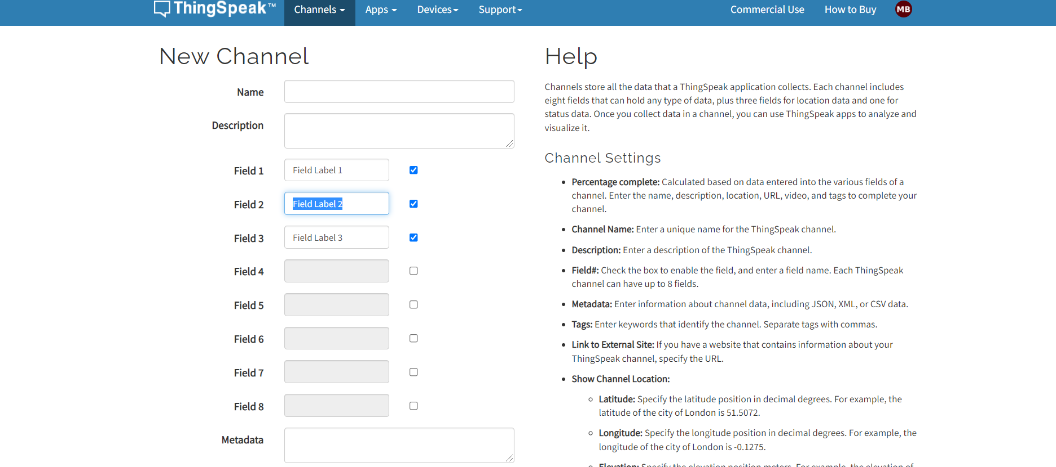
Setting up the ThingSpeak cloud
Channel setup
MATLAB Analysis setup

Slide 10
Setting up the ThingSpeak cloud
Channel setup
MATLAB Analysis setup
(email trigger)

Slide 11
Setting up the ThingSpeak cloud
Channel setup
MATLAB Analysis setup
(email trigger)

Slide 12
Setting up the ThingSpeak cloud
Channel setup
MATLAB Analysis setup
(Time control)

Slide 13
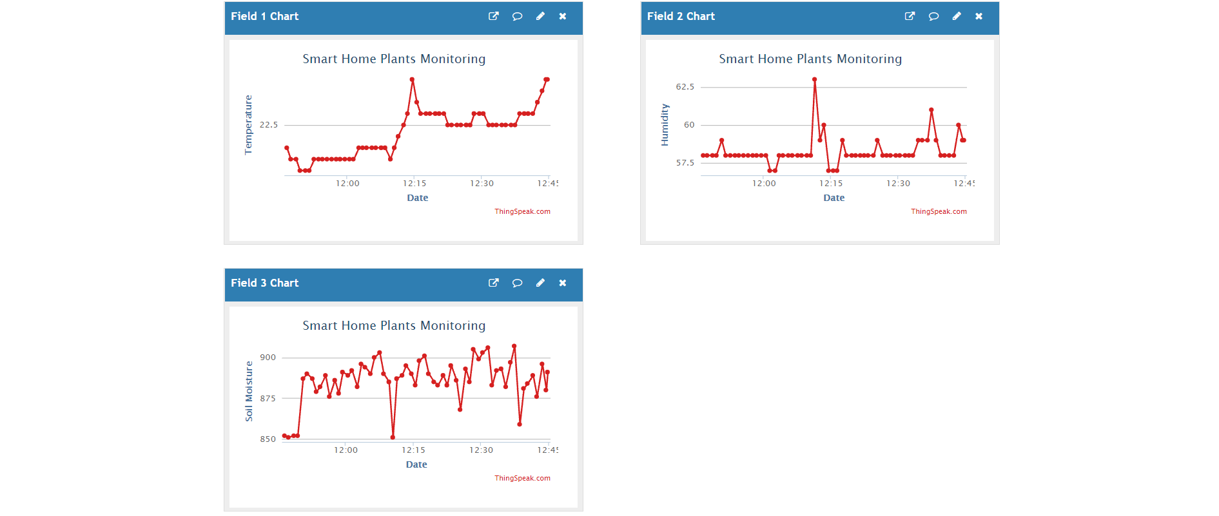
Results

Slide 14
Results

Slide 15
Conclusion
The IoT project managed to successfully collect sensor data for temperature, humidity, and soil moisture, for a plant.
The sensed data were sent to ThingSpeak cloud where the required visualization and analysis was configured appropriately.
Arduino MCUs along with ThingSpeak can provide a feasible implementation of small and large scale IoT projects of different applications.
In this project, the recorded parameters can be used for monitoring plant requirements to optimize the health and yield.
The same idea can be extrapolated to a larger setting where multiple sensors can be deployed within a precise agriculture application.

Slide 16
Thank you…

