Slide 1
AIE604 DEEP LEARNING FINAL PROJECT CONSTRUCTION QUALITY CONTROL CLASSIFICATION & DETECTION APPLICATIONS USING DEEP LEARNING
UNIVERSITY OF BAHRAIN
COLLEGE OF ENGINEERING
ELECTRICAL & ELECTRONICS ENGINEERING DEPARTMENT
Presented by:
Abdulaziz Sami Abdulla Qambar
20112926
8th June 2021

Slide 2
Content
AI in Construction,
Current Practice & Problem Definition
You Only Look Once Algorithm
YOLO Version 4
Applications Detail
Discussion & Results
Conclusion & Summary
AIE604 Deep Learning – Final Project ID: 20112926
Slide 1 / 39

Slide 3
Introduction - AI in Construction Industry
Construction sector in 2020 contributed 7.7% to Bahrain GDP [1].
A total of 330 million dinars construction projects were awarded during last year that are related to roads, housing, electricity, sewage, and telecommunication projects [1].
Bahrain Airport
Bapco Refinery
Bahrain Tram
King Hamad Causeway
Efficiency, automation, optimization, and sustainability are the goals construction sector is interested in for a cost-effective project.
Decision Support Systems
Autonomous Trucks
Drones & Computer Vision
Robots
AIE604 Deep Learning – Final Project ID: 20112926
Slide 2 / 39
Notes:
Construction industry is one of the major industries around the globe. It is the development engine of the country that represents the foundation of providing the required facilities from buildings to infrastructure for all other industries. It reflects the country urbanization and modernity.
In recent years, Artificial Intelligence (AI) integration with construction industry started to emerge due to its capability to achieve these goals.

Slide 4
Introduction – Current Practice & Problem Definition
Site Access Control: (Problem No.1)
Construction sites security and access control is an essential part of construction management.
Proper site access mechanism is required to monitor visitors access, material delivery to site, machinery access, and labor deployment.
Health, Safety & Quality Control: (Problem No.2)
48% of falls from height in construction sites lead to serious injuries and 30% lead to death [3].
In Bahrain and according to Social Insurance Organization, “45” falls from height accidents been registered in Q4 of 2020, none of them resulted death [4].
Current Practice in Ministry of Housing
Manual site access monitoring mechanism is being implemented through appointing specialized security contractor to control site access with providing patrols to roam the site for any violations or intruders. The cost of deploying “4” security personals for 12 hours shift, 7 days a week is 1,300 BD/month/project.
Deploying of human safety officers to roam the site on daily basis to evaluate contractor workmanship and measures from health & safety point of view. The health & safety officer deployment costs around 1000 BD/month/project.
AIE604 Deep Learning – Final Project ID: 20112926
Slide 3 / 39

Slide 5
Introduction – Current Practice & Problem Definition
Problem Definition:
Current site access control and H&S officer deployment practice is inefficient, costly, time consuming, and requires human personal to be deployed on site.
Motivation:
To utilize computer vision and deep learning in developing algorithms to enhance project management, quality monitoring, and control. Minimize the need for human security & safety officers.
Objectives:
To develop CNN based algorithm for real time automatic construction vehicles detection.
To develop CNN based algorithm for real time automatic detection of vehicle license plate.
To develop CNN based algorithm for real time helmet wearing detection for workers.
To develop CNN based algorithm for real time face mask wearing detection for workers.
To develop classification algorithm for crack images classification.
To evaluate & compare the results of the developed deep learning models with literature.
AIE604 Deep Learning – Final Project ID: 20112926
Slide 4 / 39

Slide 6
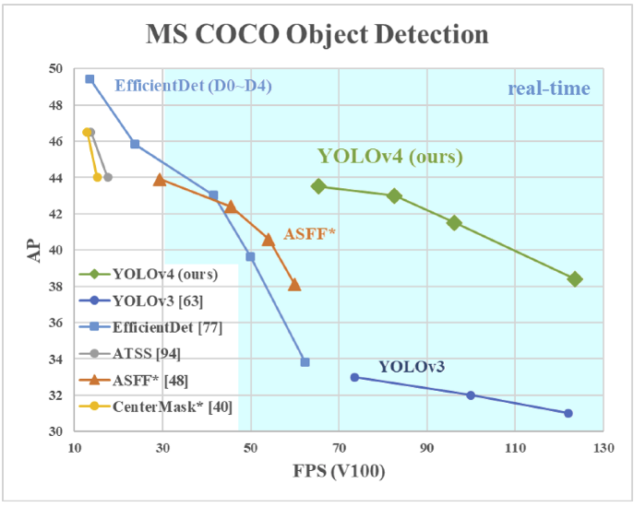
You Only Look Once – Object Detection Algorithm
You Only Look Once object detection algorithm was proposed in 2016 by Joseph Redmon. The authors called it as DarkNet [11].
YOLO object detection algorithm is preferred over the other algorithms such as: R-CNN and SSD for the following reasons:
YOLO achieves high object detection frames per second reaching 45 FPS in traditional YOLO algorithm version 1 [11].
YOLO doesn’t use the window sliding concept used in R-CNN as it analyzes the features of the whole image simultaneously during training. Leading to less false positives [11] and enabling a better feature context understanding.
YOLO algorithm results are considered more generalized compared to other algorithms as it can be applied on new domains and perform well [11].
YOLO Version 4:
In 2020, YOLOv4 was released by Alexey Bochkovskiy et al [14], which can achieve 10% better mAP results and 12% better FPS results compared to YOLOv3.
Figure 1: YOLO version 4 performance [17]
AIE604 Deep Learning – Final Project ID: 20112926
Slide 5 / 39
Notes:
There are several known detection algorithms such as: RCNN-SSD & YOLO

Slide 7
You Only Look Once Version 4 Architecture
YOLOv4 architecture is divided to 4 parts which are: Backbone, Neck, Dense Prediction, and Sparse Prediction [14].
Figure 2: YOLO version 4 architecture [17]
The backbone of YOLOv4 is concerned with image features extraction. It is based on CSPDarknet53 architecture.
The neck purpose is to increase the information aggregated in the feature extraction part by collecting feature maps at different backbone stages.
The one stage object detector is called Dense Prediction which is used to localize the bounding boxes and classify the objects identified.
Sparse Prediction is used to improve the object detection & classification results.
AIE604 Deep Learning – Final Project ID: 20112926
Slide 6 / 39

Slide 8
You Only Look Once Version 4 Architecture
Bag of Freebies (BoF):
Combination of training strategies and techniques that aim to improve the algorithm performance without increasing the computational cost.
Photometric Distortion
Geometric Distortion
CutOut
DropBlock
Mosiac
Bag of Specials (BoS):
Combination of plugins and post processing techniques that enhance the algorithm performance with an increase in the prediction computation cost that is less than the performance improvement in terms of percentage. Ex. Non-Maximum Suppression.
Algorithm Selection:
Based on above analysis and our intended projects, we have decided to develop the object detection algorithms using a YOLOv4 with utilizing transfer learning merits and removing the classification part to train a new classifier neural network as per our objectives.
AIE604 Deep Learning – Final Project ID: 20112926
Slide 7 / 39
Notes:
Despite Faster R-CNN algorithm is the most accurate in object detection, yet it is not the quickest
In addition, Faster R-CNN is not able to detect small objects

Slide 9
Applications Details – Algorithms Framework
Object Detection Algorithms Framework:
Every object detection problem shown in this research will be developed using Python language on Google Collaboratory Pro platform and will follow a pre-defined structured framework.
Data Collection
The object detection projects that will be developed are:
Data Preprocessing
Development of construction vehicles detection algorithm.
Development of vehicle license plate detection algorithm.
Development Helmet detection algorithms.
Development of Face Mask Detection algorithm.
Labeling
Converting labeling format to text format
Image resizing & augmentation
Modeling
Results Evaluation
Figure 3: Object Detection Modeling Framework
AIE604 Deep Learning – Final Project ID: 20112926
Slide 8 / 39

Slide 10
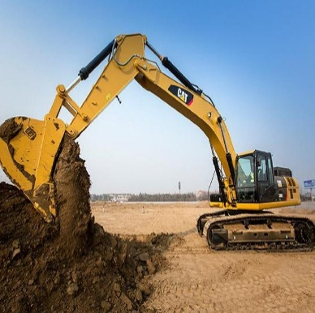
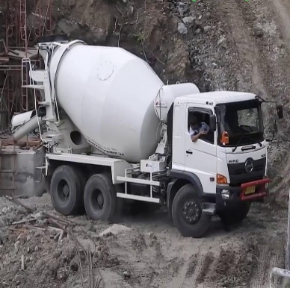
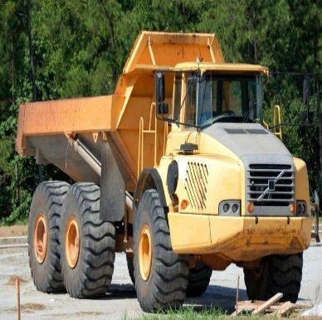
Applications Details – Construction Vehicles Detection Algorithm
An object detection algorithm will be trained using YOLOv4 algorithm to detect “3” types of construction vehicles.
3
Classes
2,825
Images
5,995
Objects
Figure 4: Construction vehicles images
AIE604 Deep Learning – Final Project ID: 20112926
Slide 9 / 39

Slide 11
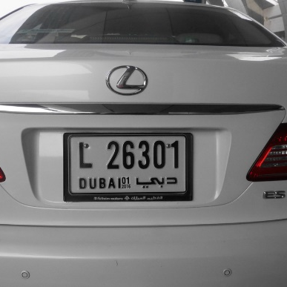
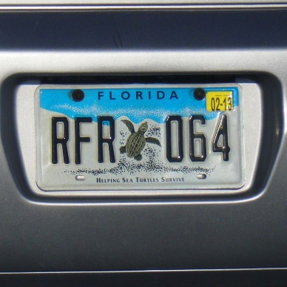
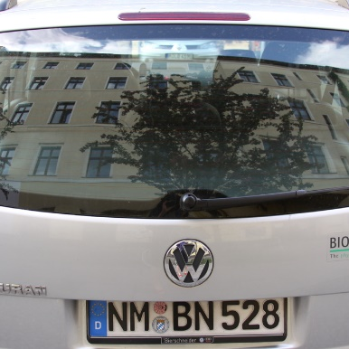
Applications Details – Construction Vehicles Detection Algorithm
An object detection algorithm will be trained using YOLOv4 algorithm to detect license plate of vehicles.
1
Classes
2,386
Images
3,446
Objects
Figure 5: License plate vehicles images
AIE604 Deep Learning – Final Project ID: 20112926
Slide 10 / 39

Slide 12
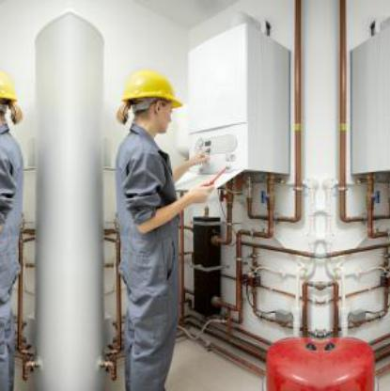
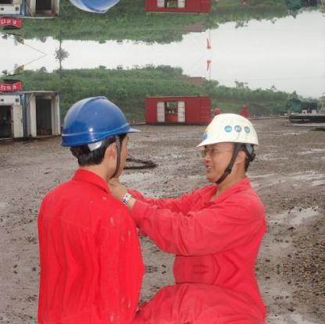
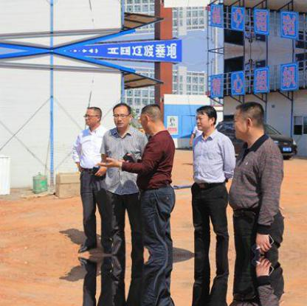
Applications Details – Helmet Detection Algorithm
An object detection algorithm will be trained using YOLOv4 algorithm to detect “2” objects.
2
Classes
7,035
Images
26,424 Objects
Figure 6: Helmet images
AIE604 Deep Learning – Final Project ID: 20112926
Slide 11 / 39

Slide 13
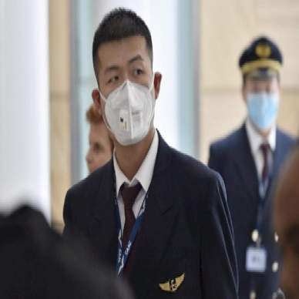
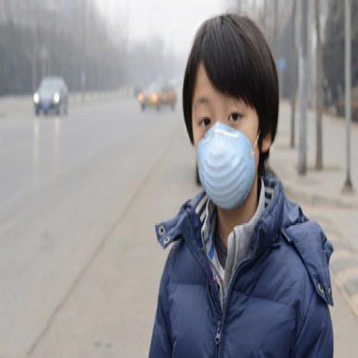
Applications Details – Face Mask Detection Algorithm
An object detection algorithm will be trained using YOLOv4 algorithm to detect “2” objects.
2
Classes
827
Images
3,900 Objects
Figure 7: Face mask images
AIE604 Deep Learning – Final Project ID: 20112926
Slide 12 / 39

Slide 14
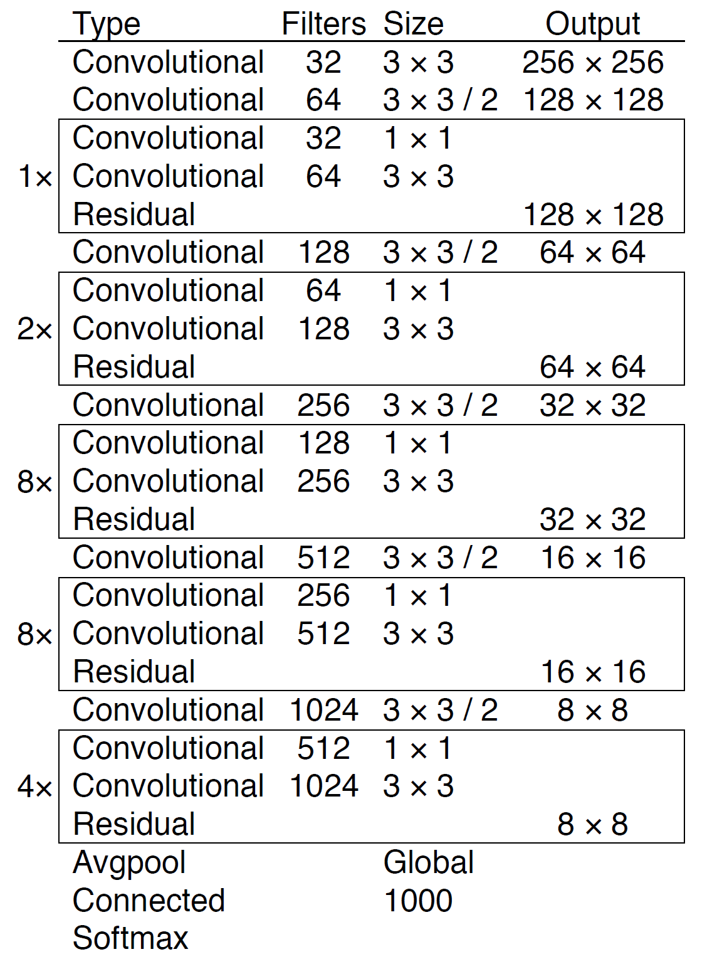
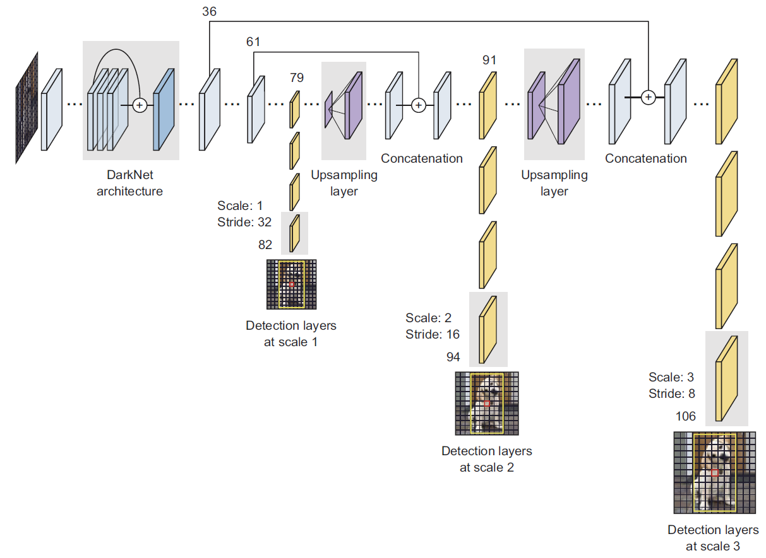
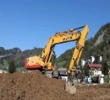
Applications Details – Object Detection Algorithm Architecture
Figure 8: Algorithm’s framework summary [12], [13]
AIE604 Deep Learning – Final Project ID: 20112926
Slide 13 / 39

Slide 15
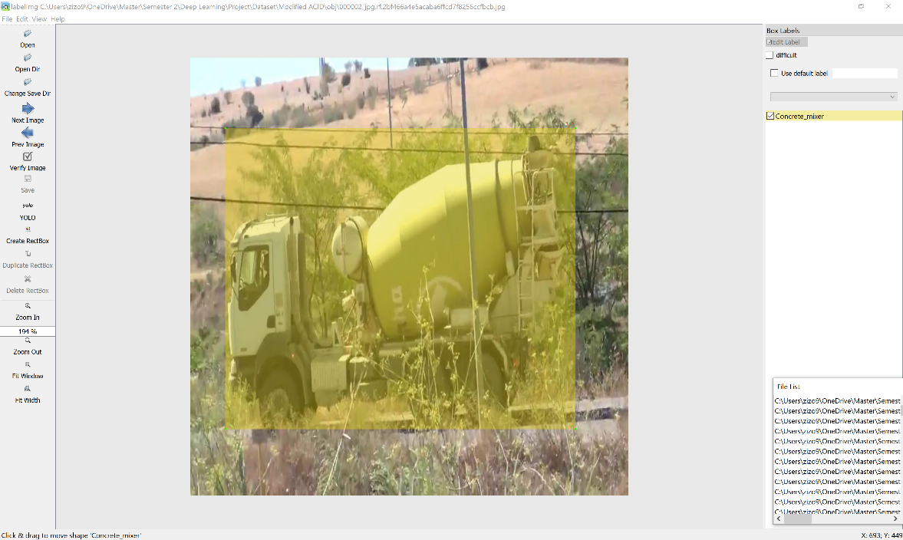
Applications Details – Data Preparation
Image Labeling:
Labeling Format:
LabelImg software is a free opensource tool written in Python for images labeling.
The labeling tool can save the annotated images as XML format or saving it as text format that is compatible with YOLO format.
Roboflow website provides image processing services including labeling, augmentation, and annotation format conversion with different pricing plans.
The image datasets along with their XML annotation been merged in single file and uploaded to “roboflow” website for annotation conversion.
It should be noted that the website charges 10$ for every 1,000 converted images.
Figure 9: LabelImg tool graphical user interface
0 0.633355 0.527252 0.078616 0.091214
Figure 10: Roboflow Logo
AIE604 Deep Learning – Final Project ID: 20112926
Slide 14 / 39

Slide 16
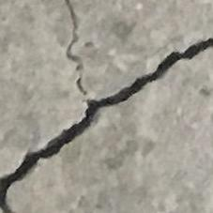
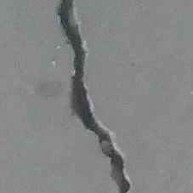
Applications Details – Concrete Cracks Classification Algorithm
A classification algorithm will be trained using CNN algorithm to detect “2” objects.
2
Classes
40,000
Images
40,000 Objects
Figure 11: Concrete cracks images
AIE604 Deep Learning – Final Project ID: 20112926
Slide 15 / 39

Slide 17
Applications Details – Hardware & Software Requirements
Hardware Specifications:
Software Requirements:
The device used to develop the algorithm is DELL XPS15 equipped with Intel Core i7-10750H CPU (10th Generation) @ 2.60 GHz, 16 GB RAM DDR4, 1 TB SSD, and NVIDIA GeForce GTX 1650 Ti GPU.
Another GPU been rented from Google Collaboratory with a cost of 9.99 $ / month to develop this project. In off-peak hours, access to T4 or P100 GPU will be available for usage.
In addition, with this subscription, the user gets access to 25.46 GB RAM which is double the speed of the free Google Colab version.
10 software's are required to be installed which are:
Python
GIT
Cmake
Visual Studio
GPU drivers latest update
CUDA
CuDNN
OpenCV
Cmake Open CV configuration
Building OpenCV in visual Studio
Figure 12: Google Collaboratory Logo
AIE604 Deep Learning – Final Project ID: 20112926
Slide 16 / 39

Slide 18
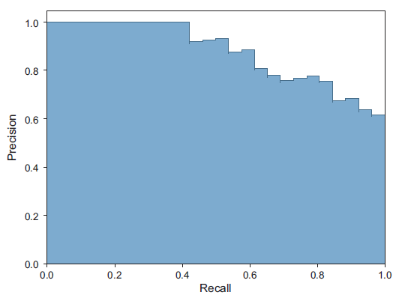
Applications Details – Algorithm Evaluation Metrics
Evaluation Metrics:
Several parameters will be used to evaluate the algorithms such as: Precision, recall, accuracy, confusion matrix, F-score, IoU, and mAP metrics.
$$Precision \left(P\right)=\frac{TP}{TP+FP} , Recall \left(R\right)=\frac{TP}{TP+FN}$$
$$Accuracy=\frac{TP+TN}{TP+TN+FP+FN} , F−score=2×\frac{ P×R }{P+R}$$
$$IoU=\frac{Intersection of areas detected with ground truth }{Union of areas detected with ground truth}$$
Figure 13: Precision-recall curve sample [13]
AIE604 Deep Learning – Final Project ID: 20112926
Slide 17 / 39

Slide 19
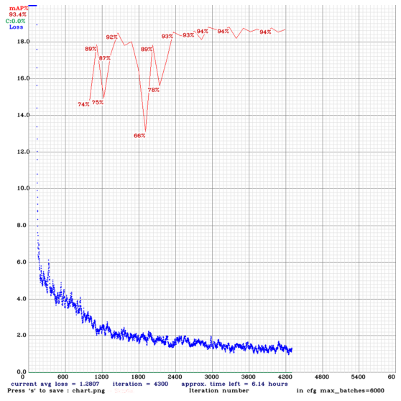
Results & Discussion – Construction Vehicles Detection Algorithm
A YOLOv4 algorithm been trained to detect construction vehicles by removing the classifier part and training new classifier. The training duration took 15 hours 18 minutes till reaching 4,300 iterations with 6 hours left to complete the training.
Scan the QR code to view a video of construction vehicles detection in Wadi Al Sail & East Sitra Housing Projects
Figure 14: Learning curves of training loss and accuracy vs iteration
AIE604 Deep Learning – Final Project ID: 20112926
Slide 18 / 39

Slide 20
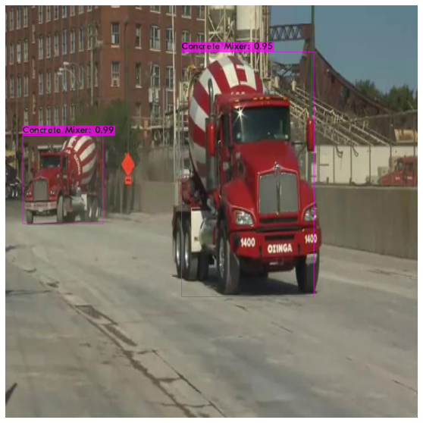
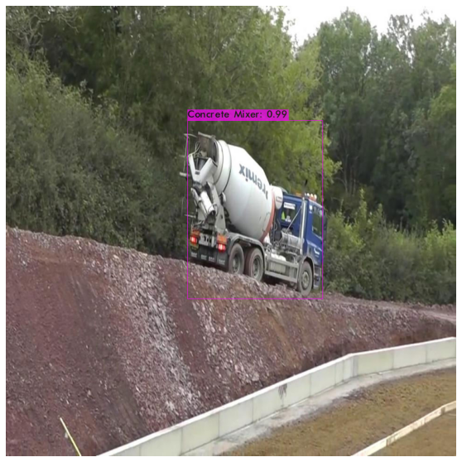
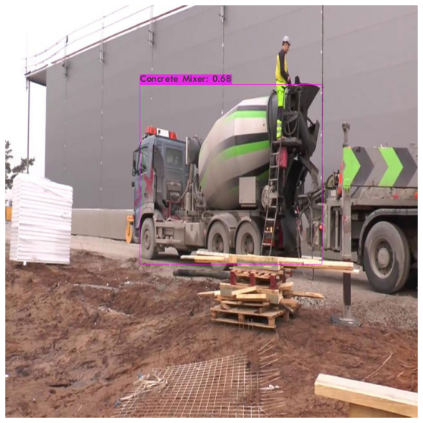
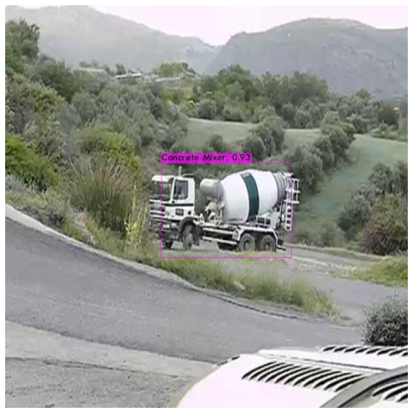
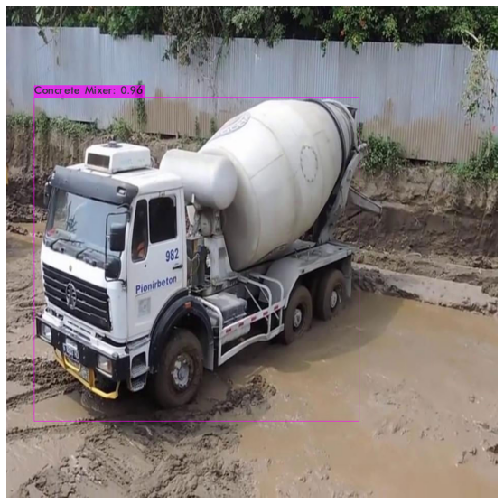
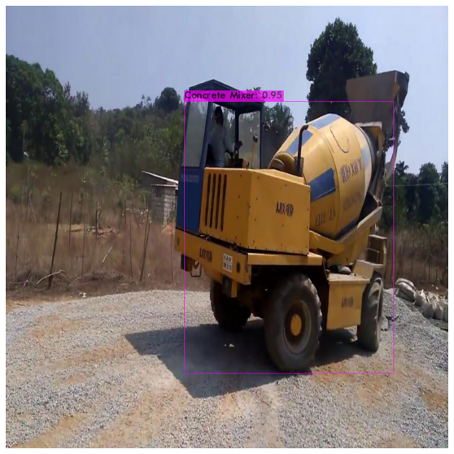
Results & Discussion – Construction Vehicles Detection Algorithm
Figure 15: Concrete mixer detection images
AIE604 Deep Learning – Final Project ID: 20112926
Slide 19 / 39

Slide 21
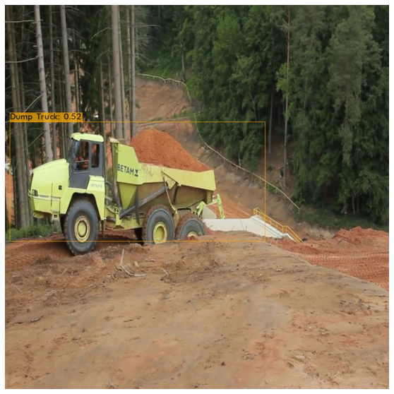
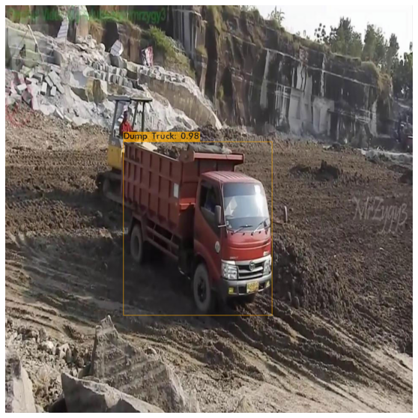
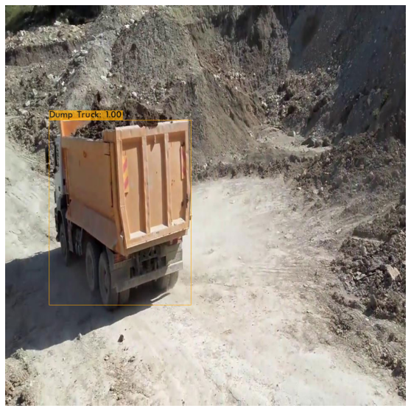
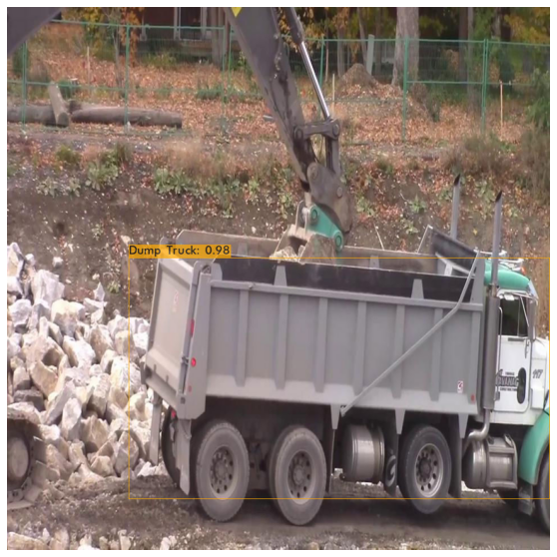
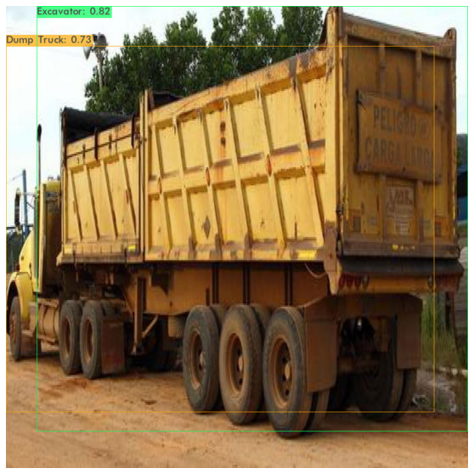
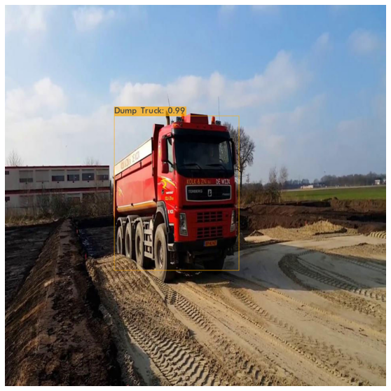
Results & Discussion – Construction Vehicles Detection Algorithm
Figure 16: Dump trucks detection images (Above picture classified twice)
AIE604 Deep Learning – Final Project ID: 20112926
Slide 20 / 39

Slide 22
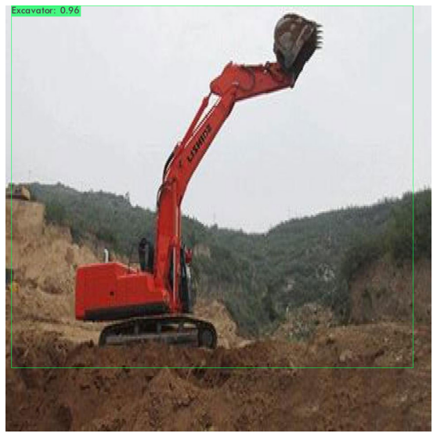
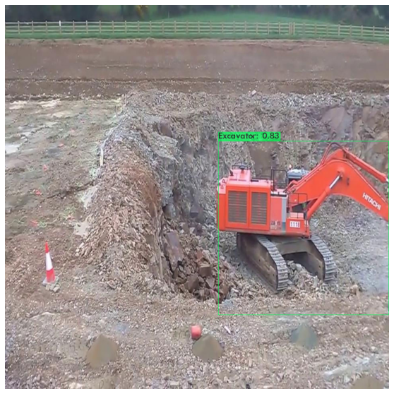
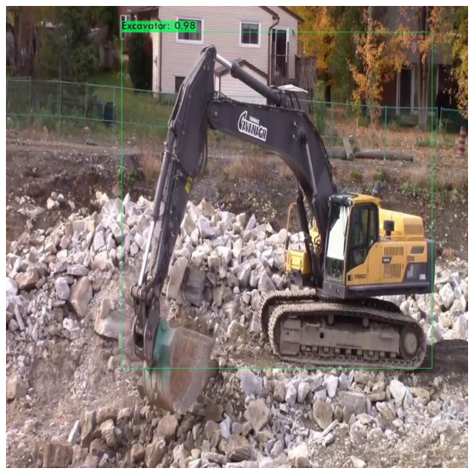
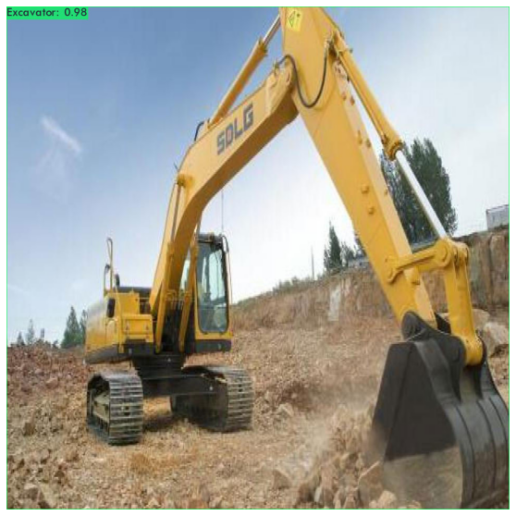
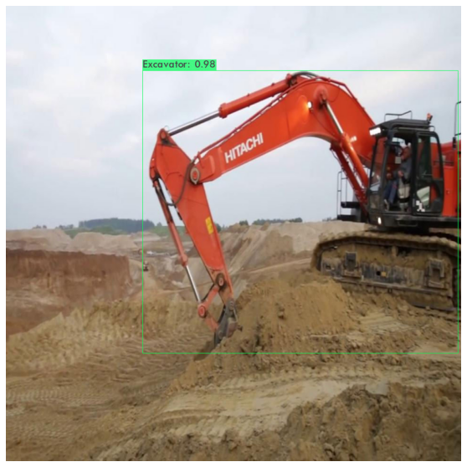
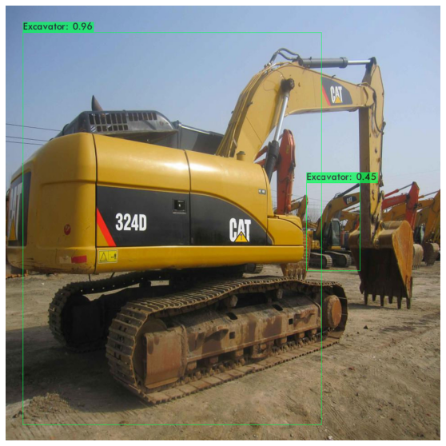
Results & Discussion – Construction Vehicles Detection Algorithm
Figure 17: Concrete mixer detection images
AIE604 Deep Learning – Final Project ID: 20112926
Slide 21 / 39

Slide 23
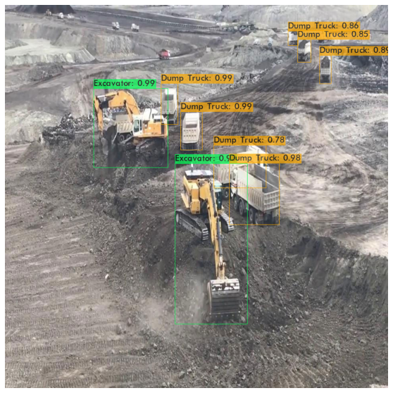
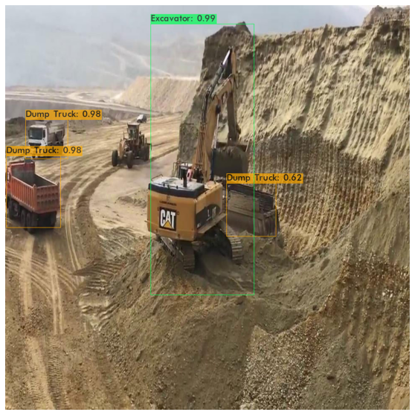
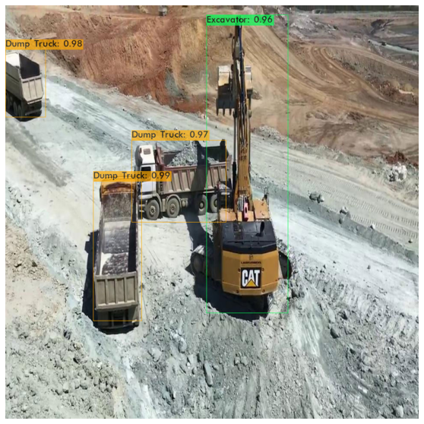
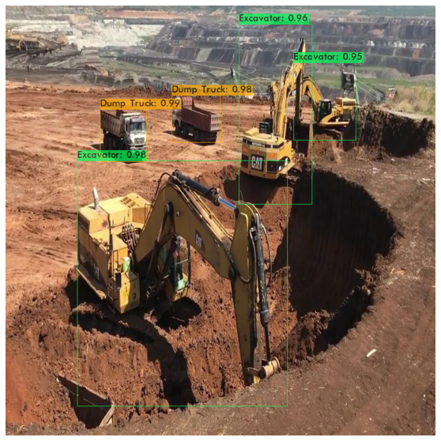
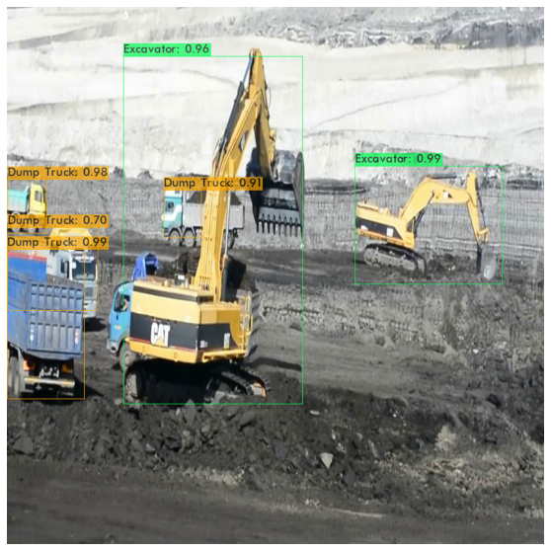
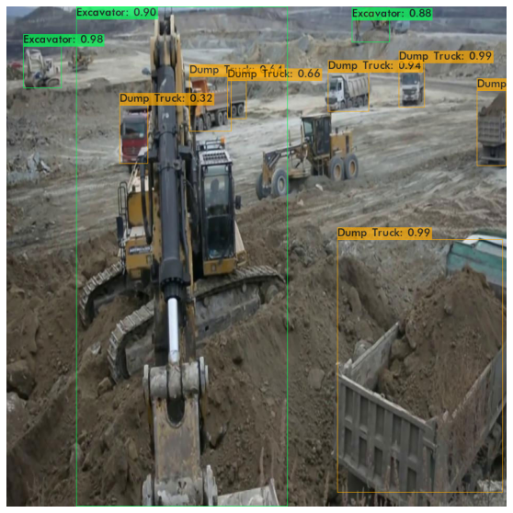
Results & Discussion – Construction Vehicles Detection Algorithm
Figure 18: Multiple class detection images
AIE604 Deep Learning – Final Project ID: 20112926
Slide 22 / 39

Slide 24
Results & Discussion – Construction Vehicles Detection Algorithm
Discussion:
Although improved Faster R-CNN proposed by Fang, W. et al. [6] achieved 93% mAP result, almost similar to our algorithm, yet it suffers in FPS by scoring 9.9 FPS which is 40% less than our algorithm detection speed.
This also shows that R-CNN algorithms suffer from low FPS against YOLO algorithm.
AIE604 Deep Learning – Final Project ID: 20112926
Slide 23 / 39

Slide 25
Results & Discussion – License Plate Detection Algorithm
The license plate detection algorithm training was done on YOLOv4 with removing the classifier part and training new classifier. The training duration took 10 hours till reaching 2,060 iterations with 23 hours left to complete the training.
Scan the QR code to view a video of license plate detection captured in Nuwaidrat
Figure 19: Learning curves of training loss and accuracy vs iteration
AIE604 Deep Learning – Final Project ID: 20112926
Slide 24 / 39

Slide 26
Results & Discussion – Construction Vehicles Detection Algorithm
Figure 20: License plate detection images
AIE604 Deep Learning – Final Project ID: 20112926
Slide 25 / 39

Slide 27
Results & Discussion – Helmet Detection Algorithm
The helmet detection algorithm training was done on YOLOv4 with removing the classifier part and training new classifier. The training duration took 12 hours 16 minutes till reaching 2,372 iterations with 19 hours left to complete the training.
Scan the QR code to view a video of helmet detection in Qalali & Tubli Housing Projects
Figure 21: Learning curves of training loss and accuracy vs iteration
AIE604 Deep Learning – Final Project ID: 20112926
Slide 26 / 39

Slide 28
Results & Discussion – Helmet Detection Algorithm
Figure 22: Helmet detection images
AIE604 Deep Learning – Final Project ID: 20112926
Slide 27 / 39

Slide 29
Results & Discussion – Helmet Detection Algorithm
Figure 23: Site inspection (Housing Foundation) in Wadi Al Sail Housing Project
AIE604 Deep Learning – Final Project ID: 20112926
Slide 28 / 39

Slide 30
Results & Discussion – Helmet Detection Algorithm
Discussion:
It is noticed that not only the algorithm affects the detection speed, but also the video format and resolution.
It should be highlighted that the algorithm was not able to detect “No Helmet” class if the person is wearing mask because it was trained to detect visible faces not wearing helmet and not masked faces not wearing helmet.
it can be stated that the algorithm is relatively biased towards visible faces to determine the detection class.
The reason behind this type of bias can be the unbalanced class images as the “No Helmet” class images amount was higher by 3 times than the “Helmet” class.
AIE604 Deep Learning – Final Project ID: 20112926
Slide 29 / 39

Slide 31
Results & Discussion – Face Mask Detection Algorithm
The face mask detection algorithm training was done on YOLOv4 with removing the classifier part and training new classifier. The training duration took 11 hours 43 minutes till reaching 2,200 iterations with 25 hours left to complete the training.
Scan the QR code to view a video of face mask detection in Qalali Housing Project
Figure 24: Learning curves of training loss and accuracy vs iteration
AIE604 Deep Learning – Final Project ID: 20112926
Slide 30 / 39

Slide 32
Results & Discussion – Face Mask Detection Algorithm
Figure 25: Face mask detection images
AIE604 Deep Learning – Final Project ID: 20112926
Slide 31 / 39

Slide 33
Results & Discussion – Face Mask Detection Algorithm
Figure 26: H.E. Minister of Housing visit to East Sitra Housing Project
AIE604 Deep Learning – Final Project ID: 20112926
Slide 32 / 39

Slide 34
Results & Discussion – Face Mask Detection Algorithm
Discussion:
Our results were the lowest against several other algorithms results retrieved from literature due to the following reasons:
The literature algorithms been trained on different datasets that are larger than our dataset reaching to 13 times large.
Our dataset images are more limited to similar environment. i.e., they are less variant compared to other datasets that were collected from various environments and backgrounds. Thus, it has less capability to generalize.
AIE604 Deep Learning – Final Project ID: 20112926
Slide 33 / 39

Slide 35
Results & Discussion – Concrete Crack Classification Algorithm
Crack classification results were obtained from 8 model configurations. Each model developed had an additional feature that the previous model did not have.
AIE604 Deep Learning – Final Project ID: 20112926
Slide 34 / 39

Slide 36
Results & Discussion – Concrete Classification Algorithm
AIE604 Deep Learning – Final Project ID: 20112926
Slide 35 / 39

Slide 37
Results & Discussion – Concrete Classification Algorithm
AIE604 Deep Learning – Final Project ID: 20112926
Slide 36 / 39

Slide 38
Results & Discussion – Concrete Classification Algorithm
AIE604 Deep Learning – Final Project ID: 20112926
Slide 37 / 39

Slide 39
Results & Discussion – Concrete Classification Algorithm
Discussion:
The best model achieved 98.90% accuracy in testing and 100% accuracy in training. It utilized the transfer learning from a VGG16 model.
The only change done is that the classifier part (2 FCN) and 3 feature extraction layers been removed and replaced with 2 FCN layers having 512 neurons & 2 neurons, respectively.
The worst model surprisingly achieved 55.16% in testing and 98.20% in training.
The low results cause seems to be due to introducing normalization. As this trend was also noticed in model no.4.
3 x 3 CONV. 64
3 x 3 CONV. 128
3 x 3 CONV. 256
3 x 3 CONV. 512
3 x 3 CONV. 512
Max Pooling / 2
Avg. Pooling 512
FC. 512
SoftMax 2
Figure 37: Model 6 Classification algorithm architecture
AIE604 Deep Learning – Final Project ID: 20112926
Slide 38 / 39

Slide 40
Conclusion
The developed applications proved that utilization of deep learning in construction sites can enhance site management and reduce efforts of day-to-day activities.
The labors adherence to health and safety protocol can be evaluated intelligently and simultaneously monitored on a wide scale area covering the whole project without the need to deploy health & safety officers on daily bases at every construction project.
The security personal can be replaced with intelligent license plate detection algorithm to automate the gate access control.
It can enhance the supervision team control on contractor performance.
All these merits will be achieved with savings in cost, time, efforts, reducing manpower requirement, improving safety, and productivity.
The future research can be done in integrating and deploying the developed algorithms on camera devices distributed over construction sites.
In addition, developed algorithms can be integrated with report generation system to produce daily reports automatically showing the number of manpower and machinery attended site.
AIE604 Deep Learning – Final Project ID: 20112926
Slide 39 / 39

Slide 41
Results Summary
AIE604 Deep Learning – Final Project ID: 20112926
Results Summary

Slide 42
References
Ministry of Finance & National Economy, "Bahrain Economic Quarterly Report," Ministry of Finance & National Economy, April 2021. [Online]. Available: https://cutt.ly/xnsJvpX [Accessed 02 May 2021].
A. A. Saeed, "3 Billion Dollars King Hamad Causeway Construction Cost," Al Ayam Newspaper, 14 September 2018. [Online]. Available: https://cutt.ly/xnsH6Tl [Accessed 01 May 2021].
Dji Enterprise, "Aerial Surveing and AEC," Dji Enterprise, 2021. [Online]. Available: https://enterprise.dji.com/surveying [Accessed 10 May 2021].
Fang, Q., Li, H., Luo, X., Ding, L., Luo, H., Rose, T. M., & An, W., "Detecting non-hardhat-use by a deep learning method from far-field surveillance videos," Elsevier Automation in Construction, no. 85, pp. 1-8, 2018.
Fang, W., Ding, L., Luo, H., & Love, P. E., "Falls from heights: A computer vision-based approach for safety harness detection," Elsevier Automation in Construction, vol. 91, pp. 1-8, 2018.
Social Insurance Organization, "Statistical Report - 2020 Quarter 4," Social Insurance Organization, Manama, 2020. [Online]. Available: https://cutt.ly/MnsJOp6 [Accessed 02 May 2021].
Xiang, X., Lv, N., Guo, X., Wang, S., & El Saddik, A., "Engineering vehicles detection based on modified faster R-CNN for power grid surveillance," MDPI Sensors, vol. 18, no. 7, pp. 1-13, 2018.
Fang, W., Ding, L., Zhong, B., Love, P. E., & Luo, H., "Automated detection of workers and heavy equipment on construction sites: A convolutional neural network approach," Elsevier Advanced Engineering Informatics, vol. 37, pp. 1-4, p. 6, pp. 8-10, 2018.
Xiao, B., & Kang, S. C., "Development of an Image Data Set of Construction Machines for Deep Learning Object Detection.," ASCE Journal of Computing in Civil Engineering, vol. 35, no. 2, pp. 1-16, 2021.
Chen, S., Tang, W., Ji, T., Zhu, H., Ouyang, Y., & Wang, W., "Detection of Safety Helmet Wearing Based on Improved Faster R-CNN," in IEEE 2020 International Joint Conference on Neural Networks (IJCNN), pp. 1-2, pp. 5-6, 2020.
Nagrath, P., Jain, R., Madan, A., Arora, R., Kataria, P., & Hemanth, J., "SSDMNV2: A real time DNN-based face mask detection system using single shot multibox detector and MobileNetV2," Elsevier Sustainable cities and society, no. 66, pp. 1-5, pp.7-10, 2021.
AIE604 Deep Learning – Final Project ID: 20112926
References 1 / 2

Slide 43
References
Yu, J., & Zhang, W., "Face mask wearing detection algorithm based on improved YOLO-v4," MDPI Sensors, vol. 21, no. 9, pp. 1-2, p. 11, pp. 13-14, pp. 16-19, 2021.
M. Elgendy, CNN architecture, New York: Manning Publications Co., pp, 240-337 2020.
Redmon, J., Divvala, S., Girshick, R., & Farhadi, A., "You only look once: Unified, real-time object detection," in In Proceedings of the IEEE conference on computer vision and pattern recognition, pp.1-8, 2016.
Redmon, J., & Farhadi, A., "YOLO9000: better, faster, stronger," in Proceedings of the IEEE conference on computer vision and pattern recognition, pp.1-8, 2017.
Redmon, J., & Farhadi, A., "Yolov3: An incremental improvement," arXiv, pp. 1-5, 2018.
Bochkovskiy, A., Wang, C. Y., & Liao, H. Y. M., "YOLOv4: Optimal Speed and Accuracy of Object Detection," Computer Vision and Pattern Recognition, pp. 1-11, 2020.
Du, Y., Pan, N., Xu, Z., Deng, F., Shen, Y., & Kang, H., "Pavement distress detection and classification based on YOLO network," International Journal of Pavement Engineering, pp. 1-7, pp. 11-13, 2020.
Silva, L. A., Sanchez San Blas, H., Peral García, D. P., Sales Mendes, A. S., & Villarubia González, G. V., "An Architectural Multi-Agent System for a Pavement Monitoring System with Pothole Recognition in UAV Images," MDPI Sensors, vol. 20, no. 21, pp. 1-6, pp. 9-18, 2020.
Majidifard, H., Jin, P., Adu-Gyamfi, Y., & Buttlar, W. G., "Pavement image datasets: A new benchmark dataset to classify and densify pavement distresses.," Transportation Research Record, vol. 2674, no. 2, pp. 1-9, 2020.
Nie, M., & Wang, C., "Pavement Crack Detection based on yolo v3," in IEEE 2nd International Conference on Safety Produce Informatization (IICSPI), pp. 1-3, 2019.
AIE604 Deep Learning – Final Project ID: 20112926
References 2 / 2

