Slide 1
Deep Reinforcement Learning for Traffic Control
By Ahmed Alsahlawi , Supervised by Prof. Mohab Mangoud

Slide 2
AGENDA
01
Introduction & Problem
02
Significance of DRL
03
DRL vs. Other Methods
04
Everything Else
05
Demo Code
06
Restults & conclusion

Slide 3
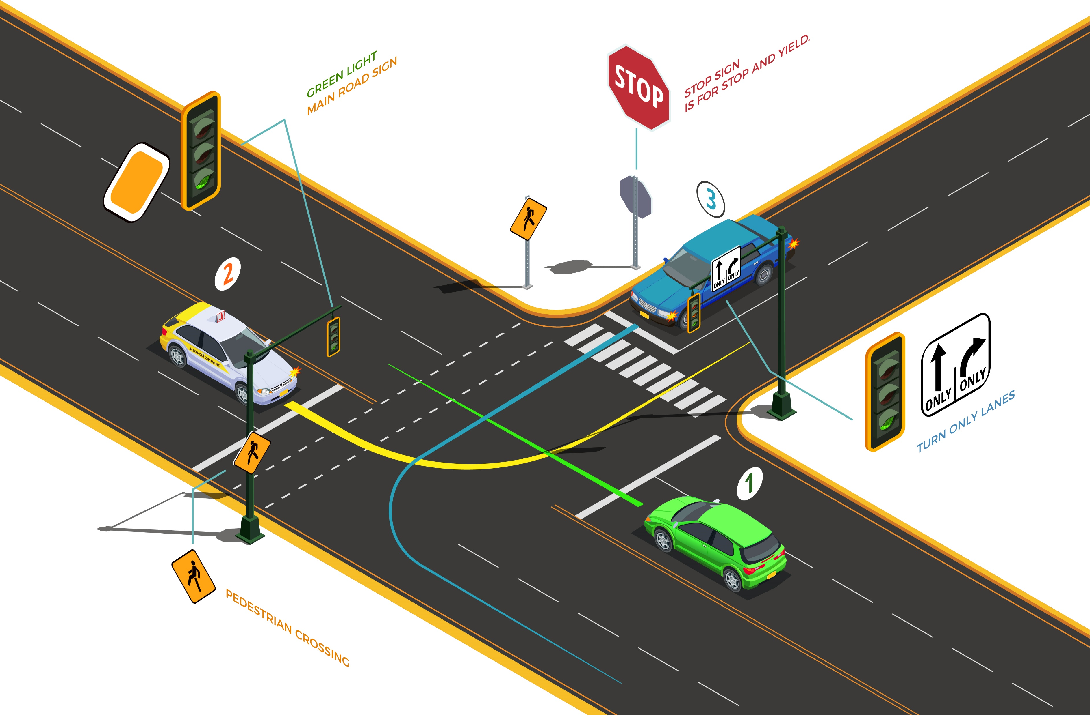
Current Problem
Traditionally Controlled
Controlled with logic and sensors, not considering queue size and how to optimize phases and turns.
Long Waiting Times
Slow movement of vehicles and long waiting queues in deterministic traffic signals control.
Blocked Intersections
cross-blocking occurs when vehicles cannot cross an intersection despite a green signal being activated and green idling when no vehicle present.
Notes:
Rising traffic congestion is an inescapable condition in large and growing metropolitan areas across the world. As Peak-hour traffic congestion is a result of the way modern societies operate.
Most of these congestions happens at entering the intersections, where the Traffic Entering intersections is greater than the traffic leaving it.
This traditional method has several in managing traffic control
A traffic phase consists of a combination of green signals allocated to a set of lanes simultaneously for non-conflicting movements at an intersection.
cycle -> sequence of phases

Slide 4
Significance of DRL
Real Time
DRL enables an agent to adapt to the real-time traffic condition that evolves in a complex and unpredictable manner due to unexpected disturbances, E.g. bad weather conditions and road accidents
Multiple Approaches
DRL can be a model-based or model-free approach, and it enables an agent to perform self-learning on the fly without having prior knowledge about the operating environment like traffic condition and network.
There are Several success stories of the use of DRL over the years have brought new and refreshed enthusiasm to the world of
artificial intelligence
Rewarding Mechanism
DRL represents reward with system goal(s) and performance measure(s). E.g. reward changes with the average waiting time, queue length, or throughput of vehicles at an intersection.
Curse of dimensionality
DRL addresses the curse of dimensionality, which can affect the traditional RL approach, when applied to TSC. This is because TSC has a large state space as there are multiple factors affecting a traffic network.
Notes:
Example: DeepMind: Implemented DRL playing ATARI and Alpha Go Board Game.
Successful Applications of DRL : , such as robotics, natural language processing, health care , business management , Industry 4.0 , smart grid , computer vision , transportation, particularly TSC and driver-less vehicles

Slide 5
DRL vs. Other Approaches
Genatics
Algorithm
Dynamic
Programming
Reinforcement
Learning
Fuzzy Logic
Defines Membership functions that maps input to output between 0 and 1
Parameters or variables, namely genes, forming chromosome with initial population.
Breaks a complex problem into a collection of simpler sub-problem, each sub-problem solved separately.
Explore and exploits different state-action pairs with highest possible rewards
Issues: larger values may fall outside the range of 1 and 0 due to the effect of disturbances, such as bad weather conditions and road accidents.
Issues: Larger number of chromosomes and complicated representations are needed as problem extends. like change traffic network with multiple intersections.
Issues: Longer time needed to compute multiple solutions ( e.g. change traffic phase and adjust traffic phase split) for multiple sub-problems.
Issues: Large number of states is needed to provide abstract representations of high-dimensional and complex inputs.
Notes:
DRL has the ability to:
Approximate Q-value for a given states ( to deal with disturbances and solve complex problems)
Uses experiences replay and target network to reduce time required for training.
DRL is able to deal with high-d state space.

Slide 6
Rest of Literature Content
Rest of the paper
DRL
Applications
Open Issues
With CNNs,LSTM
SAE & 3DQN
Effects of DQN
Issues with
Simulators
Notes:
SAE: stacked auto encoders
Open issues:
EFFECTS OF DYNAMICITY TO DQN
LEARNING EFFICIENCY OF DQN FOR TSC
EFFECTS OF TRAFFIC DISTURBANCES TO LEARNING IN DQN FOR TSC
DEVELOPING TRAFFIC SIMULATORS FOR INVESTIGATING DQN-BASED TSCs
SAFETY ISSUE OF DQN FOR TSC
THE FAIRNESS AND PRIORITIZED ACCESS ISSUE

Slide 7
DQN Code
Agent Implementation

Slide 8
Tools & Components Used
Development parts
SUMO
Python
NIVIDIA GPU
Simulation of Urban Mobility.
Open source.
Simulate Traffic & intersections
Easy to program
Rich with Data Science libraries like TensorFlow, Keras.
Open source
Training tuning libraries to speed up training process
creating high performance GPU-accelerated applications

Slide 9
Code Walkthrough
Steps before result
STEP
04
STEP
03
STEP
Save results, plots models and configurations
02
Testing & simulation of TSC
STEP
01
Training & simulation of the TSC
Initialization of Training & Simulation configurations

Slide 10
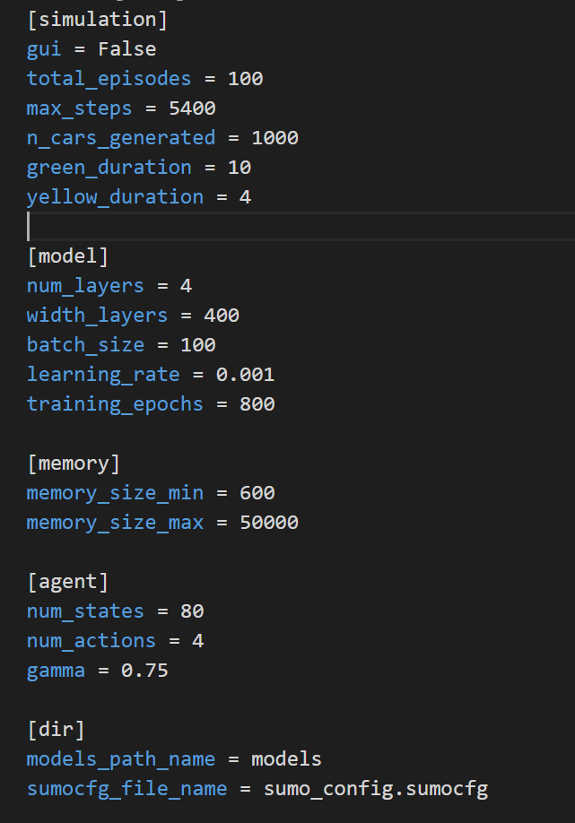
STEP 1 – Configuration of parameters
Simulation: episodes, steps, cars, light signals.
Model: model layers, batch size, alpha and epochs.
Memory: min & max ( for memorizing experiences)
Agent: states & actions
Dir: directories and SUMO file name

Slide 11
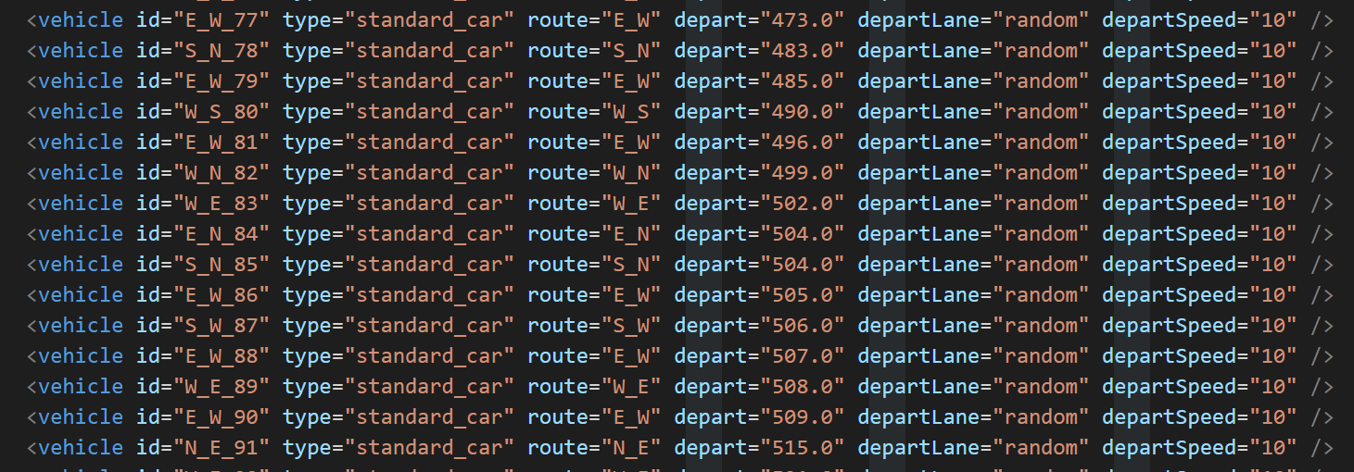
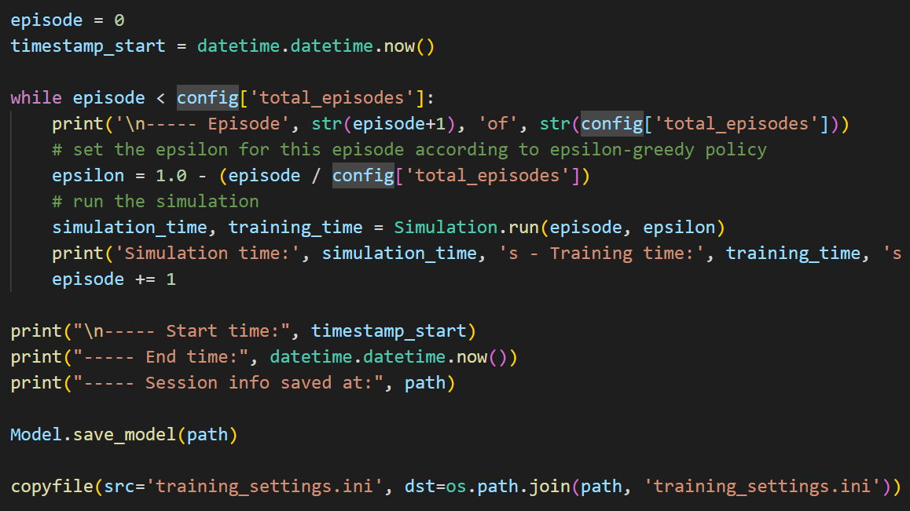
STEP 2 – Training Phase
First Build the model (Neural Network), Generate traffic then create the simulation.
Next, we loop the episodes to get epsilon and perform the real time simulation.
Finally, we save the model and copy it to separate folder
Notes:
Epsilon-Greedy is a simple method to balance exploration and exploitation by choosing between exploration and exploitation randomly. The epsilon refers to the probability of choosing to explore, exploits most of the time with a small chance of exploring.

Slide 12
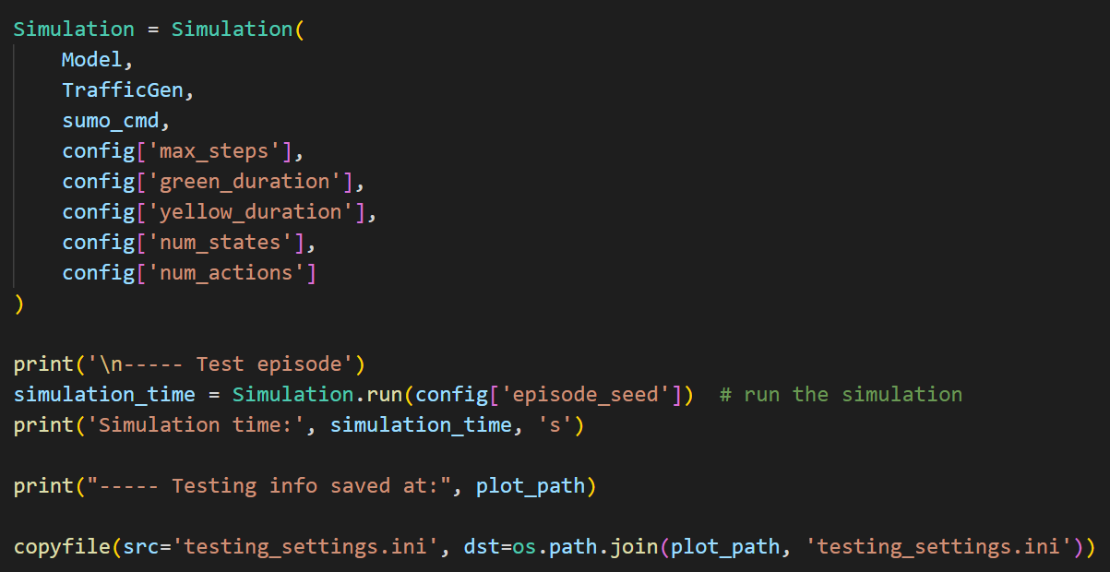
STEP 3 – Testing Phase
GUI can be enabled to check testing results.
We perform one simulation, to test the efficiency of the model.
Result plots and configuration file saved after as a checkpoint.
The traffic is optimized, congestions reduced to the minimal.

Slide 13
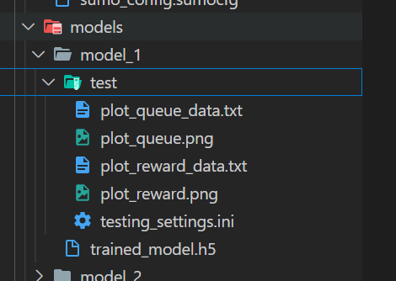
STEP 4 – Finishing Step
We save the trained model with the config we used to generate it.
Queue & Rewards data are stored and visualized.

Slide 14
FINAL RESULT
Traffic Congestion in one intersection solved effectively.
DQN Agent were able successfully to optimize the traffic over time.
Average queue waiting time reduced significantly.
LIMITATIONS
Hardware took around 7 training hours.
The selected scenario can be improved by applying multiple intersections and agents.
Speed of vehicle should be randomized to mimic real scenario.

Slide 15
CONCLUSION
Deep Reinforcement Learning proved to be efficient to solve complex problems like traffic signals control.
More considerations need to be addressed like variable speeds, adding more vehicles and also to include multi-agent and multiple intersection issue.

Slide 16
References
[1] F. Rasheed, K.-L. A. Yau, R. M. Noor, C. Wu, and Y.-C. Low, “Deep Reinforcement Learning for Traffic Signal Control: A Review,” IEEE Access, vol. 8, pp. 208016–208044, 2020.
[2] H. Ge, Y. Song, C. Wu, J. Ren, and G. Tan, “Cooperative deep Q-learning with Q-value transfer for multi-intersection signal control,” IEEE Access, vol. 7, pp. 40797–40809, 2019.
[3] “Traffic Signal Timing via deep reinforcement learning,” IEEE/CAA Journal of Automatica Sinica, vol. 3, no. 3, pp. 247–254, 2016.
[4] S. Park, E. Han, S. Park, H. Jeong, and I. Yun, “Deep Q-network-based Traffic Signal Control Models,” PLOS ONE, vol. 16, no. 9, 2021.
[5] L. Song and W. Fan, “Traffic Signal Control under mixed traffic with connected and automated vehicles: A transfer-based deep reinforcement learning approach,” IEEE Access, vol. 9, pp. 145228–145237, 2021.
[6] “A new solution for freeway congestion: Cooperative Speed Limit Control using distributed reinforcement learning,” IEEE Xplore. [Online]. Available: https://ieeexplore.ieee.org/document/8666107. [Accessed: 06-Jun-2022].
[7] AndreaVidali, “deep Q-learning agent for traffic signal control: A Framework where a deep Q-learning reinforcement learning” GitHub. [Online]. Available: https://github.com/AndreaVidali/Deep-QLearning-Agent-for-Traffic-Signal-Control. [Accessed: 06-Jun-2022].

Slide 17
THANK
YOU!

