Slide 1
An Overview of DL-based Network Intrusion Detection System
University of Bahrain
College of Engineering
MSc in Artificial Intelligence Systems
AIE604: Deep Learning Applications
Prepared by: Fatema Abduljabbar Jawad Sarhan
ID: 20163743
Supervised by: Prof. Mohab Mangoud

Slide 2
Agenda
Related Work
Results and Discussion
Previous work and observations
Comparison and discussion
Introduction
Problem Design
Conclusion
Problem statement and real-life ex.
The proposed design, algorithms applied in the design
Challenges and future work

Slide 3
Introduction

Slide 4
What is NIDS?
Network infections, eavesdropping, and malicious attacks are on the rise.
leading society, and government departments to prioritize network security.
Intrusion detection may effectively overcome these issues.
By building an efficient deep learning-based NIDS it can detect normal and malicious behaviors in the network.

Slide 5
Latest Attacks
Netwalker ransomware is a Windows-specific virus that encrypts and exfiltrates all data. Following a successful attack, victims are presented with a ransom letter demanding a bitcoin payment in return for the complete decryption of the compromised data.
1
The Netwalker Ransomware operators claim to have successfully attacked the University of California San Francisco (UCSF), stolen unencrypted data, and encrypted their computers.
2
Netwalker posted on their data leak that they had encrypted Michigan State University, and if a ransom was not paid, they would publicly release stolen data if not paid. This deadline has come and gone, and the ransomware operators have publicly released their data.
3
This ransomware operation is known to target exposed Remote Desktop Services and use spam to gain access to enterprise-networks where it then steals unencrypted files before encrypting the computers.

Slide 6
Related Work

Slide 7
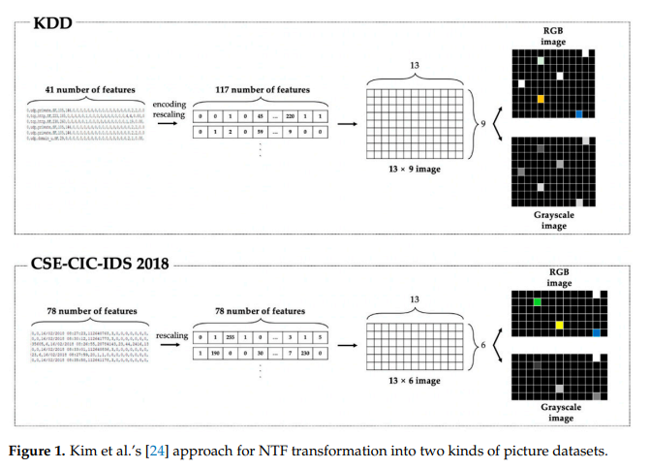
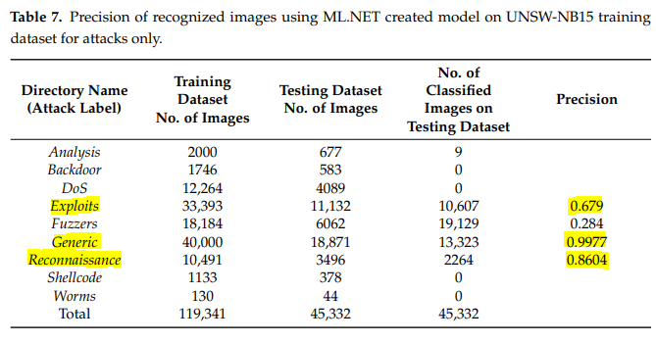
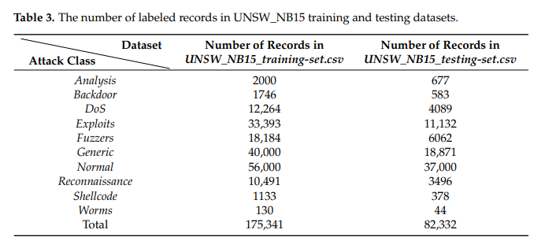
J. Toldinas, et, al. "A Novel Approach for Network Intrusion Detection Using Multistage Deep Learning Image Recognition”
They have used UNSW-NB15 dataset which has 9 types of attacks.
The features of the network are translated into four-channel images (Red, Green, Blue, and Alpha).
The images are used to train and evaluate a deep learning model that has already been pre-trained.
The suggested solution in the first stage detects regular traffic with 93.4 percent accuracy on the benchmark UNSW-NB15 network intrusion dataset.
The suggested method in the second step, when detecting the kind of attack, obtains 99.8% accuracy in detecting a generic attack, 86 percent accuracy in detecting a Reconnaissance attack, and 67.9% accuracy in detecting an Exploits attack on the benchmark UNSW-NB15 network intrusion dataset.

Slide 8
J. Toldinas, et, al. "A Novel Approach for Network Intrusion Detection Using Multistage Deep Learning Image Recognition”
The BOUN DDoS dataset has a huge number of records, totaling more than nine million records (total 9,335,605). The training for such a number of images may take a great deal of time, so they randomly select a smaller number of records for the experiment and form two clusters from them. The first cluster contains records for training—19,035 DDos attack traffic records and 39,073 attack-free user traffic NTF records. The second cluster contains records for testing—12,411 DDos attack traffic records and 34,412 attack-free user traffic records.
The suggested method achieves 99.7% accuracy in detecting a DDoS attack and 99.7% accuracy in detecting normal traffic on the benchmark BOUN DDoS network incursion dataset.

Slide 9
Problem Design

Slide 10
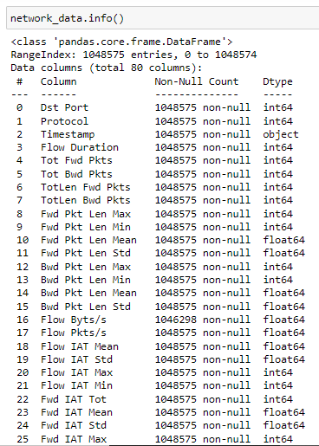
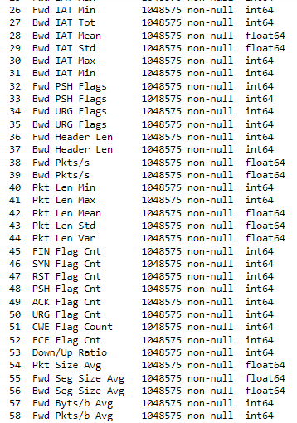
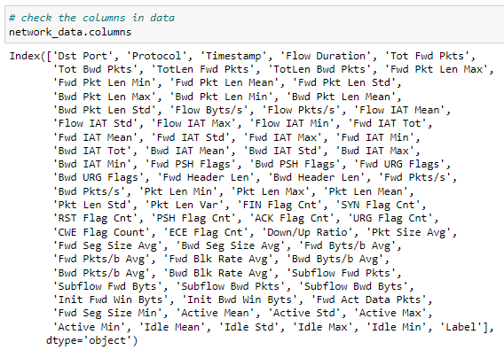
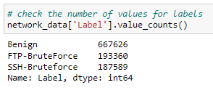
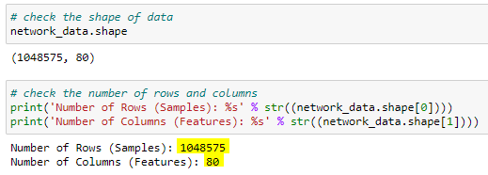
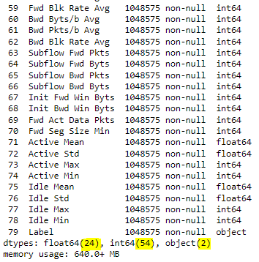
Dataset
CSE-CIC-IDS2018 on AWS
The label values are 3, “Benign” which is the normal connection, and two BruteForce type (FTP and SSH) which are the attack connections.
Provided by University of New Brunswick
The dataset is very huge, we have around 80 features, and more than 1 million samples which is interesting.
We have a total of 80 features of which 24 features are of type float, 54 features of type integer, and 2 features of type object. And the memory consumption data is more than 640MB.

Slide 11
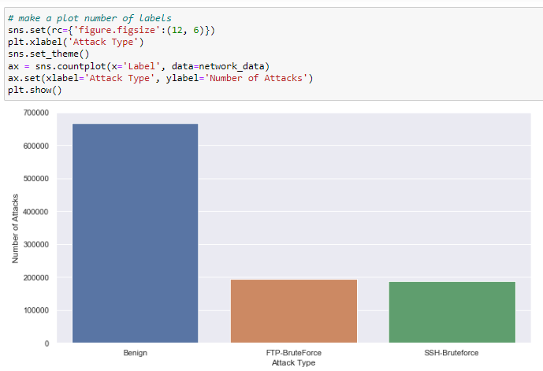
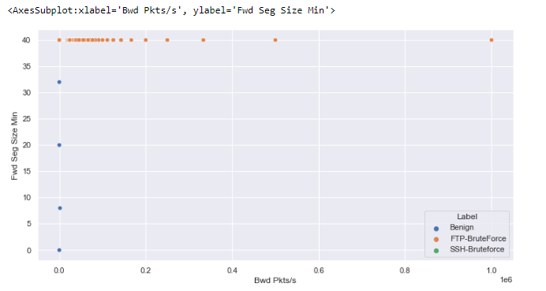
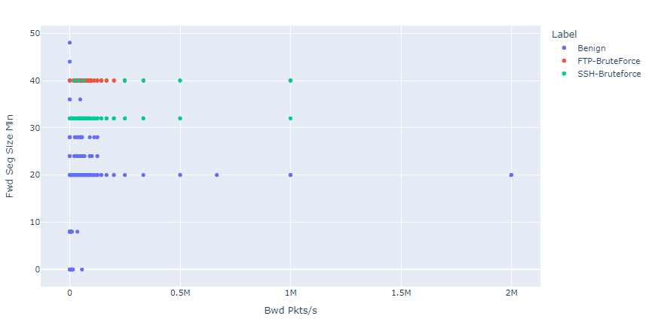
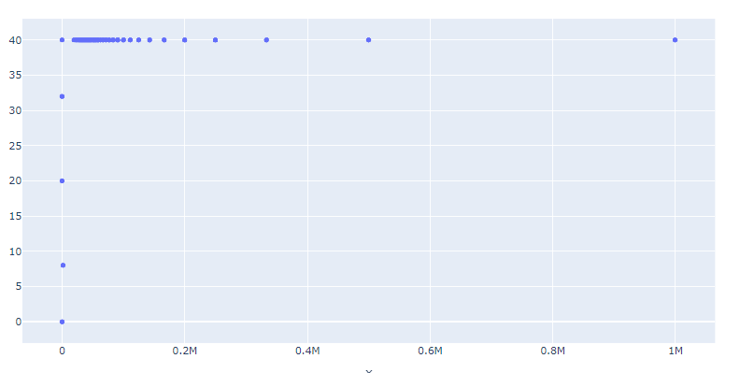
Data Visualization
CSE-CIC-IDS2018 on AWS
If we combine both brute force attacks, benign attacks will remain more than brute force attacks.
This is a scatter plot for “Bwd Pkts/s”: number of backward packets per second and “Fwd Seg Size Min”: minimum segment size observed in the forward direction.
We can also notice here that SSH-Bruteforce attacks happens more likely when “Fwd Seg Size Min” = 32 and “Bwd Pkts/s” = 0-0.2*10^6
This is the scatter plot with labeled attacks, we can notice here that the FTP-Brute Forces happens most likely when “Fwd Seg Size Min” = 40 and “Bwd Pkt/s” = 0-0.2*10^6

Slide 12
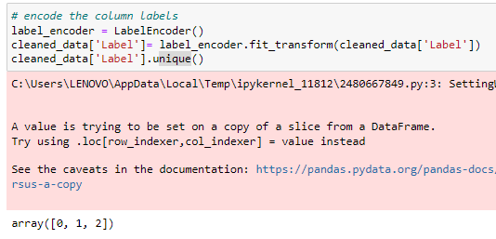
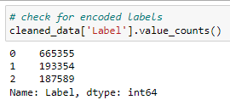
Label Encoding
CSE-CIC-IDS2018 on AWS
“0” = Benign, “1” = BruteForceFTP, “2” = BruteForceSSH
The data's Label feature offers three labels: Benign, BruteForceFTP, and BruteForceSSH. These are all in string format. We need to turn them into numbers so that our neural network can recognize their representations.

Slide 13
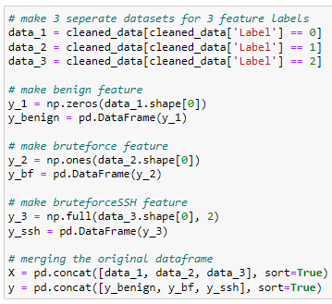
Reshaping data for CNN
CSE-CIC-IDS2018 on AWS
We are going to have three datasets for the three attacks labels.
data_1 for Normal attacks, data_2 for FTP BruteForce, data_3 for SSH BruteForce

Slide 14
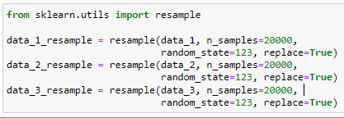
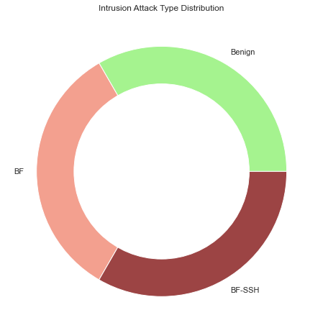
Data Argumentation
CSE-CIC-IDS2018 on AWS
To eliminate bias in data, we must utilize data argumentation to remove bias from data and create equal distributions.
Resampling data in three sets.
Then combine them together.
The distribution of the training dataset on nested pie chart.

Slide 15
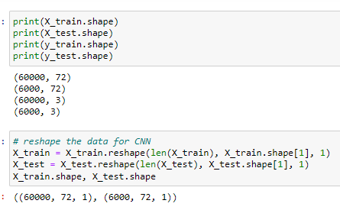
Data Splicing
CSE-CIC-IDS2018 on AWS
This phase involves dividing the data into train and test sets. 80 percent of the data will be utilized for training and 20 percent will be used for testing.
There are 60,000 datapoints for train data, 6,000 datapoints for test data, and a total of 72 features.

Slide 16
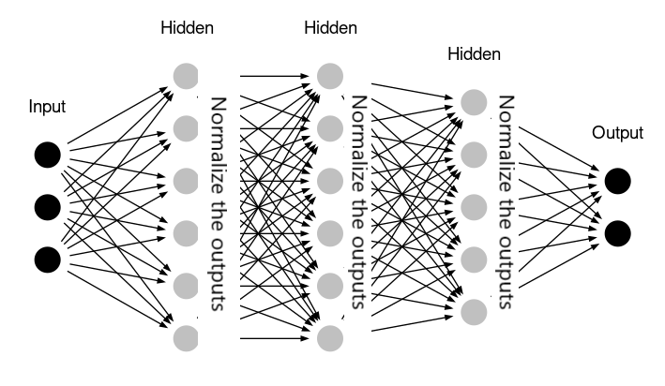
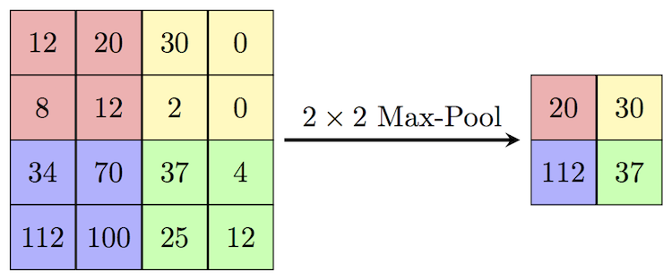
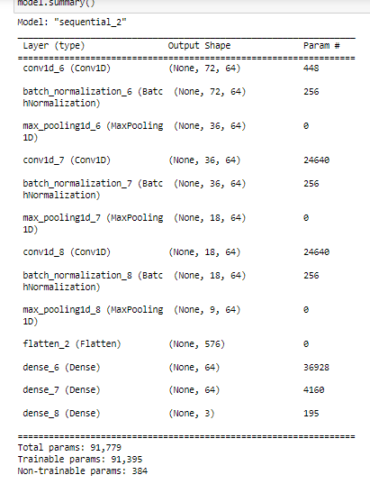
Layers
CSE-CIC-IDS2018 on AWS
The flatten() flattens multidimensional input tensors into a single dimension, allowing you to model your input layer and create your NN model, then effectively transmit those inputs into every single neuron of the model.
The typical deeply linked neural network layer is the dense layer. It is the most popular and widely utilized layer.
Batch-normalization is done in mini-batches rather than the entire data collection. It speeds up instruction and employs faster learning rates, making learning simpler.
Max pooling lowers computing costs by lowering the number of parameters to learn and gives basic translation invariance to the internal representation.
1D Convolution is a layer that is used to detect features in a vector.
https://analyticsindiamag.com/hands-on-guide-to-implement-batch-normalization-in-deep-learning-models/
https://www.w3resource.com/numpy/manipulation/ndarray-flatten.php
https://paperswithcode.com/method/max-pooling

Slide 17
Results and Discussion

Slide 18
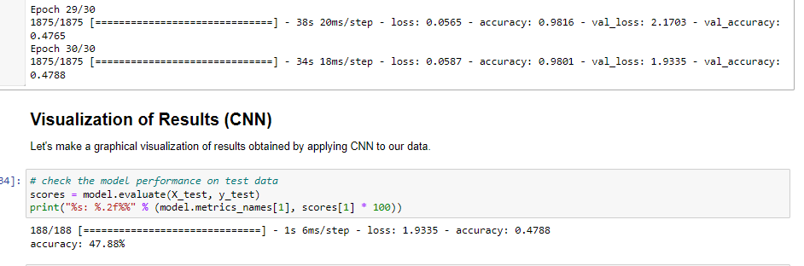
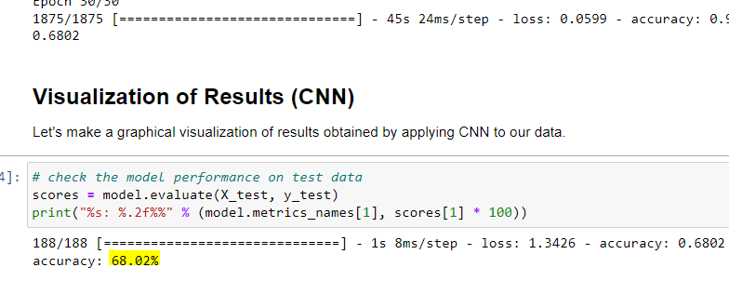
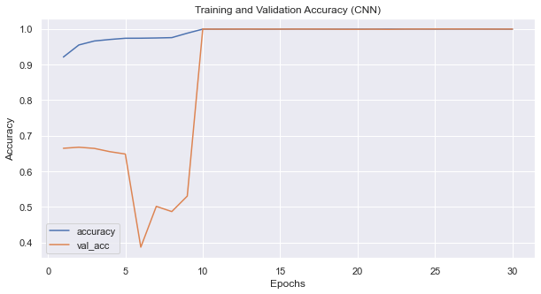
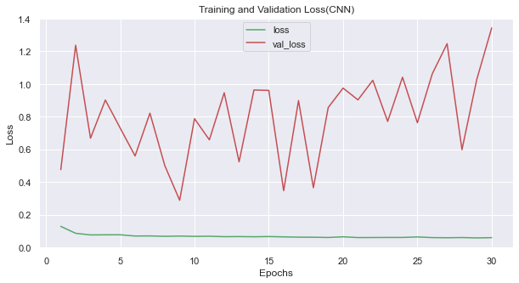
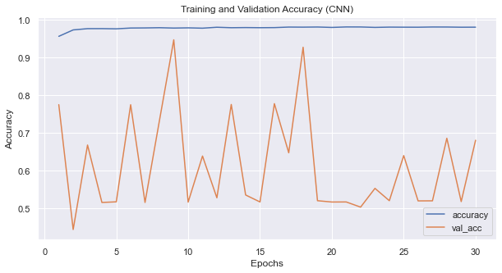
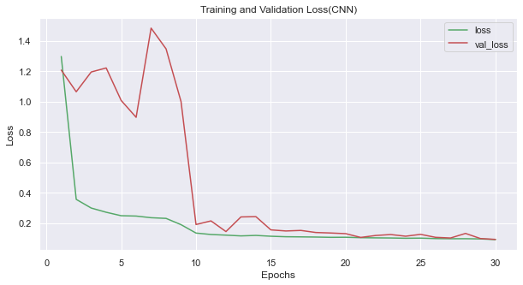
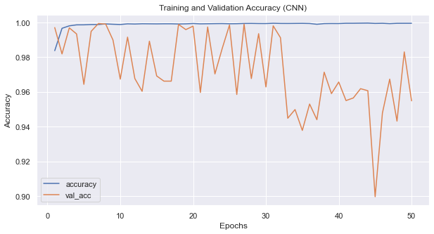
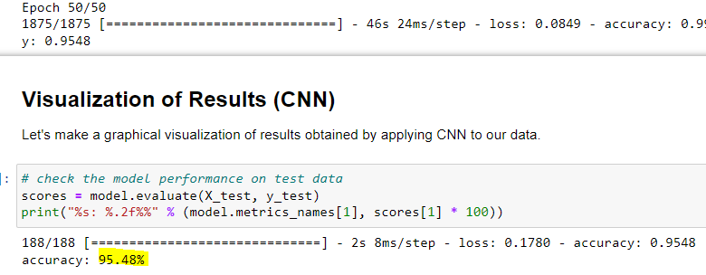
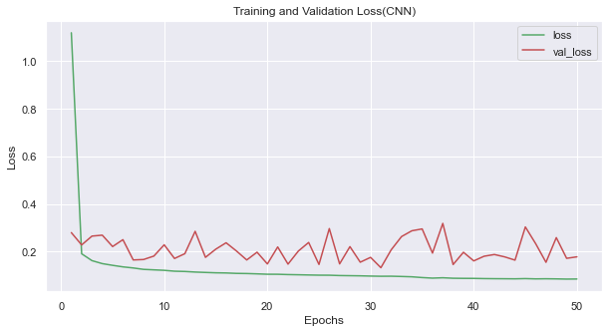
Results
2nd Attempt
3rd Attempt
1st Attempt
4th Attempt
Before regularization, Accuracy 68.02%, and batch =30
Before regularization, Batch=30, Accuracy 47.88%
We can notice here that the validation accuracy was very low, and it started to increase to reach 99.9%, validation loss it was very high, and then while training it has reached nearly 0.
Overfitting: we can notice the overfitting of the validation accuracy and validation loss score here:
After regularization, Accuracy: 99.93%, batch =30
After regularization, Accuracy: 95.48%, batch =50
The validation accuracy started to decrease when epoch reaches 45 and the validation loss is not stable as well.

Slide 19
Accuracy
1st Attempt
2nd Attempt
47.88%
68.02%
3rd Attempt
4th Attempt
99.93%
95.48%

Slide 20
Conclusion

Slide 21
Conclusion
Deep learning algorithms have demonstrated their effectiveness in:
Autonomously selecting features
Dimensionality reduction
Argumentation
Classification tasks.
Deep Learning is used extensively in a wide range of applications including:
Speech recognition
Natural language processing
Computer vision
Image processing, and intrusion detection

Slide 22
Conclusion
Deep learning algorithms are extremely useful in the development of an intrusion detection system (IDS) for identifying various forms of attacks.
The primary goal of employing deep learning algorithms is to find anomalies in both processes’ dimensionality reduction and classification jobs.
Deep learning techniques outperforms typical machine learning techniques when dealing with complex huge data sets.

Slide 23
Conclusion- pros and cons
NIDS has several advantages:
Being relatively safe from direct attacks because hackers may be unable to trace it.
Faster than a host-based detection system.
Helpful in detecting internal and external threats or attacks.
Among the downsides of NIDS are:
Cannot read or identify encrypted data.
The possibility of false positives is substantial.
It is time-consuming since it monitors a big volume of data.

Slide 24
Conclusion- Future work
Implement a real-time NIDS for actual networks using deep learning technique.
More evaluation metrics will be carried out.
Reduce computational complexity of the proposed NIDS without compromising on the detection accuracy.

Slide 25
References

Slide 26
References:
J. Toldinas, A. Venčkauskas, R. Damaševičius, Š. Grigaliūnas, N. Morkevičius and E. Baranauskas, "A Novel Approach for Network Intrusion Detection Using Multistage Deep Learning Image Recognition",Electronics, vol. 10, no. 15, p. 1854, 2021. Available: 10.3390/electronics10151854.
Z. Wang, "Deep Learning-Based Intrusion Detection With Adversaries",IEEE Access, vol. 6, pp. 38367-38384, 2018. Available: 10.1109/access.2018.2854599.
T. Su, H. Sun, J. Zhu, S. Wang and Y. Li, "BAT: Deep Learning Methods on Network Intrusion Detection Using NSL-KDD Dataset",IEEE Access, vol. 8, pp. 29575-29585, 2020. Available: 10.1109/access.2020.2972627.
A. Javaid, Q. Niyaz, W. Sun and M. Alam, "A Deep Learning Approach for Network Intrusion Detection System", Proceedings of the 9th EAI International Conference on Bio-inspired Information and Communications Technologies (formerly BIONETICS), 2016. Available: 10.4108/eai.3-12-2015.2262516.
A. Boukhalfa, A. Abdellaoui, N. Hmina and H. Chaoui, "LSTM deep learning method for network intrusion detection system", International Journal of Electrical and Computer Engineering (IJECE), vol. 10, no. 3, p. 3315, 2020. Available: 10.11591/ijece.v10i3.pp3315-3322.
https://www.upguard.com/blog/what-is-netwalker-ransomware
https://www.bleepingcomputer.com/news/security/netwalker-ransomware-continues-assault-on-us-colleges-hits-ucsf/
https://cisomag.eccouncil.org/importance-of-intrusion-detection-system-in-cybersecurity/
A. Salih et al., "Deep Learning Approaches for Intrusion Detection", Asian Journal of Research in Computer Science, pp. 50-64, 2021. Available: 10.9734/ajrcos/2021/v9i430229.

