Slide 1
Deep Reinforcement Learning for Communication and Network
Presented by: Najeeba Mohd
Supervised by: Prof. Mohab Mangoud
For AIE604 course project

Slide 2
Content
Introduction
Why and how
Related work
AI in network in general, RL in network
RL tool for network and implementation
What is needed next
Challenges and conclusion
Points of study and improvements

Slide 3
Why ?
Modern networks
Computational techniques became unmanageable
Network nature
Dynamic, decentralized, and ad-hoc
Increased services
Need AI system for close monitoring and control
Requirement
Maximum throughput with minimum energy
DRL tools to find optimal policies for network entities in reasonable time

Slide 4
Related work - A
Network roll-out
Architecture and topology optimization
New requirements for 5G topology
Example: determination of splitter location for Passive Optical Networks (PONS) roll-out
Network Operation
Resource allocation and network configuration
Example: Optimal route establishment, and traffic management optimization based on traffic volume and direction prediction.
Predictive maintenance
Examples: Network failure identification, predicting maintenance and self-healing (e.g. SDN)
Alarms managements absorbs much energy from operators and require prompt response, some could be fake alarms

Slide 5
Related work - B
Network access and rate control
Optimal decisions related to: channel selection and throughput maximization
Dynamic spectrum access: auto select a channel (reward for successful transmission with low interference, penalty for failing with high interference)
HetNets: users randomly located in network with Base stations (BS), (reward for satisfying the condition, Signal to Interference pulse Noise Ration not exceeding QoS requirements)
Cashing and offloading
Cashing in wireless devices aims to reduce access delays, energy consumption and total amount of traffic
For big data analysis need computational resources and cashing capabilities closer to user
BS is required to take decisions for storing or not storing the currently requested content in the limited cache storage size (rewarded while the long-term cache hit-rate is maximized, based on the total number of requests for each content)

Slide 6
Related work - B
Network Security
vulnerable to different attacks including Denial of Service (DoS)
Jamming attacks in radio networks, where an attacker send Radio Frequency (RF) jamming signals with high power, causing interference to legitimate channels and reduce SINR at receivers (DRL choose to select a channel or leave to another BS)
Traffic engineering and routing
Optimizing a path to forward the data traffic from source to destination
Learn from past observations for routing optimization, the agent determine the path for all source-destination pairs
The model aims to minimizing the delay, by automatically adapting routing configuration based on current traffic conditions and bandwidth request between each pair, the agent then is rewarded based on a function of the mean network delay

Slide 7
NS3-gym Tool
For the aim of improving and optimizing dynamic complex networks, we need to understand the component’s parameters and network performance metrics
Lack of training environments, where RL needs interactions but not suitable for real-world environments (cost of devises), and not enough getting environments built on a case-by-case basis
Introducing ns3-gym, which combines RL tool (OpenAI Gym, python-based) with network simulation tool (ns-3, C++ based)

Slide 8
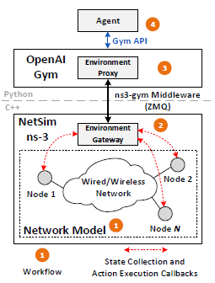
Ns3-Gym
Ns3-gym works as a gate for the RL environment to be fed by the data generated in the simulator.
the simulation should be accurately mapping the real-world environment
The Gym framework is a python independent code, mainly it will provide an interface to access the state and execute actions in that environment.
The Middleware in the framework consists of environment gateway (C++) and environment proxy (Python).
The gateway is located within the simulator to gather environment states and provide it as structured numerical data and also translates the received actions.
the proxy task is to expose the received environment state toward the agent through the Gym API

Slide 9
Ns3-gym implementation
Before implementation, we need to mention that we have went through many sources to get familiar with DRL concept, starting with the MDP and going through the RL and Q-Learning equations, until reaching the understanding of DQL.
One of the good sources explaining RL in a clear simple way: https://www.youtube.com/playlist?list=PLgPe2w6G51vNh8uG_11VqXA389oufBVMo
step by step through required installations and implementations (including guidance for OS).
Additional tool: Ubuntu Operating System (Linux-based) over a Virtual Machine

Slide 10
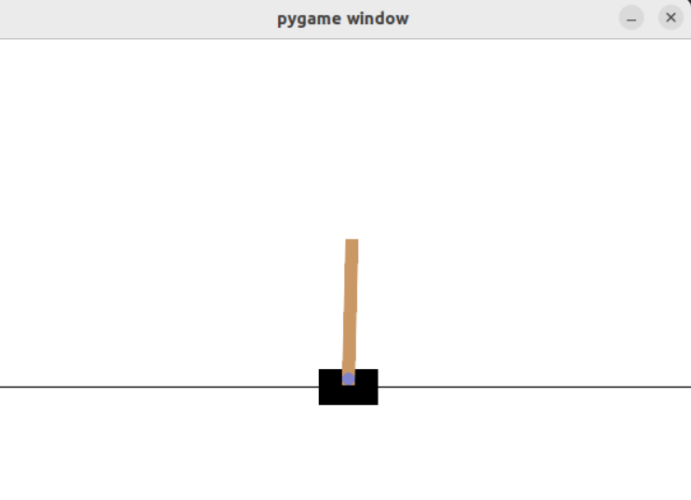
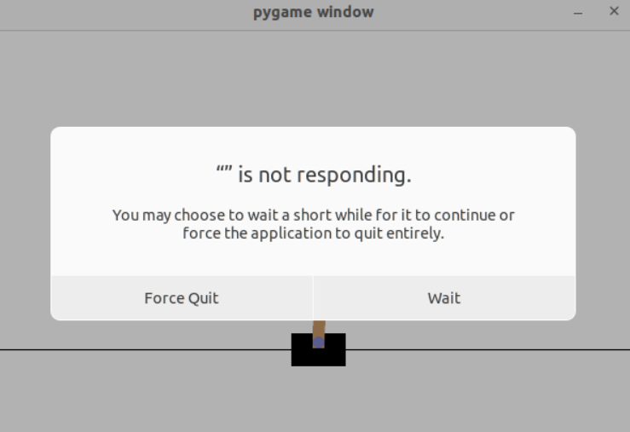
Ns3-gym implementation
CartPole from Gym library
Example 1

Slide 11
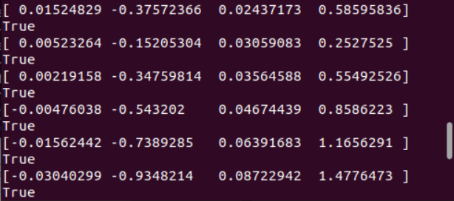
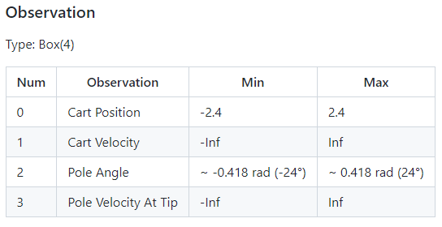
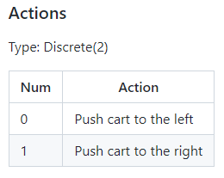
Ns3-gym implementation
Loop ?
CartPole from Gym library
CartPole from Gym library
Example 1

Slide 12
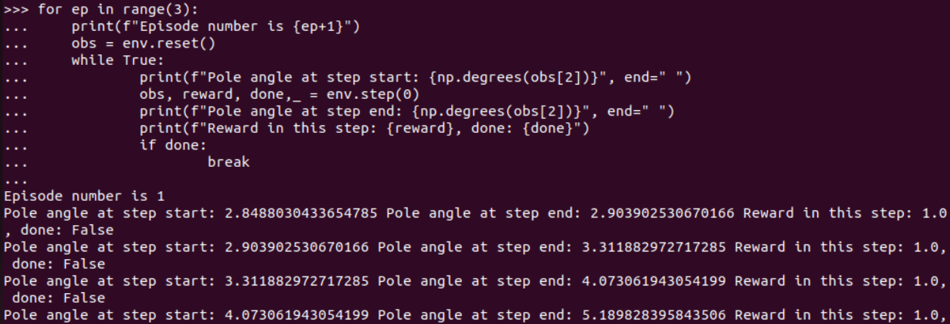
Ns3-gym implementation
Loop ?
CartPole from Gym library
CartPole from Gym library
Example 1

Slide 13
Ns3-gym implementation
Test example for ns3-gym
Example 2

Slide 14
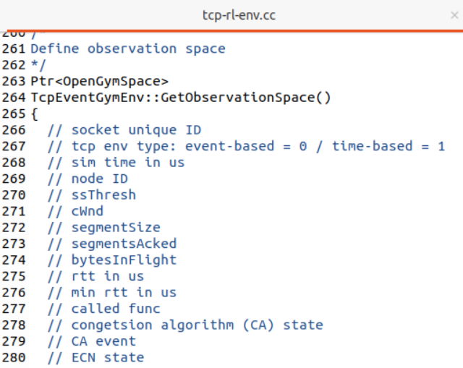
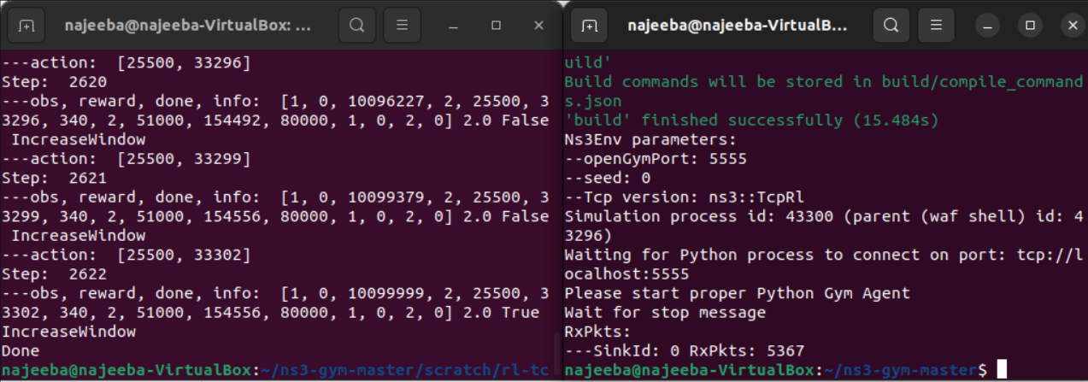
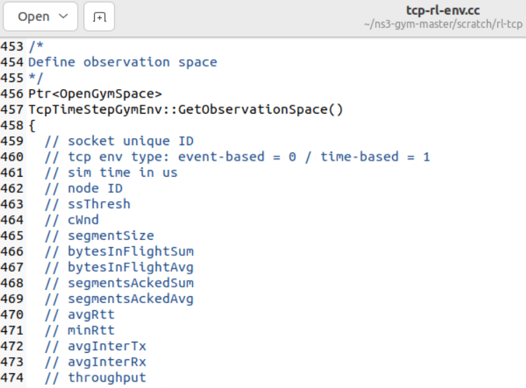
Ns3-gym implementation
TCP example for ns3-gym
Example 3

Slide 15
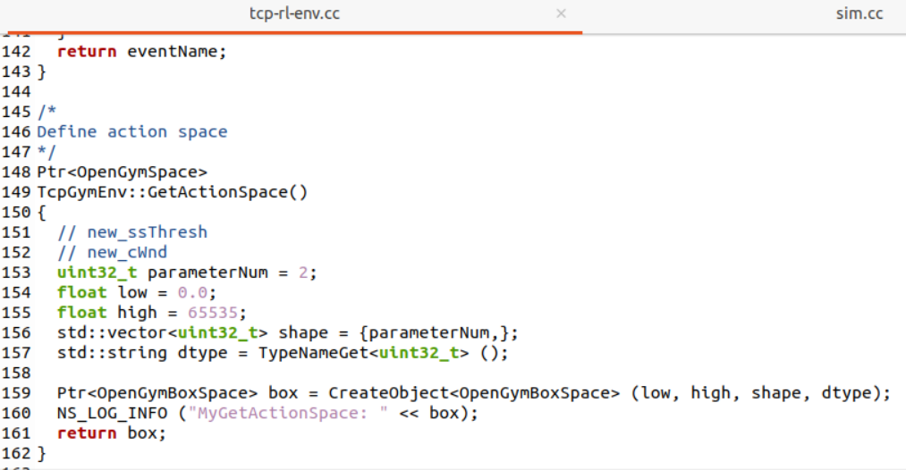
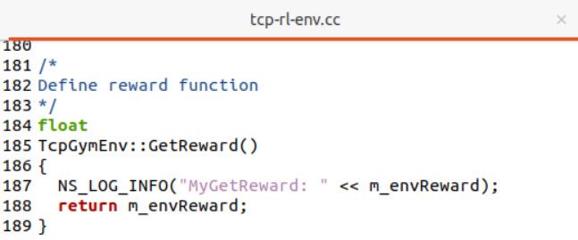
Ns3-gym implementation
TCP example for ns3-gym
Example 3

Slide 16
Challenges and Future work
ML and network
It is thought that network researchers lack the knowledge of ML, and at the same time ML researchers lacks the knowledge of networking, due to that, this field needs to be more involved in researches to utilize the abilities of ML for optimizations.
Environment
the nature of the application, that there is no data collection to train the model, and the need of setting the environment similar to the real-world in order to get accurate results.
Technical abilities
the technical issues that could arise in between, will require the researcher to be familiar with all required skills, including working with C++ and Python together, and the full understanding of communications and network behaviors. Furthermore, the ability to observe the results for large environments

Slide 17
References:
[1] Luong, N.C., Hoang, D.T., Gong, S., Niyato, D., Wang, P., Liang, Y.C. and Kim, D.I., 2019. Applications of deep reinforcement learning in communications and networking: A survey. IEEE Communications Surveys & Tutorials, 21(4), pp.3133-3174.
[2] Gawłowicz, P. and Zubow, A., 2019, November. Ns-3 meets openai gym: The playground for machine learning in networking research. In Proceedings of the 22nd International ACM Conference on Modeling, Analysis and Simulation of Wireless and Mobile Systems (pp. 113-120).
[3] Balmer, R.E., Levin, S.L. and Schmidt, S., 2020. Artificial Intelligence Applications in Telecommunications and other network industries. Telecommunications Policy, 44(6), p.101977.
[4] Saravanan, P., Subramaniyaswamy, V., Sivaramakrishnan, N., Prakash, M.A. and Arunkumar, T., 2014. Data mining approach for subscription-fraud detection in telecommunication sector. Contemporary Engineering Sciences, 7(11), pp.515-522.
[5] https://www.youtube.com/playlist?list=PLgPe2w6G51vNh8uG_11VqXA389oufBVMo
[6] https://www.gymlibrary.ml/
[7] https://github.com/openai/gym/wiki
[8] https://github.com/tkn-tub/ns3-gym

Slide 18
Thank you☺

