Slide 1
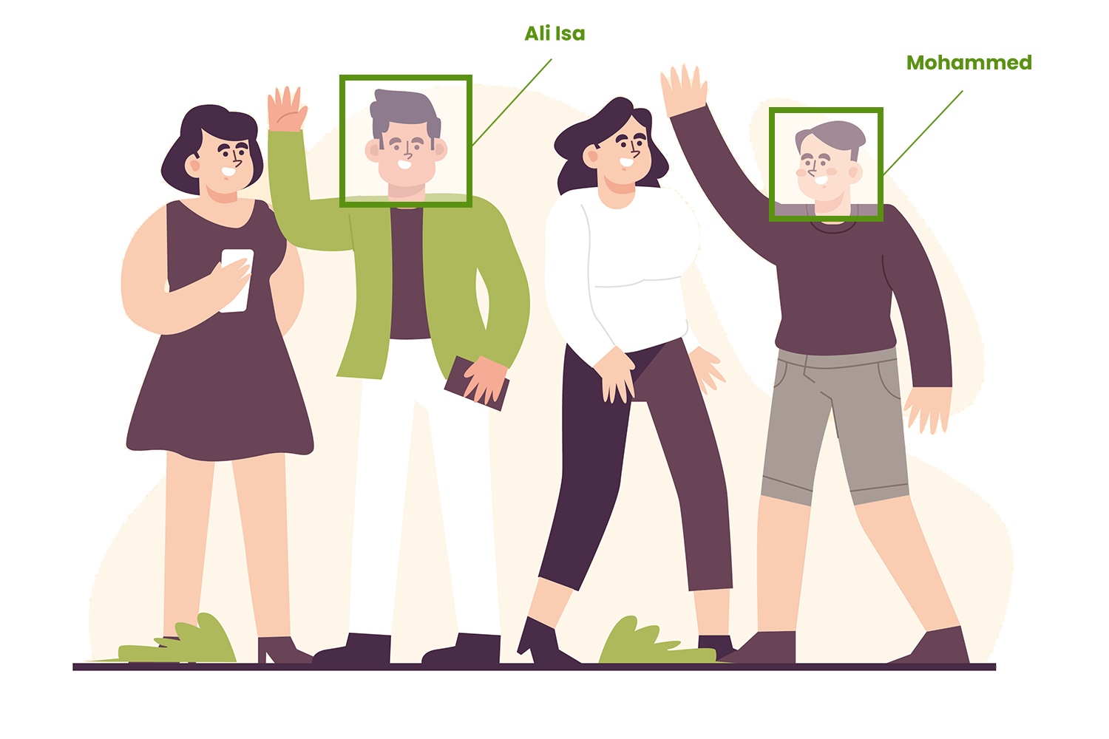
University of Bahrain
College of Engineering
Electrical & Electronic Engineering Department
MPs ATTENDANCE SYSTEM
BASED ON FACE RECOGNITION
USING DEEP TRANSFER LEARNING
Prepared By
Farooq Abdulaziz
Student ID# 19992198

Slide 2
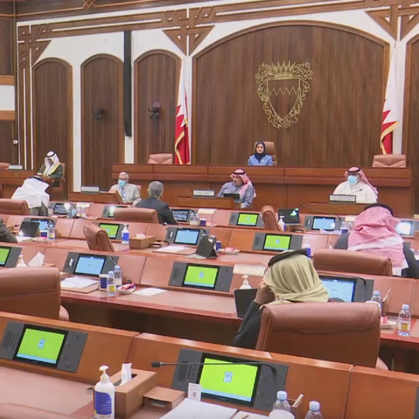
PROBLEM STATEMENT.
Weekly
Parliament Session
40
Members
Parliament chamber
21
Minimum MPs
Counting MP’s
attendance
Notes:
Maintaining the attendance record with the conventional method is a challenging task. For instance, in the council of representatives, a chairman can conduct the weekly session with at least 21 out of 40 members of parliaments should be attended for the session to occur. The conventional method of counting the total number of attendees is time-consuming, and there is always a chance of a mistake or a delay.

Slide 3
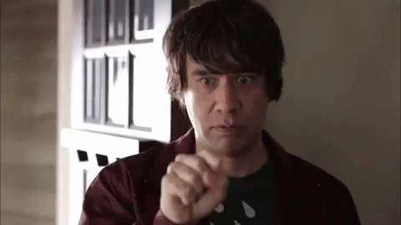
PROBLEM STATEMENT.
Risk of Human Error
Time Consuming
Repetitive Work
Ineffective & Outdated

Slide 4
OBJECTIVE.
Total Attendance
04
X
Y
Z
W
Notes:
Develop a reliable automatic real-time face recognition-based attendance system
Integrate the system with a database to record all the attendance

Slide 5
MODEL ARCHITECTURE.
Training Process
Face
Detection
Image
Dataset
Image
Training
Trained
Algorithm
Web cam
Trained
Algorithm
Identified
User
10
Members
Attendance
Database
Real-time Face Recognition
Attendance System

Slide 6
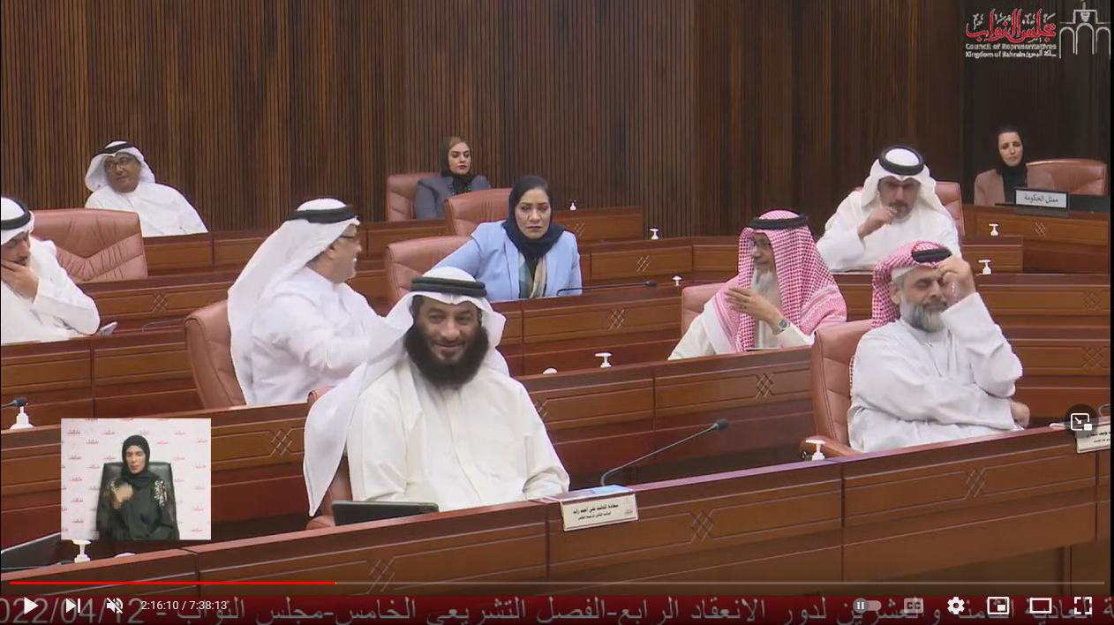
FACE DETECTION.
Ultra Light Face Detector
Face Landmarks
MTCNN YoloFace Faced Ultralight Face Face-Recognition

Slide 7
DATA COLLECTION.
Ali Abbas
Ali Abbas
Salman Ali
Salman Ali
1
Younis Isa
2
Younis Isa
Users Videos
Users Images
Mustafa Khalifa
Mustafa Khalifa
Ameer Hasan
Ameer Hasan
Default Files
Auto Generated Files

Slide 8
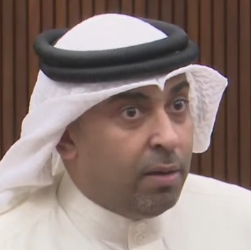
DATA COLLECTION.
224 * 224
Video Footage
Mohammed
Al Abbasi
Jassim
Ahmed

Slide 9
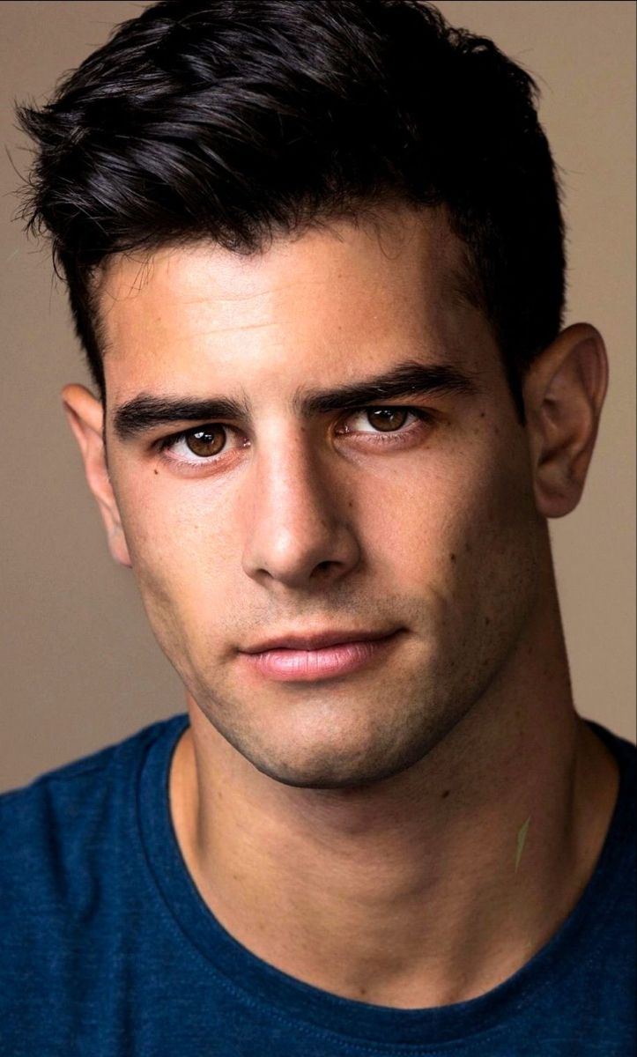
FACE ALIGNMENT.
Identifying the geometric structure of faces in digital images
Attempting to obtain a canonical alignment of the face based on translation, scale, and rotation.
Original
Centered
Rotate
Scale
Notes:
Thus, face alignment can be seen as a form of “data normalization”. Just as you may normalize a set of feature vectors via zero centering or scaling to unit norm prior to training a machine learning model, it’s very common to align the faces in your dataset before training a face recognizer.

Slide 10
DATA PREPROCESSING.
25K
80%
Yousif Ali
IMAGES
Jassim Abbas
Training
Khalid Abdulla
20%
Yousif Ali
16
Users Images
Validation
MEMBERS
Testing
Auto Splitted images into training, validation, and testing folder

Slide 11
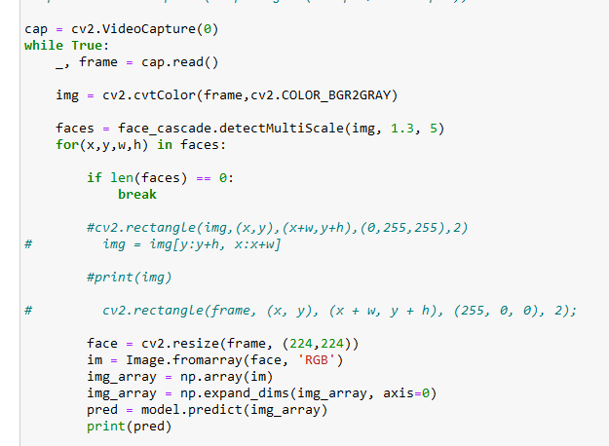
FACE RECOGNITION.
detectMultiScale() function will help us to find the features/locations of the new image
scaleFactor: how much the image size is reduced at each image scale
minNeighbors: specifying how many neighbors each candidate rectangle should have to retain it
This will affect the quality of the detected faces. Higher value results in fewer detections but with higher quality.

Slide 12
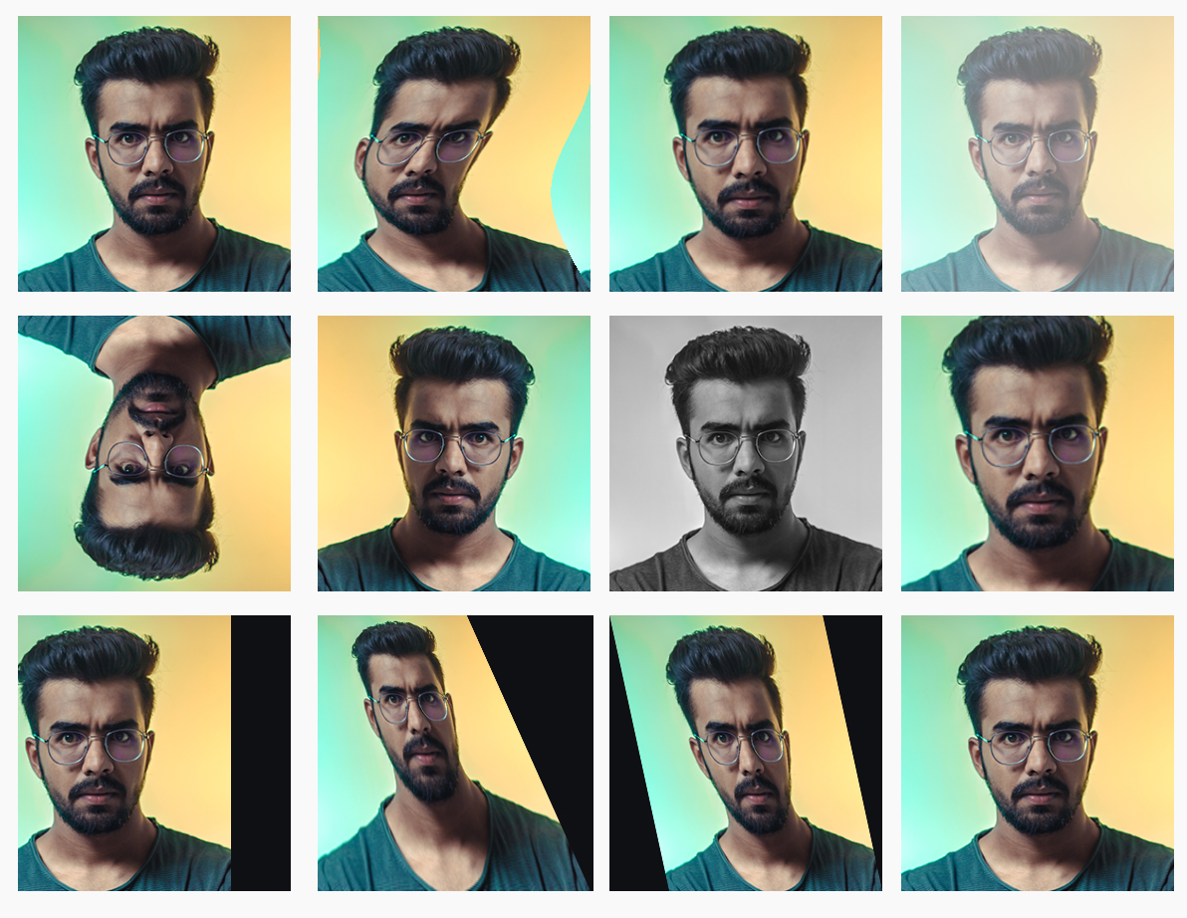
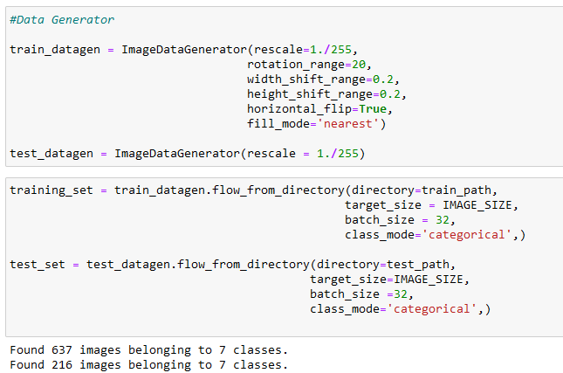
DATA AUGMENTATION.
Notes:
The objective of ImageDataGenerator is to import data with labels easily into the model. It is a very useful class as it has many function to rescale, rotate, zoom, flip etc. The most useful thing about this class is that it doesn’t affect the data stored on the disk. This class alters the data on the go while passing it to the model.
Here I am creating and object of ImageDataGenerator for both training and testing data and passing the folder which has train data to the object trdata and similarly passing the folder which has test data to the object tsdata.

Slide 13
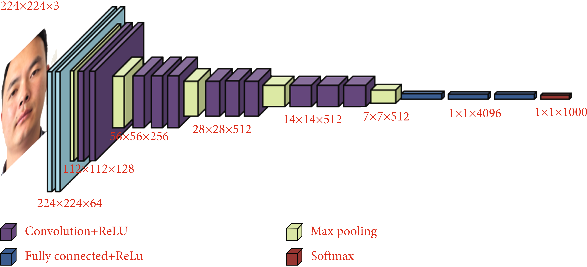
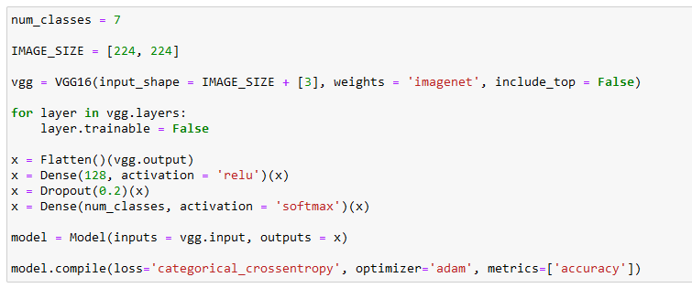
PRE-TRAINED NETWORKS.
Notes:
Here in this part I will import VGG16 from keras with pre-trained weights which was trained on imagenet. Here as you can see that include top parameter is set to false. the pre-trained weights will only be downloaded for convolution layers and no weights will be downloaded for dense layers.
Since my problem is to detect 10 MPs and it has 10 classes so the last dense layer of my model should be a 10 unit softmax dense layer.

Slide 14
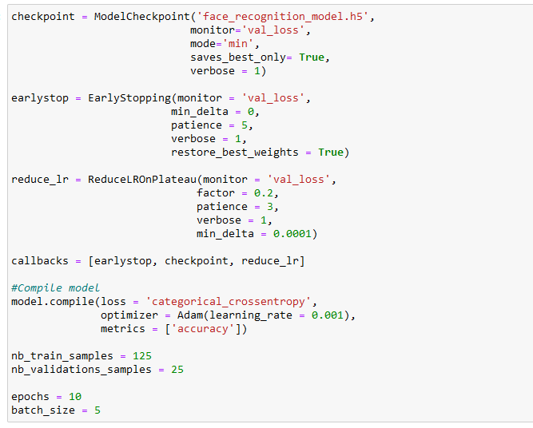
TRAINING PROCESS.
Model Checkpoint
Early Stopping
Reduce LR On Plateau
Notes:
After the creation of the model I will import ModelCheckpoint and EarlyStopping method from keras. I will create an object of both and pass that as callback functions to fit_generator.
ModelCheckpoint helps us to save the model by monitoring a specific parameter of the model. In this case I am monitoring validation accuracy by passing val_acc to ModelCheckpoint. The model will only be saved to disk if the validation accuracy of the model in current epoch is greater than what it was in the last epoch.
EarlyStopping helps us to stop the training of the model early if there is no increase in the parameter which I have set to monitor in EarlyStopping. In this case I am monitoring validation accuracy by passing val_acc to EarlyStopping. I have here set patience to 20 which means that the model will stop to train if it doesn’t see any rise in validation accuracy in 20 epochs.
ReduceLROnPlateau : Reduce learning rate when a metric has stopped improving

Slide 15
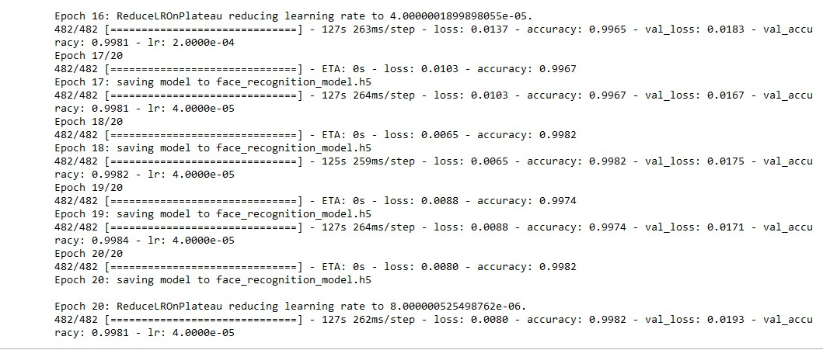
TRAINING PROCESS.
Early Stopping
Reduce LR On Plateau
Notes:
After the creation of the model I will import ModelCheckpoint and EarlyStopping method from keras. I will create an object of both and pass that as callback functions to fit_generator.
ModelCheckpoint helps us to save the model by monitoring a specific parameter of the model. In this case I am monitoring validation accuracy by passing val_acc to ModelCheckpoint. The model will only be saved to disk if the validation accuracy of the model in current epoch is greater than what it was in the last epoch.
EarlyStopping helps us to stop the training of the model early if there is no increase in the parameter which I have set to monitor in EarlyStopping. In this case I am monitoring validation accuracy by passing val_acc to EarlyStopping. I have here set patience to 20 which means that the model will stop to train if it doesn’t see any rise in validation accuracy in 20 epochs.
ReduceLROnPlateau : Reduce learning rate when a metric has stopped improving

Slide 16
DASHBOARD.

Slide 17
DEVELOPMENT TOOLS.

Slide 18
DEVELOPMENT TOOLS.
Pusher
+1
www.
Flask
Python
Admin
Web cam
Mysql

Slide 19
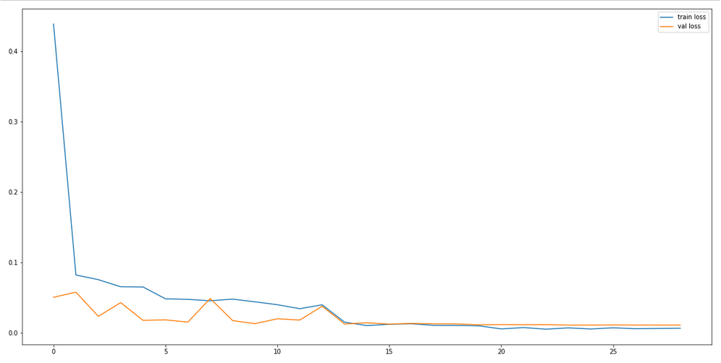
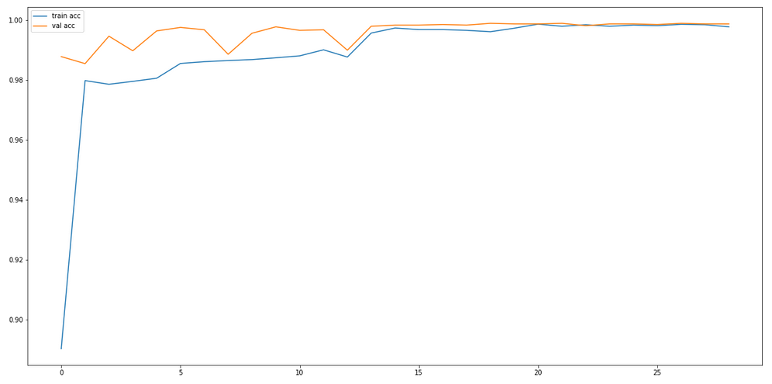
RESULTS & ANALYSIS.
VGG16
99.7%
99.8%
CNN
Training. Accuracy
Val. Accuracy
Results of Loss Accuracy
Results of Training Accuracy

Slide 20
CONCLUSION.
The performance of proposed system based on VGG-16 CNN architecture is evaluated by tuning various parameters to enhance the recognition accuracy of the system designed. Maximum recognition accuracy achieved 99.75% and 99.80% for validation accuracy.
This work can be extended by investigating more pre-trained CNN models and by including more human facial image data.

Slide 21
REFERENCES.
Pranav, K. B., & Manikandan, J. (2020). Design and evaluation of a real-time face recognition system using convolutional neural networks. Procedia Computer Science, 171, 1651-1659.
Alhanaee, K., Alhammadi, M., Almenhali, N., & Shatnawi, M. (2021). Face Recognition Smart Attendance System using Deep Transfer Learning. Procedia Computer Science, 192, 4093-4102.
Winarno, E., Al Amin, I. H., Februariyanti, H., Adi, P. W., Hadikurniawati, W., & Anwar, M. T. (2019, December). Attendance system based on face recognition system using cnn-pca method and real-time camera. In 2019 International Seminar on Research of Information Technology and Intelligent Systems (ISRITI) (pp. 301-304). IEEE.
Diyasa, G. S. M., Fauzi, A., Idhom, M., & Setiawan, A. (2021, March). Multi-face Recognition for the Detection of Prisoners in Jail using a Modified Cascade Classifier and CNN. In Journal of Physics: Conference Series (Vol. 1844, No. 1, p. 012005). IOP Publishing.
Yang, H., & Han, X. (2020). Face recognition attendance system based on real-time video processing. IEEE Access, 8, 159143-159150.
Hussain, S. A., & Al Balushi, A. S. A. (2020). A real time face emotion classification and recognition using deep learning model. In Journal of Physics: Conference Series (Vol. 1432, No. 1, p. 012087). IOP Publishing.

Slide 22
THANK YOU.

