Slide 1
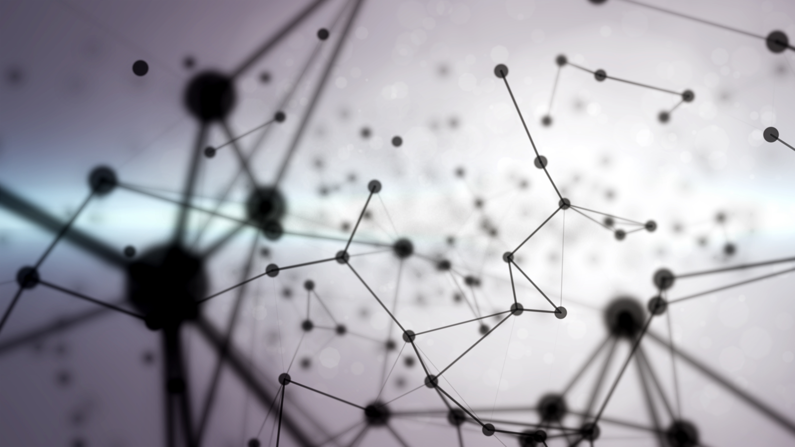
GAN VARIANTS FOR FASHION MNIST DATASET
By Ghadeer

Slide 2
Why the generative model?
Ref1: shows the training examples and right-side shows the newly generated data samples — images from the ImageNet dataset
Realistic samples generation & handling of missing data.
Generating new data for training without human supervision & interventions.
Generative models are essential in the perspective of modern AI.

Slide 3
GAN Variants

Slide 4
GAN
Trains two networks simultaneously
Discriminator is a binary classifier
G produces realistic data, & D gets better to predict the fake ones
Min-max loss: the generator tries to minimize this function while the discriminator tries to maximize it
log(D(x)) refers to the probability that the generator is rightly classifying the real image
Maximizing log(1-D(G(z))) would help it to correctly label the fake image that comes from the generator
Generator confuses discriminator by generating realistic data
Ref1: GAN architecture & loss function

Slide 5
Deep Convolutional GAN (DCGAN)
A new class of convolutional neural networks (CNN)
Stabilizes GAN training
Architectural constraints included in the CNN architecture:
Demonstrates steady training procedure
Achieved great performance
Notes:
Another source: Using ReLU activation in generator for all layers except for the output, which uses tanh.

Slide 6
Conditional GAN (CGAN)
Ref1: CGAN architecture & loss function
Can be constructed by feeding the extra auxiliary information
Generator generates conditional real-looking data
CGAN can control the generation of data by dictating the type of data generated through applied condition
Notes:
the conditional version of GAN. These types of networks can be constructed by merely feeding the extra auxiliary information (e.g., class label), which extends the GAN into CGAN. Generator of CGAN takes the extra auxiliary information c (class label, text or images) and a latent vector z so that it generates conditional real-looking data � z c , and discriminator of CGAN takes the extra auxiliary information c (class label, text or images) and real data x, so that it distinguishes generator generated samples- � � z c from real data x. CGAN can control the generation of data, which is impossible with the vanilla GAN

Slide 7
Wasserstein GAN (WGAN)
Proposed a substitute loss function derived through Earth-Mover (EM) or Wasserstein distance
Not like the standard GAN cost function where discriminator works as a binary classifier function
Discriminator used to fit the Wasserstein distance
Partially remove the mode collapse obstacle to stabilize the GAN training
May still produce poor quality images
Limited capability to model complex functions

Slide 8
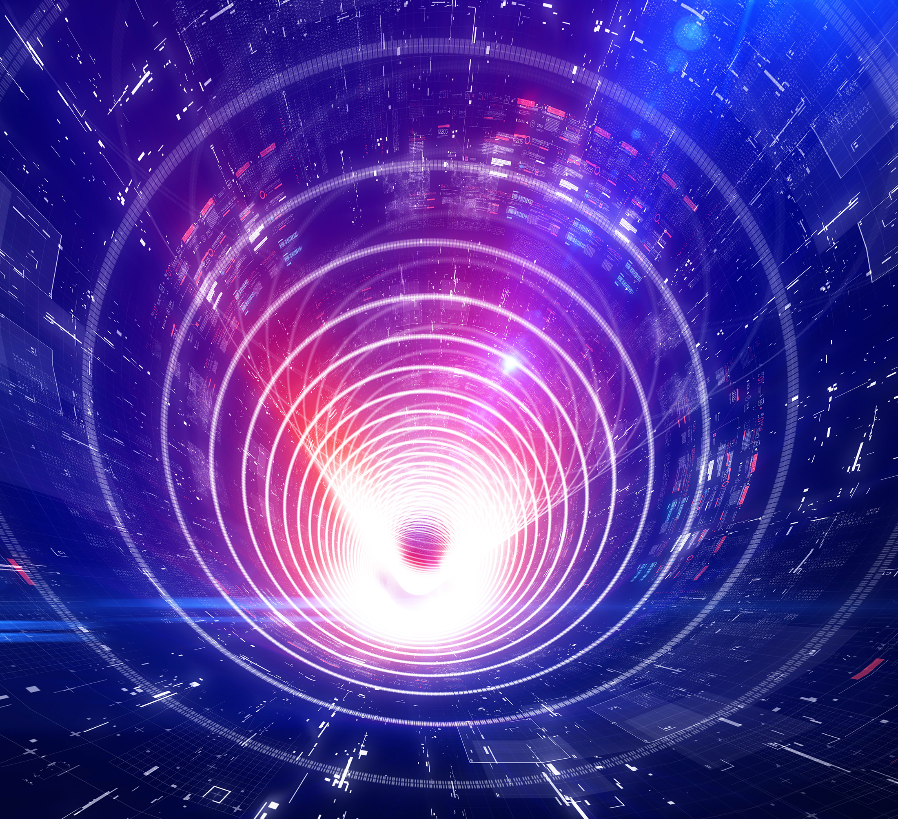
WGAN Gradient Penalty (WGAN-GP)
Framework further extended the idea of WGAN
Introduces gradient penalty (GP) term on the discriminator for the implementation of the 1- Lipschitz condition
Improve GAN training stability
Produce high-quality samples
Notes:
The idea of Gradient Penalty is to enforce a constraint such that the gradients of the critic's output w.r.t the inputs to have unit norm
1- Lipschitz condition : is used for a bound on the modulus of continuity a function. In particular, a function f:[a,b]→Rf:[a,b]→R is said to satisfy the Lipschitz condition if there is a constant MM such that|f(x)−f(x′)|≤M|x−x′|∀x,x′∈[a,b].(1)(1)|f(x)−f(x′)|≤M|x−x′|∀x,x′∈[a,b].
The smallest constant MM satisfying (1)(1) is called Lipschitz constant. The condition has an obvious generalization to vector-valued maps defined on any subset of the euclidean space RnRn: indeed it can be easily extended to maps between metric spaces

Slide 9
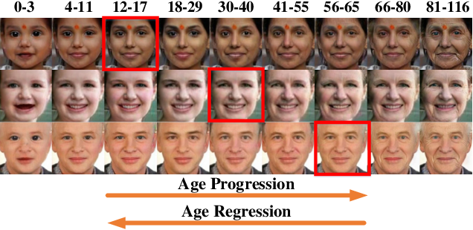
GAN Applications
Face aging
Text-to-image synthesis
Image manipulation applications
Object detection
Image in-painting: Refilling the missing pixels of an image
Sketch synthesis
Ref 2: Samples results of age progression and regression

Slide 10
Problem
Find the best GAN to generate images based on Fashion MNIST dataset
Comparing the generated images of different types of GAN
Notes:
Another source: Using ReLU activation in generator for all layers except for the output, which uses tanh.

Slide 11
Implementation

Slide 12
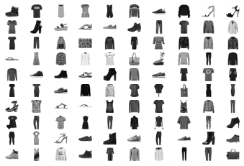
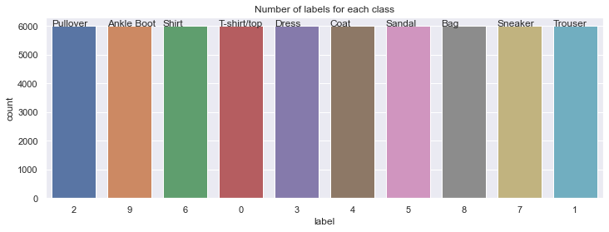
Fashion-MNIST Dataset
Training set of 60,000 samples
28x28 grayscale picture with a label from one of ten categories
785 columns, the first contains class labels, the others are the pixel values
Fashion MNIST data sample
Number of labels for each class
Notes:
the conditional version of GAN. These types of networks can be constructed by merely feeding the extra auxiliary information (e.g., class label), which extends the GAN into CGAN. Generator of CGAN takes the extra auxiliary information c (class label, text or images) and a latent vector z so that it generates conditional real-looking data � z c , and discriminator of CGAN takes the extra auxiliary information c (class label, text or images) and real data x, so that it distinguishes generator generated samples- � � z c from real data x. CGAN can control the generation of data, which is impossible with the vanilla GAN

Slide 13
DCGAN

Slide 14
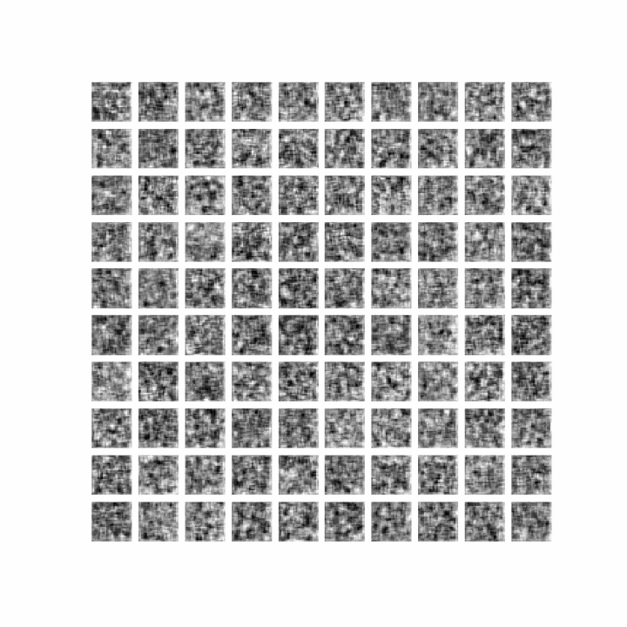
DCGAN 1
I tried to run the code from “Deep Learning for Vision Systems” book
It indicated to get good results, it will need to run around 10000 epochs
Was only able to run it up to 353 epochs
DCGAN code from ref 4 generated images after 353 epochs
Notes:
the conditional version of GAN. These types of networks can be constructed by merely feeding the extra auxiliary information (e.g., class label), which extends the GAN into CGAN. Generator of CGAN takes the extra auxiliary information c (class label, text or images) and a latent vector z so that it generates conditional real-looking data � z c , and discriminator of CGAN takes the extra auxiliary information c (class label, text or images) and real data x, so that it distinguishes generator generated samples- � � z c from real data x. CGAN can control the generation of data, which is impossible with the vanilla GAN

Slide 15
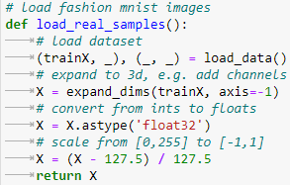
DCGAN 2: Preparation of Data
Original code by Jason Brownlee
Loading Fashion MNIST dataset
Using training dataset for model training
Adding additional channel dimension to make black/white images three-dimensional
Loading images
Notes:
the conditional version of GAN. These types of networks can be constructed by merely feeding the extra auxiliary information (e.g., class label), which extends the GAN into CGAN. Generator of CGAN takes the extra auxiliary information c (class label, text or images) and a latent vector z so that it generates conditional real-looking data � z c , and discriminator of CGAN takes the extra auxiliary information c (class label, text or images) and real data x, so that it distinguishes generator generated samples- � � z c from real data x. CGAN can control the generation of data, which is impossible with the vanilla GAN

Slide 16
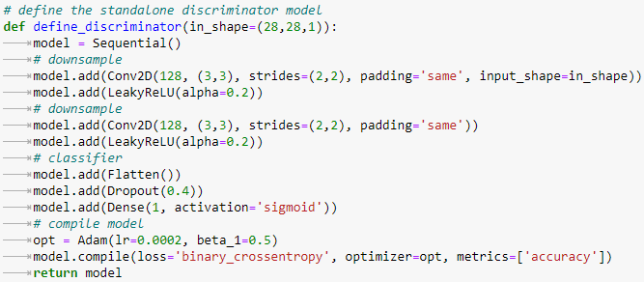
GAN Discriminator
Input 28X28 grayscale picture
Predicts whether it is real (class=1) or fake (class=0)
Built as a convolutional neural network
GAN best practices:
LeakyReLU activation function with a slope of 0.2
A 2X2 stride to downsample
Adam version of stochastic gradient descent with a learning rate of 0.0002 and a momentum of 0.5
GAN Discriminator Code

Slide 17
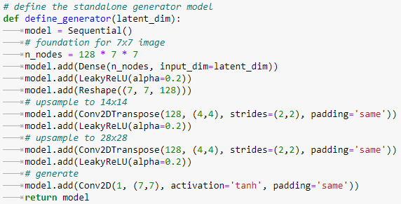
GAN Generator
Takes a point in the latent space as input
Generates a single 28X28 grayscale picture as output
Utilizing a fully connected layer to interpret the point in the latent space
Provide enough activations to reshape the output picture into multiple copies (128) of a low-resolution version
Upsampled twice, each time utilizing transpose convolutional Layers to double the size and quadruple the area of the activations.
GAN best practices:
LeakyReLU activation
A kernel size that is a factor of the stride size
Hyperbolic tangent (tanh) activation function in the output layer
GAN Generator Code

Slide 18
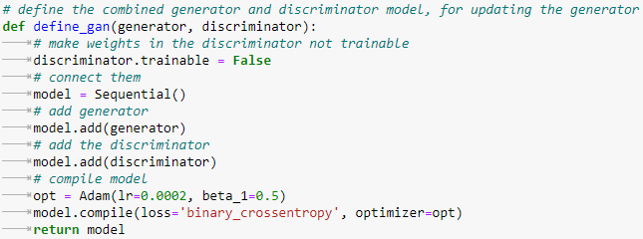
GAN Model
GAN model that merges the generator and discriminator models into one bigger model
Model uses output & error computed by the discriminator model to train the model weights in the generator
Discriminator model trained independently
Weights in this bigger GAN model are tagged as non trainable to guarantee that only the generator model's weights are adjusted
A batch size of 128 samples
Each training epoch involves around 468 (60,000/128) batches
GAN Model Code

Slide 19
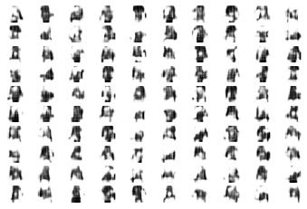
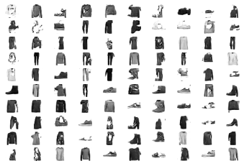
DCGAN results
Epoch 1
Epoch 20
Notes:
Another source: Using ReLU activation in generator for all layers except for the output, which uses tanh.

Slide 20
CGAN

Slide 21
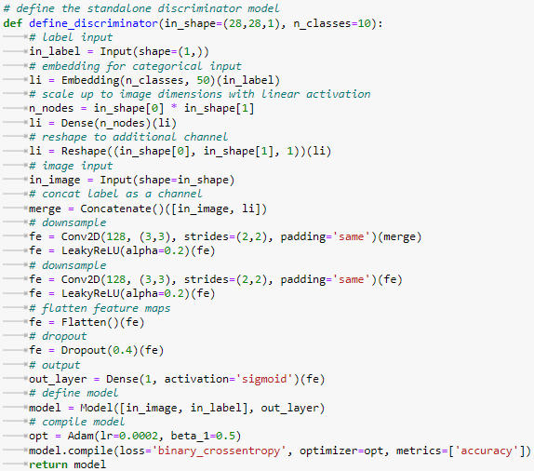
CGAN Discriminator
Using Functional API instead of using sequential API
Input 28X28 grayscale picture & class label
Class label is transmitted via a 50-size Embedding layer
Discriminator model will learn a distinct 50-element vector representation for each of the 10 classes
Embedding's output sent to a fully connected layer with linear activation
Activations reshaped into a channel of a 28X28 picture & concatenated with the input image
Predicts whether it is real (class=1) or fake (class=0)
GAN best practices:
LeakyReLU activation function with a slope of 0.2
A 2X2 stride to downsample
Adam version of stochastic gradient descent with a learning rate of 0.0002 and a momentum of 0.5
CGAN Discriminator Code

Slide 22
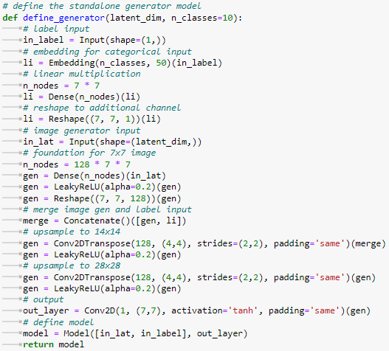
CGAN Generator
Updated to take class label and a point in the latent space as input
Generates a single 28X28 grayscale picture as output
Class label sent through an embedding layer to map it to a distinct 50-element vector
Fully connected layer's activations are resized into a single 7x7 feature map
To match the unconditional generator model's 7x7 feature map activations added
Then upsampled
GAN best practices:
LeakyReLU activation
A kernel size that is a factor of the stride size
Hyperbolic tangent (tanh) activation function in the output layer
CGAN Generator Code

Slide 23
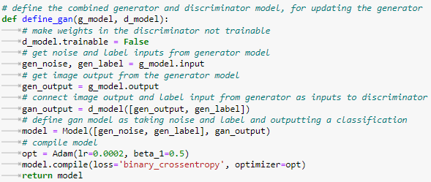
CGAN Model
GAN model that merges the generator and discriminator models
Take a point in latent space & a class label as input to evaluate whether the input is real or fake
When using functional API, it's essential to explicitly connect the image generated from the generator with class label input as inputs to the discriminator model
Allows the same class label input to flow down into the discriminator and generator
CGAN Model Code

Slide 24
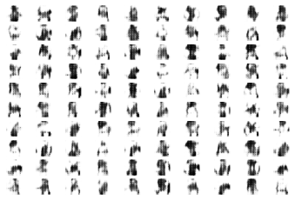
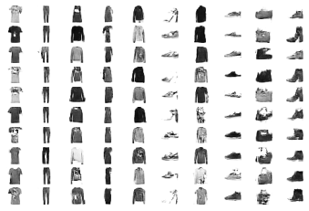
CGAN results
Epoch 1
Epoch 20
Notes:
Another source: Using ReLU activation in generator for all layers except for the output, which uses tanh.

Slide 25
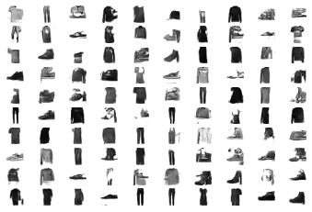
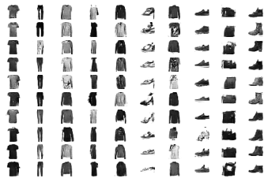
Changing the dropout from 0.4 to 0.3
GAN epoch 20
CGAN epoch 20
Notes:
Another source: Using ReLU activation in generator for all layers except for the output, which uses tanh.

Slide 26
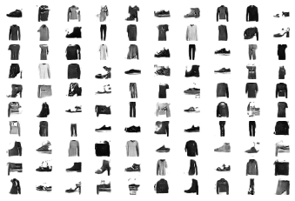
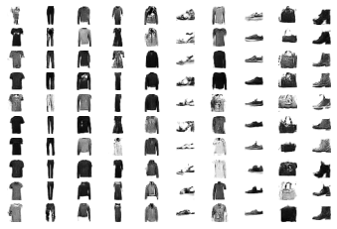
Changing the discriminator kernel size to 4,4
GAN epoch 20
CGAN epoch 20
Notes:
Another source: Using ReLU activation in generator for all layers except for the output, which uses tanh.

Slide 27
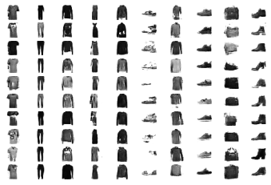
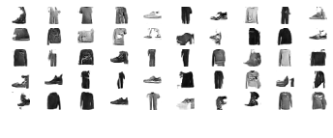
Changing the latent dimension from 100 to 200
GAN epoch 20
CGAN epoch 20
Notes:
Another source: Using ReLU activation in generator for all layers except for the output, which uses tanh.

Slide 28
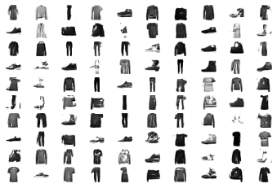
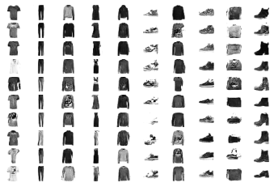
Changing embedding layer size from 50 to 100
GAN epoch 20
CGAN epoch 20
Notes:
Another source: Using ReLU activation in generator for all layers except for the output, which uses tanh.

Slide 29
WGAN-GP

Slide 30
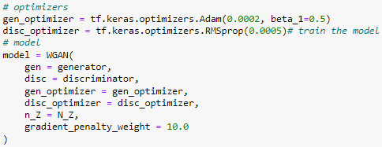
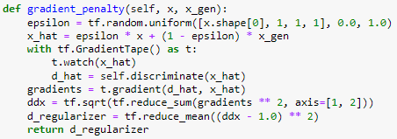
WGAN-GP Steps
Loading packages
Loading the Fashion-MNIST dataset
Defining the network as tf.keras.model object Defining the generator and discriminator architecture
Creating combined model with gradient penalty weight
Training it
Original hyperparameters: batch size: 512, generator kernel size: 3, discriminator kernel size: 3 & learning rate of 0.0001

Slide 31
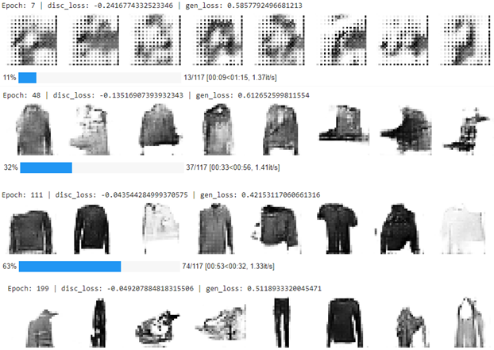
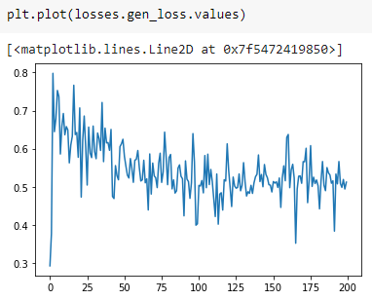
Batch size: 512, generator kernel size: 3, discriminator kernel size: 3 & learning rate of 0.0001
Notes:
Another source: Using ReLU activation in generator for all layers except for the output, which uses tanh.

Slide 32
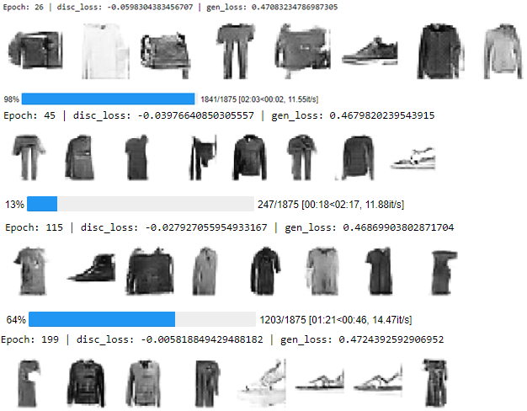
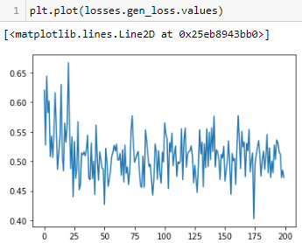
Batch size to 32 & generator kernel size to 4
Notes:
Another source: Using ReLU activation in generator for all layers except for the output, which uses tanh.

Slide 33
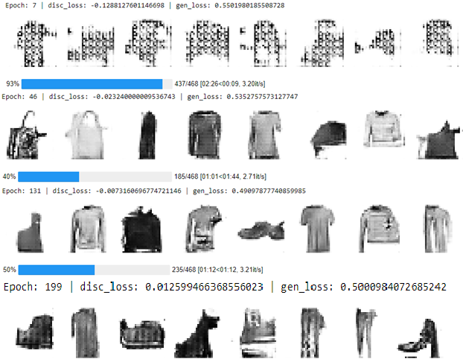
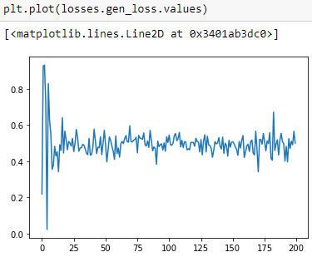
Batch size to 128, learning rate 0.0002 & generator kernel size 4
Notes:
Another source: Using ReLU activation in generator for all layers except for the output, which uses tanh.

Slide 34
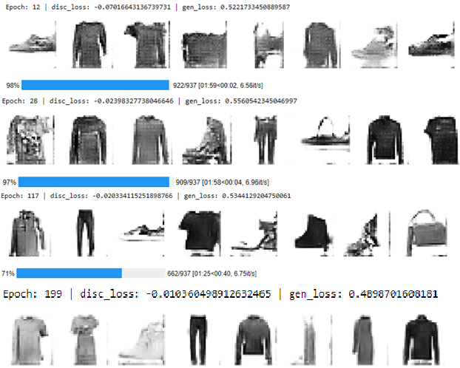
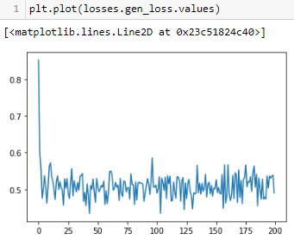
Batch size to 64, learning rate 0.0002, discriminator and generator kernel size 4
Notes:
Another source: Using ReLU activation in generator for all layers except for the output, which uses tanh.

Slide 35
Discussion 1
Using manual GAN evaluation to evaluate the model.
CGAN had the best generated images
CGAN model had the best performance when we changed the discriminator kernel size from 3,3 to 4,4
WGAN-GP performed better than DCGAN
WGAN-GP best results with batch size to 64, learning rate 0.0002, discriminator and generator kernel size 4.
Reducing the batch size made the training faster

Slide 36
Discussion 2
DCGAN discriminator loss was around 0.6 and generator loss was around 0.7
CGAN discriminator loss was around 0.6 and generator loss was around 0.8.
WGAN-GP discriminator loss was around – 0.025 and generator loss was around 0.5.
The last WGAN-GP generator loss image, shows that the generator has better learning rate compared to the other tries.

Slide 37
Challenges
Lack of proper evaluation metrics
Need high processing resources & time to train
Notes:
unsupervised learning

Slide 38
Conclusion
GAN has the power to facilitate several new practical applications in many other domains, image, audio, and video in the future
The CGAN performance was the best compared to the other models since it employed class labels
WGAN-GP had better performance than DCGAN
GAN models have great potential
However, there are difficulties in training:
Lack of appropriate assessment metrics
Requirement for a large amount of processing resources and time

Slide 39
References
A. Jabbar, X. Li, and B. Omar, “A survey on generative adversarial networks: Variants, applications, and training,” ACM Computing Surveys, vol. 54, no. 8, pp. 1–49, 2022
Q. Li, Y. Liu, and Z. Sun, “[PDF] age progression and regression with spatial attention modules: Semantic scholar,” undefined, 01-Jan-1970. [Online]. Available: https://www.semanticscholar.org/paper/Age-Progression-and-Regression-with-Spatial-Modules-Li-Liu/5aa14005bc97589114580d0f29d43fb1362299a8. [Accessed: 18-Apr-2022].
“Google colaboratory,” Google Colab. [Online]. Available: https://colab.research.google.com/drive/1Xcu_vxP0sIEsNwECHG3rRAq52OvpWyXM?usp=sharing#scrollTo=XxwdNinkrfIQ. [Accessed: 31-May-2022].
M. Elgendy, “Generative adversarial networks (GANs),” in Deep Learning for Vision Systems, Shelter Island, NY: Manning Publications Co, 2020, pp. 341–373.
A. Béres, “Google colaboratory,” Google Colab. [Online]. Available: https://colab.research.google.com/github/keras-team/keras-io/blob/master/examples/generative/ipynb/gan_ada.ipynb#scrollTo=L9JnWPe076nV. [Accessed: 31-May-2022].
V. Makkapati and A. Patro, “Enhancing symmetry in gan generated fashion images,” Artificial Intelligence XXXIV, pp. 405–410, 2017.
A. Acosta, A. Ochoa Zezzatti, G. Delgado, and J. Mejía, “Image creation using generative adversarial networks (gan ...” [Online]. Available: https://www.rcs.cic.ipn.mx/2020_149_6/Image%20Creation%20Using%20Generative%20Adversarial%20Networks%20_GAN_%20Applied%20to%20the%20Fashion%20Industry.pdf. [Accessed: 07-Mar-2022].
A. Saha, “Generative adversarial networks using Pytorch,” Medium, 20-Aug-2020. [Online]. Available: https://attyuttam.medium.com/generative-adversarial-networks-using-pytorch-3ad31cc61ac8. [Accessed: 06-Mar-2022].
Gökhan Yildirim, Calvin Seward, and Urs Bergmann. 2018. Disentangling Multiple Conditional Inputs in GANs. In Proceedings of KDD Fashion Workshop (KDD). ACM, New York, NY, USA, Article 4, 5 pages.
5. A. Helwan, “Generate new fashion designs with a generative Adversarial Network (GAN),” CodeProject, 19-Mar-2021. [Online]. Available: https://www.codeproject.com/Articles/5297330/Generate-New-Fashion-Designs-with-a-Generative-Adv. [Accessed: 06-Mar-2022].
I. Goodfellow, “NIPS 2016 tutorial: Generative Adversarial Networks,” arXiv.org, 03-Apr-2017. [Online]. Available: https://arxiv.org/abs/1701.00160v4. [Accessed: 06-Mar-2022].
J. Brownlee, “How to evaluate generative Adversarial Networks,” Machine Learning Mastery, 12-Jul-2019. [Online]. Available: https://machinelearningmastery.com/how-to-evaluate-generative-adversarial-networks/. [Accessed: 01-Jun-2022].
“Google colaboratory,” Google Colab. [Online]. Available: https://colab.research.google.com/github/timsainb/tensorflow2-generative-models/blob/master/3.0-WGAN-GP-fashion-mnist.ipynb#scrollTo=00dI2M4iSYcE. [Accessed: 03-Jun-2022].
14. J. Hui, “Gan - Wasserstein Gan &amp; WGAN-GP,” Medium, 31-May-2021. [Online]. Available: https://jonathan-hui.medium.com/gan-wasserstein-gan-wgan-gp-6a1a2aa1b490. [Accessed: 06-Jun-2022].
15. “Frequently asked questions,” Machine Learning Mastery, 12-Jun-2019. [Online]. Available: https://machinelearningmastery.com/faq/single-faq/why-is-my-gan-not-converging/. [Accessed: 07-Jun-2022].

