Slide 1
TRAFFIC SIGN RECOGNITION
AIE604 - Deep Learning Applications

Slide 2
TABLE OF CONTENTS
01
02
07
03
04
Aim of the Project
YOLO
Dataset
Tools Used
06
05
Conclusion
Results
Experiment

Slide 3
01
AIM OF THE PROJECT
AIE604 - Deep Learning Applications

Slide 4
AIM OF THE PROJECT
The goal of the project is identifying traffic signs of Bahrain using a Deep Learning model. At the end of the project a model will be produced to identify traffic signs from real time video streaming. We will be detecting the below signs:
Several Speed Limit
Stop
Parking
Road Hump
No U-Turn
Others

Slide 5
Uses Cases
Self Driving Car
Traffic Assistance Driving Systems

Slide 6
02
YOLO
AIE604 - Deep Learning Applications

Slide 7
YOLO – You Only Look Once
YOLO proves to be a cleaner and more efficient for doing object detection since it provides end-to-end training. Both the algorithms are fairly accurate but, in some cases, YOLO outperforms Faster R-CNN in terms of accuracy, speed and efficiency. [6]

Slide 8
YOLO Release Dates Timeline
YOLOv1
YOLOv3
YOLOS
PP-YOLOv2
VOLO-NAS
YOLOv8
2015
2016
2018
2020
2021
2022
2023
YOLOv2
YOLOv9000
PP-YOLO
YOLOv5
YOLOv4
YOLOv7
YOLOv6

Slide 9
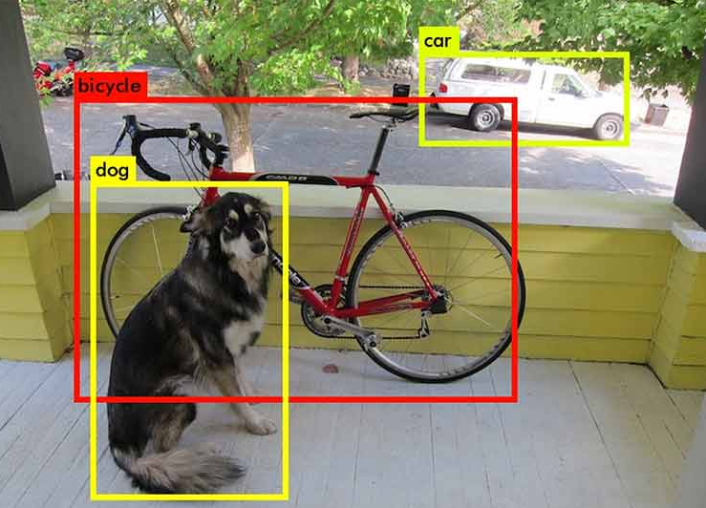
Object Localization
$$P_{c}$$
$$B_{x}$$
$$B_{y}$$
$$B_{w}$$
$$B_{h}$$
$$C_{1}$$
$$C_{2}$$
$$C_{3}$$
$$0.93$$
$$22$$
$$50$$
$$40$$
$$90$$
$$1$$
$$0$$
$$0$$
$$0.98$$
$$36$$
$$25$$
$$95$$
$$90$$
$$0$$
$$1$$
$$0$$
$$0.81$$
$$75$$
$$96$$
$$45$$
$$30$$
$$0$$
$$0$$
$$1$$
=
$P_{c}$ = Probability of the class
$B_{x}$ = x of center point of the bounding box
$B_{y}$ = y of center point of the bounding box
$B_{w}$ = Width of the bounding box
$B_{h}$ = Height of the bounding box
$C_{1}$ = Class 1
$C_{2}$ = Class 2
$C_{3}$ = Class 3

Slide 10
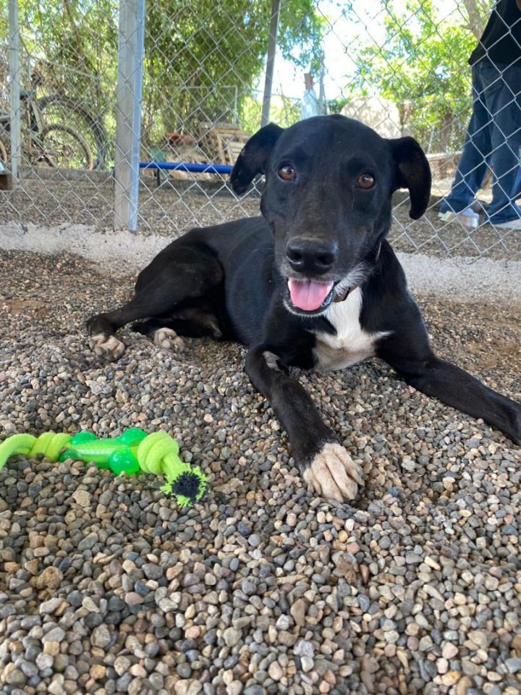
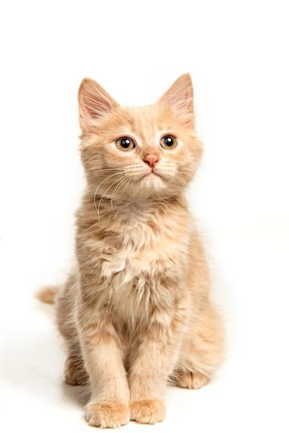
Training Flow
X-train
Y-train
$$1$$
$$22$$
$$50$$
$$40$$
$$90$$
$$1$$
$$0$$
$$P_{c}$$
$$B_{x}$$
$$B_{y}$$
$$B_{w}$$
$$B_{h}$$
$$C_{1}$$
$$C_{2}$$
YOLO-NAS
$$0$$
$$33$$
$$54$$
$$56$$
$$85$$
$$0$$
$$1$$

Slide 11
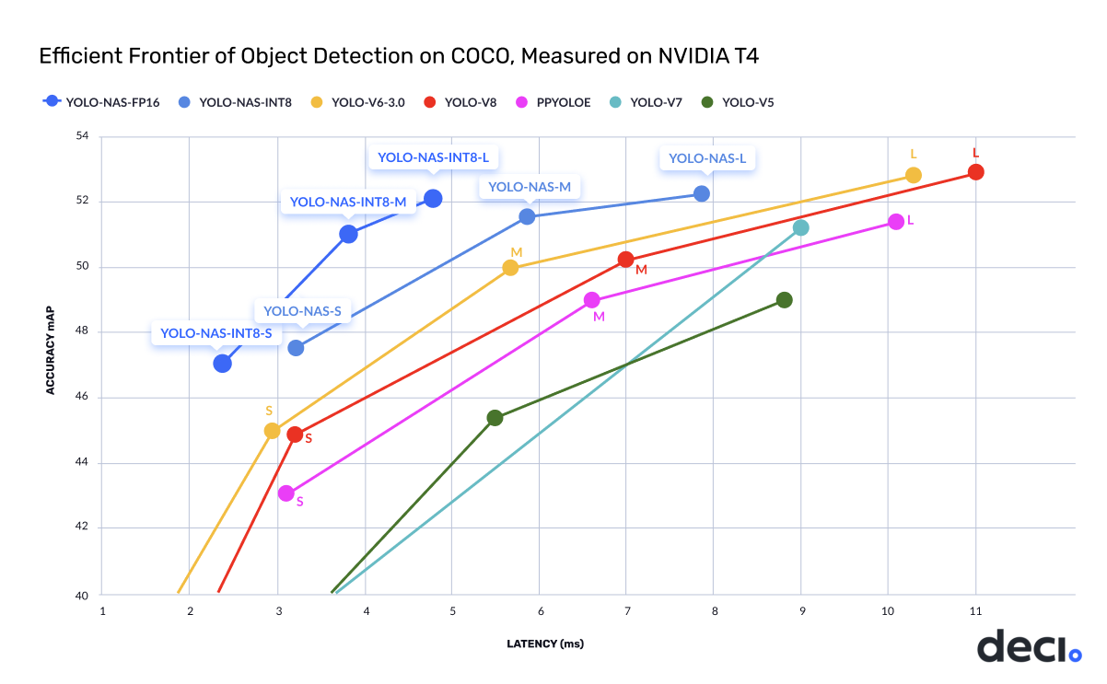
Comparison of YOLO Versio
Note
This data may change depending on hardware
This data may change depending on dataset
Each model may perform different depending on application
[7]

Slide 12
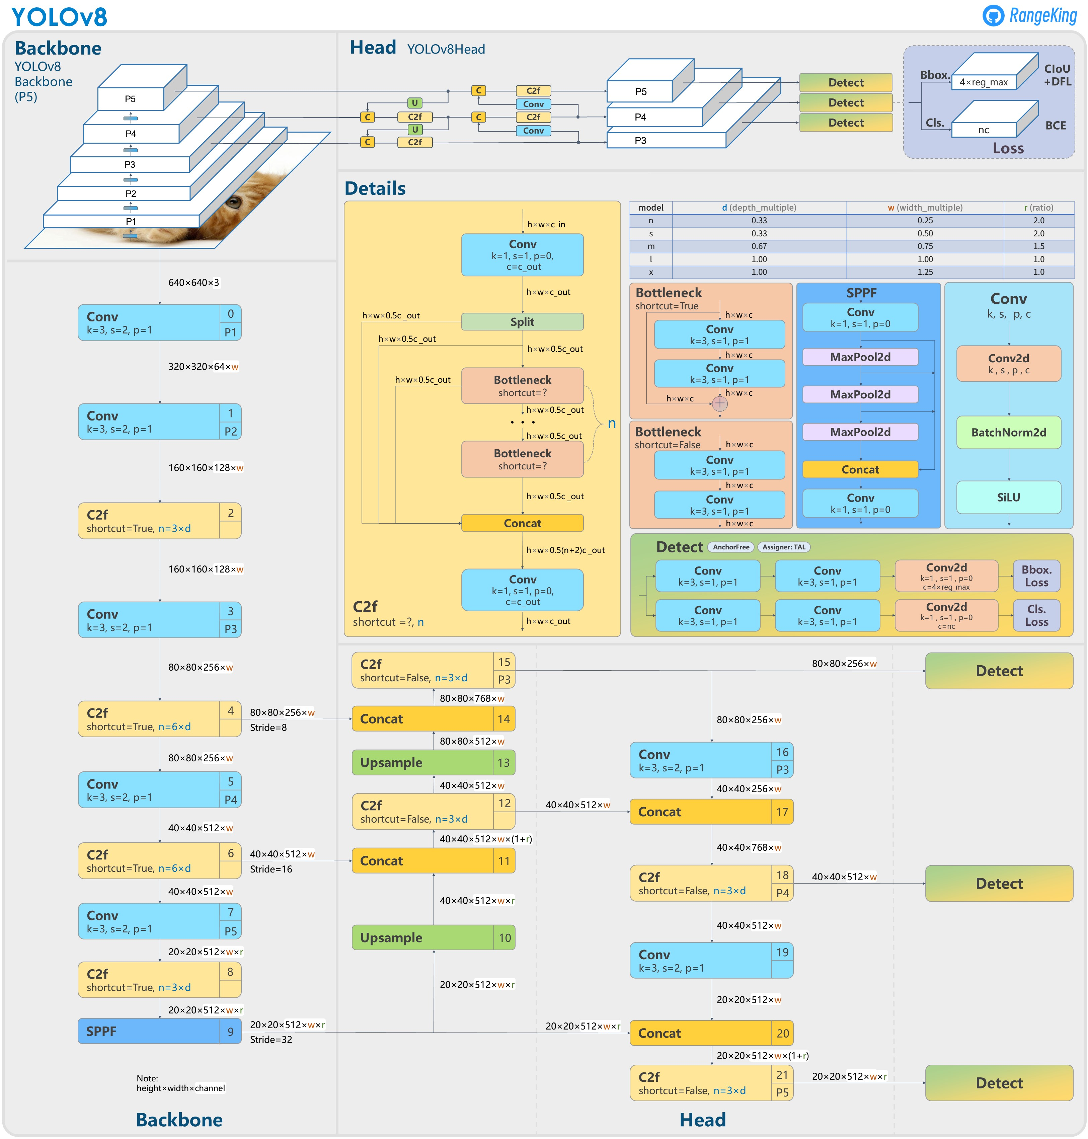
YOLOv8
Details on YOLOv8 [5]
Default batch size = 16
Default input image size = 640 x 640
Default trained dataset = COCO128
Default classes = 80
Advantages [6]
Faster inference speed
Improved accuracy
Better generalization
Smaller model size
Enhanced feature fusion
[5]

Slide 13
03
Used Dataset
AIE604 - Deep Learning Applications

Slide 14
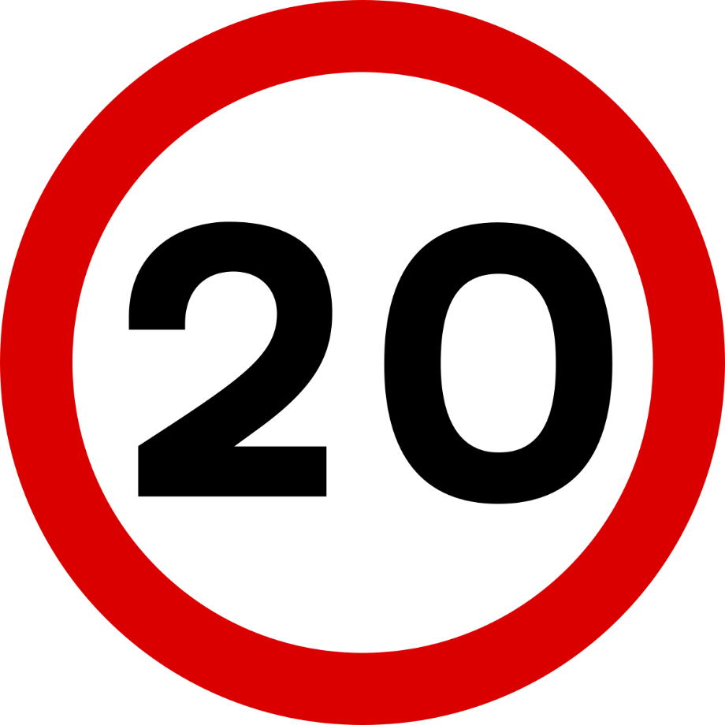
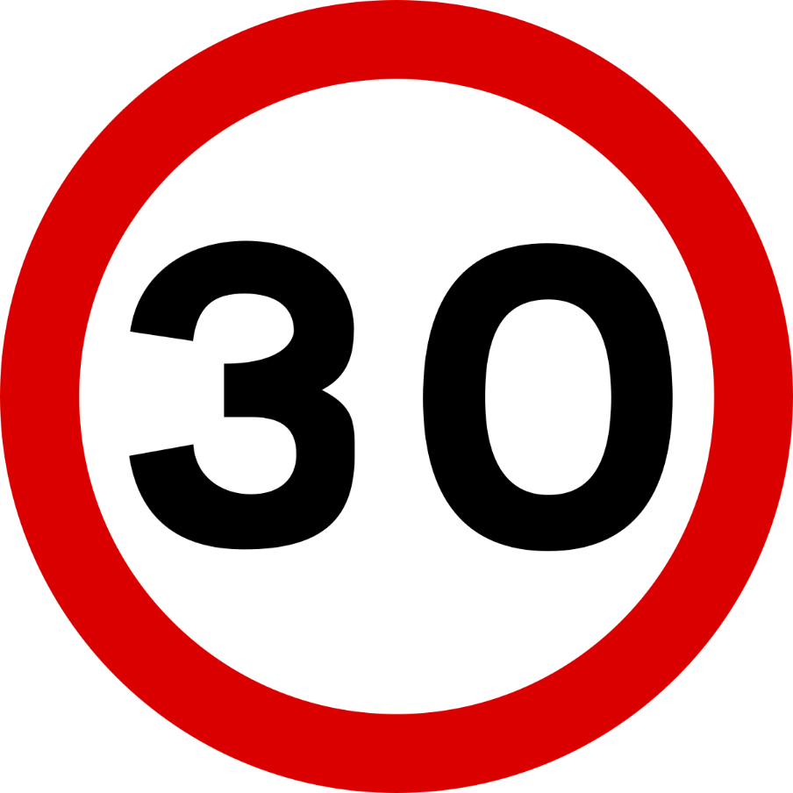
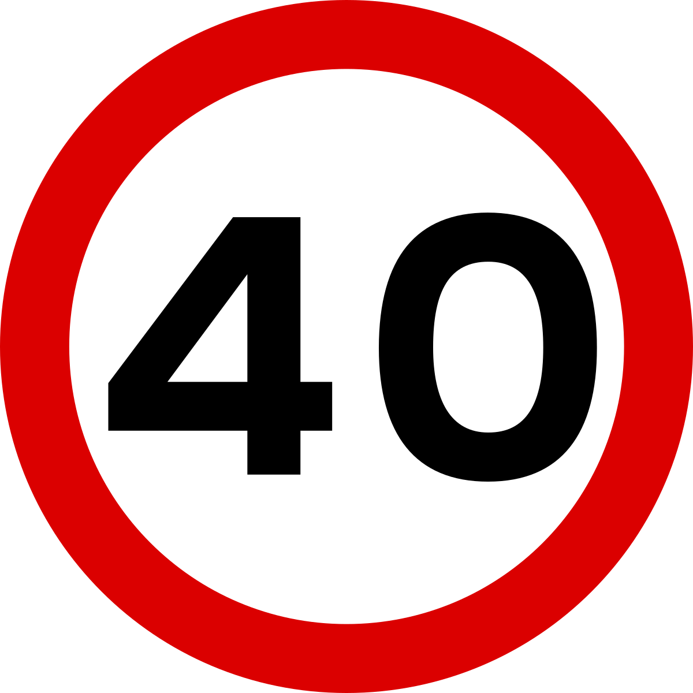
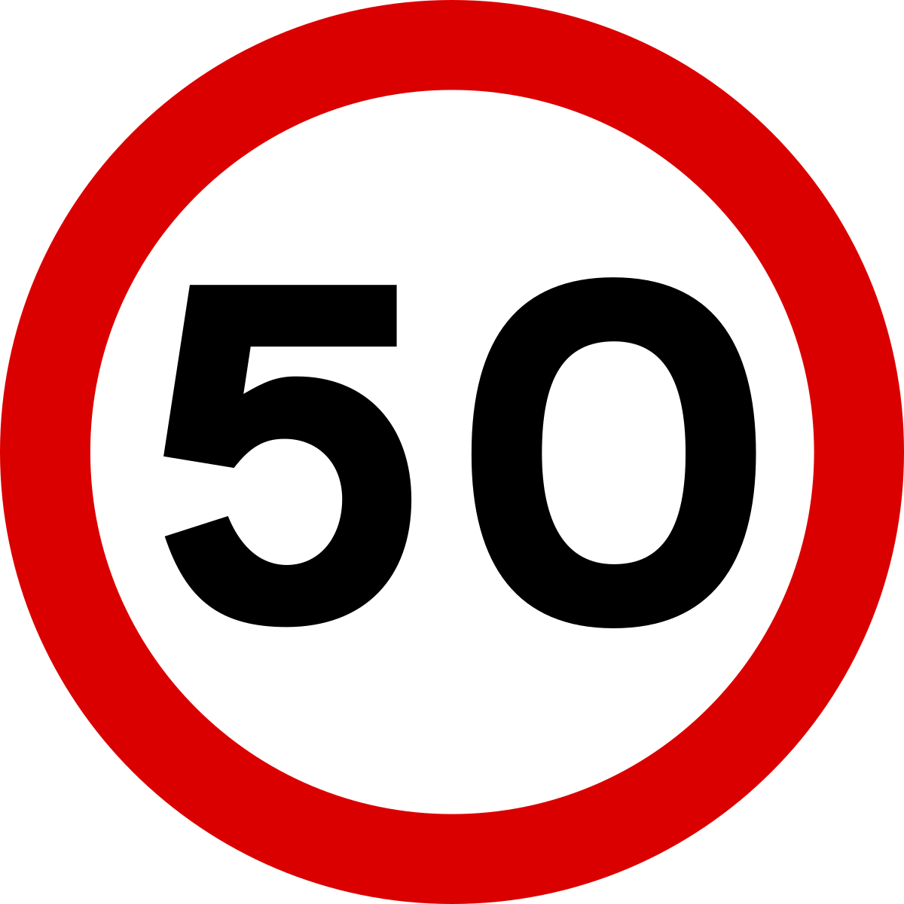
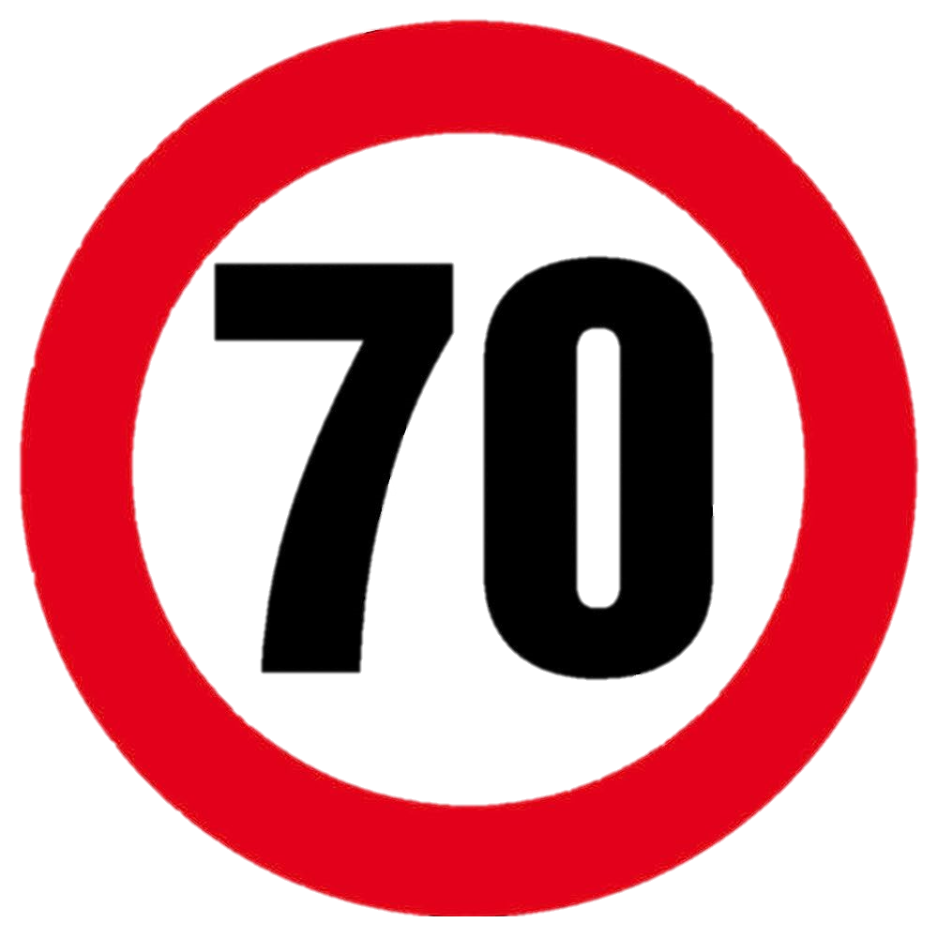
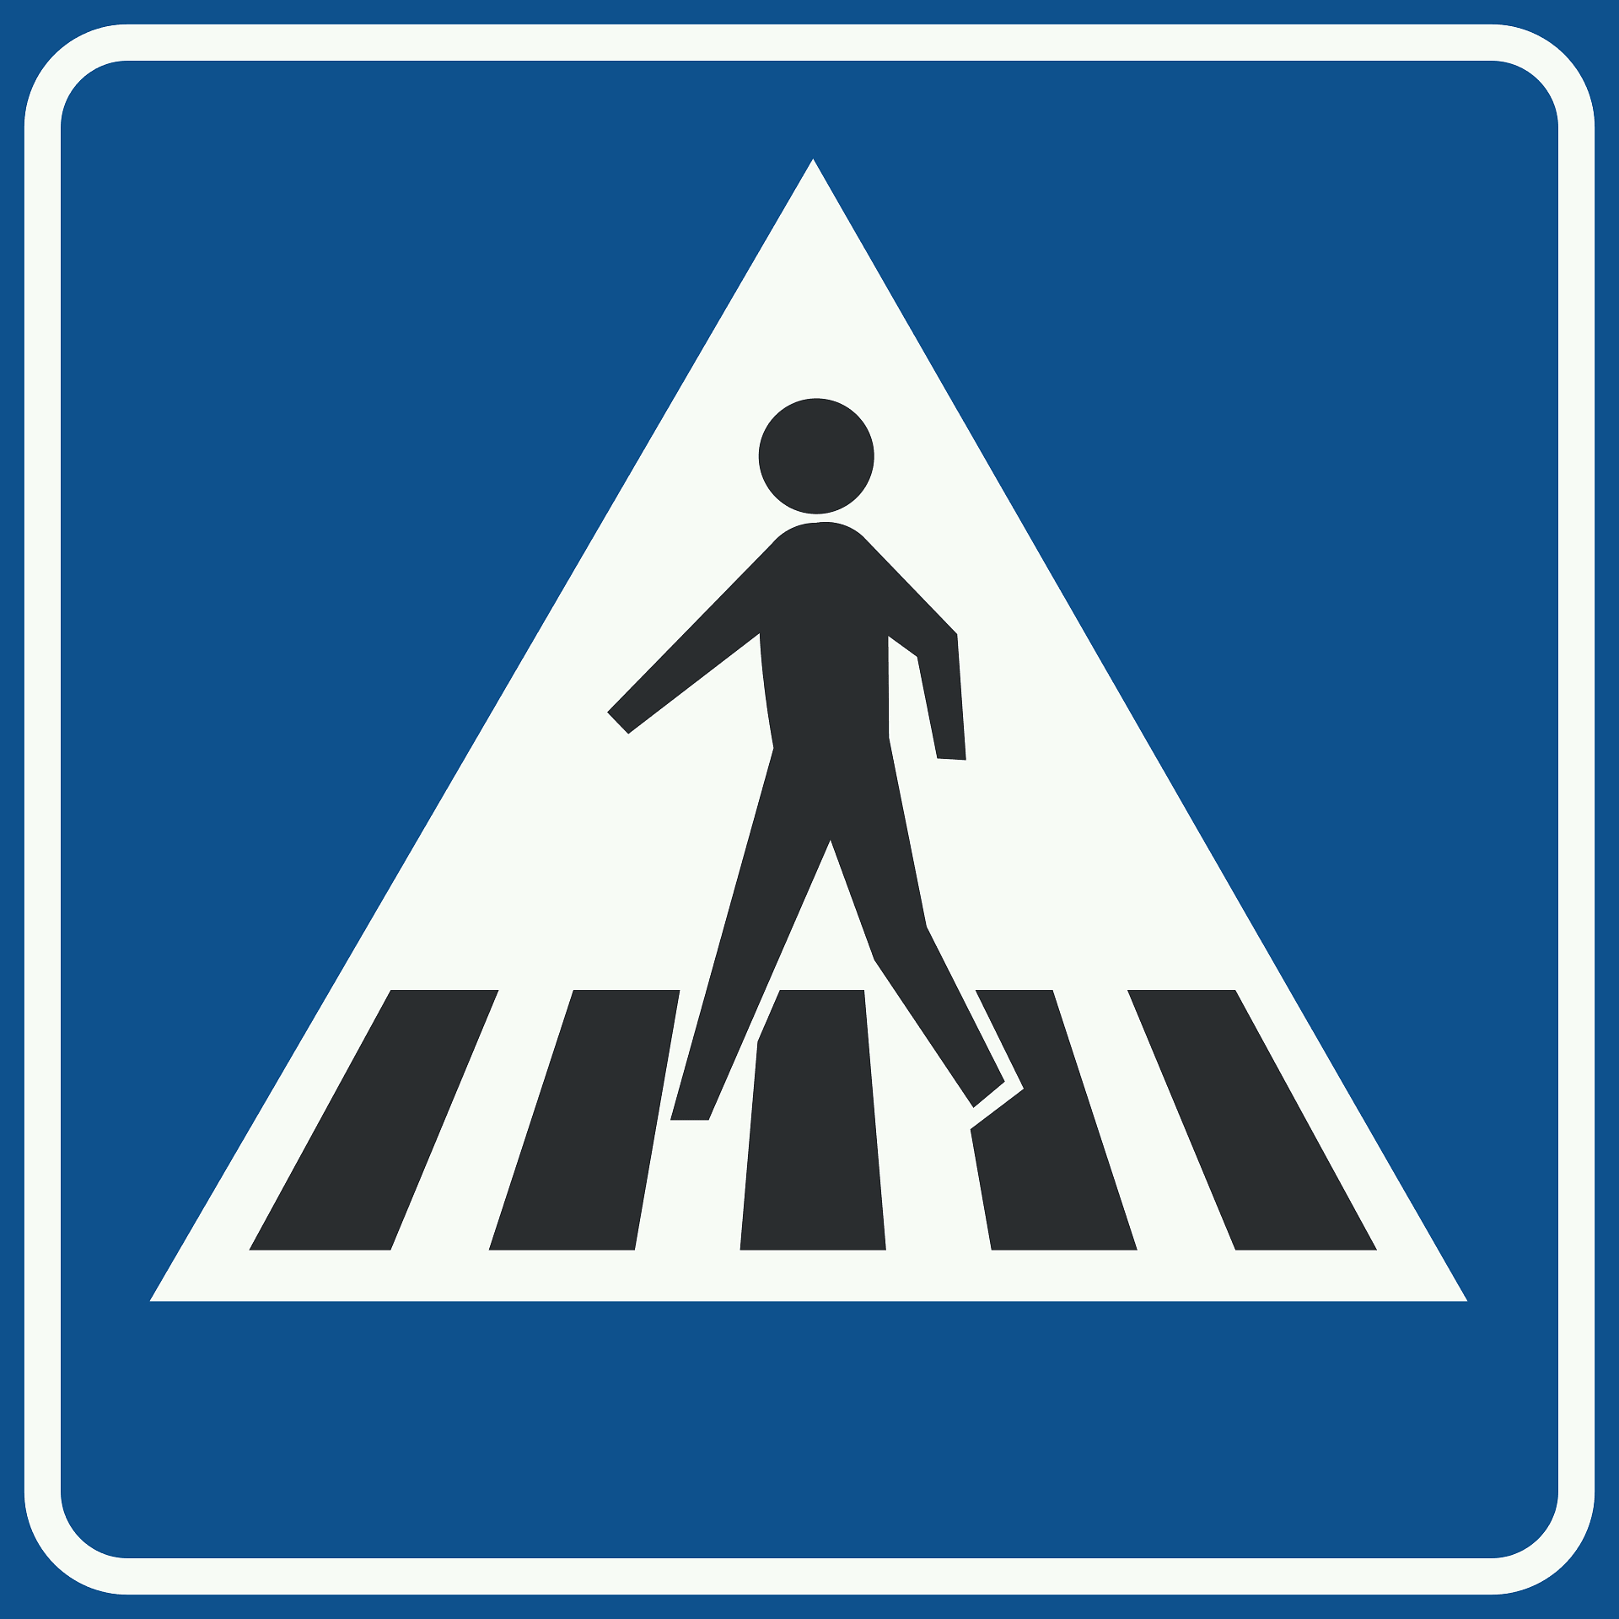
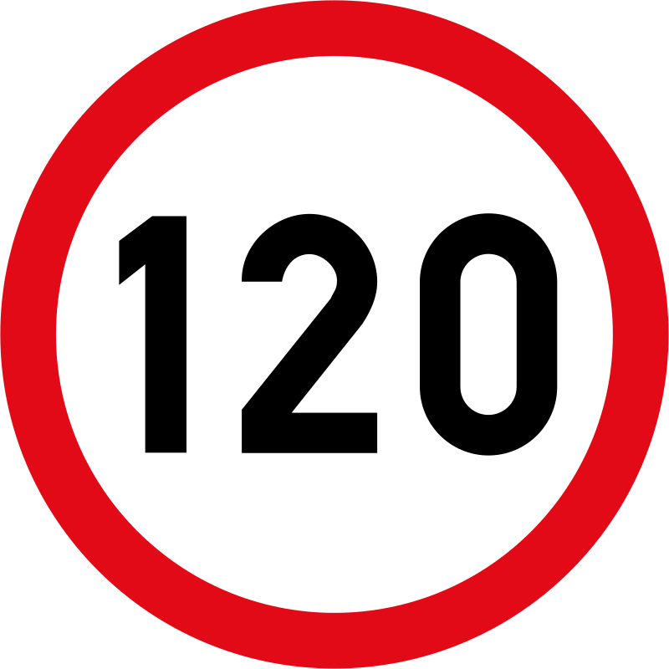
Classes
20 SPEED LIMIT
30 SPEED LIMIT
40 SPEED LIMIT
50 SPEED LIMIT
60 SPEED LIMIT
70 SPEED LIMIT
80 SPEED LIMIT
100 SPEED LIMIT
SLOW
PEDESTRIAL CROSSWAY
NO U-TURN
NO ENTRY
HUMP AHEAD
STOP
120 SPEED LIMIT

Slide 15
Source of Dataset
Several sources were used to get the database
S.No. | Source | Country
1 | Mendeley Data- (PMU ) | Saudi Arabia
2 | Kaggle - 1 | Unknown
3 | Kaggle - 2 | Unknown
4 | Kaggle - 3 | Unknown
Note:
All classes were take from 4 different sources

Slide 16
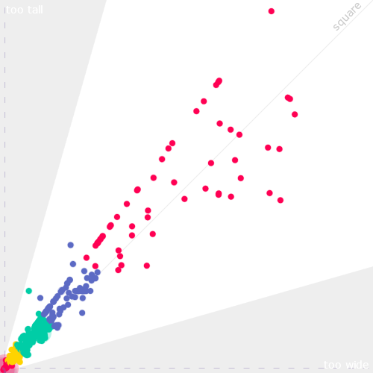
More information on the dataset
1024
50,50
1024
15
1949
1964
Classes
Images
Total Annotation

Slide 17
04
TOOL USED
AIE604 - Deep Learning Applications

Slide 18
Tool used
Visual Studio code
Python
To implement python code for real-time use
Main coding Language
Roboflow
To produce dataset and their labels
Google Colab
Ultralytics
To implement python code to import and train YOLOv8
Python library to import and train the YOLOv8 model

Slide 19
05
Experiment
AIE604 - Deep Learning Applications

Slide 20
Basic flow of the coding and the tool used
+
Python
Ultralytics
Preprocessing
Train
Deploy
Roboflow
Google Colab
Visual Studio code

Slide 21
Preprocessing (+ Augmentation)
Brightness
1949 Images
1949 Images
Import
Label
Resize
640 x 640
Final Dataset
5847 Images
Saturation
1949 Images
NOTE:
The data split to 70/29/1 i.e., Training/Validating/Testing

Slide 22
Training
Results
Display Confusion matrix
Display F1 score
Display Precision
Display Recall
Install Libraries
Import Libraries
Import Dataset
Training
Install Ultralytics
Install Roboflow
Import Ultralytics
Import YOLOv8
Import Roboflow
Import IPython
Importing the dataset from roboflow
Training the YOLO Model
Prediction
TIME TAKEN:
3 hours 45 minutes
Predict using model
NOTE:
Trained on 50 epochs

Slide 23
Deploy
Import Libraries
Deploy model
Run the webcam
Import Ultralytics
Import YOLOv8
Import cv2
Run the trained model
Visal Studio Code

Slide 24
06
Experiment Results
AIE604 - Deep Learning Applications

Slide 25
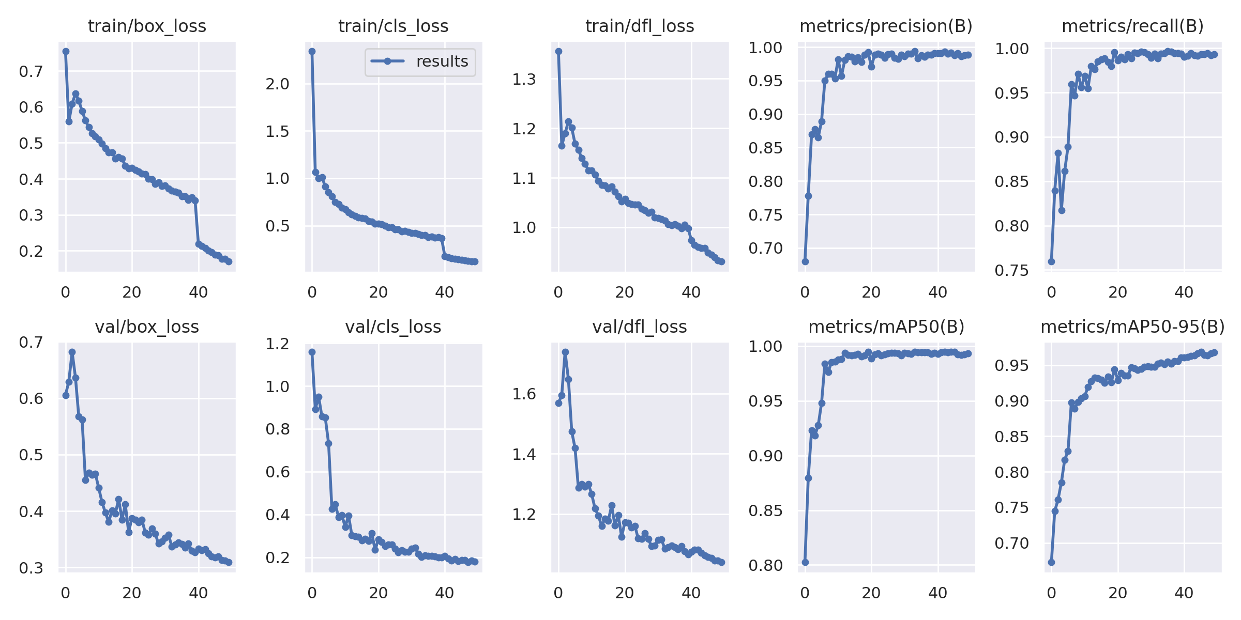
Loss and MAP Graph

Slide 26
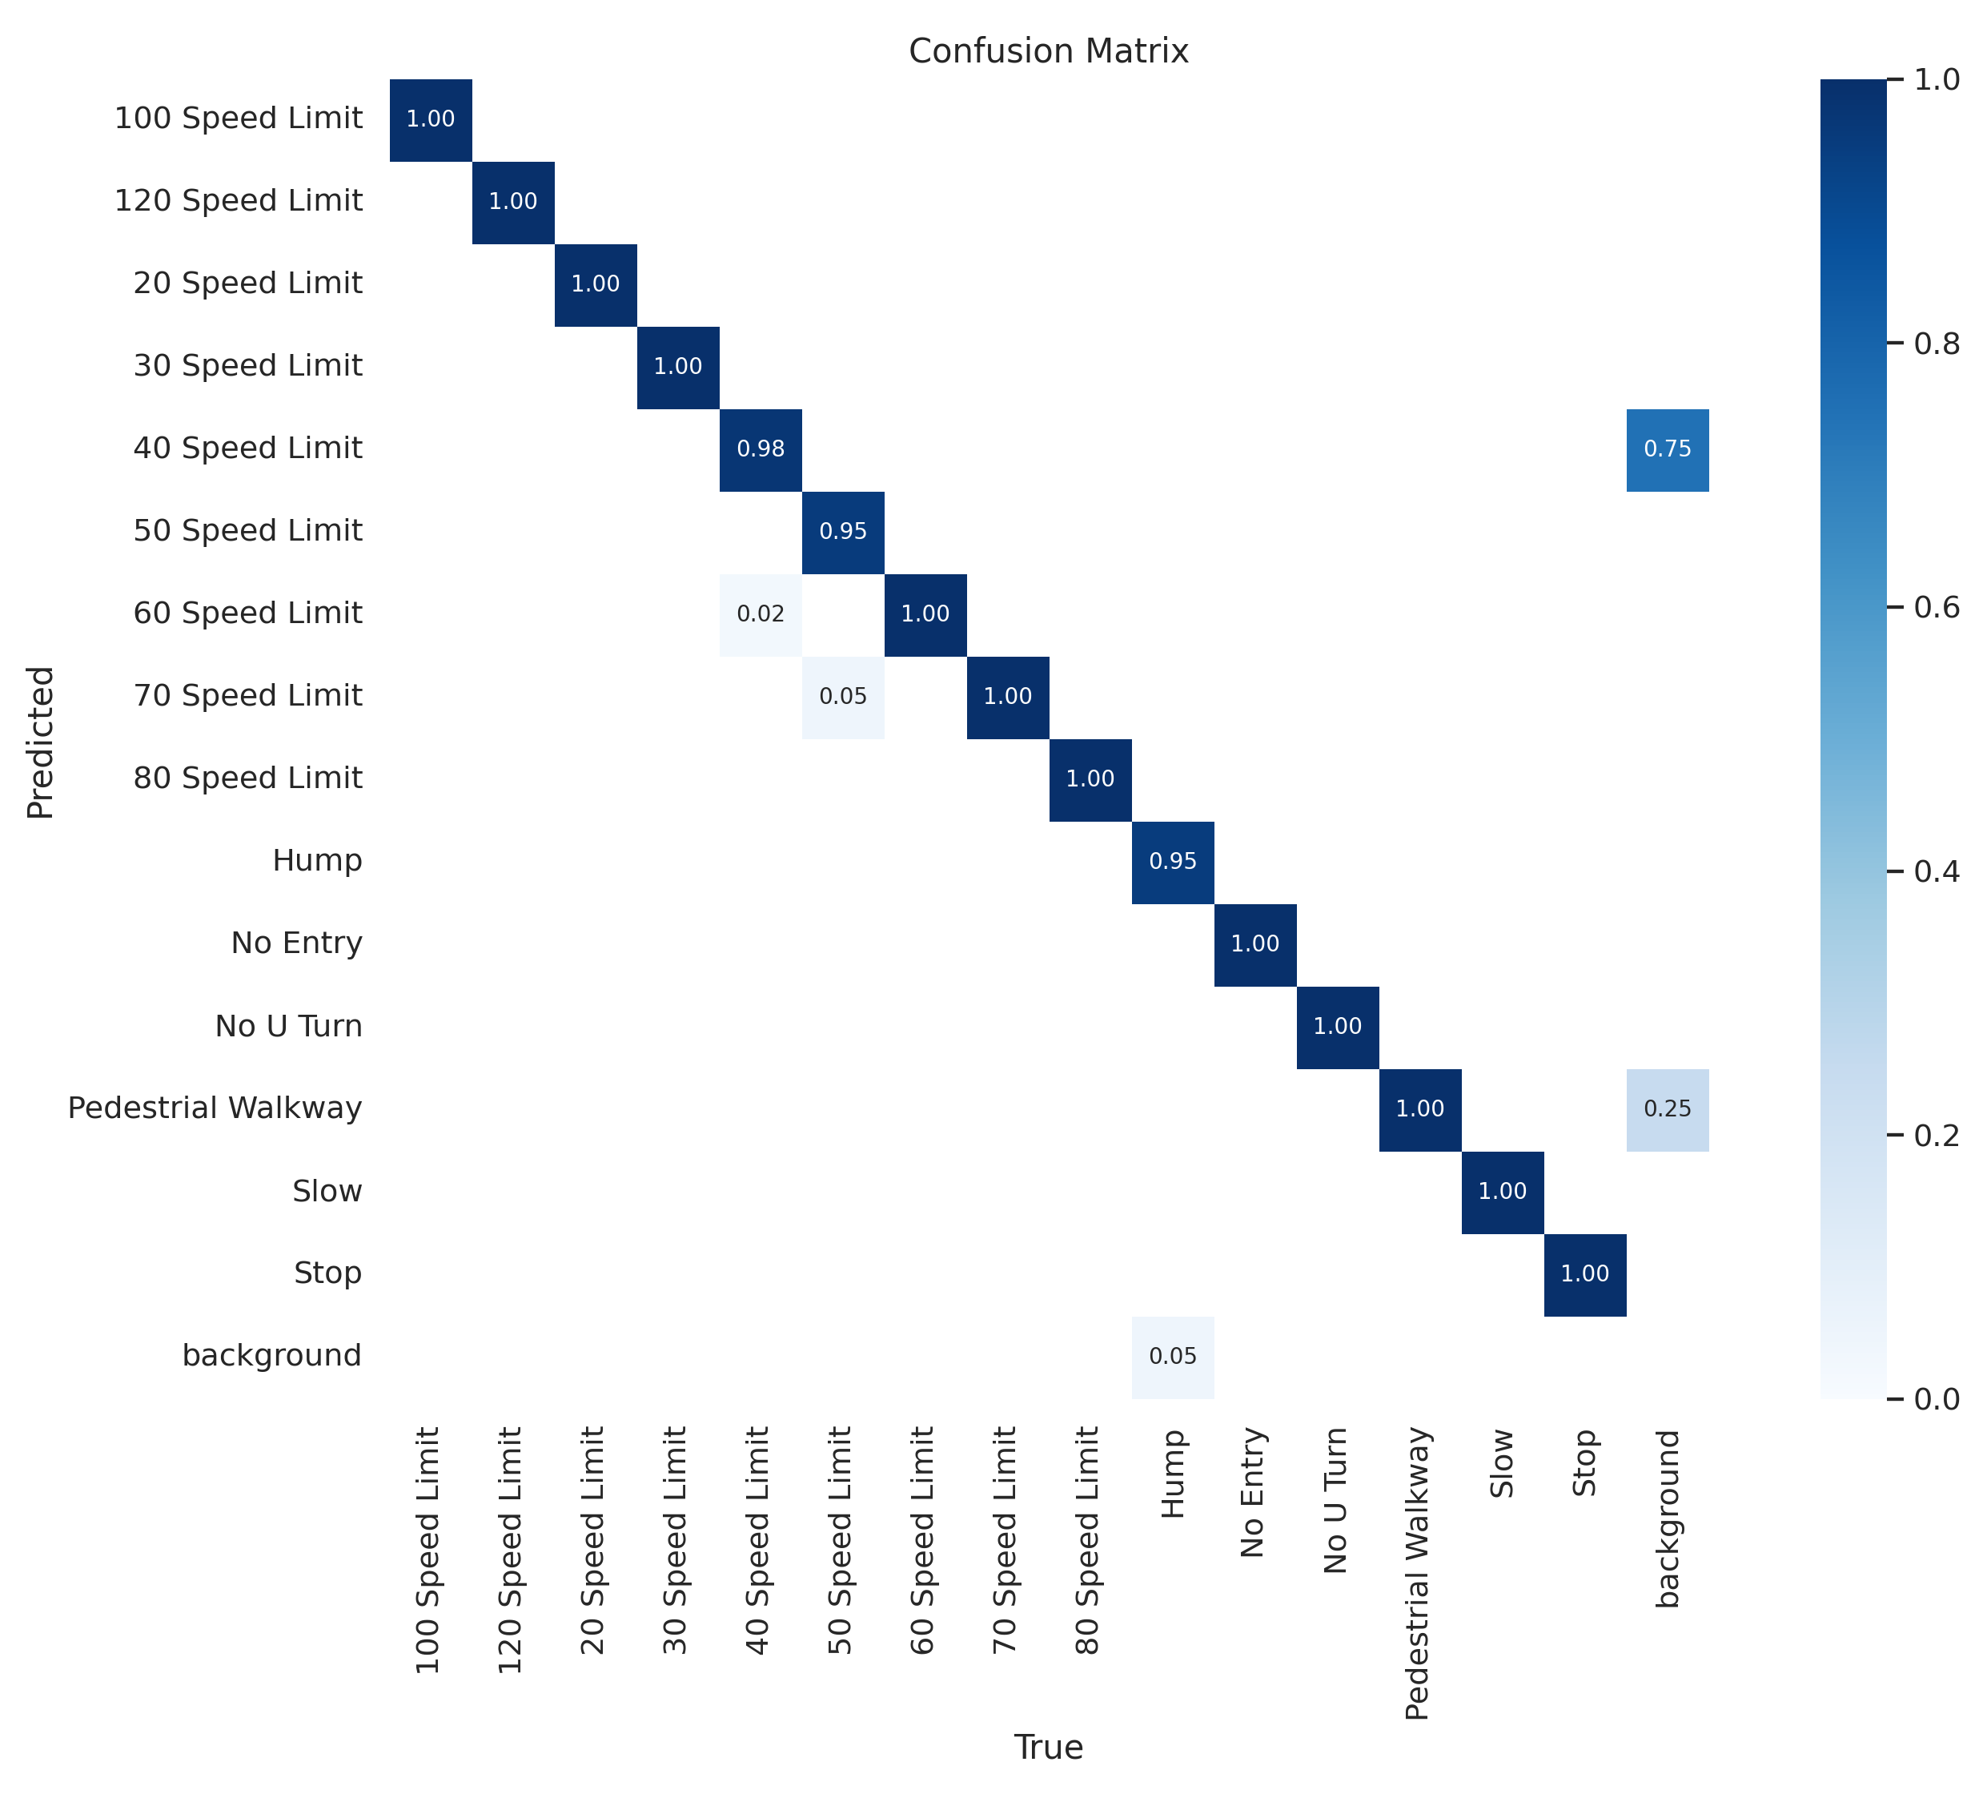
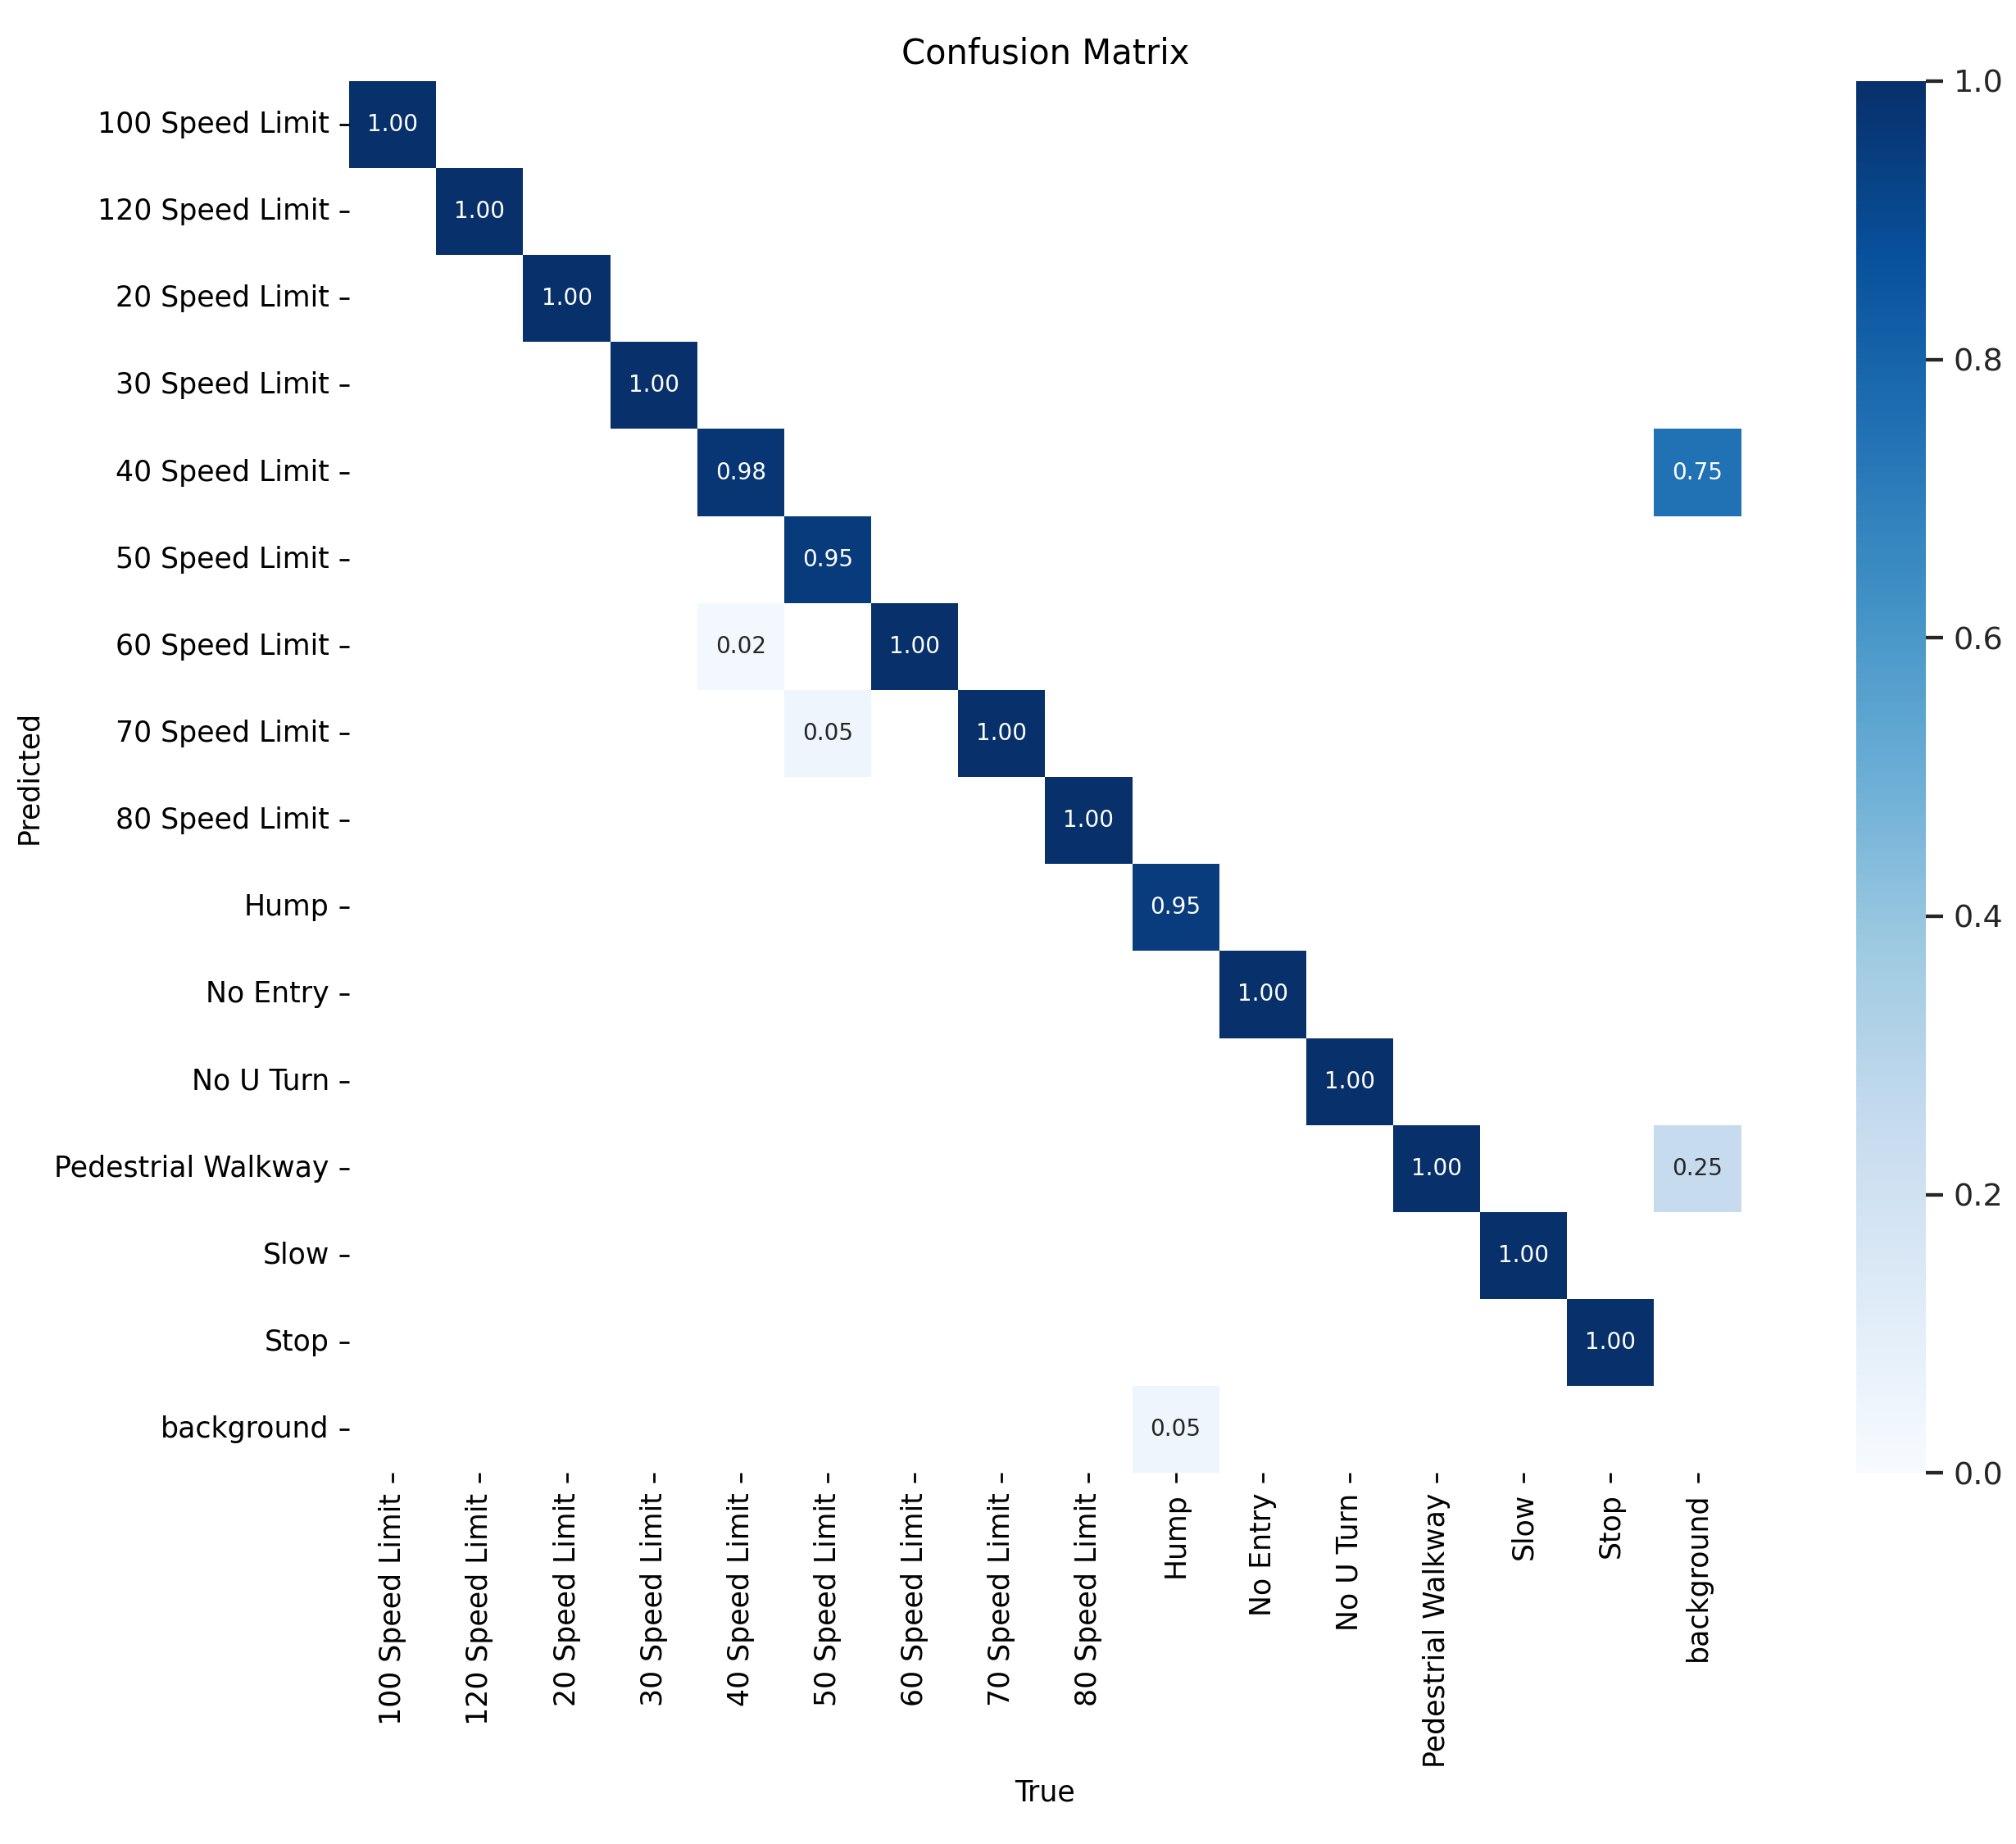
Confusion Matric
Training Data
Validating Data

Slide 27
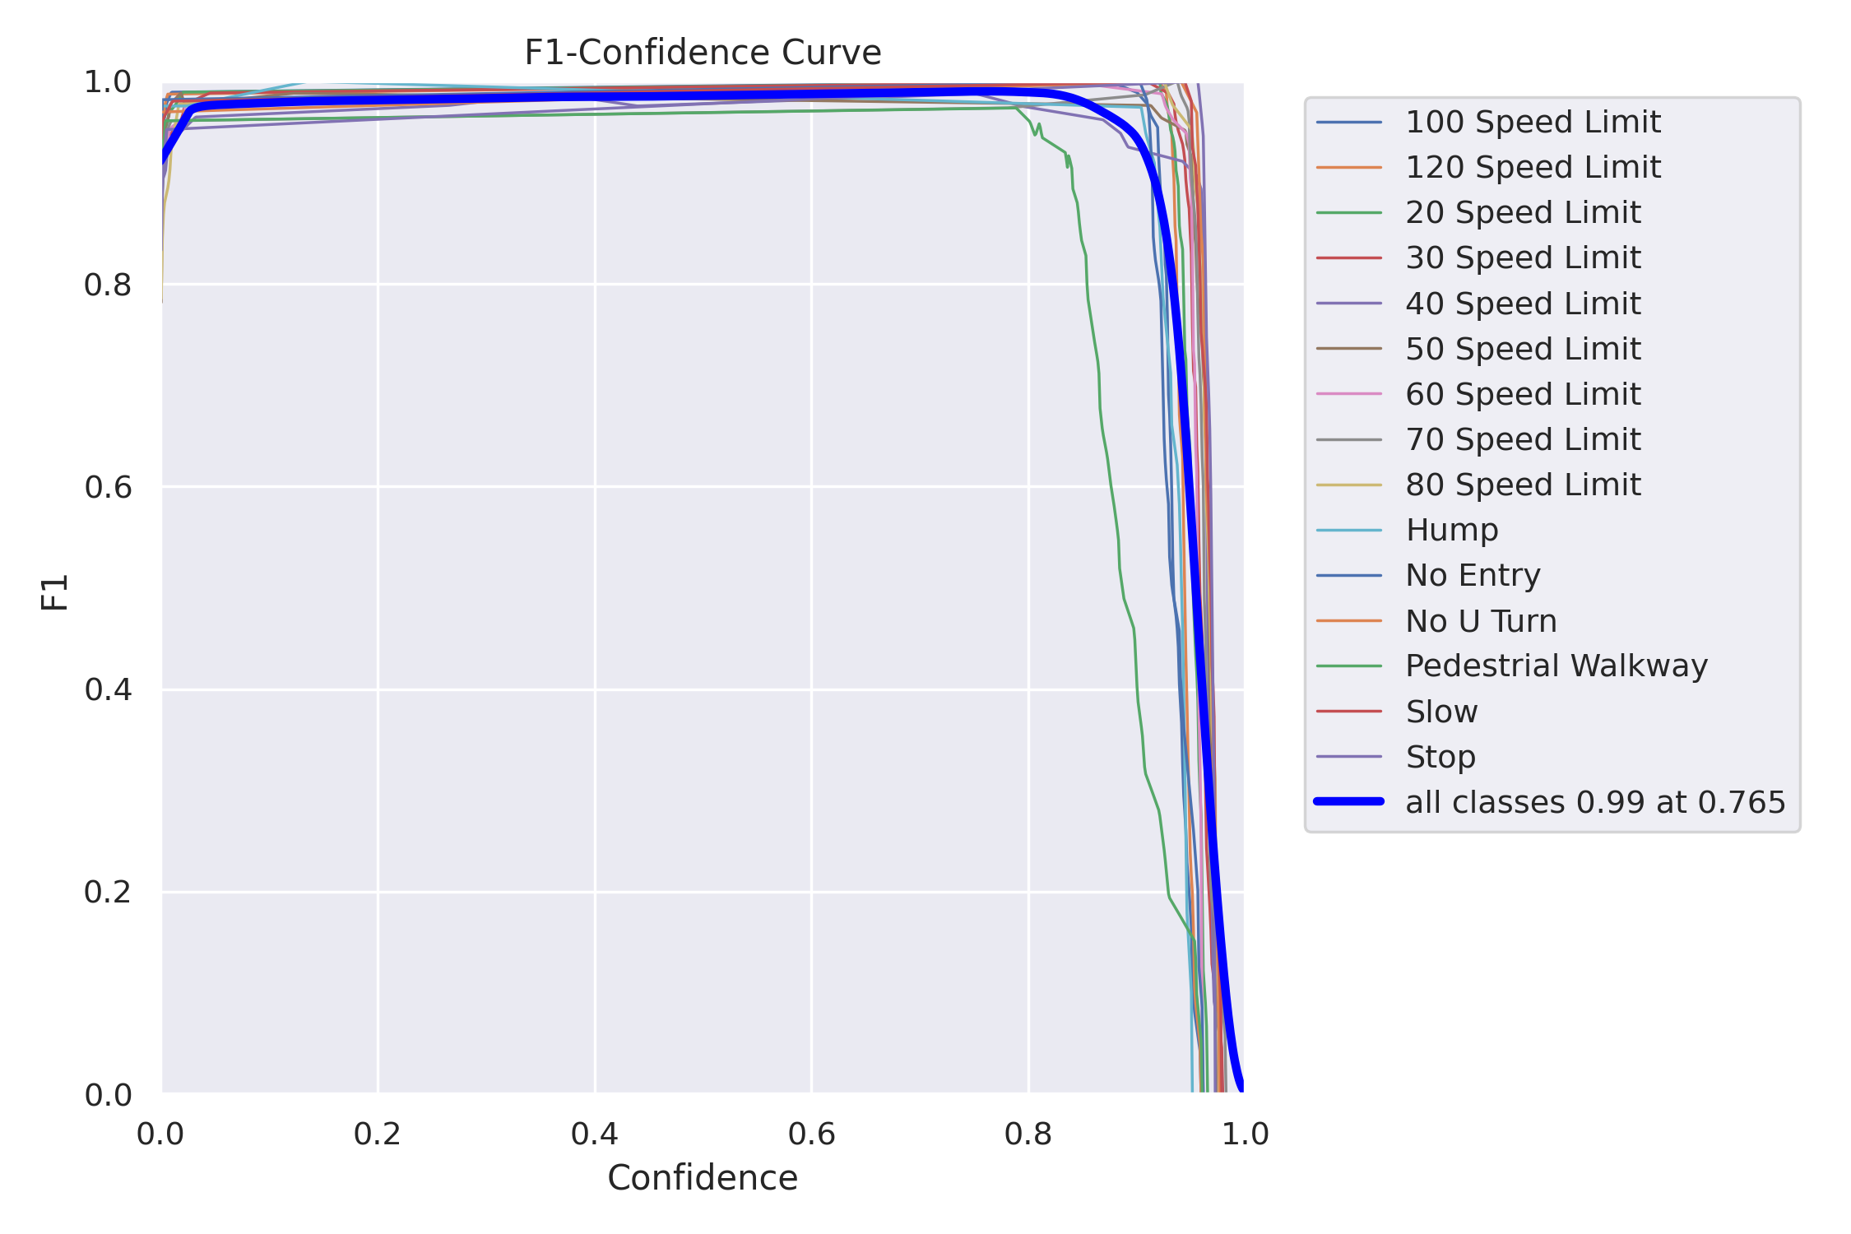
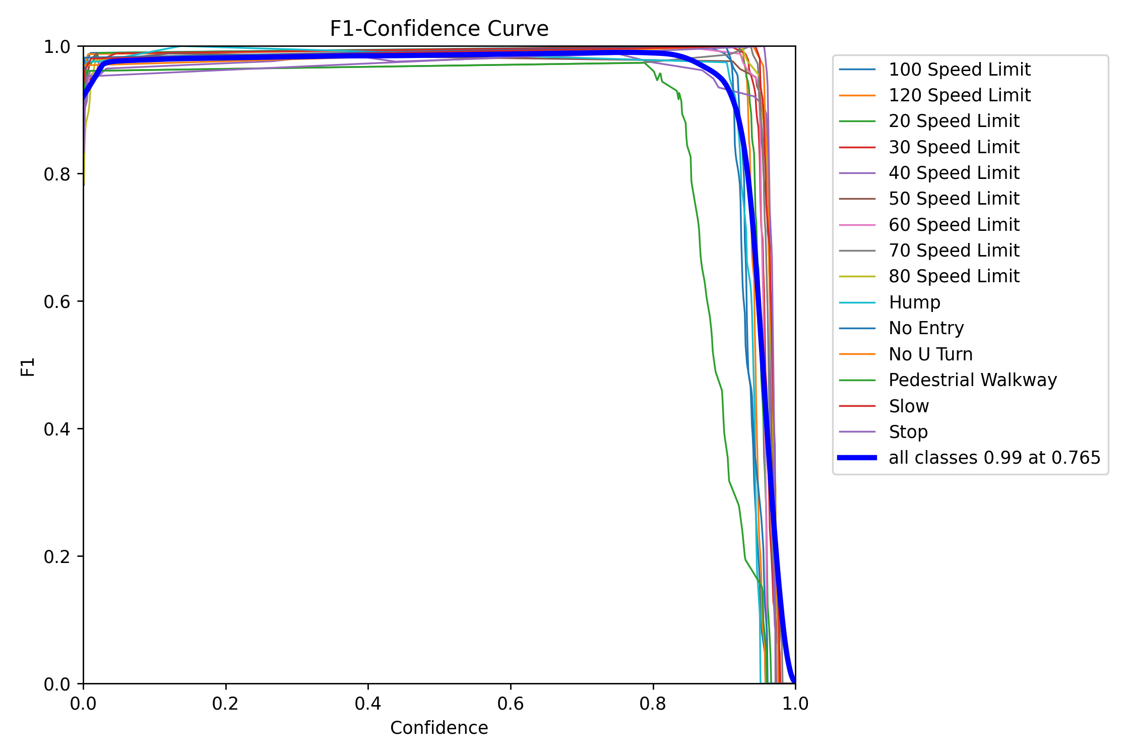
F1 Score
Training Data
Validating Data
$$F1=2∗(\frac{precision∗recall}{precision+recall})$$

Slide 28
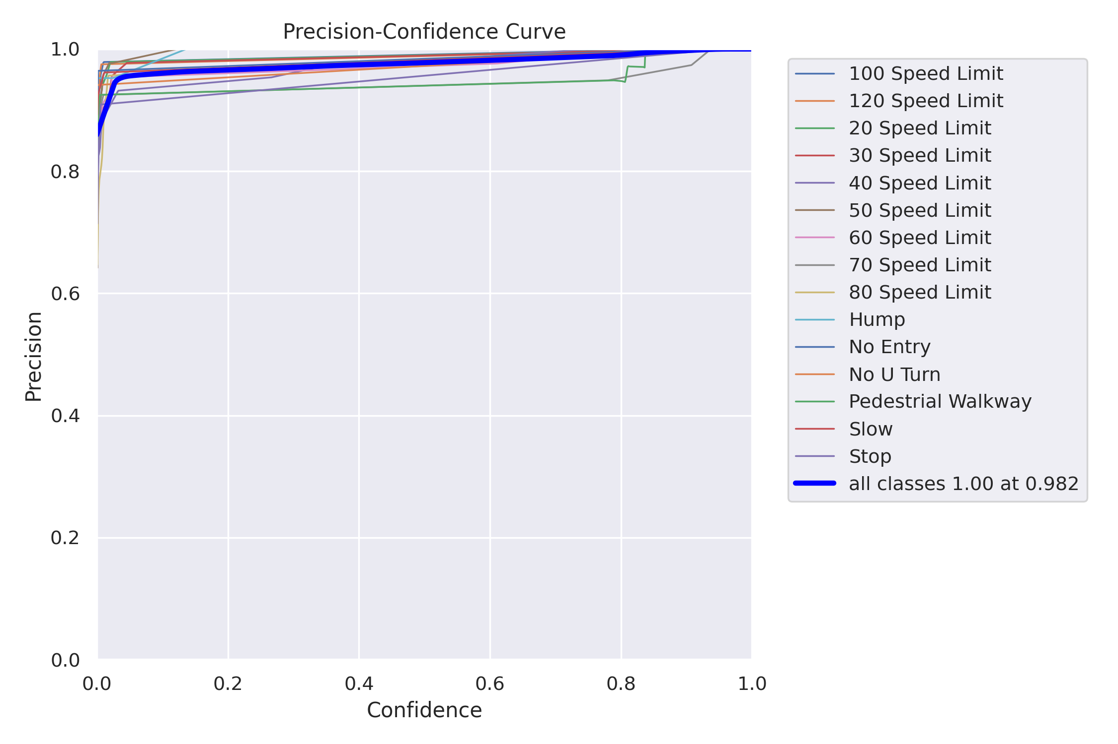
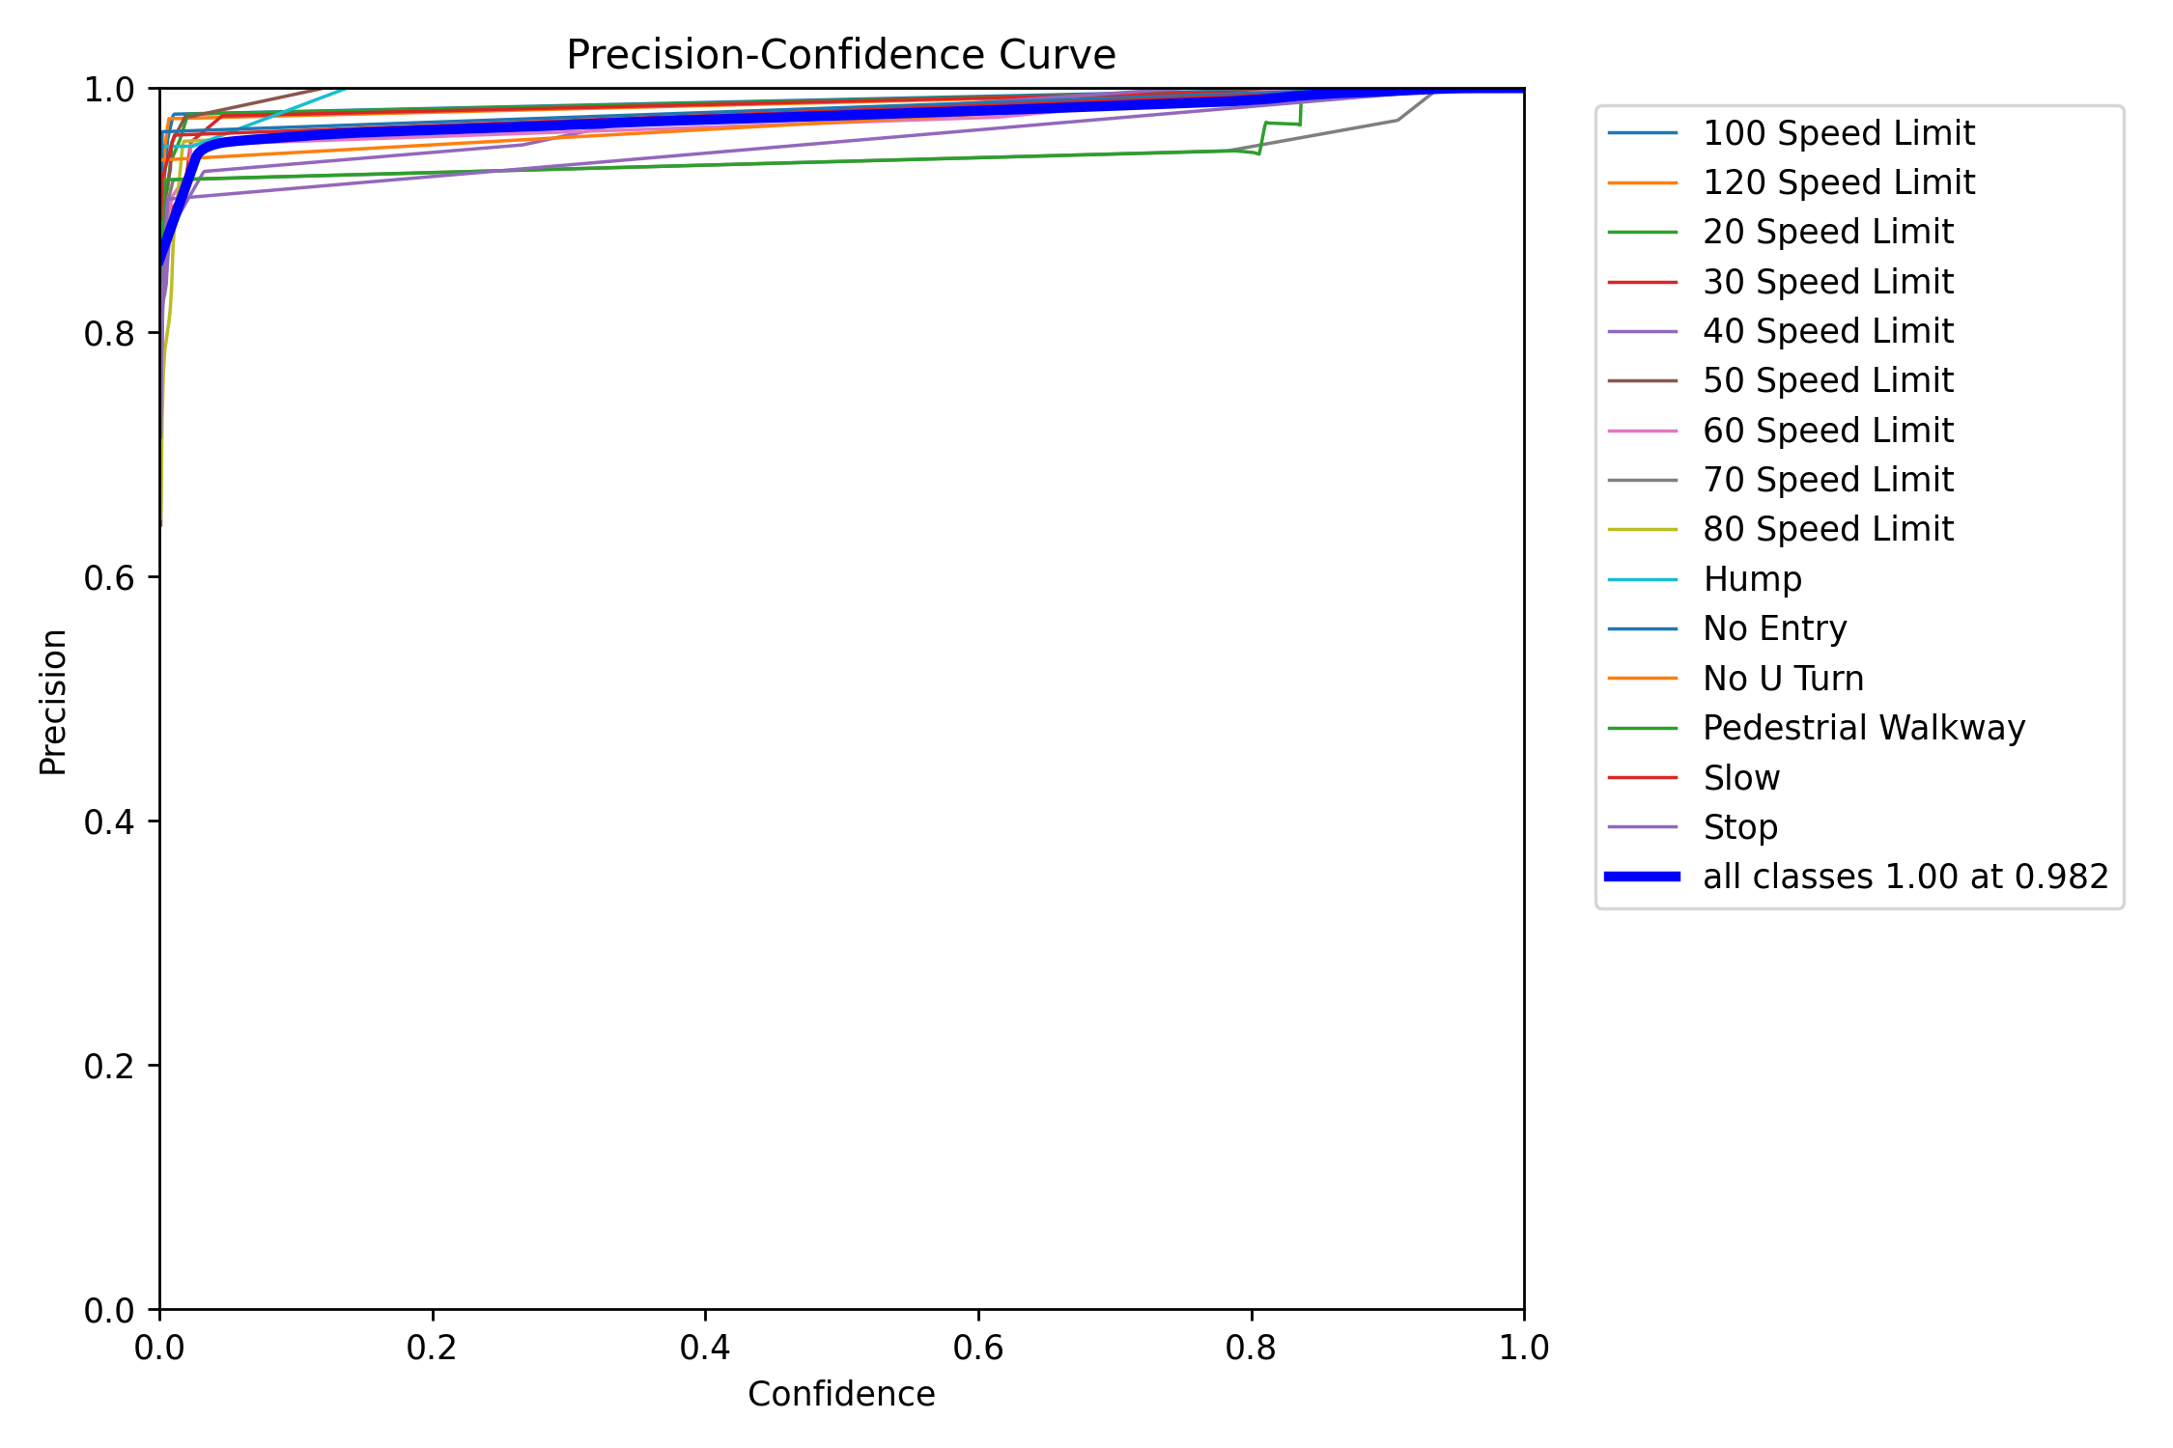
Precision
Training Data
Validating Data
$$Precision=(\frac{True Positive}{True Positive+False Positive})$$

Slide 29
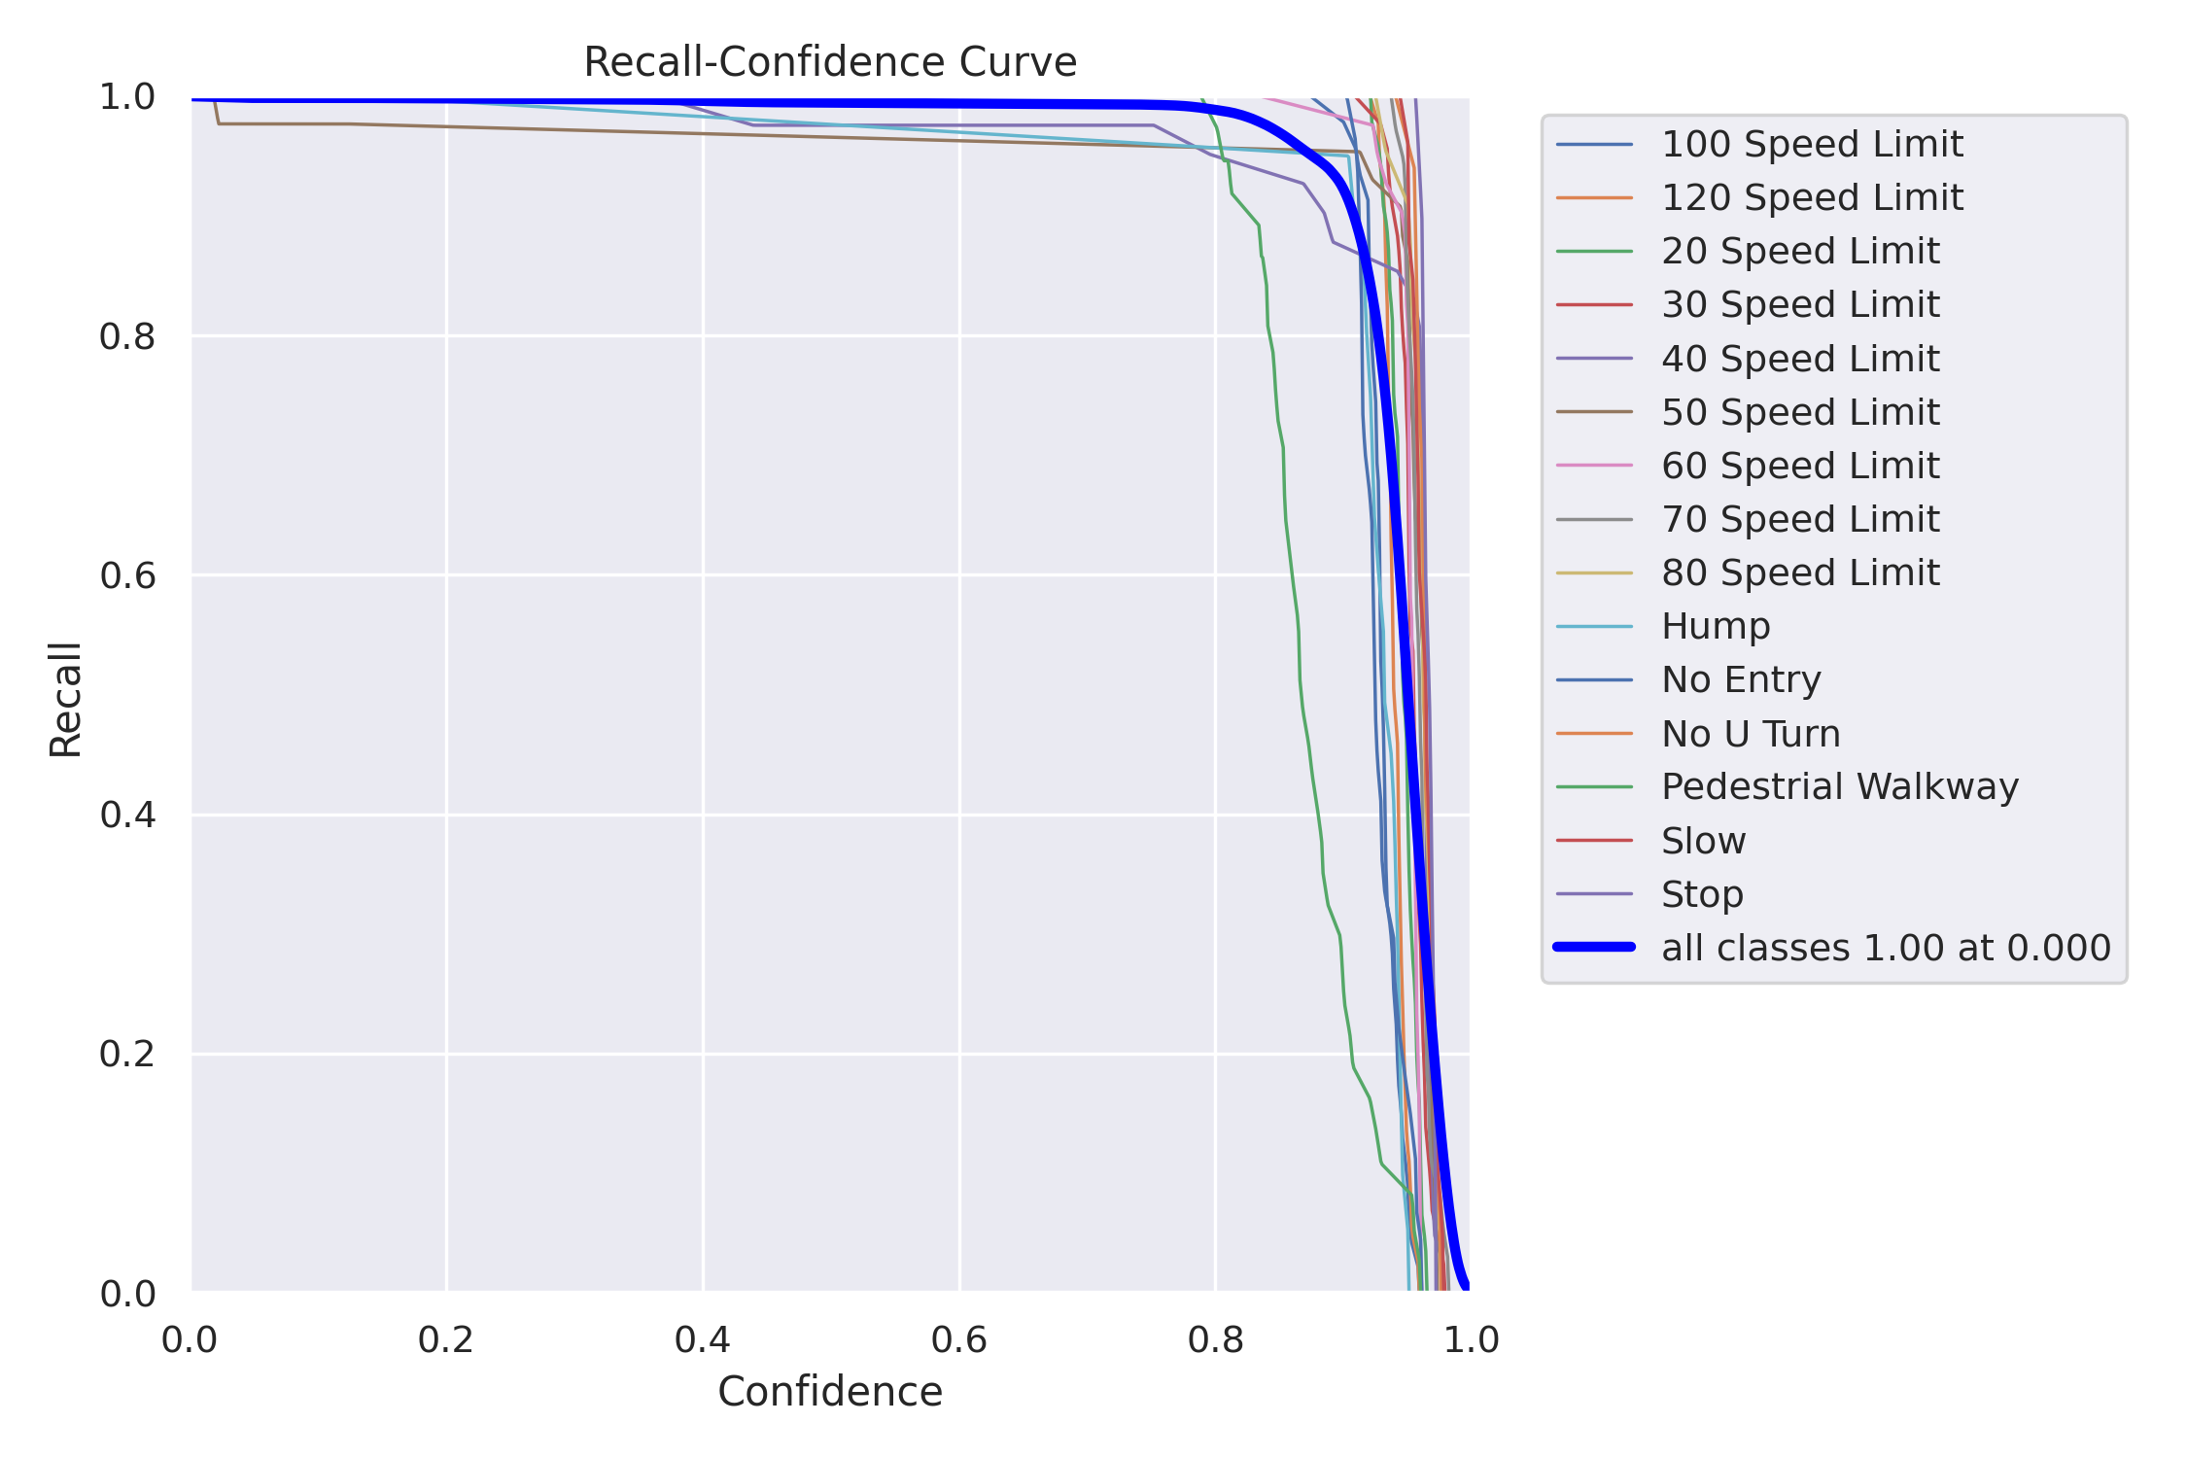
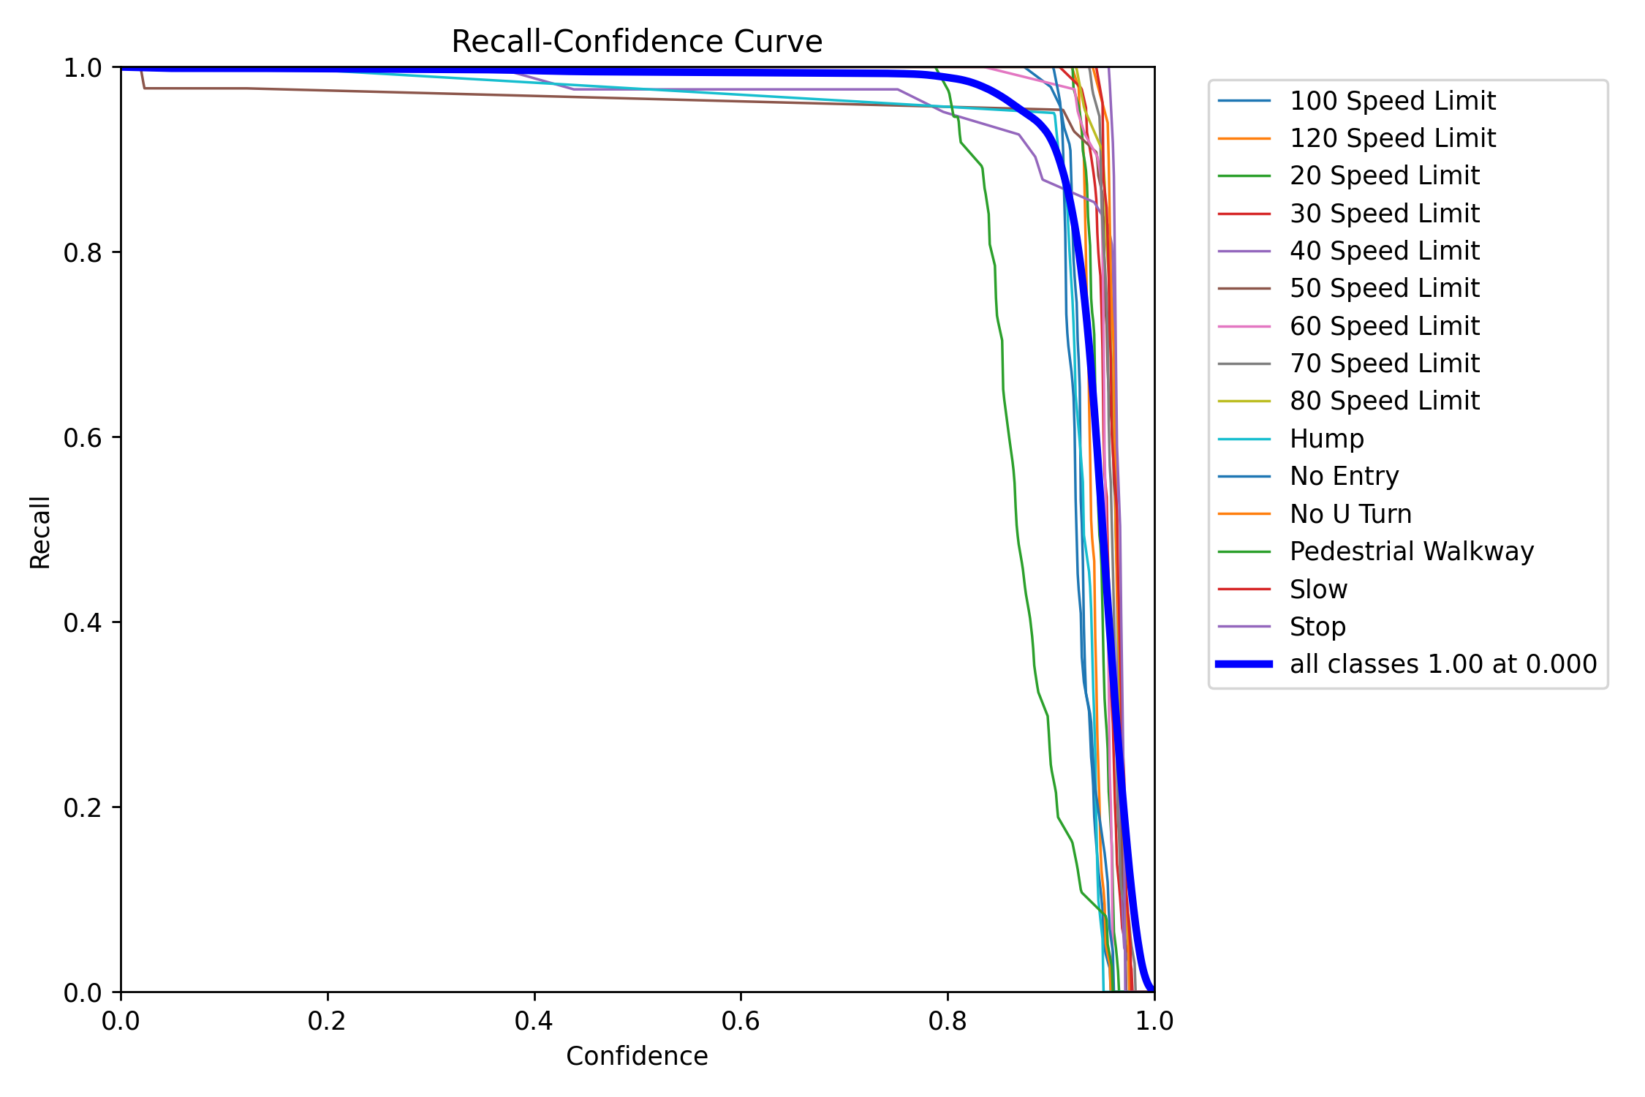
Recall
Training Data
Validating Data
$$Recall=(\frac{True Positive}{True Positive+False Negative})$$

Slide 30
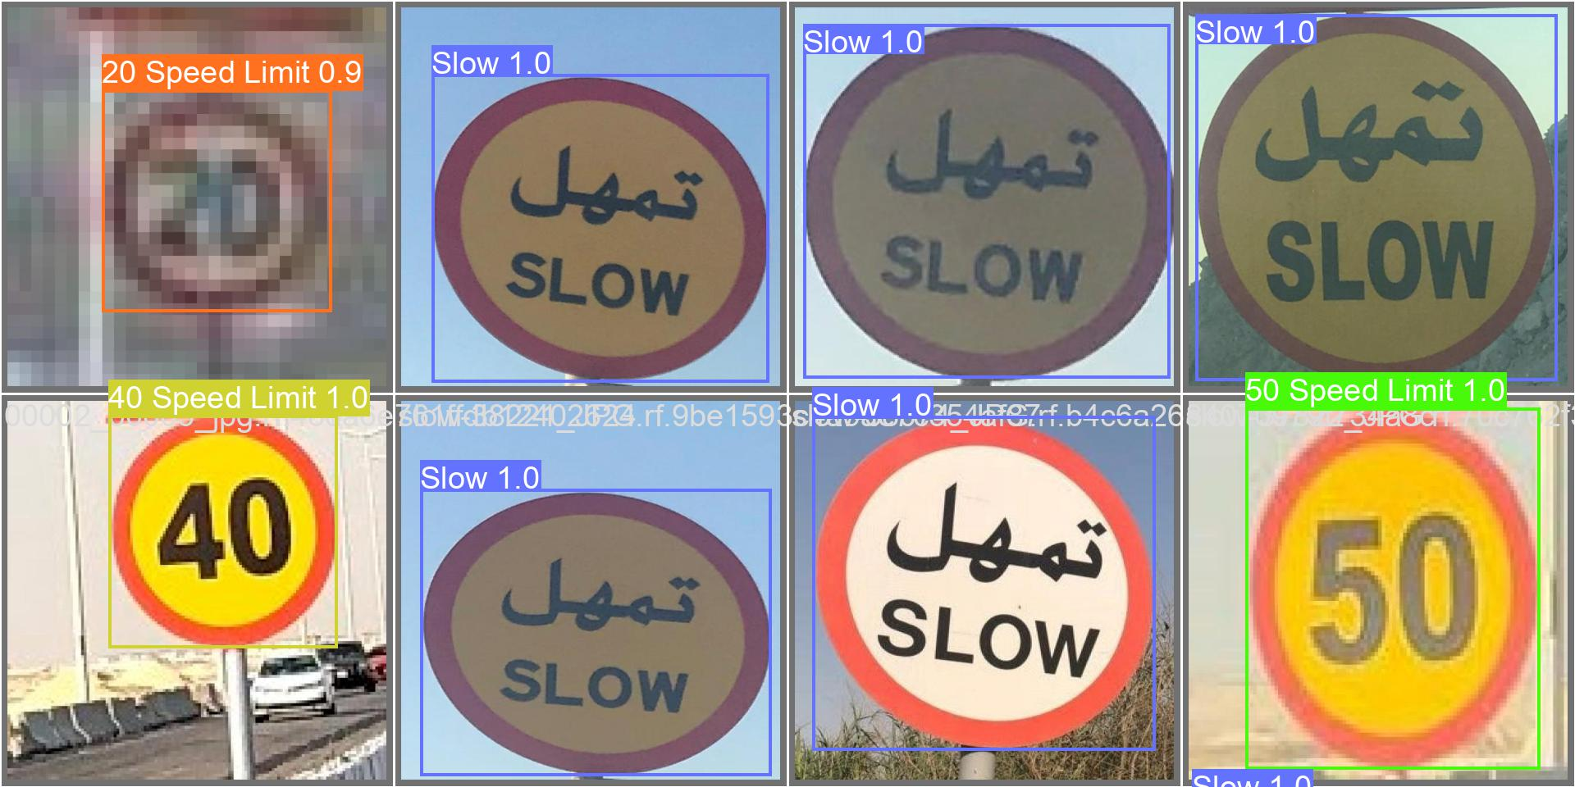
Prediction (Validation dataset)

Slide 31
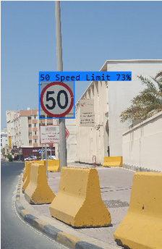
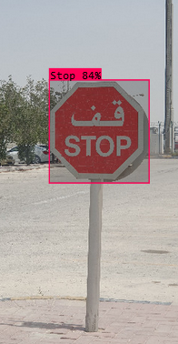
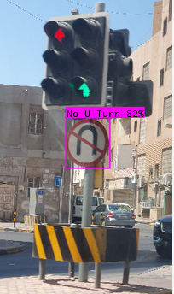
Prediction (Bahrain Road )

Slide 32
DEMO!
Using a webcam to show the YOLOv8 custom trained model.

Slide 33
07
CONCLUSION
AIE604 - Deep Learning Applications

Slide 34
CONCLUSION
In conclusion, we have shown that YOLOv8 is effective for recognizing traffic signs in Bahrain. Our method showed promise in terms of precision, recall, and F1 score, indicating that it might increase traffic safety and decrease infractions. To address the limitations of our study and examine the generalizability and scalability of our methodology, additional study is required.

Slide 35
THANKS!
DO YOU HAVE ANY QUESTIONS?
By : Ahmed Sadri

Slide 36
REFERENCES
[5] Model Structure of YOLOv8 Detection Models. Ultralytics, 2023.
[6] J. R. Terven and D. M. Córdova-Esparza, “A COMPREHENSIVE REVIEW OF YOLO: FROM YOLOV1 TO YOLOV8 AND BEYOND,” ACM COMPUTING SURVEYS.
[7] Effecient Frontier of Object Detection on COCO Measured on NVIDIA T4. Deci Research Team, 2023.
[8] M. M. Vikram, A YOLO Based Approach for Traffic Sign Detection, Apr. 2018. [1] C.
[9] Y. Wang and R. C. Yue, Traffic Sign Detection using You Only Look Once Framework.
[10] N. S. Artamonov and P. Y. Yakimov, “Towards real-time traffic sign recognition via Yolo on a mobile GPU,” Journal of Physics: Conference Series, vol. 1096, p. 012086, 2018. doi:10.1088/1742-6596/1096/1/012086
[11] D. V. Filatov, K. V. Ignatev, A. V. Deviatkin, and E. V. Serykh, “Application of machine learning methods for traffic signs recognition,” IOP Conference Series: Materials Science and Engineering, vol. 315, p. 012008, 2018. doi:10.1088/1757-899x/315/1/012008
[12] C. Gong, A. Li, Y. Song, N. Xu, and W. He, “Traffic sign recognition based on the yolov3 algorithm,” Sensors, vol. 22, no. 23, p. 9345, 2022. doi:10.3390/s22239345

Slide 37
REFERENCE OF DATASET
[1] S. malik, “Traffic_set,” Kaggle, https://www.kaggle.com/datasets/srthk5/traffic-set (accessed Jun. 9, 2023).
[2] HarelC, “Traffic signs dataset,” Kaggle, https://www.kaggle.com/datasets/harelc/traffic-signs-dataset (accessed Jun. 9, 2023).
[3] G. Latif, “Arts: Arabic traffic sign dataset,” Mendeley Data, https://data.mendeley.com/datasets/4tznkn45mx/1 (accessed Jun. 9, 2023).
[4] Xiaxxx, “Pieton,stop,50,30,speed_bump,” Kaggle, https://www.kaggle.com/datasets/xiaxxx/geicar-pivoane (accessed Jun. 9, 2023).

