Slide 1








UNIVERSITY OF BAHRAIN
COLLEGE OF ENGINEERING
ELECTRICAL AND ELECTRONICS ENGINEERING
MS. ARTIFICIAL INTELLIGENT
SmartGuard
Camera Motion Detection
Ammar Yaser

Slide 2




Contents
01
02
03
Introduction
System Desgin
Implementation
04
05
Show Case
Conclusion
Notes:
Our content is divided into Five pieces, Starting with the Literatures

Slide 3

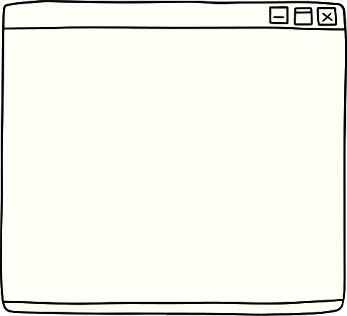


01
Introduction
What is the goal of this project?
This project aims to build security camera integrated with motion detection. While it solves the gap in the software maintenance part. Moreover, it is an application of the concepts that been discussed in the course.

Slide 4

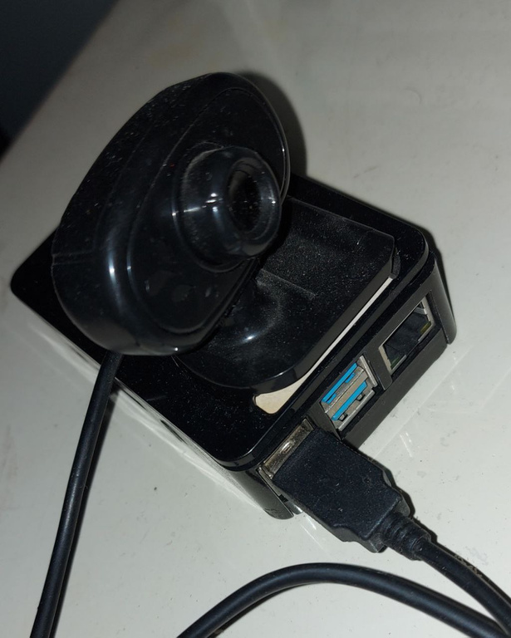
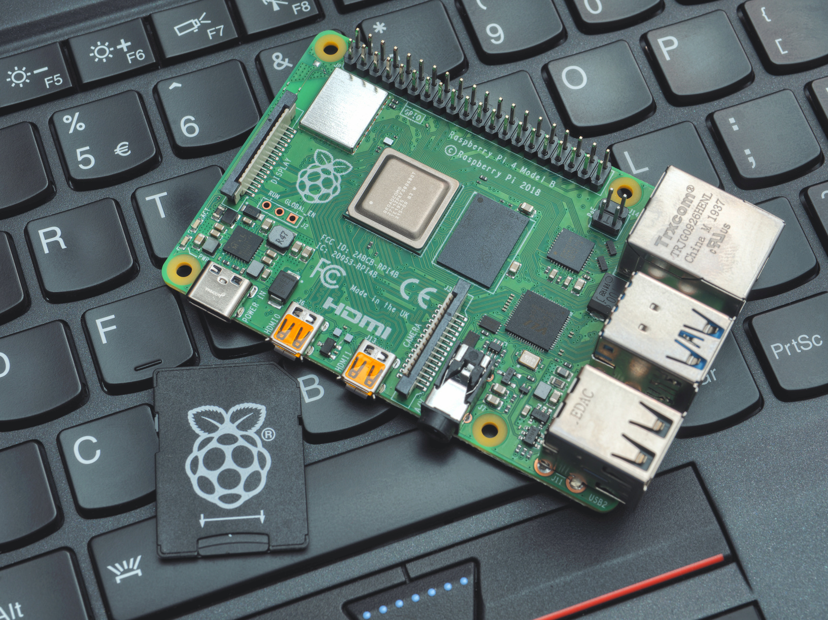

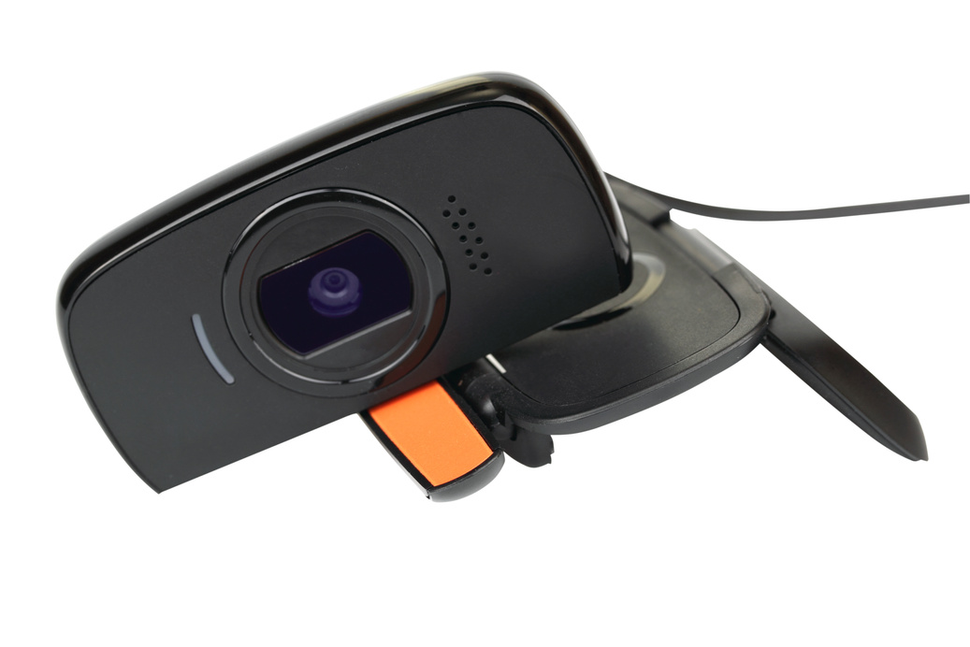


02
Hardware
Raspberry Pi 4
+
Webcam

Slide 5





Software
PuTTY
Amazon Web Services
RealVNC
S3 \ DynamoDB \ IoT Core (MQTT)
Kinesis Live Video Streaming (HLS)
Identity and Access Management (IAM)
Secure Shell (SSH)
Remote Framebuffer (RFB)

Slide 6
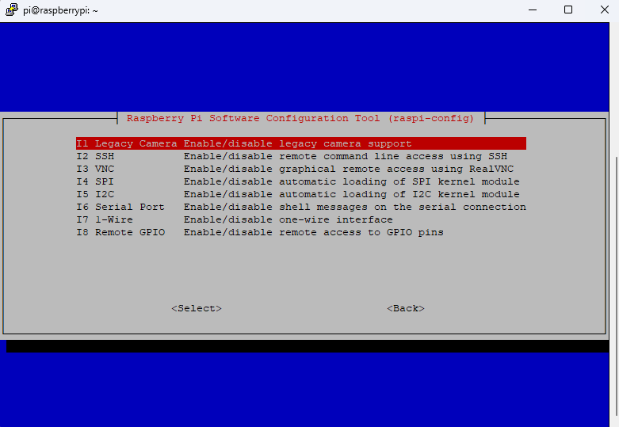
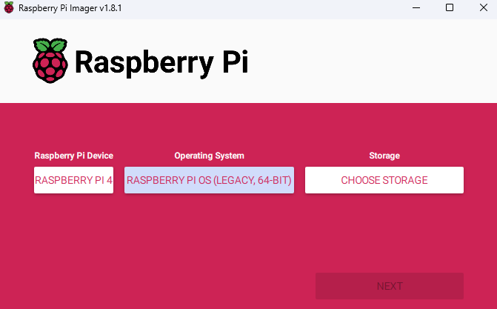
03
Raspberry Pi OS
Legacy Version

Slide 7
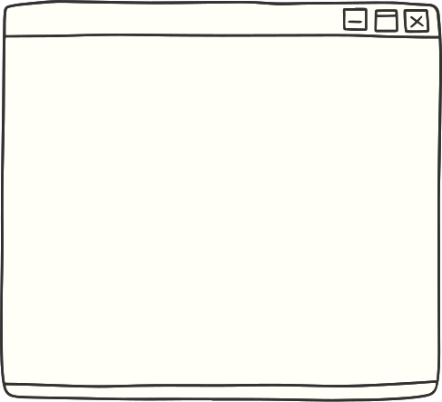
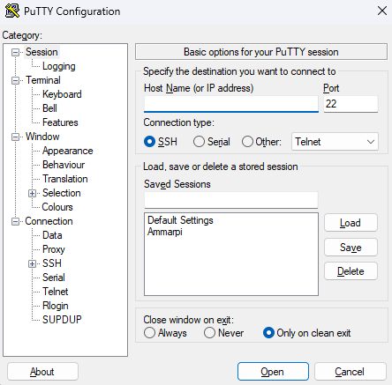
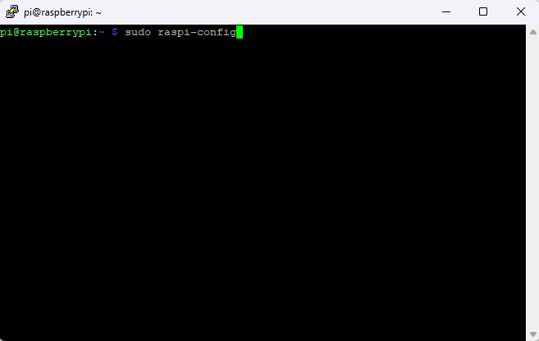
PuTTY
PuTTY is a free and open-source terminal emulator, serial console and network file transfer application. It supports several network protocols like SSH (Secure Shell).

Slide 8
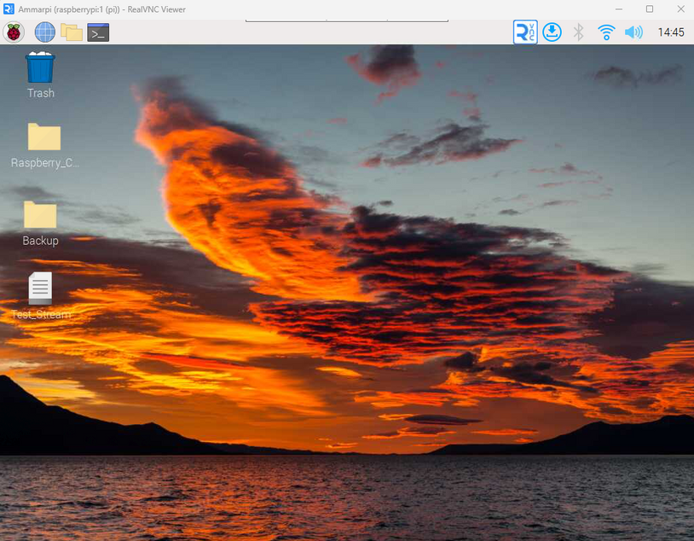
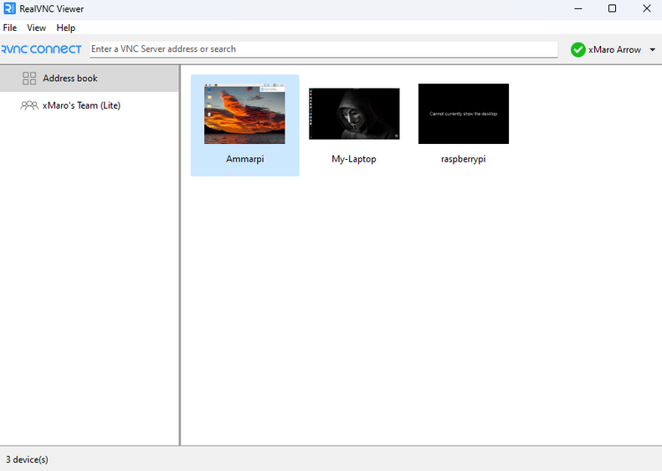
RealVNC
RealVNC is a company that provides remote access software. Their VNC Connect software consists of a server (VNC Server) and client (VNC Viewer) application, which exchange data over the RFB protocol to allow the Viewer to control the Server's screen remotely.

Slide 9

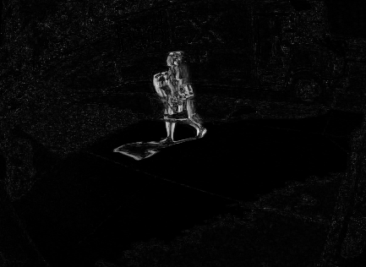
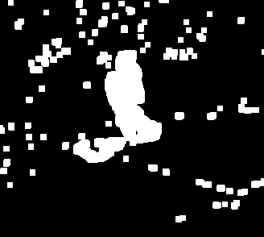
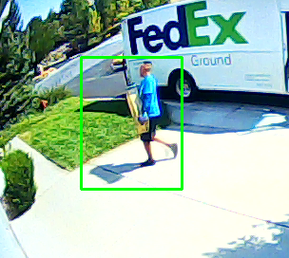
Motion Detection
Grayscale
Gaussian blur
Thresholding
Dilate the thresholded
Contours
Draw Rectangle

Slide 10

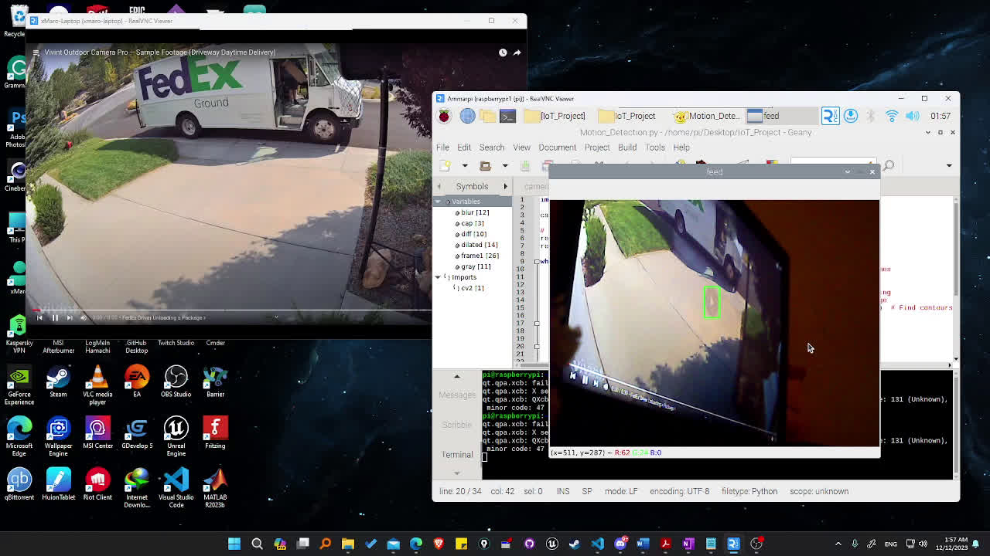
Motion Detection

Slide 11
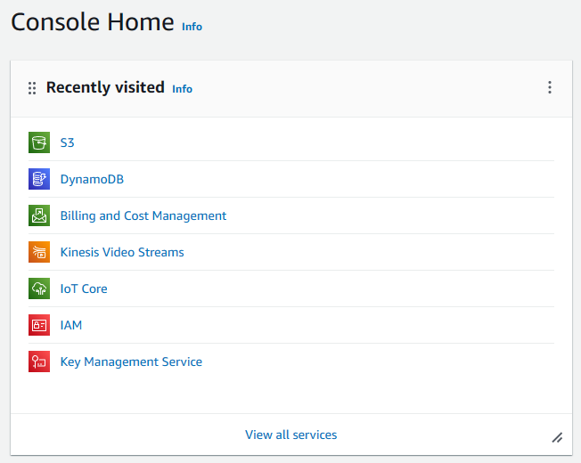

Amazon Web Services

Slide 12

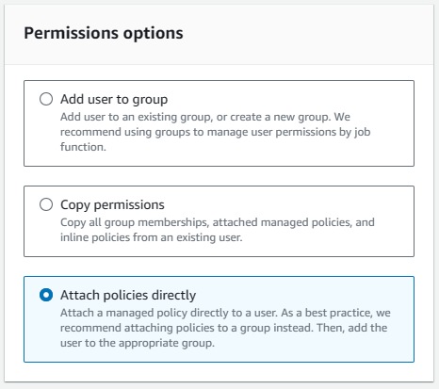
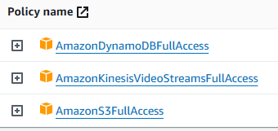


Identity and Access Management (IAM)

Slide 13

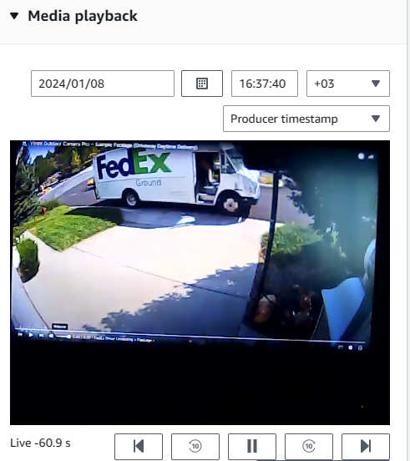
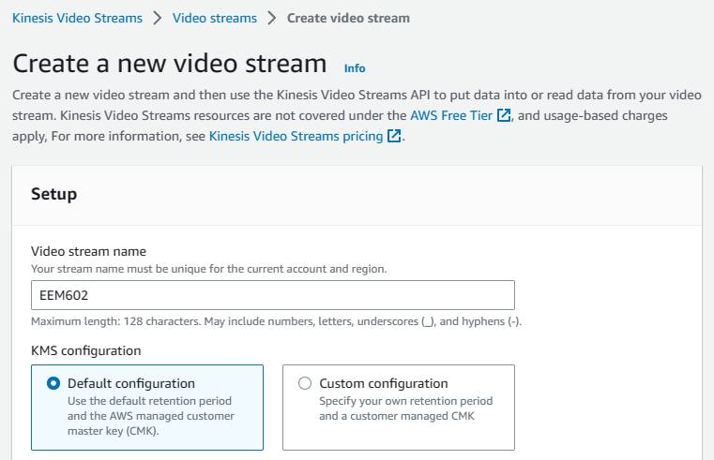

Kinesis Video Streaming

Slide 14


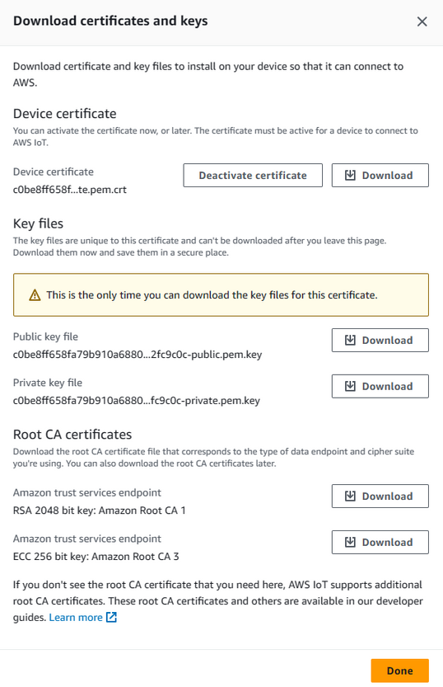

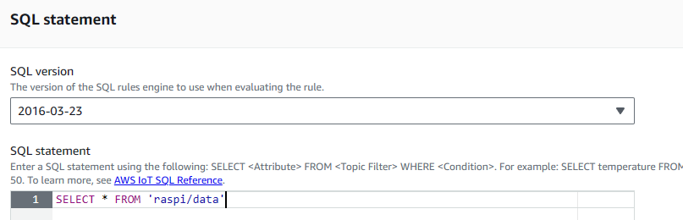
Amazon IoT Core Service

Slide 15
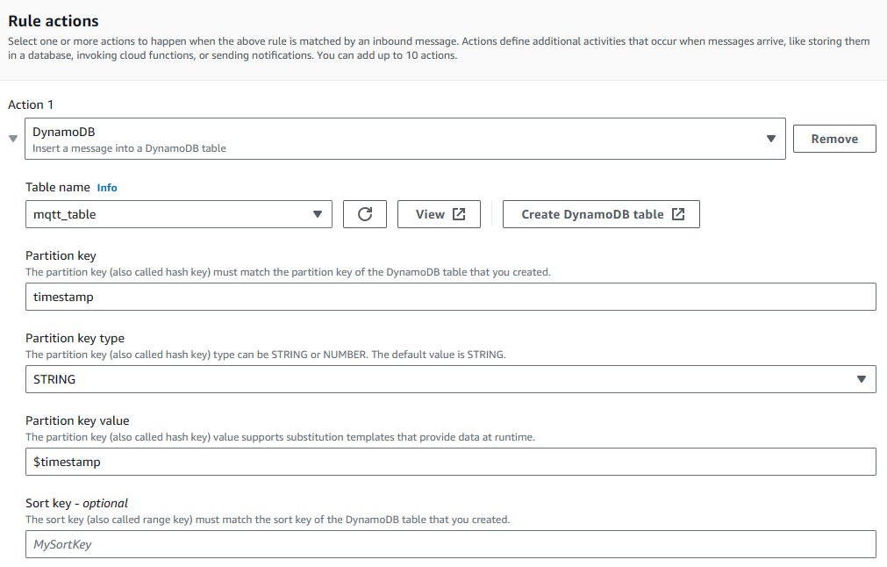
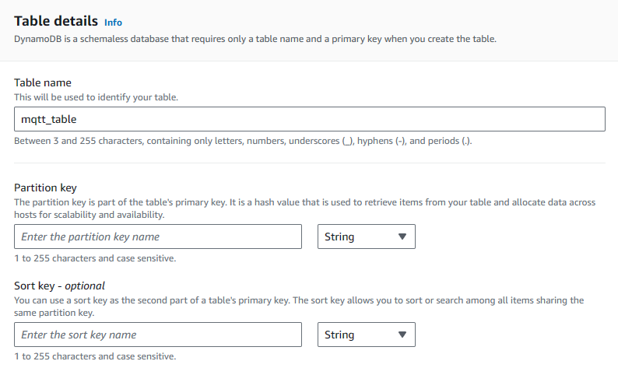

DynamoDB

Slide 16
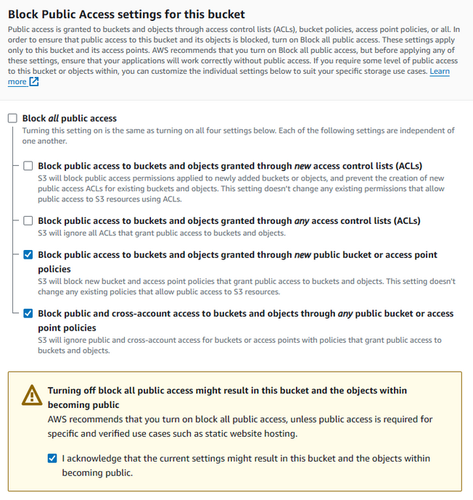
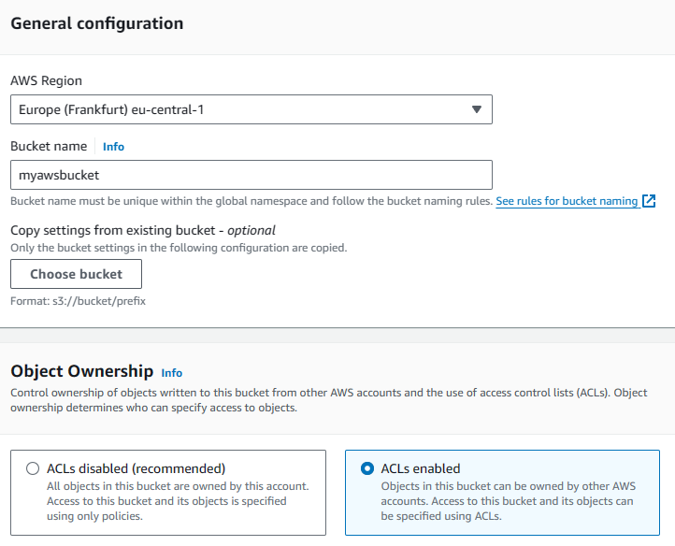

Amazon S3

Slide 17

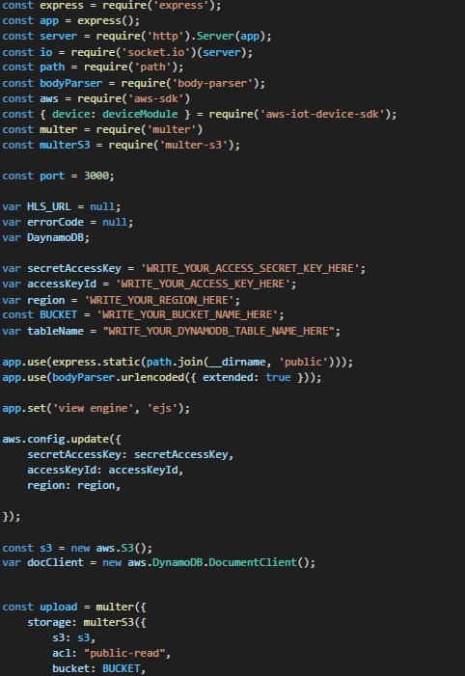
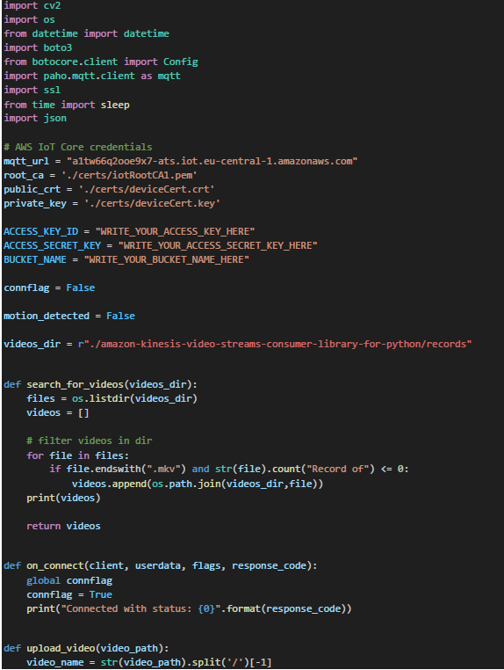
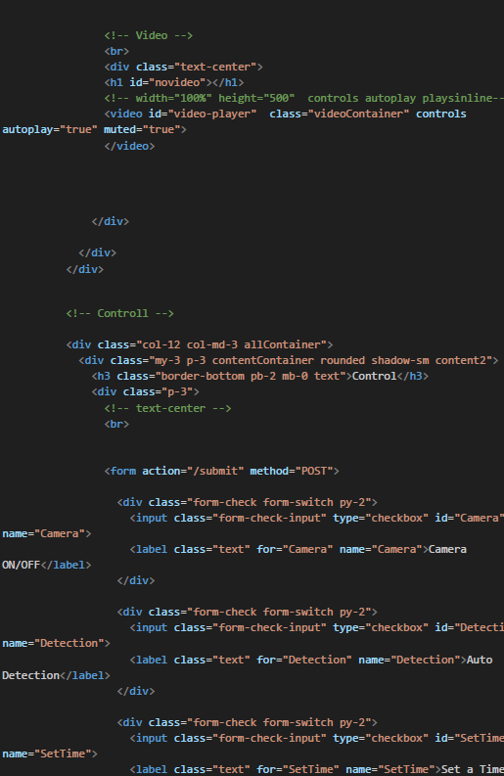
Motion Detection
AWS (S3, MQTT)
Codes
JavaScript
HTML

Slide 18

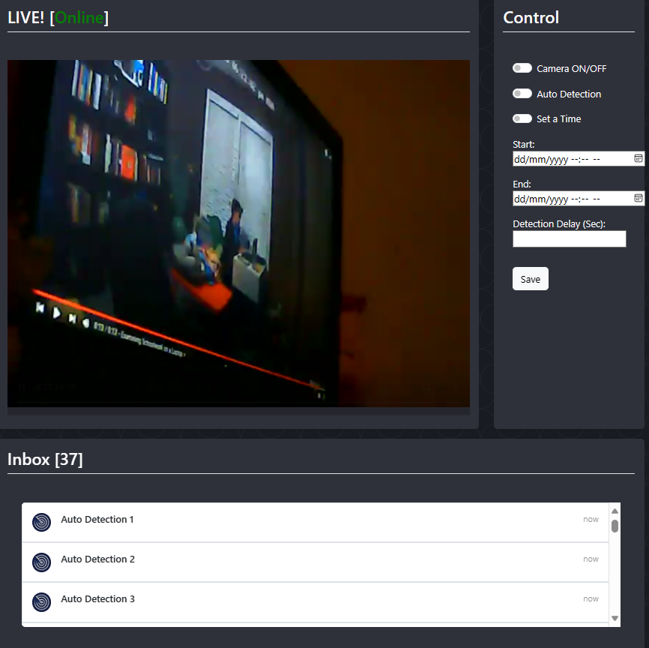
Show Case
Live Stream
Control Panel
Inbox Motion History

Slide 19
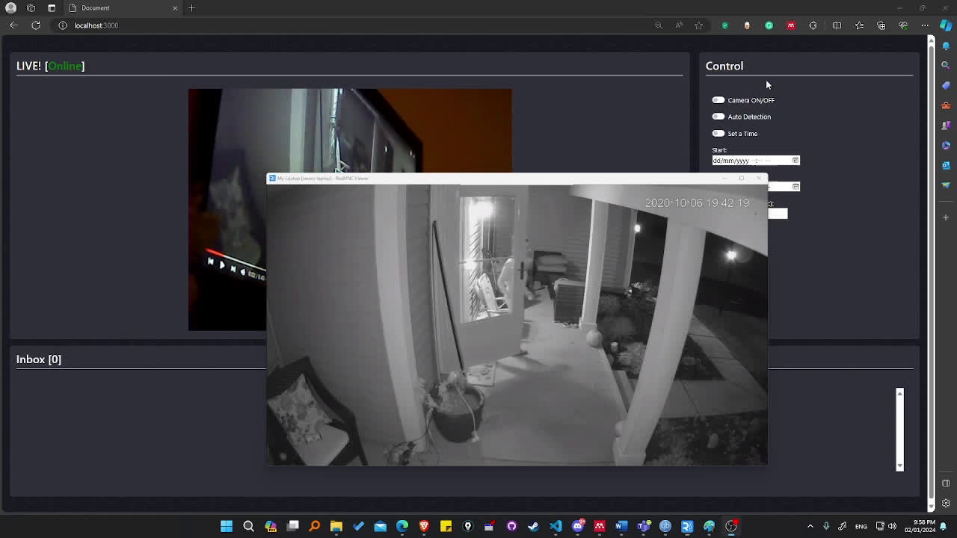
Conclusions

Slide 20

Thank you

