Slide 1
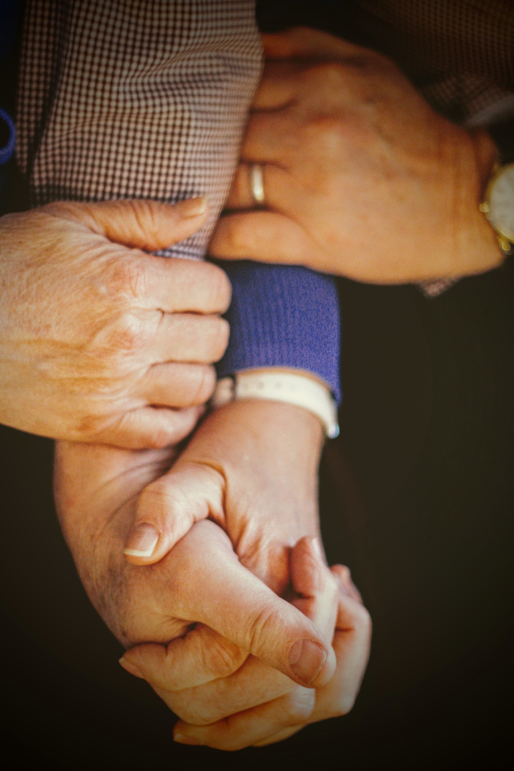
ENHANCING QUALITY OF LIFE:
ADVANCED WEARABLES FOR PATIENT AND ELDERLY MONITORING
Project Presentation
January 09, 2024
Prepared By: Mohamad Zafar Iqbal Badar
Submitted To: Prof. Mohab Mangoud
Photo by Joshua Hoehne on Unsplash

Slide 2
Table of Contents
01
02
03
04
Introduction
Probelm Statement
Proposed System
How It Works?
05
06
Challenges
Conclusion
A

Slide 3
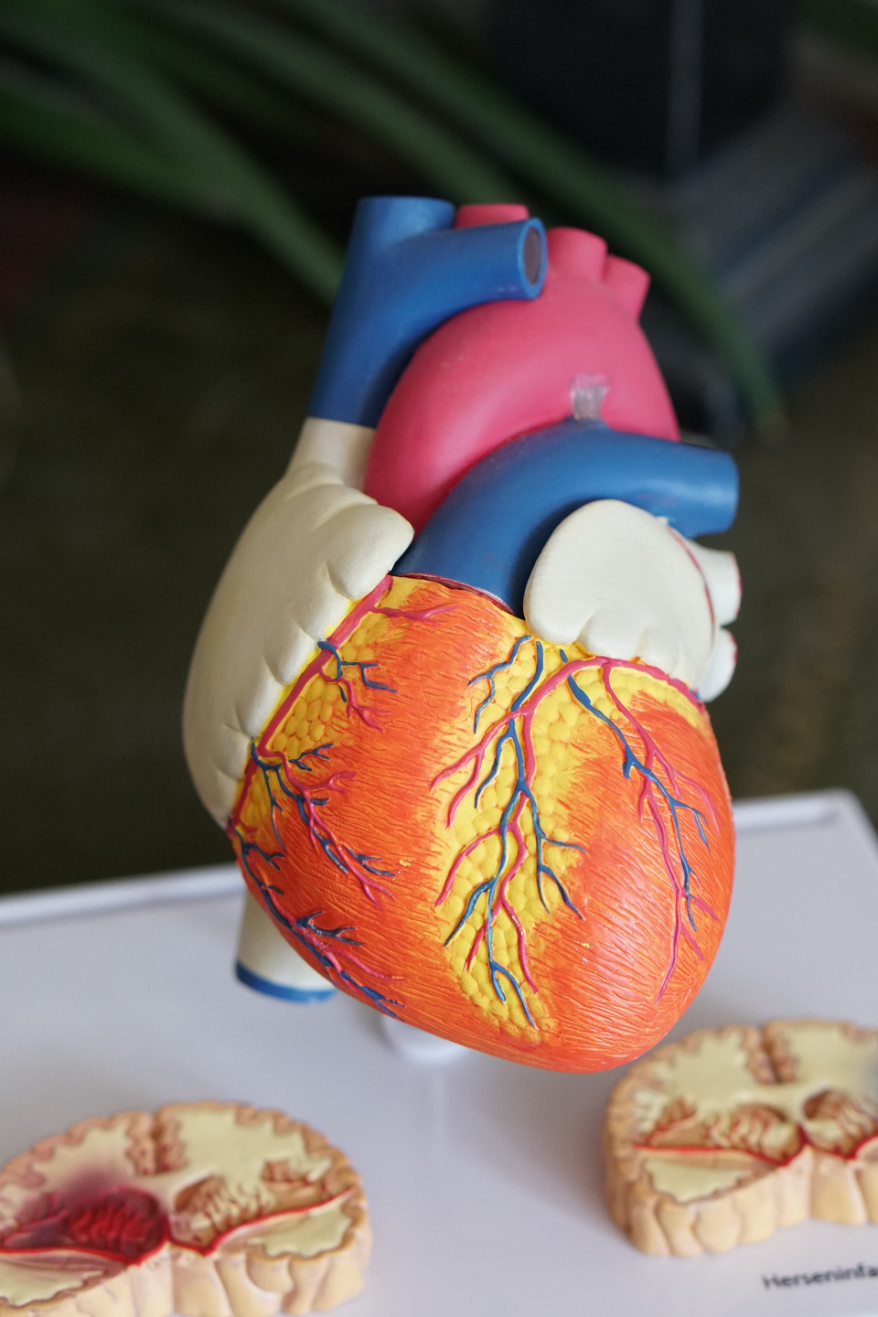
01.
Introduction
Pitch Deck By
Fauget Capital Technology
1
Photo by Robina Weermeijer on Unsplash

Slide 4
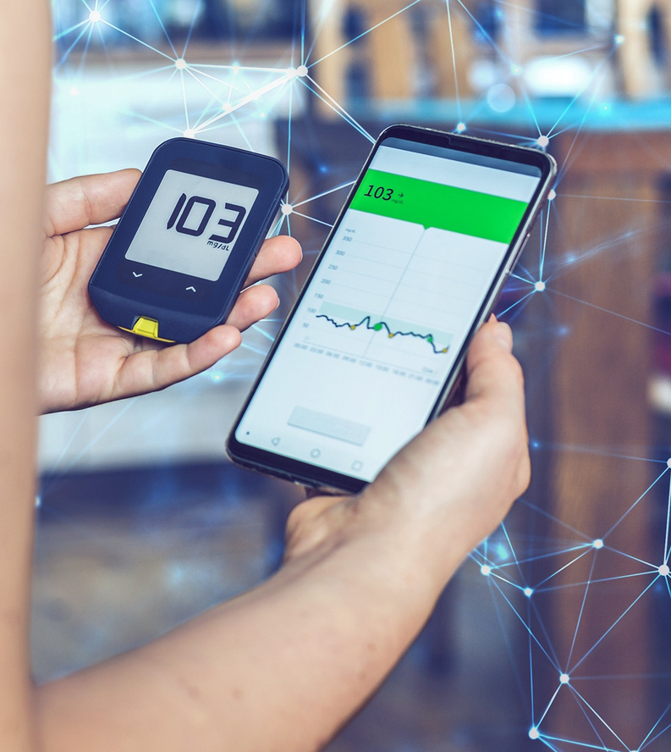
01. Introduction
Health 4.0 evolution
Internet of Medical Things (IoMT).
Predictive and proactive healthcare
Interconnected Network
Artificial Intelligence
Blockchain
Big Data Analytics
Internet of Things
https://unsplash.com
2

Slide 5
An average US hospital room has 15-20 connected devices, such as wearables and heart monitors.
Relevent Software
Software outsource company
September 20, 2023

Slide 6
01. Introduction
Key Advantages of IoMT
Improved Patient Care
Improved Patient Experience
Lowered Per-Patient Costs
Reduced Burden on Practitioners
CHARACTERISTIC FEATURES OF GENERIC IoT AND H-IoT as seen in [1]
4

Slide 7
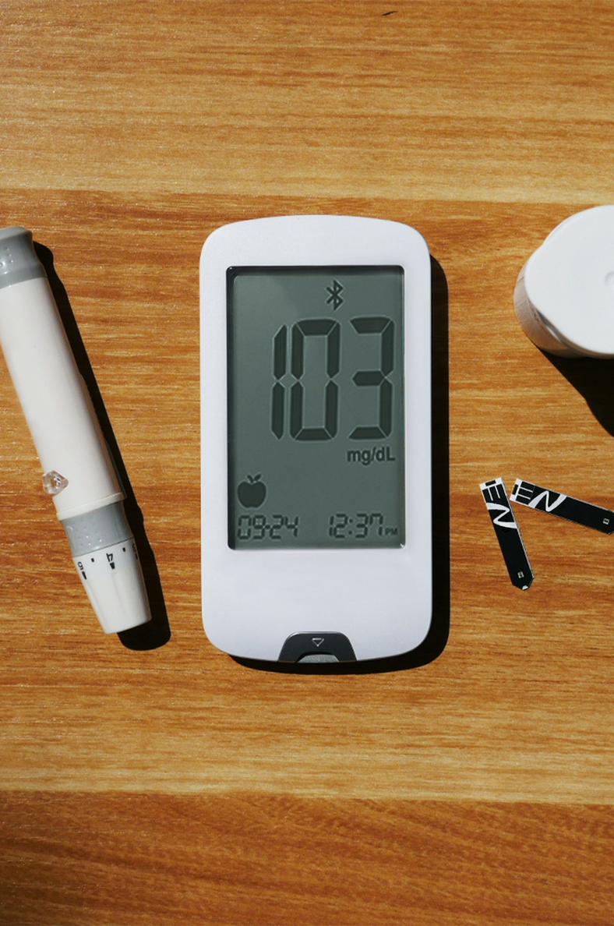
02.
Problem Statment
Pitch Deck By
5
Photo by isens usa on Unsplash

Slide 8
02. Problem Statement
Identifying Key Challenges in Modern Healthcare Monitoring
Limited Continuous Health Monitoring
Delayed Detection and Treatment:
6

Slide 9
02. Problem Statement
Identifying Key Challenges in Modern Healthcare Monitoring
Geographical limitation in Healthcare Access
Data Security and Privacy Concerns
7

Slide 10
03.
Proposed System
Pitch Deck By
Fauget Capital Technology
8
Photo by Artur Łuczka on Unsplash

Slide 11
ADVANCED WEARABLES FOR PATIENT AND ELDERLY MONITORING
“VITALGUARD”

Slide 12
03. Proposed System
Key Features
ECG
Monitoring
Pulse Rate
Monitoring
Steps Counter
and Fall Detection
Activity
Tracker
10

Slide 13
03. Proposed System
Literature Review
Paper #1: Covid-19 Patient Health Monitoring System Using IoT
M. I. Abdullah, L. Raya, M. A. A. Norazman and U. Suprihadi
Published in EEE 13th Control and System Graduate Research Colloquium (IC- SGRC), Shah Alam, Malaysia, 2022
11.A

Slide 14
03. Proposed System
Paper #1: Covid-19 Patient Health Monitoring System Using IoT
Heart Rate and Blood Saturation
Body
Temperature
Environment Temperature and Humidity
Board: Arduino ESP32
11.B

Slide 15
03. Proposed System
Literature Review
Paper #2: Portable and Real-Time IoT-Based Healthcare Monitoring System for Daily Medical Applications
A. I. Siam et al.
Published in IEEE Transactions on Computational Social Systems
2022
12.A

Slide 16
03. Proposed System
Paper #2: Portable and Real-Time IoT-Based Healthcare Monitoring System for Daily Medical Applications
ECG
Monitoring
Body
Temperature
Heart Rate
and
Blood Saturation
Activity
Tracker
12.B

Slide 17
03. Proposed System
Research Survey
A cross-sectional survey was conducted in December 2023 using Google Forms.
Structured to assess various aspects of wearable health monitors.
13

Slide 18
14

Slide 19
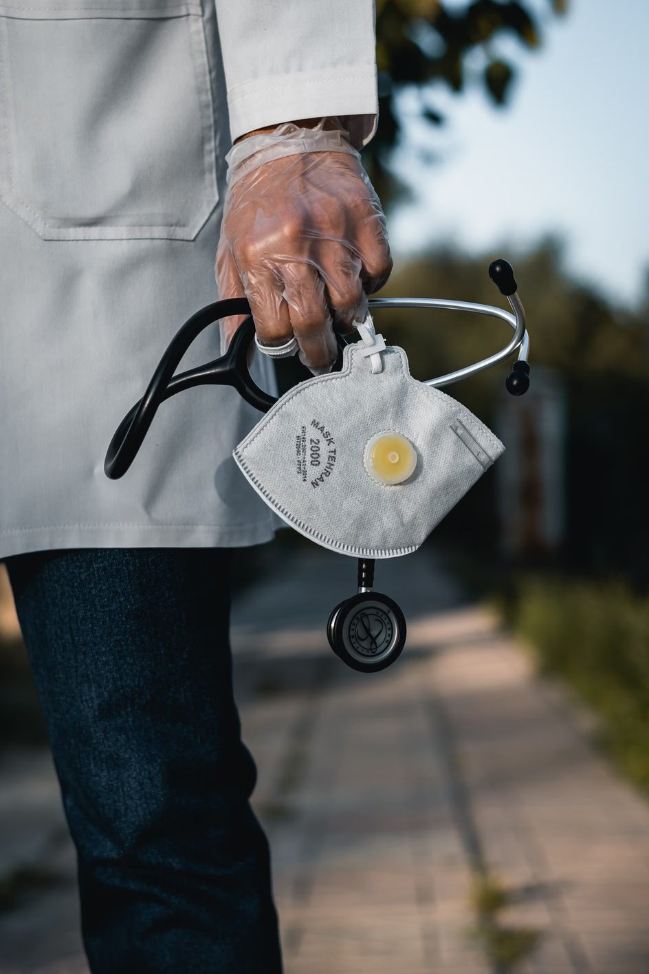
04.
How It Works?
Pitch Deck By
Fauget Capital Technology
16
https://unsplash.com

Slide 20
04. How It Works?
Hardware Components
Arduino Nano
RP2040 Connect
Pulse Sensor
Heart Monitor Sensor
17

Slide 21
04. How It Works?
Hardware Components
Breadboard Power Supply
Buzzer
18

Slide 22
04. How It Works?
Software
Breadboard Power Supply
Twilio
19

Slide 23
04. How It Works?
Overall Pricing
20

Slide 24
Overview of System Architecture
04. How It Works?
21

Slide 25
Overview of System Architecture
04. How It Works?
22

Slide 26
04. How It Works?
Overview of System Architecture
Arduino Cloud Dashboard
24

Slide 27
05.
Challenges and Futurework
Pitch Deck By
Fauget Capital Technology
24
Photo by Jukan Tateisi on Unsplash

Slide 28
05. Challenges and Futurework
Challenges Faced
Reducing noise in ECG and pulse sensor readings
High component costs from sourcing in the Kingdom of Bahrain.
Data Privacy
CHARACTERISTIC FEATURES OF GENERIC IoT AND H-IoT as seen in [1]
25

Slide 29
05. Challenges and Futurework
Future Work
Integration of a temperature sensor and gas sensors
Upgrading to wireless connectivity
CHARACTERISTIC FEATURES OF GENERIC IoT AND H-IoT as seen in [1]
26

Slide 30
06.
Conclusion
Pitch Deck By
Fauget Capital Technology
27
https://unsplash.com

Slide 31
05. Conclusion
Improved Quality of Life: Improved health management and life quality.
Sophisticated System Features: Integration of ECG, pulse rate monitoring, and an Arduino cloud dashboard for accessible, real-time health data.
User Feedback and System Adaptability: understanding of user needs and healthcare practices, guided by user feedback.
28

Slide 32
05. Conclusion
Reference
[1]
[2]
[3]
M. I. Abdullah, L. Raya, M. A. A. Norazman and U. Suprihadi, ”Covid-19 Patient Health Monitoring System Using IoT,” in 2022 IEEE 13th Control and System Graduate Research Colloquium (IC- SGRC), Shah Alam, Malaysia, 2022, pp. 155-158, doi: 10.1109/ICS- GRC55096.2022.9845162.
A. I. Siam et al., “Portable and Real-Time IoT-Based Healthcare Monitoring System for Daily Medical Applications,” in IEEE Transactions on Computational Social Systems, vol. 10, no. 4, pp. 1629-1641, Aug. 2023, doi: 10.1109/TCSS.2022.3207562.
M. Al-rawashdeh, P. Keikhosrokiani, B. Belaton, M. Alawida, and A. Zwiri, “IOT adoption and application for Smart Healthcare: A systematic review,” Sensors, vol. 22, no. 14, p. 5377, 2022. doi:10.3390/s22145377
29

Slide 33
Thank You
Mohamad Zafar Iqbal Badar
Student Id: 20180910
EEM 602 - Internet of Things
Submitted To: Prof. Mohab Mangoud
Professor, Telecommunications and Networks Engineering
EEM602 Project Seminar

