Slide 1
UNIVERSITY OF BAHRAIN
COLLEGE OF ENGINEERIN
MASTER OF ENGINEERING OF AI
Term Project
SMART METER PROJECT COMBIND WITH IOT PHASE 1
PROF. MOHAB MANGOUD
Presentation by :
ALAWI SHARAF - 202301262

Slide 2
UNIVERSITY OF BAHRAIN
Agenda
History of AMI & Machine Learning
Paper Reviews
Project Steps
Results
Challenges
Future recommendations
02

Slide 3
HISTORY OF SMART METER & MACHINE LEARNING
A brief history of technologies
Smart Meter scaled with IoT
Concept of Automated Meter Reading (AMR) on telephone lines
Sophisticated AMR using wireless technologies
2 ways smart
meters
1950 to 1960
1965
1970s
1980s
1990s
2000 to 2020
Revival of ML, start of algorithms (training neural networks)
ML Major advancements: improved algorithms for decision trees
Concept of ML born
First ML programs developed
like Samuel checker
ERA of Big data, AI Deep Learning & scaled Industrial usecase
03

Slide 4
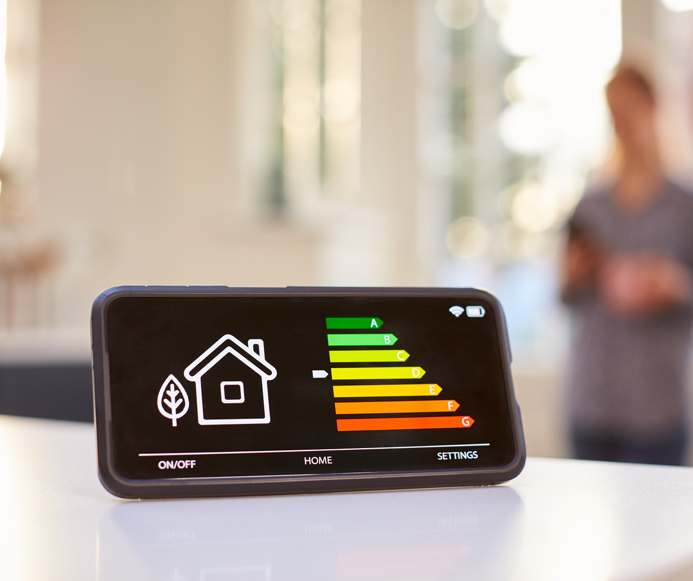
INTRODUCTION
WHY SMART METER & AIoT
ENHANCED ENERGY EFFICINCY
The need for energy is becoming more expansive with the growth of population around the Globe
IMPROVED GRID RELIABILITY & MAINTENANCE
With the Peak load forecast using the AI technologies, Provider will be able to meet demand and improve network reliability
PERSONLISED CUSTOMER EXPERIENCE
With more data consumer will be able to enhance usage behavior's to reduce cost
04

Slide 5
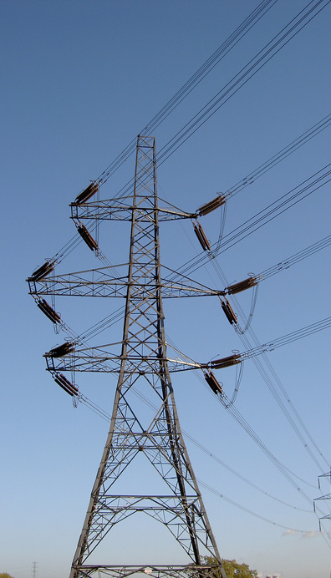
PAPER REVIEWS 2
AMI Smart Meter Big Data Analytics for Time Series of Electricity Consumption
PROBLEM
Analyzes 5-minute electricity consumption data from 100 commercial buildings to develop a simple forecast model, enhancing energy management and anomaly detection, Model Used : ARIMA, Exponential Smoothing & STL Decompostion.
RESULT
STL + Arima is winning against STL+EXP
Mohammad Harun Rashid (2018) Pace University, USA
05

Slide 6
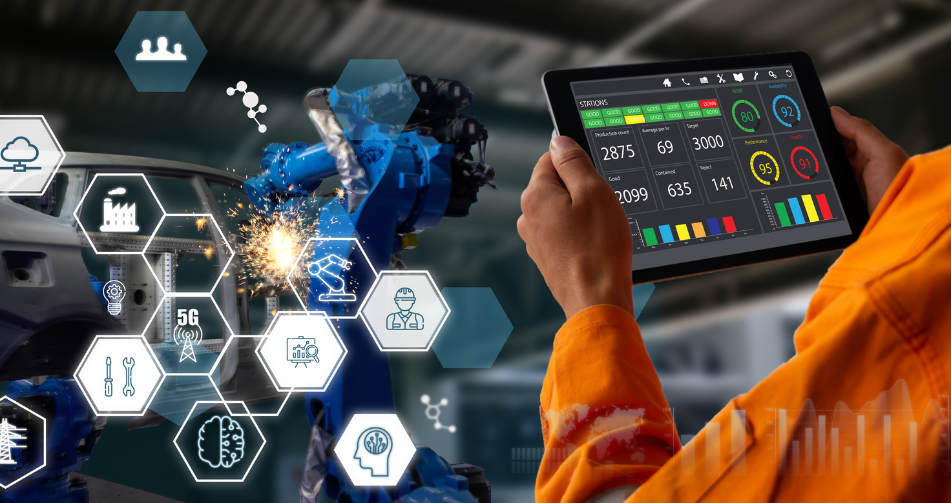
PAPER REVIEWS 1
PROBLEM
Anomaly Detection in Electricity Consumption Data using Deep Learning
Develop a deep learning-based approach for detecting anomalies in electricity consumption data an hour in advance, using LSTM models and considering various weather and temporal features..
RESULT
The study employs a dynamic threshold (Exponential Moving Average - EMA) for better classification, accounting for seasonal noise in the data. Notably, a significant increase in electricity consumption was observed during periods with global anomalies, highlighting the effectiveness of these detection methods.
Kardi, M; Al Saif, Tekinerdogan, B; Catala, JoaoP.S.(2021) Portugal
06

Slide 7
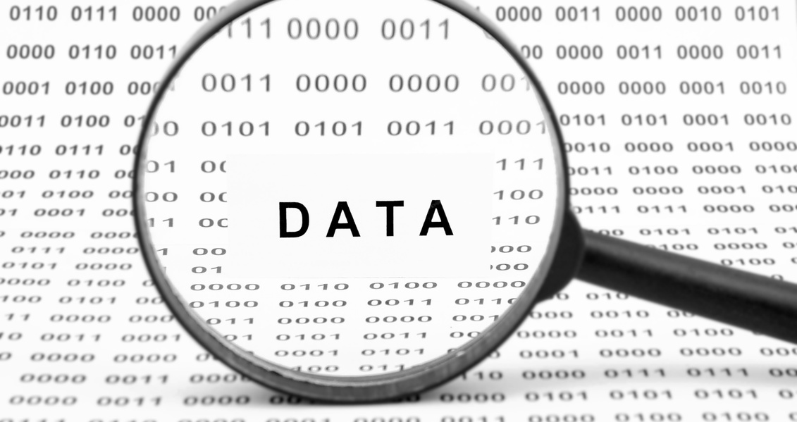
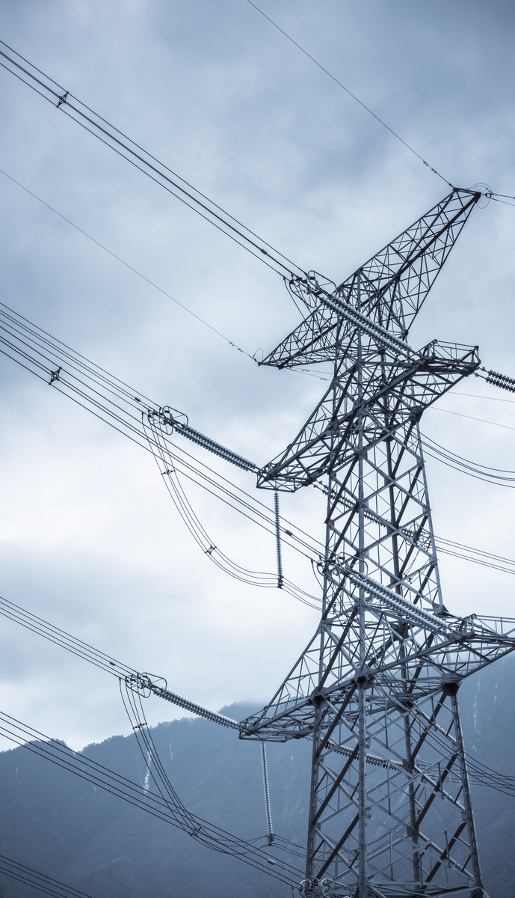
PAPER REVIEWS 3
PROBLEM
A residential labeled dataset for
smart meter data analytics
The paper aims to address the scarcity of labeled data in smart meter datasets by introducing SustDataED2, a comprehensive dataset with detailed appliance consumption labels for more effective machine learning applications in electricity usage analysis.
RESULT
Produced a detailed, labeled dataset for advanced smart meter data analytics and machine learning testing in electricity consumption for a single house hold over 96 days and individual consumptions data for 18 appliances
L. Pereira, D. Costa, and M. Ribeiro (2022)
07

Slide 8
AMI INFRUSTRUCUTRE
SMARTMETERS
The core element of AMI, at the customer side, provides consumptions on intervals
COMM NETWORKS
to transmit the large volume of interval load data from meter to utility back office
MDMS
Meter data managment systems to store & process the interval load data & intigrate it to other systems like billings , CIS, OMS, DMS
Reference (1)
AMI System
08

Slide 9
MACHINE LEARNING TECHNIQUES
CLASSICAL ML
NEURAL NETWORK
DEEP LEARNING
Linear Regression
K-Nearest Neighbor
Discriminant analysis
Naive Bayes
Decision Tree
Support Vector Machine
K-mean Clustering
Perception Network
Multi-Layer Feedforward Network
Self Organizing Map
Autoencoder
Convolutional Neural Network
Recurrent Neural Network
LSTM Network
Generative AI
ML techniques
09

Slide 10
Project Plan
DATA COLLECTION
01
DATA EXPLORATION
02
FEATURE SELLECTION
03
SustDataED2
Single House Hold 96 days
18 individual appliances
Better understanding the nature of smart meter data : time stamp, active, reactive power, voltage and current readings
Transforming raw data into a format that can be used in ML
LINEAR REGRESSION
04
ANN
05
Simple and interpretable
ideal as a starting point
Had to prepare the data
Normalizing the data
FeedForwarded NN Network
10

Slide 11
PROJECT EXECUTION
AGGREGATED
CONSUMPTIONS
APPLIANCES
CONSMPTIONS
Reference (2)
Data Collection
11

Slide 12
PROJECT EXECUTION
Implementation
PHASE 01
Data Exploration & Feature Engineering using MATLAB took quite good time ( preparing the data before training)
PHASE 02
Tried to learn and understand the how MATLAB can design the linear regression and ANN
12

Slide 13
Exploring Data Before Training: Time Slots for all values

Slide 14
Exploring Data Before Training: Scatter Plots for each data

Slide 15
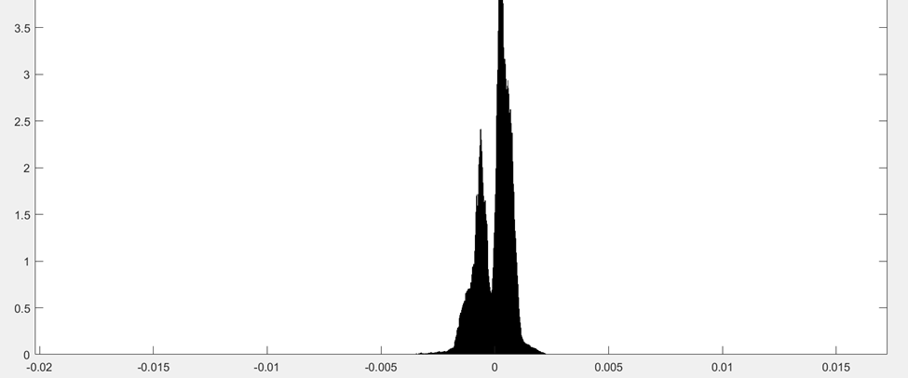
PROJECT EXECUTION
Result: Linear regression
Strong relationship between energy consumptions which make it valuable for predections
15

Slide 16
PROJECT EXECUTION
Result: ANN
Achieved high R- Squared Value of 0.9996, and RMSE was 0.00017937 , excellent predictive over linear regression
16

Slide 17
UNIVERSITY OF BAHRAIN
PROJECT EXECUTION
Challenges
Selecting the Optimal Methodology: Paving the Way to Success
Navigating Programming Language Choices for Project Efficiency
Trials and Triumphs: Methodology Experimentation and Refinement
Overcoming PC Limitations: Maximizing Resources for Project Execution
17

Slide 18
LESSON LEARNED
DATA QUALITY & PREP
Work more on preparing the data (data labels and Size are key)
MODEL ARCHITECTURE
Trying more ready models, designed for large data like K- clustering, MLFF, LSTM
LEARNING & TRAINING
Work more to test more learning rates and Training and choosing the right metrics
Future Recommendations
18

Slide 19
PRINCIPLE OF ARTIFICIAL INTELLIGENCE
Thank You So Much!
Presentation by :
ALAWI SHARAF

Slide 20
References
[1] L. Pereira, D. Costa, and M. Ribeiro,(2022) "A Residential Labeled Dataset for Smart Meter Data Analytics, Scientific Data
[2] Mohammad Harun Rashid. (2018). AMI Smart Meter Big Data Analytics for Time Series of Electricity Consumption. IEEE International Conference
[3] Kardi, M; Al Saif, Tekinerdogan, B; Catala, JoaoP.S.(2021). Anomaly Detection in Electricity Consumption Data using Deep Learning. IEEE International Conference
[4] Gubbi, J., et al. (2013). Internet of Things (IoT): A vision, architectural elements, and future directions. ScienceDirect.

